Slide 1
Dismantling the Knowledgeopoly: An Open Research Future
K. M. Ehrig-Page
UNO Libraries Institutional Repository Coordinator
This work is licensed under a Creative Commons Attribution 4.0 International License.

Slide 2
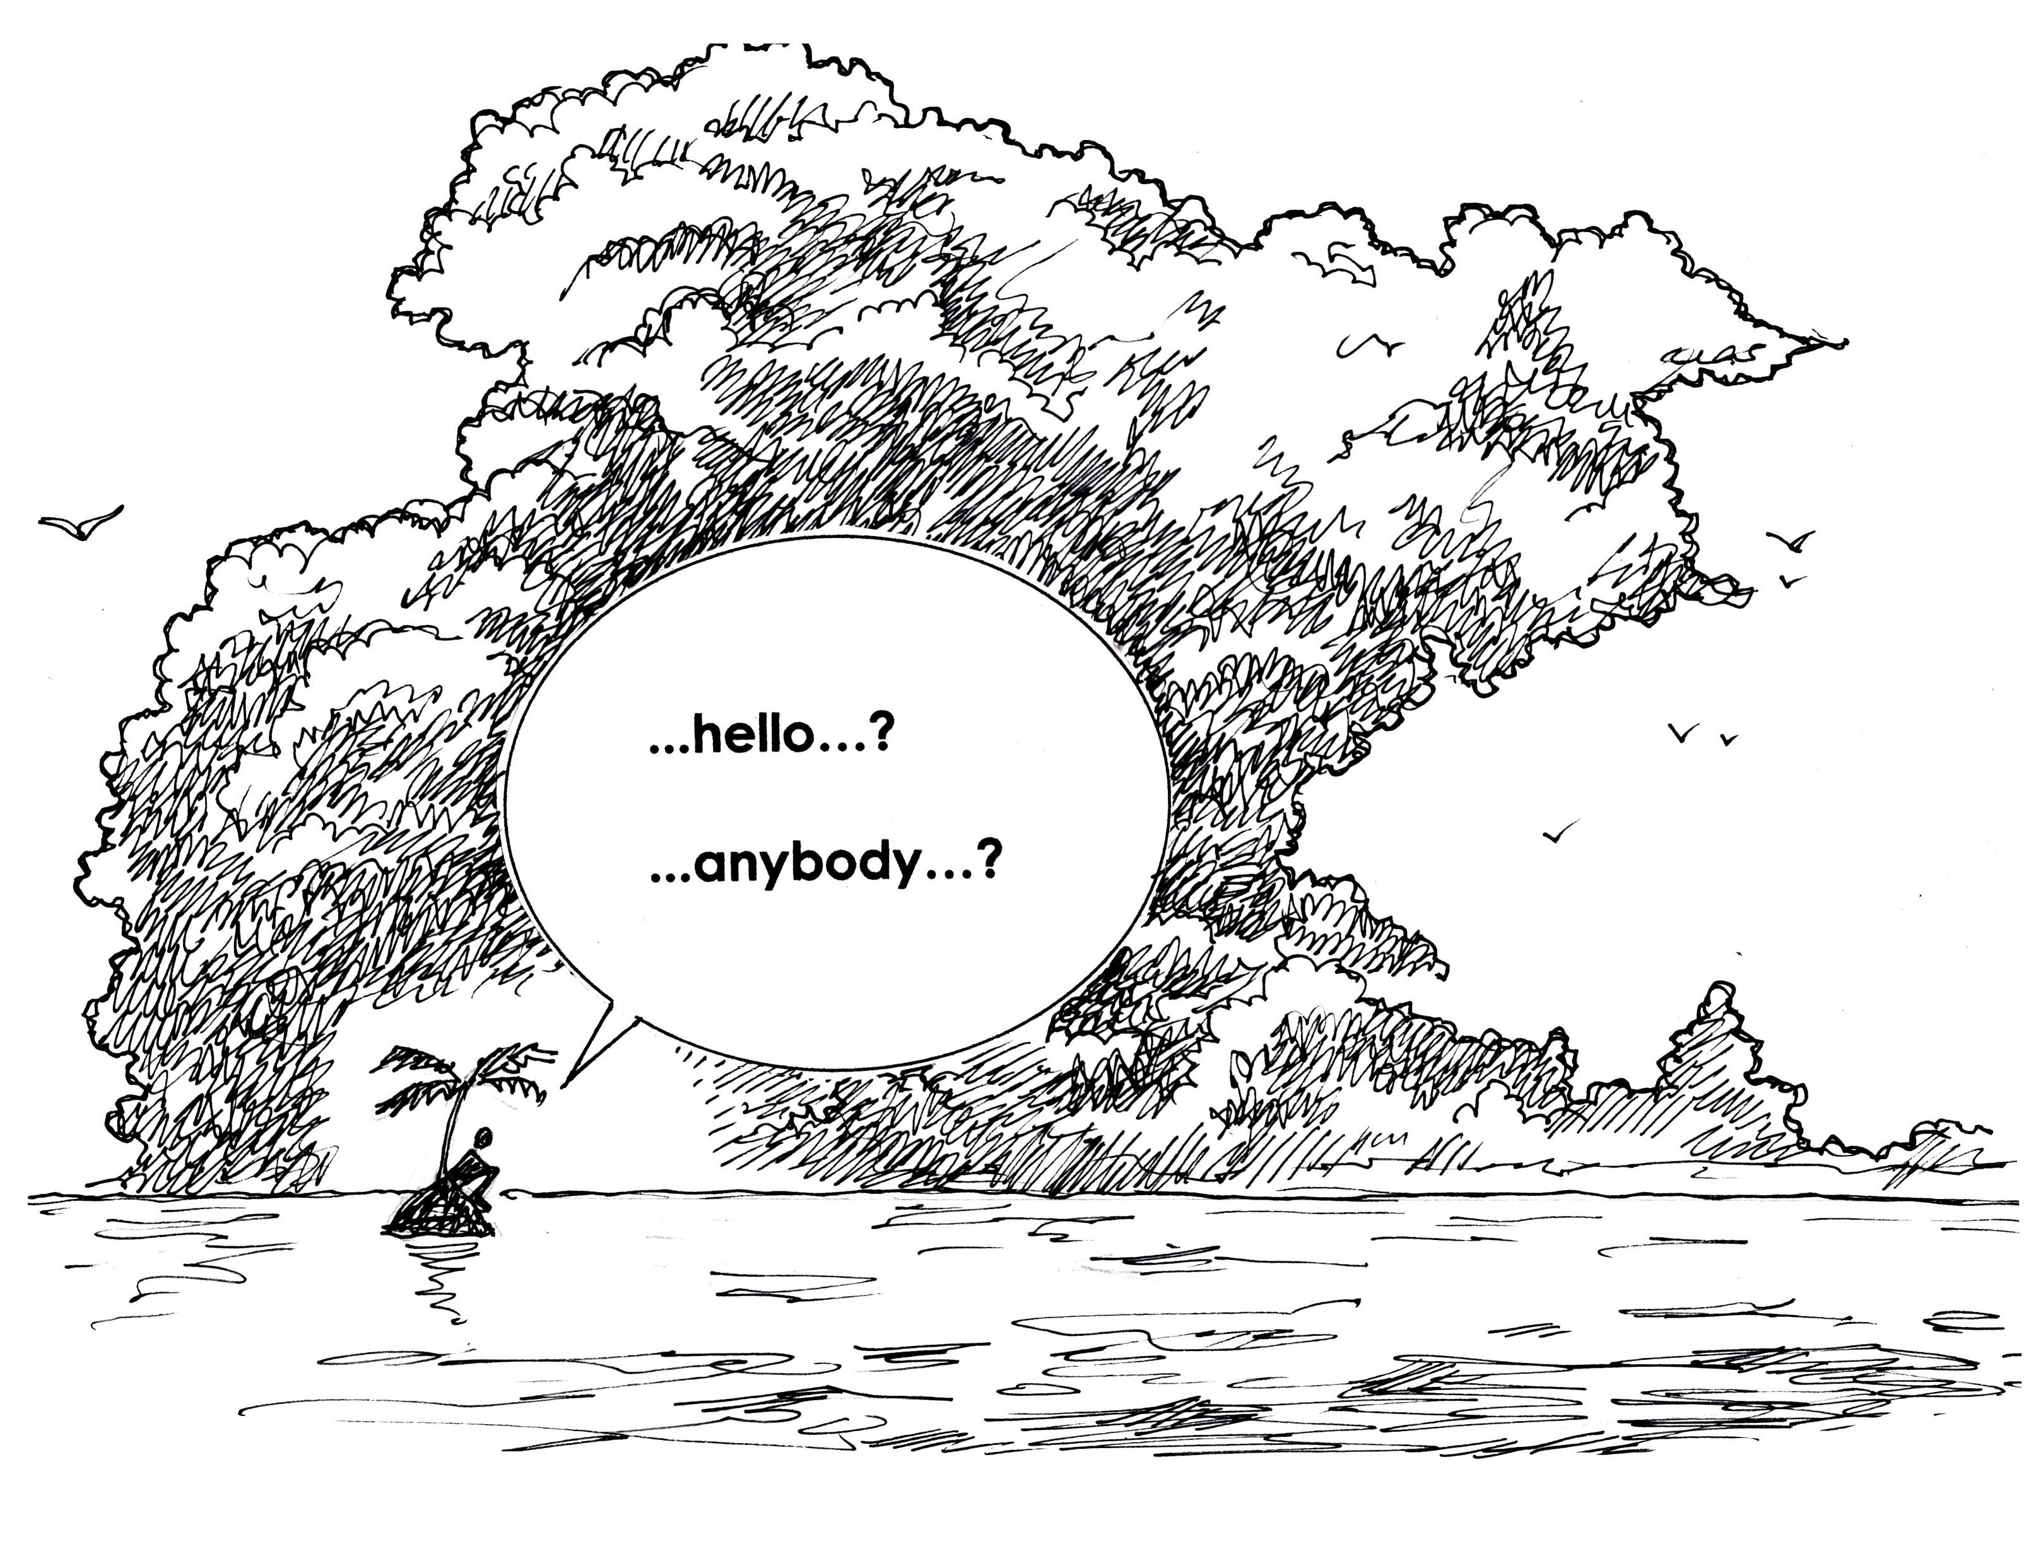
Introduction
Definitions
Open Access
Open Data
Open Educational Resources
Open Research
"Increase your visibility" by John R. McKiernan, Why Open Research? is licensed under CC BY 4.0

Slide 3
Definitions
Open Research: “Researchers around the world, in all disciplines, store, share and reuse their outputs with the wider research community, so everyone can access insights and knowledge…” Wellcome Trust
Open Access (OA): “Open Access is the free, immediate, online availability of high-quality, peer-reviewed research results.” SPARC
Open Data: “Open data is data that can be freely used, re-used and redistributed by anyone - subject only, at most, to the requirement to attribute and sharealike.” Open Data Handbook
Open Educational Research (OER): Open Educational Resources (OER) are teaching, learning and research materials… under an open license that permits no-cost access, use, adaptation and redistribution by others with no or limited restrictions. UNESCO

Slide 4
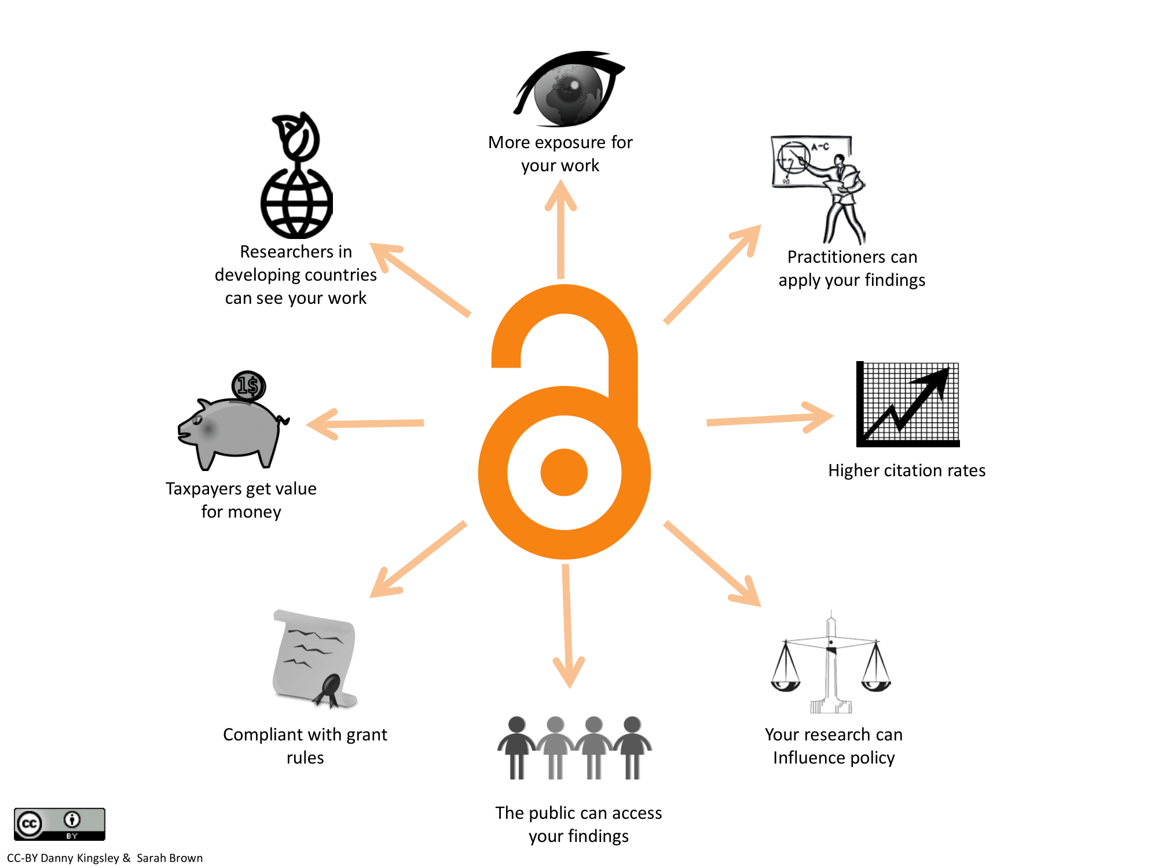
Open Access: Benefits

Slide 5
Open Access: Types
Platinum: copyright remains with the author, with no publishing fee
Gold: copyright remains with the author, for a fee
Green: copyright often remains with the publisher, though the author has the right to self-archive their work on their institutional repository

Slide 6
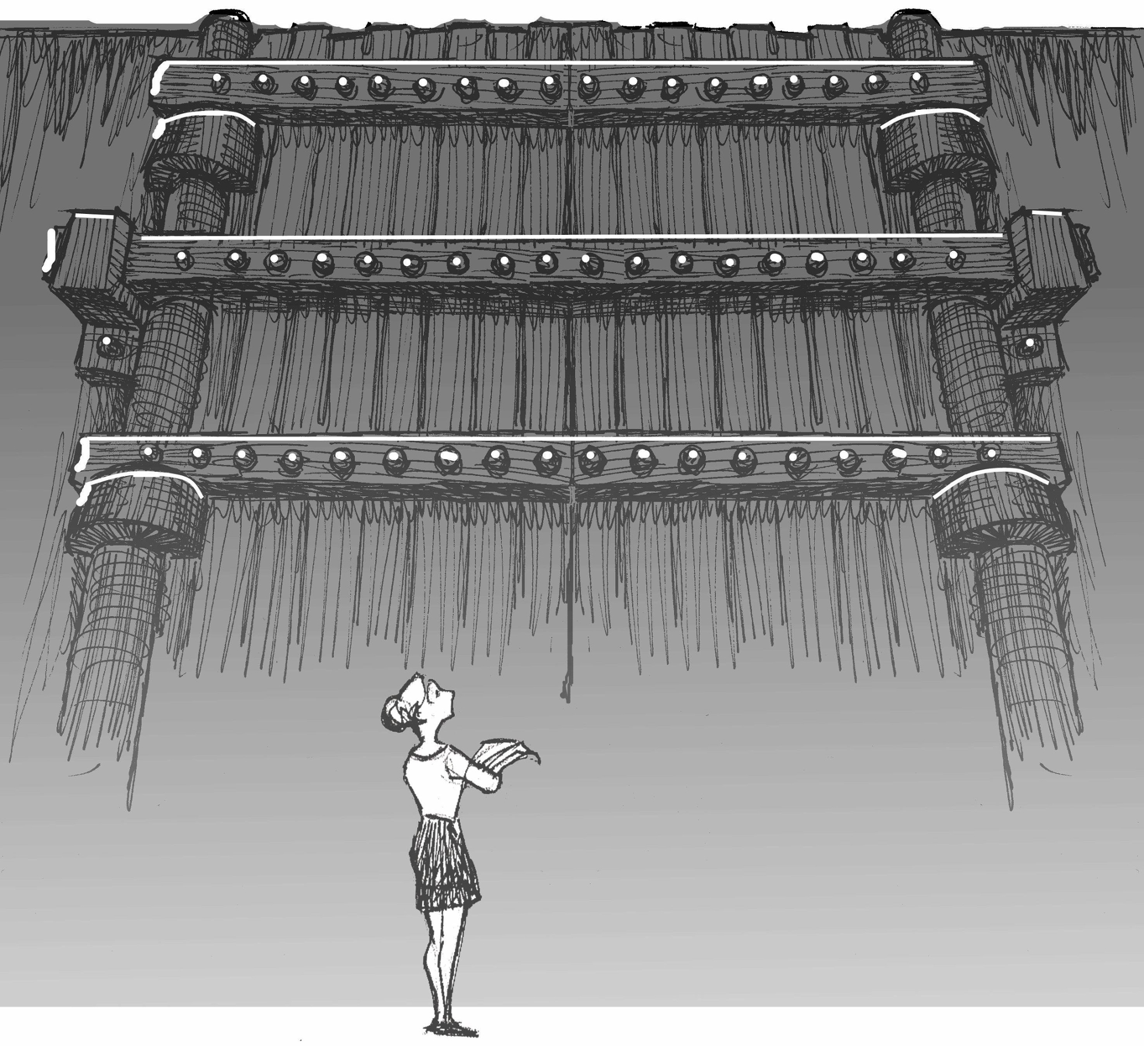
Gold Open Access: Realities
Pay to publish
Pragmatic approach to current market
Not all Gold Open Access is the same
“Image Gallery” by John R. McKiernan, Why Open Research? is licensed under CC BY 4.0

Slide 7
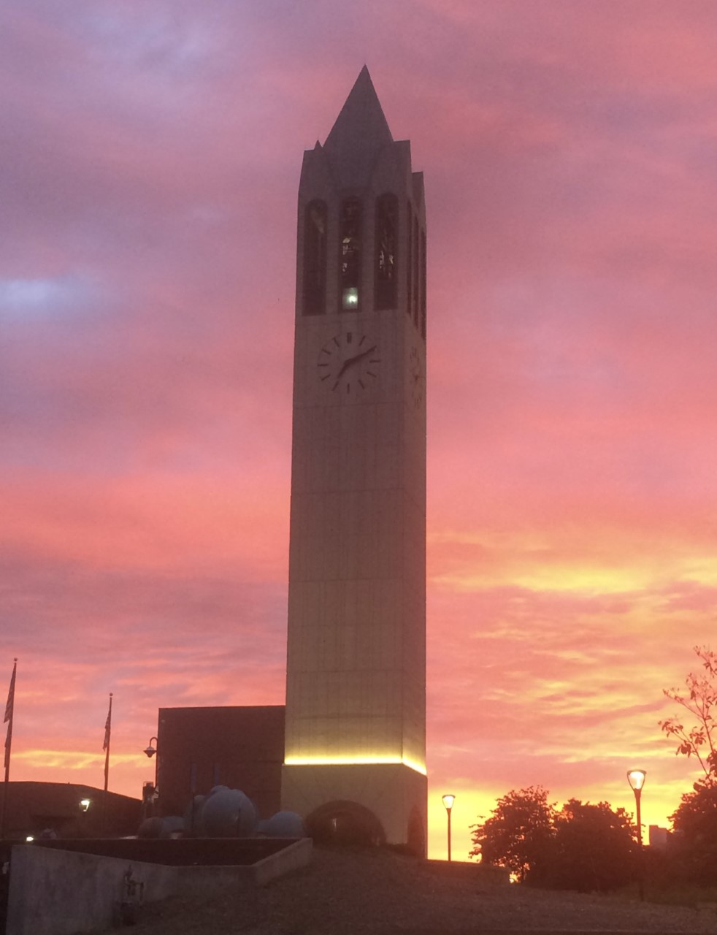
Open Access @ UNO
UNO’s experience
- OA Fund 2014-2019
- Average invoice cost: $300 higher in 2019-2020 vs. 2017-2018. $890 higher in 2019-2020 vs. 2015-2016.
- 2019-2020 Funds ran out November 2019

Slide 8
Open Access @ UNO Continued
UNO’s experience

Slide 9
Open Access @ UNO Continued
Most popular Gold Open Access journals: Fully Open Access or Hybrid?
Publisher: Fully OA or Hybrid? | Journal | Publisher | # Per Publisher | Total Paid to Publisher | Average Cost Per Publisher | Change for Individual Journal Over Time
Fully OA | Frontiers in Oncology | Frontiers | 3 | $3,365 | $1,121.67 | Frontiers in Oncology: +$740 (0.5 years)
Fully OA | Scientific Reports | Springer Nature | 3 | $5,225 | $1,742 | Scientific Reports: +$115 (2 years)
Fully OA | Sustainability | MDPI | 4 | $5,709.46 | $1,427.37 | Sustainability: +$460.81 (3 years)
Fully OA | PLOS One | PLOS | 9 | $12,730 | $1,414.44 | PLOS One: +$145 (c. 4 years)

Slide 10
Open Access @ UNO Continued
Academic Year | Fully OA | Fully OA Average OA Cost | Hybrid | Hybrid Average OA Cost
2014-2015 | 8 | $1,388.89 | 3 | $1,961.43
2015-2016 | 12 | $1,320.46 | 11 | $1,833.88
2016-2017 | 8 | $1,486.25 | 8 | $2,275
2017-2018 | 13 | $1,538.94 | 14 | $2,125.11
2018-2019 | 17 | $1,437.10 | 17 | $2,129.41
2019-2020 | 11 | $1,685.75 | 12 | $2,717.50
 | Total OA Invoices for Fully OA Journals: 69 | Fully OA Average OA Cost Overall: $1,475.75 | Total OA Invoices for Hybrid Journals: 65 | Hybrid Average OA Cost Overall: $2,197.21
 | Total Fully OA Invoices: $101,826.76 |  | Total Hybrid Invoices: $142,818.41

Slide 11
Open Access Publishing
Motivations
Greater equity in education
Increased diversity of voices
Wider variety of available material
Access and reuse rights for authors to their intellectual property
Resources
Sherpa Romeo, https://v2.sherpa.ac.uk/romeo/
Directory of Open Access Journals (DOAJ), https://doaj.org/
- Open Access Scholarly Publishing Association (OASPA), https://oaspa.org/
Open Library of the Humanities, https://www.openlibhums.org/
Kopernio, https://kopernio.com/
Open Access Button, https://openaccessbutton.org/
Unpaywall, http://unpaywall.org/
Get Full Text Research (GetFTR), https://www.getfulltextresearch.com/
Special Collection: Insights (UKSG), From Finch to Plan S: and you may ask yourself, well how did I get here?, https://insights.uksg.org/collections/special/from-finch-to-plan-s/

Slide 12
Open Educational Resources
Resources
Open Educational Resources (OER), UNO LibGuide, https://libguides.unomaha.edu/oer/home
Open Textbook Library, https://open.umn.edu/opentextbooks/
OpenStax, https://openstax.org/
OER Commons, https://www.oercommons.org/
Directory of Open Access Books (DOAB), https://www.doabooks.org/
COPIM (Community-led Open Publication Infrastructures for Monographs), https://www.copim.ac.uk/
Creative Commons License Chooser, https://creativecommons.org/choose/
License Selector, https://ufal.github.io/public-license-selector
CC License Compatibility Chart, https://wiki.creativecommons.org/wiki/Wiki/cc_license_compatibility
Adapted from the cover image of UNESCO’s "Guidelines on the development of open educational resources policies" by Aurélia Mazoyer is licensed under CC BY-SA 3.0 IGO.

Slide 13
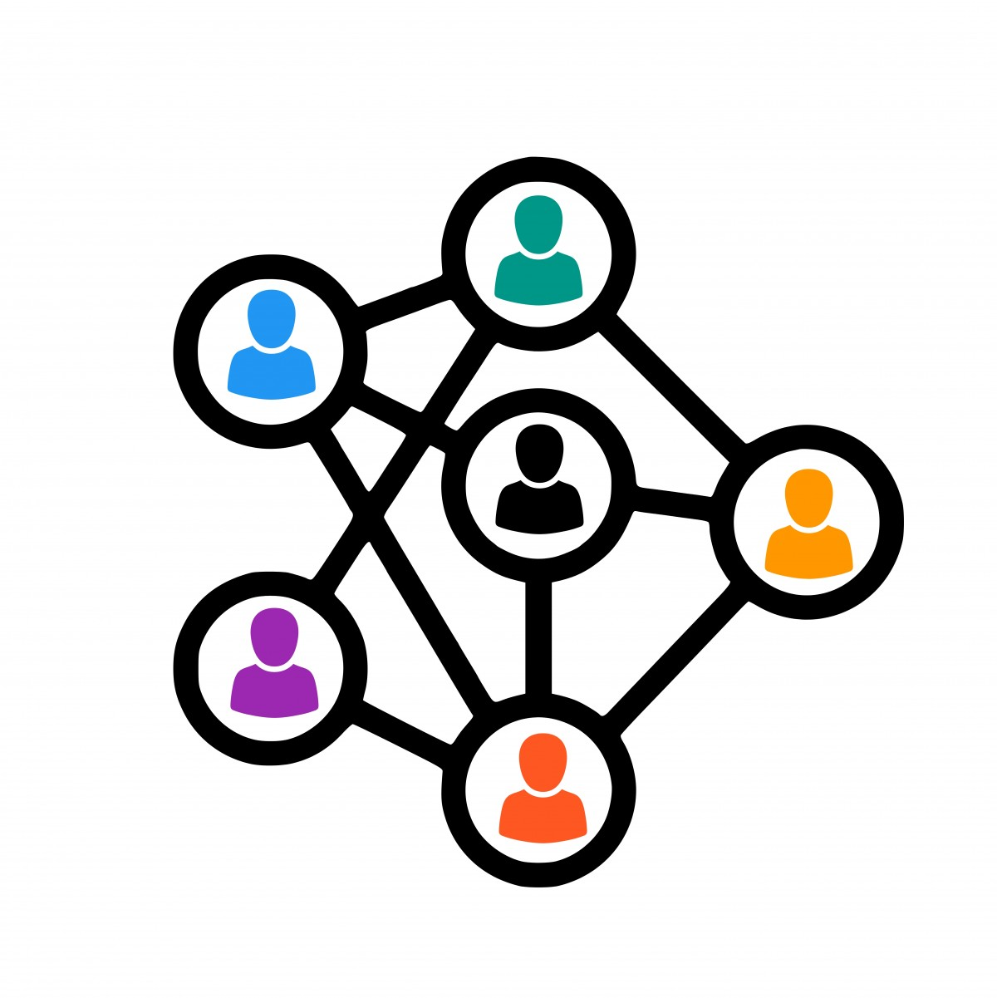
Consortiums and journal subscriptions
Big Deals
Cancelling deals
Transformative Agreements
How to achieve this:
- subscriptions
- consortial logic
- collective action
Downsides:
- contracts
- long-term negotiations
- institution size
- disciplinary focus

Slide 14
Consortiums and journal subscriptions, resources
Resources
SPARC, Big Deal Cancellation Tracker, https://sparcopen.org/our-work/big-deal-cancellation-tracking/
2020 Update: SPARC Landscape Analysis & Roadmap for Action, https://infrastructure.sparcopen.org/2020-update
Unsub, https://unsub.org/
ESAC,
https://esac-initiative.org/guidelines/

Slide 15
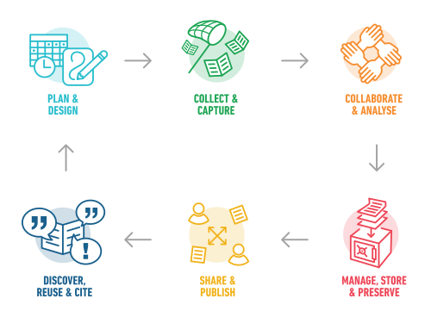
Promoting Open Research and Open Data
Institutional Repository
RDM lifecycle
Data Management Plans (DMPs)
Disciplinary differences; relatable language
Open Identifiers (e.g. ORCiD/ DOIs)
"The Research Data Management (RDM) lifecycle at the University of Cape Town (UCT)" by Gaelen Pinnock, UCT Research office / UCT eResearch centre is licensed under CC BY-SA 4.0

Slide 16
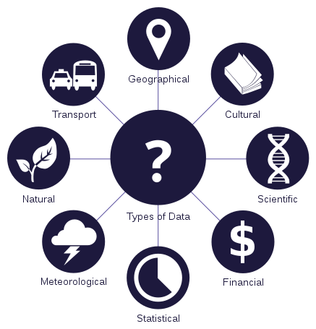
Open Data
COVID
National Library of Medicine, NCBI SARS-CoV-2 Resources
European Data Portal, Datasets
Research Data Management best practices
Data management plans
Open licensing
“Data types" by João Batista Neto is licensed under CC BY 3.0.

Slide 17
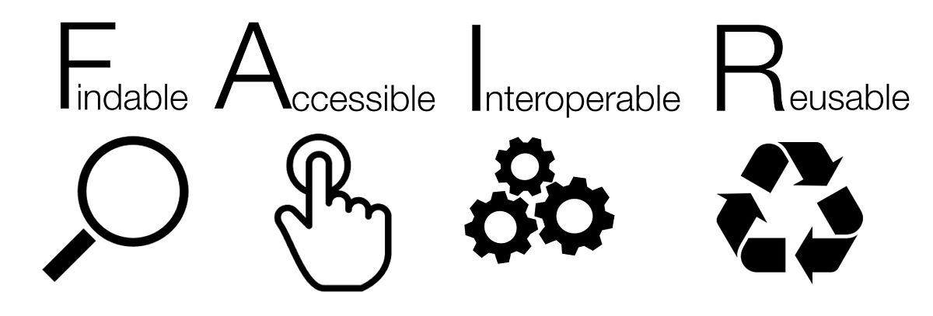
Open Data
Resources
Open Data Commons: LEGAL TOOLS FOR OPEN DATA, https://opendatacommons.org/
SPARC, Open Data, https://sparcopen.org/open-data/
Re3data.org, Registry of Research Data Repositories, https://www.re3data.org/
Open Knowledge Foundation, Open Data Handbook, http://opendatahandbook.org/
Open Research Funders Group, http://www.orfg.org/
"FAIR Guiding Principles for Data Resources" by SangyaPundir, Wikimedia is licensed under CC BY-SA 4.0

Slide 18
Open Research
“Together facing forward”
Open Research
Open Data
Open Access
Open Educational Resources

Slide 19
Open Research
Resources
OPERAS, https://operas.hypotheses.org/
Open Research Funders Group, http://www.orfg.org/
Ubiquity Press, https://www.ubiquitypress.com/
PKP- Public Knowledge Project, https://pkp.sfu.ca/
Radical Open Access Collective, http://radicaloa.disruptivemedia.org.uk/about/
“Lotipo TuOspinas” by TuOpinas is licensed under CC BY-SA 4.0.

Slide 20
Conclusion
Choose platinum over Gold Open Access
Openly license our own work
Share all stages of the research process
Invest in OER and Open Infrastructures

Slide 21
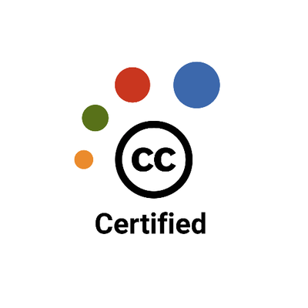
Questions?
Kate Ehrig-Page, UNO Institutional Repository Coordinator kehrigpage@unomaha.edu
https://orcid.org/0000-0002-5015-6244
Presentation URL https://unl.libguides.com/CUFall2020
https://digitalcommons.unomaha.edu/crisslibfacproc/121/

Slide 22
Thank You!

Slide 23
References
“Appendix: Courseware.” Community-Owned Infrastructure. Accessed August 3, 2020. https://infrastructure.sparcopen.org/2020-update/appendix-courseware.
“Appendix: Scholarly Journals.” Community-Owned Infrastructure. Accessed August 3, 2020. https://infrastructure.sparcopen.org/2020-update/appendix-scholarly-journals.
“Emerging Concerns: The Bigger Deal.” Community-Owned Infrastructure. Accessed August 3, 2020. https://infrastructure.sparcopen.org/2020-update/the-bigger-deal.
“ESAC – Efficiency and Standards for Article Charges.” Accessed August 26, 2020. https://esac-initiative.org/.
“License Selector.” Accessed August 21, 2020. https://ufal.github.io/public-license-selector/.
“Open Access Week.” Accessed August 12, 2020. http://openaccessweek.org/.
“Open Data Commons: Legal Tools for Open Data.” Accessed August 3, 2020. https://opendatacommons.org/.
“Open Knowledge Foundation.” Accessed August 3, 2020. https://okfn.org.
“Open Library of the Humanities.” Accessed August 6, 2020. https://www.openlibhums.org/.
“ORCID.” Accessed August 26, 2020. https://orcid.org/.
“Public Knowledge Project.” Accessed August 6, 2020. https://pkp.sfu.ca/.
“Radical Open Access – Building Horizontal Alliances.” Accessed August 6, 2020. http://radicaloa.disruptivemedia.org.uk/.
“Registry of Research Data Repositories,” n.d. re3data.org.
“Sherpa Romeo.” Accessed August 12, 2020. https://v2.sherpa.ac.uk/romeo/.

Slide 24
“Ubiquity Press,” n.d. https://www.ubiquitypress.com/.
“University of California System Strikes Landmark Open-Access Deal with Springer Nature.” Accessed August 12, 2020. https://www.insidehighered.com/news/2020/06/17/university-california-system-strikes-landmark-open-access-deal-springer-nature.
“Unsub.” Accessed July 29, 2020. https://unsub.org/.
“Update to the Roadmap for Action.” Community-Owned Infrastructure. Accessed August 3, 2020. https://infrastructure.sparcopen.org/2020-update/update-to-roadmap-for-action.
“Why Open Research?” Accessed August 21, 2020. http://whyopenresearch.org/index.
“Wiki/Cc License Compatibility - Creative Commons.” Accessed August 26, 2020. https://wiki.creativecommons.org/wiki/Wiki/cc_license_compatibility.
Adie, Euan. “Attention! A Study of Open Access vs Non-Open Access Articles.” Figshare, 2014. https://doi.org/10.6084/M9.FIGSHARE.1213690.
Al-Garadi, Mohammed Ali, Kasturi Dewi Varathan, Sri Devi Ravana, Ejaz Ahmed, Ghulam Mujtaba, Muhammad Usman Shahid Khan, and Samee U. Khan. “Analysis of Online Social Network Connections for Identification of Influential Users: Survey and Open Research Issues.” ACM Computing Surveys 51, no. 1 (January 31, 2018): 16:1–16:37. https://doi.org/10.1145/3155897.
ALLEA. “Sustainable and FAIR Data Sharing in the Humanities: Recommendations of the ALLEA Working Group E-Humanities.” Digital Repository of Ireland Publications. Accessed August 12, 2020. https://repository.dri.ie/catalog/tq582c863.
Annual Reviews. “Subscribe to Open.” Annual Reviews. Accessed August 6, 2020. https://www.annualreviews.org/page/subscriptions/subscribe-to-open.

Slide 25
Australasian Open Access Strategy Group. “Benefits of Open Access,” February 8, 2013. https://aoasg.org.au/resources/benefits-of-open-access/.
Beyond APCs: Exploring New, More Inclusive Business Models for Open Access Publishing (Webinar), 2020. https://www.youtube.com/watch?v=DJGnmJNJnsA&feature=youtu.be.
BOAI. “Budapest Open Access Initiative | Open Access: Toward the Internet of the Mind.” Accessed July 29, 2020. https://www.budapestopenaccessinitiative.org/open-access-toward-the-internet-of-the-mind.
Borgman, Christine L. “Open Data, Grey Data, and Stewardship: Universities at the Privacy Frontier.” Berkeley Technology Law Journal 33 (2018): 365.
cOAlition S. “Plan S.” Accessed August 12, 2020. https://www.coalition-s.org/.
Coalition, Scholarly Publishing and Academic Resources. “2020 Update: SPARC Landscape Analysis & Roadmap for Action.” Community-Owned Infrastructure. Accessed August 3, 2020. https://infrastructure.sparcopen.org/2020-update.
Coggins, Niccole, Jocelyn Dawson, Melanie Dolechek, and Gisela Concepción Fosado. “Guest Post — An Antiracist Framework for Scholarly Publishing.” The Scholarly Kitchen, August 6, 2020. https://scholarlykitchen.sspnet.org/2020/08/06/guest-post-an-antiracist-framework-for-scholarly-publishing/.
Čolaković, Alem, and Mesud Hadžialić. “Internet of Things (IoT): A Review of Enabling Technologies, Challenges, and Open Research Issues.” Computer Networks 144 (October 24, 2018): 17–39. https://doi.org/10.1016/j.comnet.2018.07.017.

Slide 26
COPIM. “COPIM.” Accessed August 21, 2020. https://www.copim.ac.uk/.
Creative Commons. “Choose a License.” Accessed August 21, 2020. https://creativecommons.org/choose/.
Dasler, Robin. “Data Sharing Made Easier: Use Repository Finder to Find the Right Repository for Your Data.” DataCite, September 19, 2018. https://doi.org/10.5438/WDAY-8958.
DMPonline. “DMPonline.” Accessed August 12, 2020. https://dmponline.dcc.ac.uk/.
DMPTool. “DMPTool.” Accessed August 12, 2020. https://dmptool.org/.
DOAB. “DOAB: Directory of Open Access Books.” Accessed August 21, 2020. https://www.doabooks.org/.
DOAJ. “Directory of Open Access Journals.” Accessed August 12, 2020. https://doaj.org.
DOI. “DOI,” n.d. www.doi.org.
Dubinsky, Ellen. “Does Open Access Make Cents? Return on Investment in the Institutional Repository | Dubinsky | College & Research Libraries News.” Accessed July 30, 2020. https://doi.org/10.5860/crln.80.5.281.
Duraspace.org. “DSpace - A Turnkey Institutional Repository Application.” Accessed August 19, 2020. https://duraspace.org/dspace/.
Ehrig-Page, Kate. “2019 UNO Open Access Fund Report.” UNO, 2019.
European Data Portal. “Datasets | European Data Portal.” Accessed July 30, 2020. https://www.europeandataportal.eu/en/covid-19/datasets.
Ferrell, Tonya. “LibGuides: Open Educational Resources (OERs): Home.” Accessed August 21, 2020. https://libguides.unomaha.edu/oer/home.

Slide 27
Ganapathi, Janani. “Open Educational Resources: Challenges and Opportunities in Indian Primary Education.” International Review of Research in Open and Distributed Learning 19, no. 3 (2018). https://doi.org/10.19173/irrodl.v19i3.3662.
GetFTR. “Get Full Text Research.” Accessed August 3, 2020. https://www.getfulltextresearch.com/.
GO FAIR. “GO FAIR Initiative: Make Your Data & Services FAIR.” GO FAIR. Accessed August 12, 2020. https://www.go-fair.org/.
Green, Toby. “Is Open Access Affordable? Why Current Models Do Not Work and Why We Need Internet-Era Transformation of Scholarly Communications.” Learned Publishing 32, no. 1 (2019): 13–25. https://doi.org/10.1002/leap.1219.
http://www.creatomatic.co.uk. “Creatomatic.” Project Counter (blog). Accessed August 12, 2020. https://www.projectcounter.org/about/.
Ltd, Kopernio. “Kopernio.” Accessed August 12, 2020. https://kopernio.com/.
MacLeavy, Julie, Richard Harris, and Ron Johnston. “The Unintended Consequences of Open Access Publishing – And Possible Futures.” Geoforum 112 (June 1, 2020): 9–12. https://doi.org/10.1016/j.geoforum.2019.12.010.
Manista, Frank (ed.), and Graham (ed.) Stone. “Special Collection - From Finch to Plan S: And You May Ask Yourself, Well How Did I Get Here?” UKSG. Accessed August 12, 2020. http://insights.uksg.org/collections/special/from-finch-to-plan-s/.
Max Pixel. “Subscription Subscribe Icon Button.” Accessed August 24, 2020. https://www.maxpixel.net/Subscription-Subscribe-Icon-Button-5408999.

Slide 28
Miao, Fengchun, Sanjaya Mishra, Dominic Orr, and Ben Janssen. “Guidelines on the development of open educational resources policies.” UNESCO. Accessed August 24, 2020. https://unesdoc.unesco.org/ark:/48223/pf0000371129.
National Library of Medicine. “NCBI SARS-CoV-2 Resources.” Accessed July 30, 2020. https://www.ncbi.nlm.nih.gov/sars-cov-2/.
Neto, João Batista. English: Types of Data. Translation of Document Hosted by João Batista Netoat File:Data Types - Pt Br.Svg. September 7, 2015. Data types - pt br.svg. https://commons.wikimedia.org/wiki/File:Data_types_-_en.svg.
NLA. “Nebraska Library Association - NLA Conference (Cancelled).” Accessed August 21, 2020. https://nebraskalibraries.org/NLA_Conference.
OASPA. “OASPA | Open Access Scholarly Publishers Association.” Accessed August 12, 2020. https://oaspa.org/.
OASPA. “OASPA Webinar - What Is Scholarly Publishing in the 21st Century - 4_2_20.” Accessed August 6, 2020. https://copyright.wistia.com/medias/5yci3vbnml?wtime=0.
OER Commons. “OER Commons.” Accessed July 30, 2020. https://www.oercommons.org/.
Open Access Button, “Open Access Button”. Accessed August 28, 2020. https://openaccessbutton.org/.
Open Data Handbook. “What Is Open Data?” Accessed August 12, 2020. http://opendatahandbook.org/guide/en/what-is-open-data/.
Open Data Handook. “The Open Data Handbook.” Accessed August 3, 2020. http://opendatahandbook.org/.
Open Textbook Library. “Open Textbook Library.” Accessed August 21, 2020. https://open.umn.edu/opentextbooks.

Slide 29
OpenStax. “OpenStax.” Accessed August 21, 2020. https://openstax.org/.
OPERAS. “OPERAS – Open Scholarly Communication in the European Research Area for Social Sciences and Humanities.” Accessed August 26, 2020. https://operas.hypotheses.org/.
ORFG. “Open Research Funders Group.” Open Research Funders Group. Accessed August 6, 2020. http://www.orfg.org.
Pinnock, Gaelen. English: The Research Data Management (RDM) Lifecycle at the University of Cape Town (UCT). December 1, 2018. Designer commissioned by the UCT Research office / UCT eResearch centre. https://commons.wikimedia.org/wiki/File:UCT_RDM_lifecycle_(all_icons).svg.
Piwowar, Heather A., and Todd J. Vision. “Data Reuse and the Open Data Citation Advantage.” PeerJ 1 (October 1, 2013): e175. https://doi.org/10.7717/peerj.175.
Research Data Service Committee. “UNO Research Data Practices,” 2019.
SangyaPundir. English: FAIR Guiding Principles for Data Resources. November 17, 2016. Own work. https://commons.wikimedia.org/wiki/File:FAIR_data_principles.jpg.
SPARC. “Big Deal Cancellation Tracking.” Accessed August 3, 2020. https://sparcopen.org/our-work/big-deal-cancellation-tracking/.
SPARC. “Campus Open Access Fund FAQ.” SPARC. Accessed August 12, 2020. https://sparcopen.org/our-work/oa-funds/faq/.
SPARC. “Open Access.” Accessed August 26, 2020. https://sparcopen.org/open-access/.
SPARC. “Open Data.” Accessed August 26, 2020. https://sparcopen.org/open-data/.

Slide 30
SPARC. “Sharing Experiences of Journal Cancellations on a Rapid Timeline,” July 9, 2020. https://sparcopen.org/news/2020/sharing-experiences-of-journal-cancellations-on-a-rapid-timeline/.
Tait, Alan. “Education for Development: From Distance to Open Education.” Journal of Learning for Development 5, no. 2 (2018): 101–15.
The Scholarly Kitchen. “Subscribe To Open: Annual Reviews’ Take on Open Access,” April 2, 2019. https://scholarlykitchen.sspnet.org/2019/04/02/subscribe-to-open/.
UNESCO. “Open Educational Resources (OER),” July 20, 2017. https://en.unesco.org/themes/building-knowledge-societies/oer.
University of Nebraska at Omaha. “DigitalCommons@UNO - The Institutional Repository of the University of Nebraska at Omaha.” Accessed August 12, 2020. https://digitalcommons.unomaha.edu/.
Unpaywall. “Unpaywall: An Open Database of 20 Million Free Scholarly Articles.” Accessed August 3, 2020. http://unpaywall.org/.
Vandewalle, Patrick. “Code Sharing Is Associated with Research Impact in Image Processing.” Computing in Science & Engineering 14, no. 4 (July 2012): 42–47. https://doi.org/10.1109/MCSE.2012.63.
Wellcome. “What Is Open Research?” Accessed August 26, 2020. https://wellcome.ac.uk/what-we-do/our-work/open-research.
Why Open Research? “Don’t All Researchers Have Access?” Accessed August 21, 2020. http://whyopenresearch.org/paywalls.

