Slide 1
DigitalCommons@UNO and Building Your Scholarly Profile
Jennie Tobler-Gaston, Institutional Repository Coordinator, Criss Library
Notes:
Good afternoon, my name is Jennie Tobler-Gaston I am the Institutional Repository Coordinator at Criss Library.

Slide 2
In this Presentation
Digital Commons @ UNO
What is it?
How do I get work into it?
Building Your Scholarly Profile
PINPOINT Method
Notes:
Today this presentation will cover what digital commons at UNO is and how to get your work into it. And tips how to Build Your Scholarly Profile using the PINPOINT method.

Slide 3
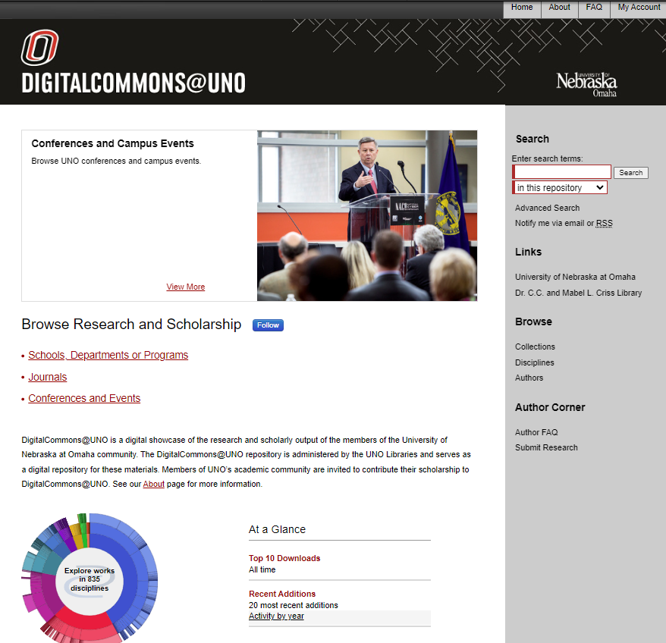
What is Digital Commons @ UNO?
UNO’s Institutional Repository
Showcases the scholarly and creative work at UNO
Open Access Repository
Notes:
DigitalCommons@UNO [click] is the institutional repository often just referred to as Digital Commons or DC – [click]
it is an open access digital repository. Open access is simply making work freely available, so that anyone with an internet connection can access it without encountering a paywall. [click]
It showcases the scholarship of the UNO community in 800 different disciplines and is a place for people to see the type of research or creative work each department is producing. As faculty members and members of the UNO community It is a great place to showcase your research or creative work.

Slide 4
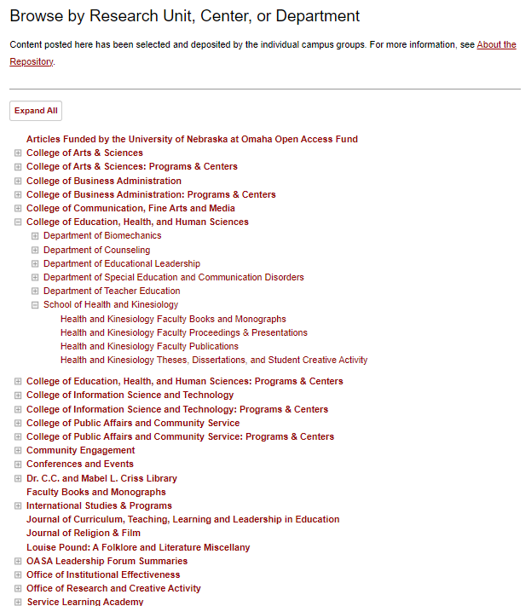
The Basics
Free
https://digitalcommons.unomaha.edu
Articles, presentations, books, chapters, creative work
Any File type
Organization
Colleges
Disciplines
Authors
Notes:
So, lets look at the basics and organization of digital commons. [click]
Digital commons is free to deposit work into, you just have to be affiliated with UNO, and free for others to use – regardless of where they are physically located or their affiliation with UNO. [click]
It is accessed at Digitalcommons.unomaha.edu. [click]
The kind of works that are typically uploaded are articles, presentations, books, chapters, and creative work – but it isn’t limited to these types of outputs – we have uploaded things such as reports and curriculum. [click]
As long as the work is in a digital form we can upload it to Digital Commons – it is not restricted by file type. [click]
Digital Commons is organized primarily into collections. Each collection is either a college, department, research unit, event, conference, or journal that calls UNO their home. You are able to search within Digital Commons in multiple ways including by college, discipline, or author.

Slide 5
Who can contribute and what can be added?
UNO Faculty, Researchers, Staff, Students, Departments, Offices…
Scholarly, educational, or research oriented
Permanent addition to the repository
Grant UNO the non-exclusive right to distribute
Copyright allows
Notes:
Who can contribute to the Digital Commons and what can be added. The requirements to add work to the institutional repository must meet five factors. [click]
First, Work added must be produced, submitted, or sponsored by UNO Faculty, Researchers, staff, students, departments or offices. We really encourage faculty both old and new, full-time and part-time, to add their work to DigitalCommons@ UNO. [click]
Work must be scholarly, educational, or research oriented in nature as this is a space for scholarship – however we do take a pretty broad view of what is considered scholarly and eductational. [click]
Work must be intended to be a permanent part of the repository - we do have avenues for you to change, adjust, or update what you submit, but it isn’t intended to be completely removed from the repository once submitted. [click]
The author or copyright holder must be willing and able to grant the University of Nebraska Omaha the non-exclusive right to distribute the work via DigitalCommons@UNO. [click]
And all deposits must meet copyright and re-use permissions – I will get more into this in a moment.

Slide 6
How do I get work on Digital Commons?
Send CV or Publications List
unodigitalcommons@unomaha.edu
Publication data analyzed for Digital Commons
We check copyright and permissions!
If we cannot use the version of record and earlier manuscript can sometimes be used
Notes:
Getting your work in to Digital Commons is simple and easy [click]
– just email your CV or Publications list to UNO Digital Commons @ UNOmaha . edu. [click]
We will check the copyright and permissions on each publication. We will also reach out to publisher that hold the copyright and request permission to deposit. If the authors are the copyright holder we will reach out to each co-author for permission. [click]
One thing to keep in mind is that if we cannot deposit the Version of record we can in some cases deposit the post print or the preprint - so it is a good idea to keep these copies available. We will reach out to you if we need any version of your work.

Slide 7
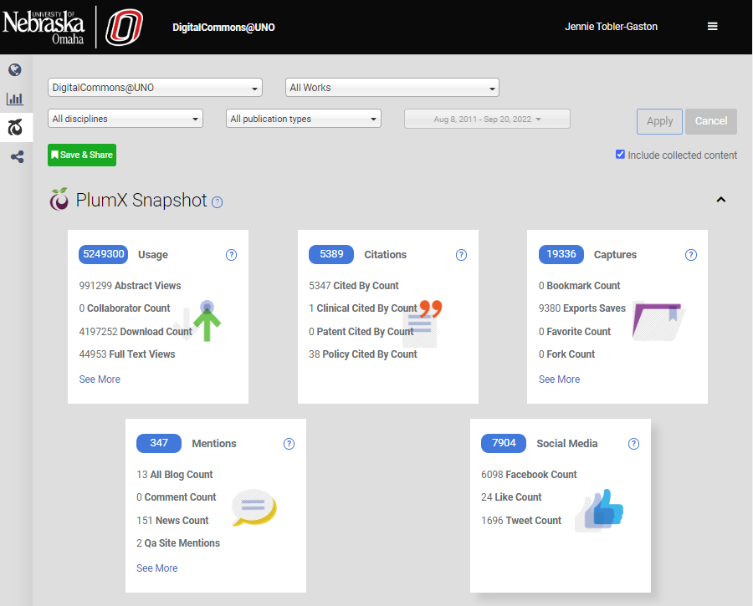
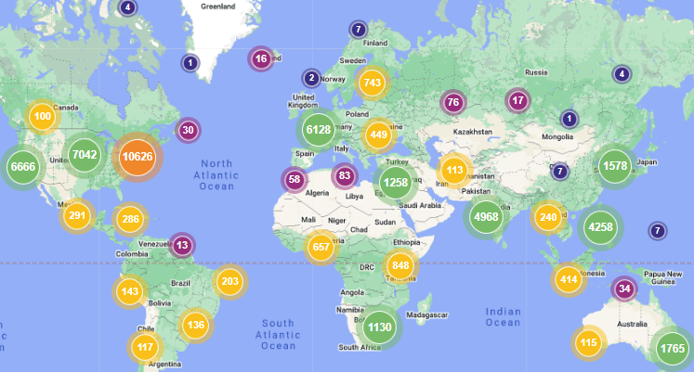
Reasons to share scholarly and creative work on Digital Commons
Boost Your Research Profile
Increase visibility of your work
Make research accessible
Increase the longevity of your work
Metrics through the Author’s
Dashboard
Centralized scholarship
Easy to share your work
Notes:
What are the benefits of participating in the DigitalCommons @ UNO? [click]
Participation can boost your research profile and present it in a more customized way. [click]
Digital Commons increases the visibility of your work since it is indexed by multiple search engines, for example Google, Google Scholar, Bing, and Duck Duck Go, making work more discoverable within search results. [click]
Since Digital Commons is an open access repository it makes your research globally accessible. [click]
It increases longevity of your work since the submissions are intended to be a permanent part of DigitalCommons @ UNO and are not removed as is the case [click]
with some databases or websites. [click]
Participation in Digital Commons allows you to create an author’s page with a dashboard that provides useful statistics, lets you track how readers are finding your work, and the monthly download reports allows for quick feedback on your work. These metrics can be useful when it comes to promotion and tenure. When you set up your account be sure to use your UNO email address. [click]
Digital Commons also creates a centralized location for your scholarship and creates access to supporting documents that can be uploaded to provide context for your research. It can be convenient to have all your work in one place. [click]
The tools on the site, such as the RSS feed, can make it easy to share your work with colleagues and students.

Slide 8
Building Your Scholarly Profile Using the PINPOINT Method
Portfolio
Institutional Repository (IR)
Network
Publishing
Open Access
ID
Name
Tracking
Notes:
So now let's look how you can build your Scholarly Profile using the PINPOINT method which stands for [click]
Portfolio, [click]
IR (which is Digital Commons @ UNO), [click]
Network, [click]
Publishing, [click]
Open Access, [click]
ID, [click]
Name, [click]
and Tracking. These subjects represent areas in which you can grow the impact of your scholarship. This method is aimed at early-career professionals though it can be used by students, faculty and researchers a like. You can use each area to varying degrees but the use of all of them to some degree will positively impact your scholarly profile.

Slide 9
Portfolio
Maintain a consistent “brand”
Professional email
Updated CV and/or publication list
Scholarly Networking Sites
Personal archives
Keep track and maintain all the areas you have a scholarly profile!
Notes:
When creating [click]
or working on your portfolio is it important to maintain a consistent brand or profile across all the platforms you choose to use. [click]
This includes having a professional email address, [click]
a current CV, and publications list available when someone searches for your information. The purpose of a portfolio is to consider your body of work as a whole, rather than a collection of pieces. [click]
As part of your portfolio, you may want to consider joining some scholarly social networking sites, like Twitter, LinkedIn, Google Scholar, ResearchGate, and Academia.edu. However, what is important to remember (particularly with the last two examples) is that if you are going to share your work online you must own the copyright or have distribution rights to that work, just because you wrote an article does not necessarily mean you have the right to reshare it. Remember to keep track of all the areas you choose to promote your work and consider cross listing to capture a wider audience. [click]
Although you are creating a portfolio to hold your work, it is wise to maintain copies of your publications, conference contributions, and creative work within your own personal archives and not rely solely on 3rd party sites. [click]
Be sure to keep track of all the places you are creating your scholarly profile and make sure to keep them updated and consistent.

Slide 10
IR
DigitalCommons@UNO - unodigitalcommons@unomaha.edu
Keeps multiple versions of your work.
Notes:
Many universities have their own institutional repository or IR. As discussed earlier Digital Commons is UNO’s IR. There are other repositories that may be discipline specific, open access or not, where you can deposit work. However, UNO libraries will be able to directly help you with the Digital Commons platform, we check copyright and permissions, and upload the work for you. As I mentioned before, due to copyright and reuse permissions it may not be possible to post the published version also called the version of record of your work online, but an earlier version might be acceptable. Always keep the multiple versions of your work for sharing purposes. Here you can see the various terms used for manuscripts throughout the publishing cycle. Again, if you would like to make your work available on Digital Commons or need help distinguishing the various manuscript versions or what can be posted on various sites email UNO digital commons @ unomaha.edu We are happy to help.

Slide 11
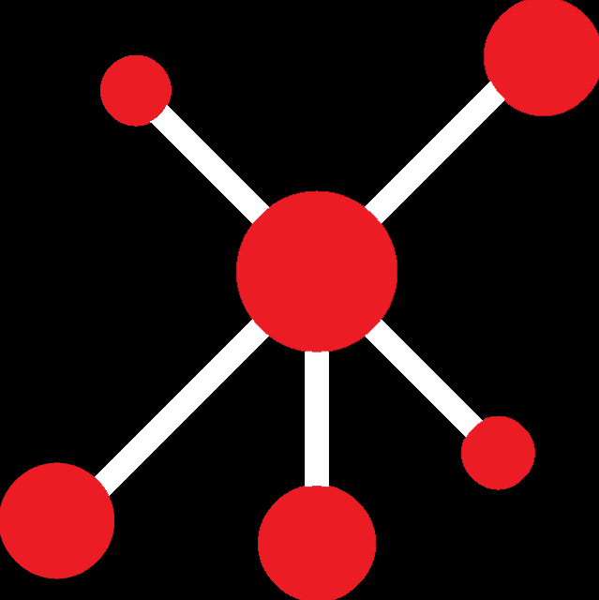
Network
Colleagues
Social Network
Professional Development Opportunities
Professional Network
Conferences
Notes:
Network refers to the professional network that helps create opportunities for collaboration. Networking is not just about finding the next career move but is about building a community, contributing to the academic landscape and giving your scholarship the visibility it deserves. There are a few good starting points for building your network, [click]
such as asking for advice from colleagues, fellow students, and contacts at other institutions about where and how they got involved in the industry. [click]
Participate in conferences as an organizer or presenter. [click]
Join a professional network or association. [click]
Share your work on social media – be sure to include DOIs or URLs to your work to capture those metrics. [click]
Take advantage of professional development opportunities outside of your discipline on such subjects as how to create an effective presentation – this not only strengthens your skills but extends your network outside your discipline which can lead to new opportunities. It is also important make an effort to stay in contact with the people you’ve networked with so that your community becomes a place of mutual support.

Slide 12
Publishing
Impact
Peer review
Reputation
Open Access
Alternative Metrics
Subject Librarians - https://www.unomaha.edu/criss-library/research-and-instruction/subject-librarians.php
Open Access and Scholarly Publishing Guide - https://libguides.unomaha.edu/openaccess
Notes:
Publishing is a huge part of your scholarly profile, and it is important to check on the quality of the journal you plan to publish in. [click]
Measurements of quality can have an impact and vary across disciplines and [click]
things like peer review [click]
and reputation can play a large part in determining the quality and impact of a journal. [click]
Other factors such as if the journal is open access [click]
or tracks alternative metrics ,such as the number of times an article is mentioned by the media can impact your choice of journal. Where you publish can influence the tenure review process – but practices vary considerably across disciplines. It is a good idea to check with your department on what publishing criteria you are expected to meet. [click]
You can also check with subject librarian for subject-specific advise. The Library has lots of resources as well to help you decide where to publish, one of the best places to [click]
start is our guide on Open Access and Scholarly Publishing that has information on our Open Access Publishing Agreements that cover APCS (article publishing charges), links to Clarivate’s Journal Citation Reports that provide Journal Impact Factors, Copyright information and how to retain your copyrights when publishing.

Slide 13
Open Access
Grants
Directory of Open Access Journals (DOAJ)
Sherpa Services
Open Access Publishing Agreements
Open Access and Scholarly Publishing Guide - https://libguides.unomaha.edu/openaccess
Librarians and Library Staff
Notes:
As briefly mentioned before, open access is the free and immediate access to academic and creative work, which helps reduce barriers to students or other researchers. The orange padlock symbol is often associated with open access content. Open access helps improve the impact of your work because it is not restricted by a paywall – in fact open access articles are sited more often than article published behind a paywall. [click]
It is always advisable to include the costs of APCs in any grants you write so that you can cover these costs in journals.[click]
There are a variety of resources that can help you assess the openness of the publishers you are working with. The Directory of Open Access Journals (DOAJ) provides a list of open access journals that they have vetted for quality through a rigorous application process – it also provides a lot information and metrics on these journals. [click]
Sherpa Services is a great resource that allows you to search a journal and find out how that journal allows you to share your work in different areas such as your personal website, the institutional repository, or on other parts of your online portfolio. [click]
One resource available to all of our UNO faculty is our Open Access Agreements through the Big Ten Academic Alliance – we currently have agreements with Cambridge University Press, PLoS, Wiley, Institute of Physics (IOP), and for monograps the MIT Press Direct to Open agreement. [click]
There are some terms and conditions and that information is easily access through our Open Access and Scholarly Publishing Guide This guide is updated regular to help you with resources [click]
and don’t forget librarians are here to help you wade through all these resources and information.
As mentioned before our subject librarians that have a wealth of information to assist with research and publishing. And if you ever have questions about Open Access or our various agreement you can always reach out to your subject librarian or me directly. The library’s purpose is to help.

Slide 14
ID
ORCiD
ResearcherID (Web of Science/Publons
Scopus Author - ID
DOIs
Notes:
Presistent IDs are becoming more and more important as part of the academic landscape. It is an easy way to consistently have your work remain findable. [click]
ORCid is a numeric id for your name that you can attach to your work – which increases the findability regardless of name changes, alternate spellings, or abbreviations. All of your scholarly output will be identified with the ORCID number no matter what institution or publisher you are associated with at the time. It is very easy and free to sign up for an ORCiD and takes only about 60 seconds. [click]
ResearchIDs from Web of Science and Publons is another way to distinguish your academic profile from others. Scopus Author IDs automatically assigns a number to track citation metrics related to those in Scopus index publications that you have submitted to. Researcher ID and Scopus Author IDs are now also recommending ORCiD IDs to fully connect and disambiguate author names. [click]
Finally, making sure that your work is assigned a Digital Object Identifier or DOI is incredibly important for ensuring your research is findable. DOIs create a persistent and unique path to articles, datasets, audio-visual content, and other online content. These are a much more stable and persistent link than web addresses and URLs. It is becoming more common for publishers to assign DOIs to articles, supplementary materials, and datasets, however if you would like a DOI added to your research contact UNODigitalCommons @ unomaha.edu.

Slide 15
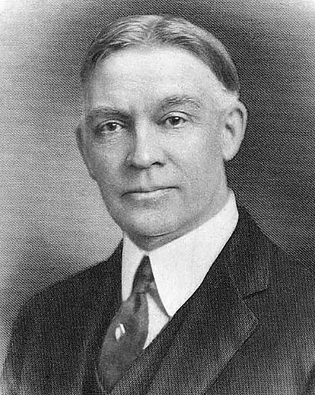
Name
Daniel Edward Jenkins
Danie E. Jenkins
Dan Jenkins
Danny Jenkins
D.E. Jenkins
Reverend Jenkins
Dr. Jenkins
Reverend Dr. Daniel E. Jenkins
Notes:
Your name is one thing that is associated with your work, but can constantly change. Check what is online about you. Is that information consistent with your scholarly profile. It is best if the name you choose for your professional body of work remains consistent. If you have a name that can take many variations, such as the founder of UNO’s name Reverend Dr. Daniel E. Jenkins – pictured here, choose the one that you most identify with. If you experience a legal name change make sure to update all aspects of your scholarly portfolio, especially your ORCID number to reflect this change. The consistency of your name will increase the discoverability of your work.

Slide 16
Tracking
Digital Commons Metrics
Altmetrics
Publons (now part of Web of Science)
Impactstory (through Twitter)
H-Index (available through Google Scholar and Web of Science)
i10 – Index
Personal Website
Notes:
Data about usage can help you focus your research and outreach efforts. For instance, if you know in which academic areas, geographical regions, and on what platforms your scholarship is most discoverable and cited, you can take a more targeted approach to your scholarship. There are variety of places you can access this type of data. [click]
Digital Commons provides information on where in the world your work in this repository is being accessed, what institutions are accessing it and download counts. To get this information you may be able access your author dashboard if you have set up an author’s page using your UNO email address or email UNODigitalCommons@unomaha.edu and we can send it to you. [click]
Altmetics is a resource that measures impact in alternate ways from the traditional citation count, such as social media usage. [click]
Publons is a profile and tracking system you can use to collect metrics on your scholarly output. [click]
Impact Story which you can sign up for through Twitter is an open source platform the collects alternative metrics. [click]
H-Index that is access through Google Scholar or Web of Science measure the number of citations of your publication as well as the number of times those publications that cited your work has been cited. [click]
The i 10-Index measure those papers with 10 or more citations and is available through Google Scholar. [click]
Finally, if you have a personal website it may provide statistical information on the administrative side. See if your website has a dashboard where the metrics would be tracked. As you can see there are many ways to track the usage surrounding your work. But these statistics are only useful if they are put into context with you as a person and professional.

Slide 17
Questions?
Jennie Tobler-Gaston
jenniegaston@unomaha.edu 402-554-5879
unodigitalcommons@unomaha.edu
Notes:
And so, in summary, I have discussed what digital commons at uno is and the benefits of submitting your work and how to build your scholarly profile using the PINPOINT method.
Any questions?

Slide 18
Selected Bibliography
DigitalCommons@UNO. Accessed September 19,2022. https://digitalcommons.unomaha.edu/.​
Ehrig-Page, K. M. (2020). The institutional repository and building your scholarly profile. [PowerPoint Slides]. Institutional repository. University of Nebraska Omaha.
​Lachner, B. (2018, September 6). Icon-Pinnadel.svg. Wikimedia Commons. https://commons.wikimedia.org/wiki/File:Icon-Pinnnadel.svg CC 0
“Open Access: Toward the Internet of the Mind.” Budapest Open Access Initiative | Open Access: Toward the Internet of the Mind. Accessed November 22, 2019. https://www.budapestopenaccessinitiative.org/open-access-toward-the-internet-of-the-mind.
Rische, L. (2017, April 13). University hat icon.svg. Wikimedia Commons. https://commons.wikimedia.org/wiki/File:University_hat_icon.svg CC BY 3.0.
University of Nebraska Omaha Criss Library. (2022, Jully). Buidling your scholarly Profile. https://libguides.unomaha.edu/scholarlyprofile
University of Nebraska Omaha Criss Library. (2022, July). Open Access and Scholarly Publishing @ UNO. https://libguides.unomaha.edu/openaccess/unoinitiatives
University of Nebraska Omaha Criss Library. (2022, January 22). About DigitalCommons@UNO. DigitalCommons@UNO. https://digitalcommons.unomaha.edu/about.htm
University of Nebraska Omaha Criss Library. (2022, January 22). Frequently asked questions. DigitalCommons@UNO. https://digitalcommons.unomaha.edu/faq.html
Notes:
Here is the selected bibliography that helped to create this presentation.

Slide 19
Thank You
Notes:
Thank you for your time today

