Slide 1
International Open Access Week
Community over Commercialization
Contact: Jennie Tobler-Gaston (she/her), Institutional Repository Coordinator
Criss Library

Slide 2
International Open Access Week

Slide 3
What is Open Access?
The free, immediate, online availability of work
Authors keep their copyright to control the integrity of their work
A fundamental change to the Scholarly Publishing Model
Re-use rights – usually by a Creative Commons License
Represented by a padlock – most often an orange padlock

Slide 4
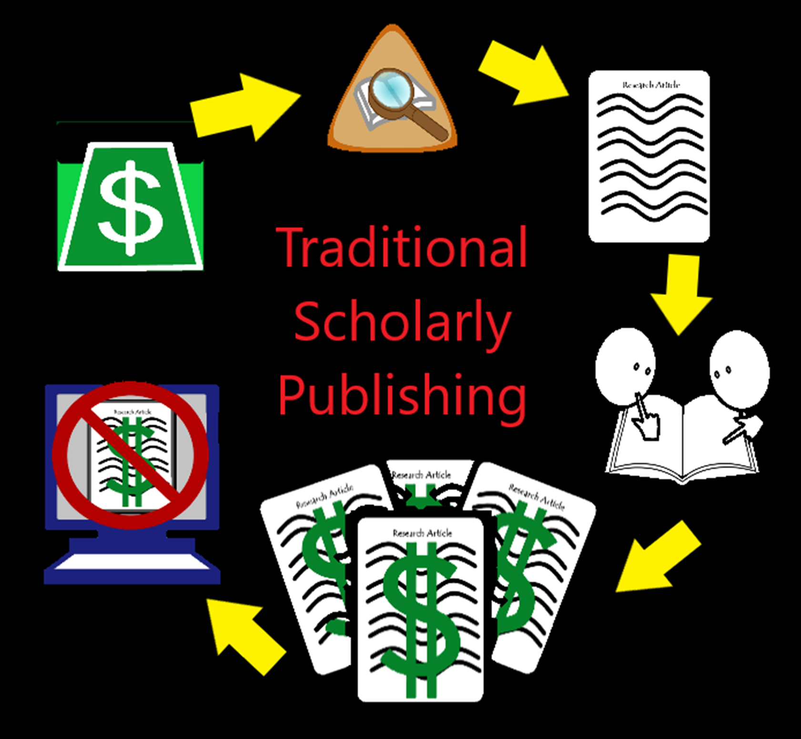
2. Researchers conduct their research
3. That research results in a paper that is submitted to a publisher (at no cost to the publisher)
1. Researchers apply for funds – usually in the form of grants, many are federally funded
4. Peer reviewers review the article and provide feedback and the author makes edits (all for free)
6. Publishers then charge users (researchers, students, or libraries) to access the work
5. Publishers then finalize and publish the final accepted version of the work

Slide 5
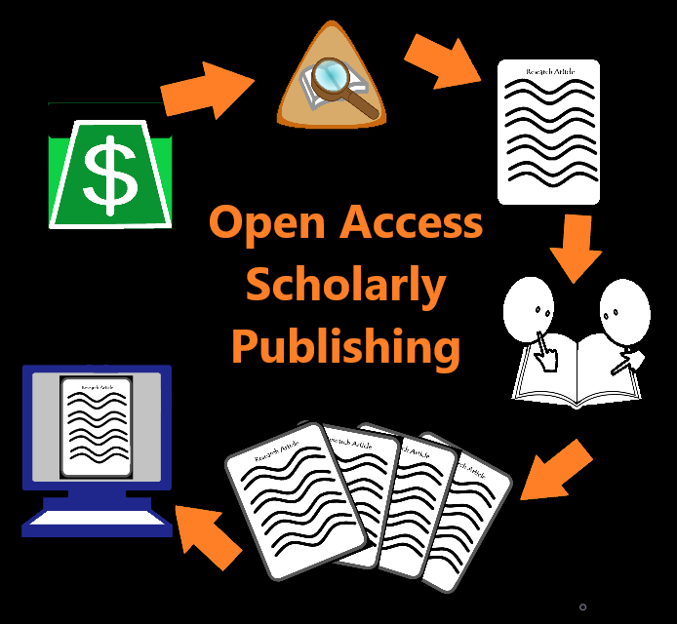
2. Researchers conduct their research
3. That research results in a paper that is submitted to a publisher (at no cost to the publisher)
1. Researchers apply for funds – usually in the form of grants, many are federally funded
4. Peer reviewers review the article and provide feedback and the author makes edits (all for free)
6. Publishers, through an open access model, make the work free and accessible online
5. Publishers then finalize and publish the final accepted version of the work

Slide 6
Open Access Models
Knowledge and research are intended to be shared and built upon – Open Access makes this possible
Four types of open access
Platinum/Diamond Open Access
Gold Open Access
Bronze Open Access
Green Open Access

Slide 7
Platinum or Diamond Open Access
The ultimate and most open form of open access
The journal does not charge Article Processing Charges (APCs)
Authors retain their copyright
Articles are openly licensed – usually with a Creative Commons License
Typically receives outside funding to support the costs of the journal

Slide 8
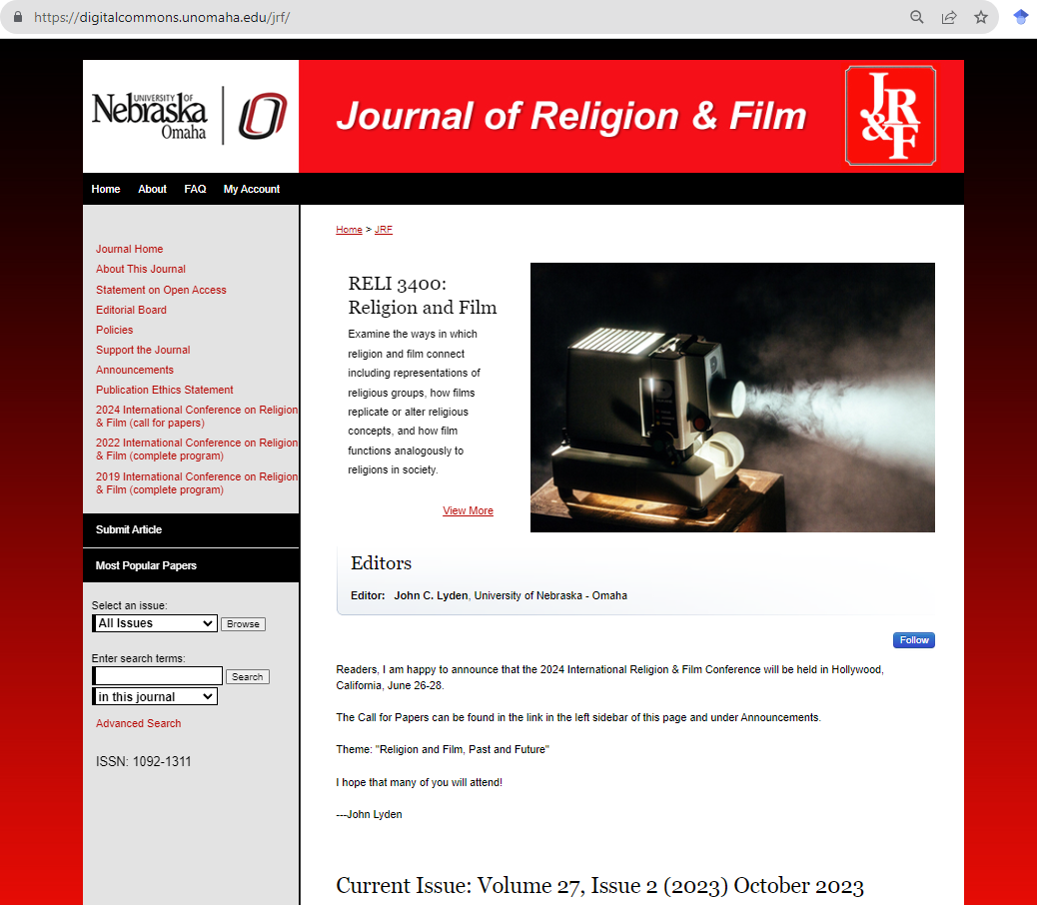
Platinum or Diamond Open Access Example
UNO’s Journal of Religion and Film
Articles are free to read and access and are licensed under the Creative Commons Attribution License
Receives institutional support
Hosted on UNO’s open access institutional repository: DigitalCommons@UNO

Slide 9
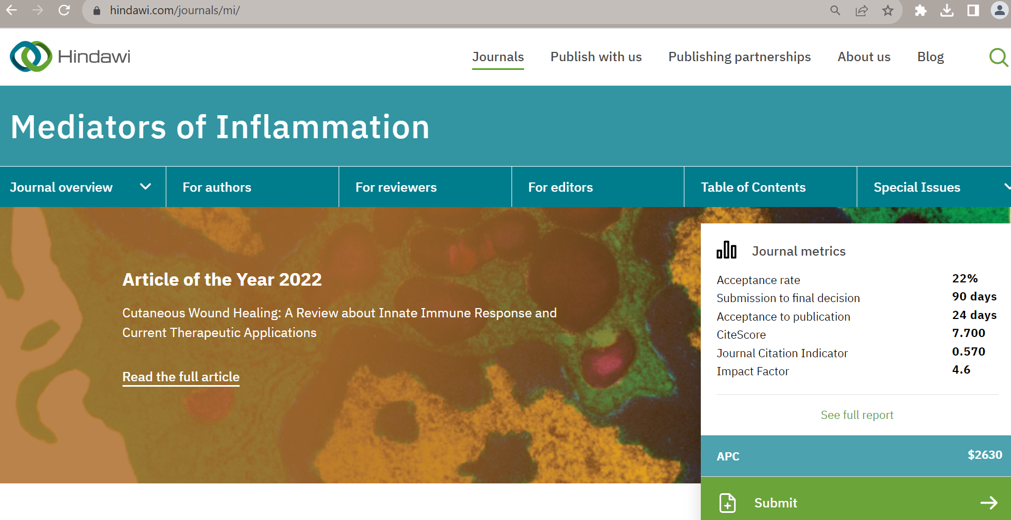
Gold Open Access Example
Hindawi's Mediators of Inflammation Journal
Articles are free to read and access and are license under the Creative Commons Attribution License
Charges a $2,630.00 APC

Slide 10
Gold Open Access
The most common and best-known type of open access
Fully Open Access journals or Hybrid (both open access and subscription based) journals that charge APCs (Article Processing Charges)
APCs can range from a couple hundred dollars to thousands of dollars per article
Authors retain their copyright
Articles are openly licensed – usually with a Creative Commons License

Slide 11
Bronze Open Access
Articles are free to read on the journal's website
Authors generally transfer their copyright to the publisher
Articles are NOT openly licensed
This prevents others from sharing, re-using, and building upon the knowledge and research within the article
Many do not consider this a true form of open access since you cannot share or re-use the work
DigitalCommons@UNO – Criss Library (this is for informational purposes only and not legal advice)

Slide 12
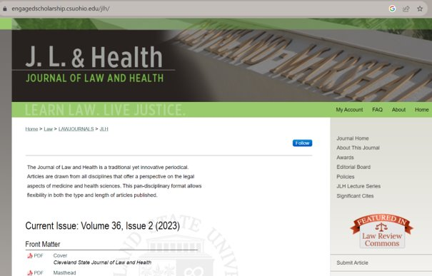
Bronze Open Access Example
Cleveland State University's
Journal of Law and Health
Free to read and access
Not openly licensed, so any reuse would need permission
DigitalCommons@UNO – Criss Library (this is for informational purposes only and not legal advice)

Slide 13
Green Open Access
This is the self-archiving form of open access
Each publisher will have their own rules and guidelines that must be followed by authors and repositories to post the article online
Publishers may require an Embargo – which is a period where the article cannot be accessed
Authors generally transfer copyright to the publisher
Usually, can post the Accepted or Submitted Manuscripts, but not the final published version
Publishers may or may not openly license - will depend on their individual polices
DigitalCommons@UNO – Criss Library (this is for informational purposes only and not legal advice)

Slide 14
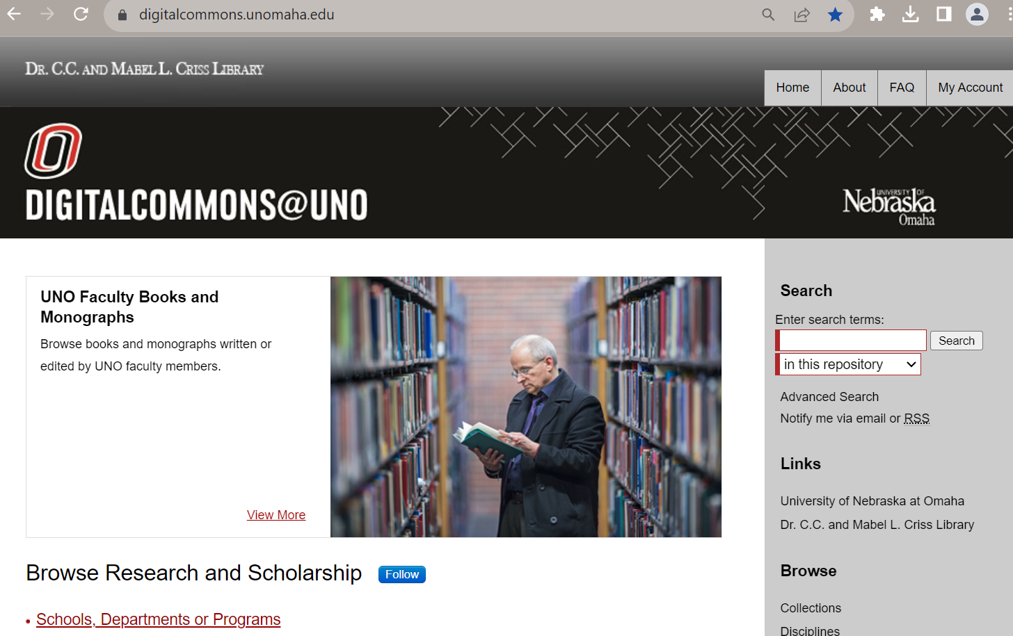
Green Open Access Example
UNO's Institutional Repository
Utilizes publisher's self- archiving policies and may require an embargo
Generally deposits the accepted manuscript
Free to read but reuse can be restricted

Slide 15
Open Access Myths
1. Open Access deprives authors of copyright
- Authors retain their copyright under Open Access unlike traditional publishing where the copyright is transferred to the publisher
2. Open Access is only for STEM disciplines
-Open Access journals can be found in all disciplines
3. Open Access is low quality and not peer reviewed
-Many Open Access journals have a rigorous peer review system and have high impact factors guaranteeing quality
4. Open Access is expensive for authors
-APCs can be very costly, but authors should include this cost in their grants and look for platinum/diamond journals

Slide 16
Open Access at UNO
DigitalCommons@UNO – UNO's Institutional Repository
UNO's Open Access Journals on DigitalCommons@UNO
Open Access Publishing Agreements
Covers or discounts Article Processing Charges (APCs)
Cambridge University Press, PLoS (Biology, Medicine, and Sustainability & Transformation), Institute of Physics, and Wiley
Details and requirements at https://libguides.unomaha.edu/openaccess/OApub

Slide 17
Open Access Benefits
Increased citation and usage
Compliance with open access mandates
Relevance
Faster and more impact
Increase interdisciplinary conversation
Wider collaboration
Greater public engagement
More equitable, affordable, and efficient

Slide 18
Creative Commons Licenses
These are copyright licenses and are legally binding
Provide upfront permission on how you can use the work without having to seek permission from the copyright holder
Follow along copyright rules – if copyright doesn’t cover it neither does Creative Commons
6 Licenses different licenses with 2 tools
4 Elements: BY, NC, ND, SA
DigitalCommons@UNO – Criss Library (this is for informational purposes only and not legal advice)

Slide 19
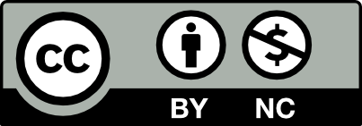
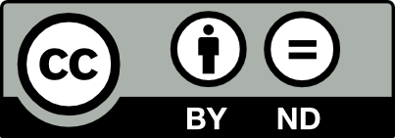
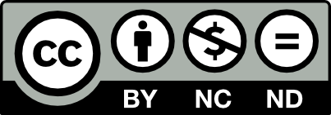
Creative Commons Licenses
CC BY – Attribution License
CC BY SA – Attribution ShareAlike License
CC BY NC – Attribution NonCommerical License
CC BY NC SA – Attribution NonCommerical ShareAlike
CC BY ND – Attribution NoDerivatives
CC BY NC ND – Attribution NonCommercial NoDerivatives
DigitalCommons@UNO – Criss Library (this is for informational purposes only and not legal advice)

Slide 20
Creative Commons Tools
NOT Licenses
CC0 – Creative Commons Zero
Puts work into the public domain – allows anyone to use the work unconditionally
No legal effect when applied to work
DigitalCommons@UNO – Criss Library (this is for informational purposes only and not legal advice)

Slide 21
Learn more….
Open Access:
Virtual workshops from the Library, October 24 at 11:30am and October 25 at 1:30pm - https://events.unomaha.edu/department/library-services
https://libguides.unomaha.edu/openaccess/home - Library guide on Open Access
https://www.openaccessweek.org/ - official International Open Access Week website
Creative Commons:
https://creativecommons.org/ - Creative Commons official website
https://libguides.unomaha.edu/openaccess/creativecommons - Library guide on all things Creative Commons

Slide 22
Selected Bibliography
Budapest Open Access Initiative. (2022). Background. BOAI. https://www.budapestopenaccessinitiative.org/
“5.1 Open Access to Scholarship” Open Access to Scholarship by Creative Commons. CC BY 4.0
DigitalCommons@UNO. Accessed September 19,2022. https://digitalcommons.unomaha.edu/
Ehrig-Page, K. M. (2020). The institutional repository and building your scholarly profile. [PowerPoint Slides]. Institutional repository. University of Nebraska Omaha.
​Guédon, J.C. (2017, February 23). “Open Access: Toward the Internet of the Mind.” Budapest Open Access Initiative - Open Access: Toward the Internet of the Mind. https://www.budapestopenaccessinitiative.org/open-access-toward-the-internet-of-the-mind.
Springer Nature. (2022). Benefits of open research. Springer Nature. https://www.springernature.com/gp/open-research/about/benefits
University of Nebraska Omaha Criss Library. (2022, July). Open Access and Scholarly Publishing @ UNO. https://libguides.unomaha.edu/openaccess/home
University of Nebraska Omaha Criss Library. (2022, January 22). About DigitalCommons@UNO. DigitalCommons@UNO. https://digitalcommons.unomaha.edu/about.htm
University of Nebraska Omaha Criss Library. (2022, January 22). Frequently asked questions. DigitalCommons@UNO. https://digitalcommons.unomaha.edu/faq.html
University of North Texas Libraries. Open Access Glossary. UNT. https://openaccess.unt.edu/open-access-glossary
Notes:
Here is a selected Bibliography of the sources that helped me create today’s presentation. Thank you for attending. (click)

Slide 23
Questions?
Jennie Tobler-Gaston (she/her)
- Institutional Repository Coordinator
Call – (402) 554 - 5879
Email – jenniegaston@unomaha.edu
Visit - Criss Library and ask for Jennie
I am always happy to answer questions

Slide 24
"International Open Access Week Slide Show" by Jennie Tobler-Gaston for the University of Nebraska at Omaha is licensed under CC BY-NC 4.0

