Slide 1
Digital Commons and Open Access
Utilizing DigitalCommons@UNO and UNO’s Open Access Publishing Agreements to make your work open and accessible
Jennie Tobler-Gaston, Institutional Repository Coordinator
Criss Library
Notes:
Good morning and thank you for joining me to learn more about DigitalCommons@UNO and the Open Access Publishing Agreements available to help make your work open and accessible. I am Jennie Tobler-Gaston, the institutional repository coordinator at Criss Library.

Slide 2
In this Presentation
DigitalCommons@UNO
Basics of Open Access
Open Access Publishing Agreements at UNO
Notes:
Today’s presentation is going cover UNO’s institutional repository, Digital Commons at UNO, how to deposit your scholarly work in the repository and the benefits of doing so, the basics and different types of open access, and the Open Access Publishing Agreements that are available and their requirements so you can publish your work open access at no cost or at a discount.

Slide 3
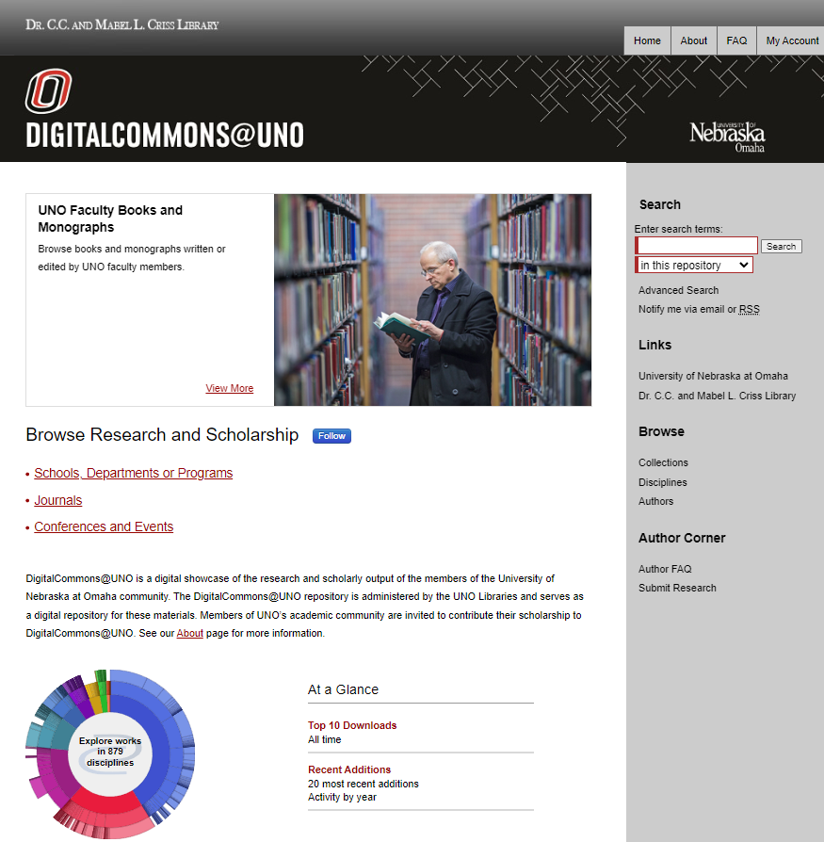
What is DigitalCommons@UNO?
UNO’s institutional repository
Showcases the scholarly and creative work at UNO
Open Access Repository
Notes:
DigitalCommons@UNO is the institutional repository for our UNO community – often just referred to as Digital Commons or DC. (click)
It is an open access digital repository that relies heavily on self-archiving or green open access which I will talk more about in just a moment. (click)
The repository showcases the amazing work that is being done here are UNO as well as the past work of our faculty. This allows students, researchers, and other interested parties from any where in the world regardless of their affiliation with UNO to access this scholarship and creative activity without having to encounter a paywall. All someone needs is an internet connection.

Slide 4
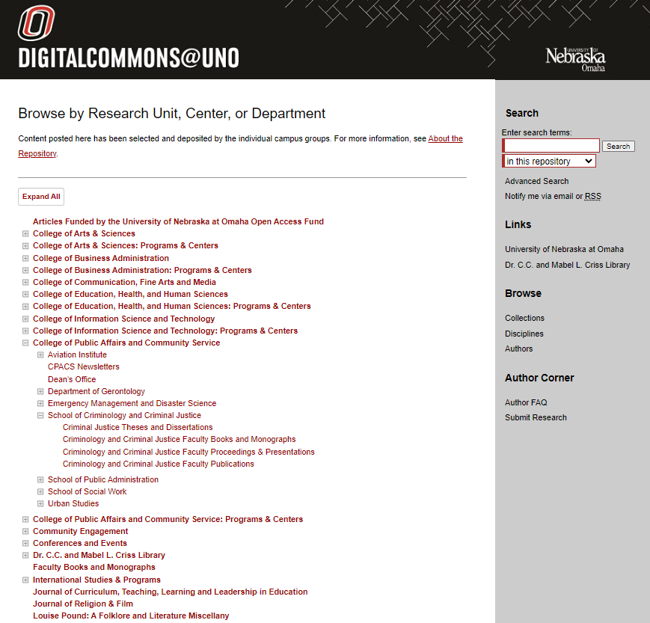
The basics
Free
https://Digitalcommons.unomaha.edu
Articles, presentations, books, chapters, and more
Any File type and size
Organization
Colleges
Disciplines
Authors
Notes:
So let’s look at the basics and organization of digital Commons. (click)
Digital Commons is free to deposit work into, but there are a few requirements to do so. First you must be affiliated with UNO in some way. The work must be scholarly, educational, or research oriented but we do take a broad view of what is considered scholarly and educational so just about anything you do in your subject area can be added. The work must be intended to be a permanent part of the repository – we have ways to update the work or limit access but it isn’t intended to be removed once deposited. And finally the author and/or the copyright holder must be willing to grant the University of Nebraska at Omaha the non-exclusive right to distribute the work via DigitalCommons@UNO. I will get more into this in just a bit.
You can access digital commons at digital commons dot un Omaha dot edu.
The types of scholarship and creative work that can be deposited is broad. Mostly it consists of articles, presentations, posters, books, chapters, but we have deposited creative work such as podcasts, videos, artwork. The only thing we do not deposit into Digital Commons is data sets. As long as the work is in a digital format we can upload it.
Digital Commons accepts any file type and size – just keep in mind that the large the file size the longer it would take a user to download. (click)
Digital Commons is organized by colleges, departments, programs, or areas of study. You can search the collections in this way or by discipline and even by author.

Slide 5
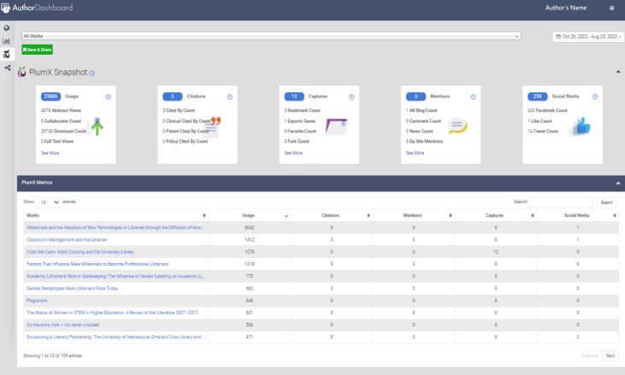
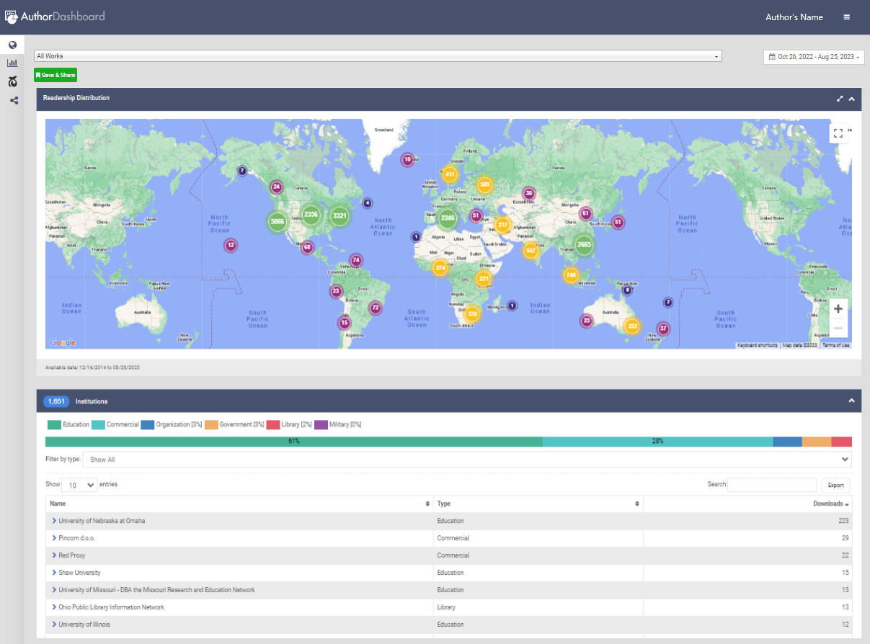
Why should you add your work to DigitalCommons@UNO?
Boost your research profile
Increase visibility of your work
Make research accessible
Increase the longevity of your work
Metrics through the Author’s Dashboard
Centralized scholarship
Easy to share your work
Notes:
What are the benefits of participating in the DigitalCommons @ UNO? [click]
Participation can boost your research profile and present it in a more customized way. [click]
Digital Commons increases the visibility of your work since it is indexed by multiple search engines, for example Google, Google Scholar, Bing, and Duck Duck Go, making work more discoverable within search results. [click]
Since Digital Commons is an open access repository it makes your research globally accessible. [click]
It increases longevity of your work since the submissions are intended to be a permanent part of DigitalCommons @ UNO and are not removed as is the case with some databases or websites. [click]
Participation in Digital Commons allows you to create an author’s page with a dashboard that provides useful statistics, lets you track how readers are finding your work, and the monthly download reports allows for quick feedback on your work. These metrics can be useful when it comes to promotion and tenure. When you set up your account be sure to use your UNO email address. [click]
Digital Commons also creates a centralized location for your scholarship and creates access to supporting documents that can be uploaded to provide context for your research. It can be convenient to have all your work in one place. [click]
The tools on the site, such as the RSS feed and many social media plug-ins, can make it easy to share your work with colleagues and students.

Slide 6
How do I add my work to Digital Commons?
Send your CV or Publications List to
unodigitalcommons@unomaha.edu
Publication data analyzed for Digital Commons
We check copyright and reuse permissions!
If we cannot use the version or record generally an earlier manuscript can be used
Notes:
Getting your work in to Digital Commons is simple and easy [click]
– just email your CV or Publications list to UNO Digital Commons @ UNOmaha . edu. [click]
I will check the copyright and permissions on each publication. I will also reach out to publisher that hold the copyright and request permission to deposit. [click]
One thing to keep in mind is that if I cannot deposit the Version of record I can in some cases deposit the post print or the preprint - so it is a good idea to keep these copies available. I will reach out to you if I need an alternate version of your work or if I cannot upload something.
It really is that simple and easy – there are no catches.

Slide 7
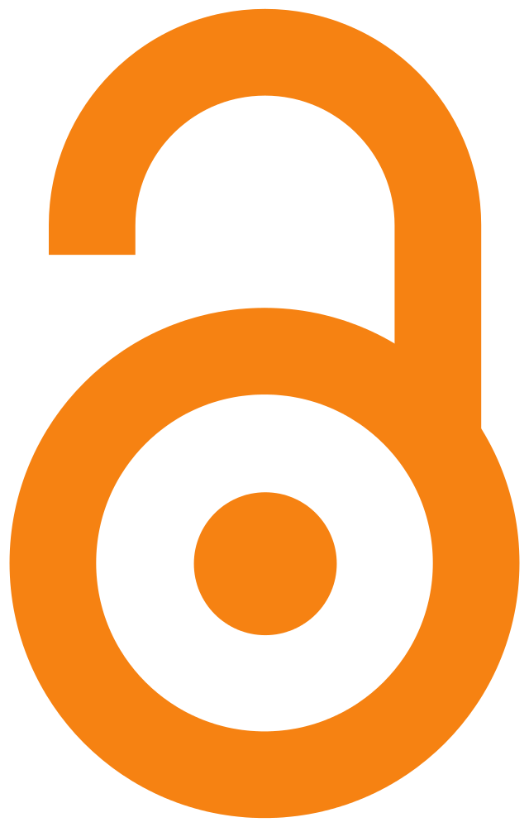
Open Access
Free, immediate, online availability of work with re-use rights and no barriers
Authors keep their copyright to control the integrity of their work
Budapest Open Access Initiative
Change to the traditional scholarly publishing model
Notes:
Open Access is founded on the principle that knowledge and research is intended to be shared and facilitates that sharing of knowledge. (click)
Open Access is the free availability on the public internet of work that allows users to read, download, copy, distribute, print, search, link to, allows indexing, and passes the work as data to software, or any other lawful purpose without financial, legal, or technical barriers other than simply accessing the internet itself. (click) In open access authors retain their copyright to control the integrity of their work and retain the right to be properly cited – but allows re-use of their work to grow knowledge and research world wide. (click) These definitions of Open Access come from the Budapest Open Access Initiative that arose from a meeting of the Open Society Institute (now called open society foundations) which was a collection of scholars across many disciplines exploring the best ways to accelerate progress in the international effort to make research in all fields freely available on the internet. The Open Society Foundations continues to meet to develop recommendations and approaches to opening up research and knowledge for all. [click]
Open access is a fundamental change to scholarly publishing – in traditional scholarly publishing model researchers apply for funds many through public agencies like the federal government, the researcher conducts research that generally results in a paper, that paper is submitted to a journal and is then reviewed by peer reviewers, the reviewers provide feedback the author makes adjustments the journal prepares to publish that paper – up to this point all the work has been done for free or paid for by those previously mentioned funders. The journal publishes the article and then charges for access to that article which prevents others from accessing that paper in many cases the funders that paid for the original research. Open access changes the model at the point of publishing so that the paper and knowledge can be shared freely. This is done in a couple of ways with the different open access types. (Click)

Slide 8
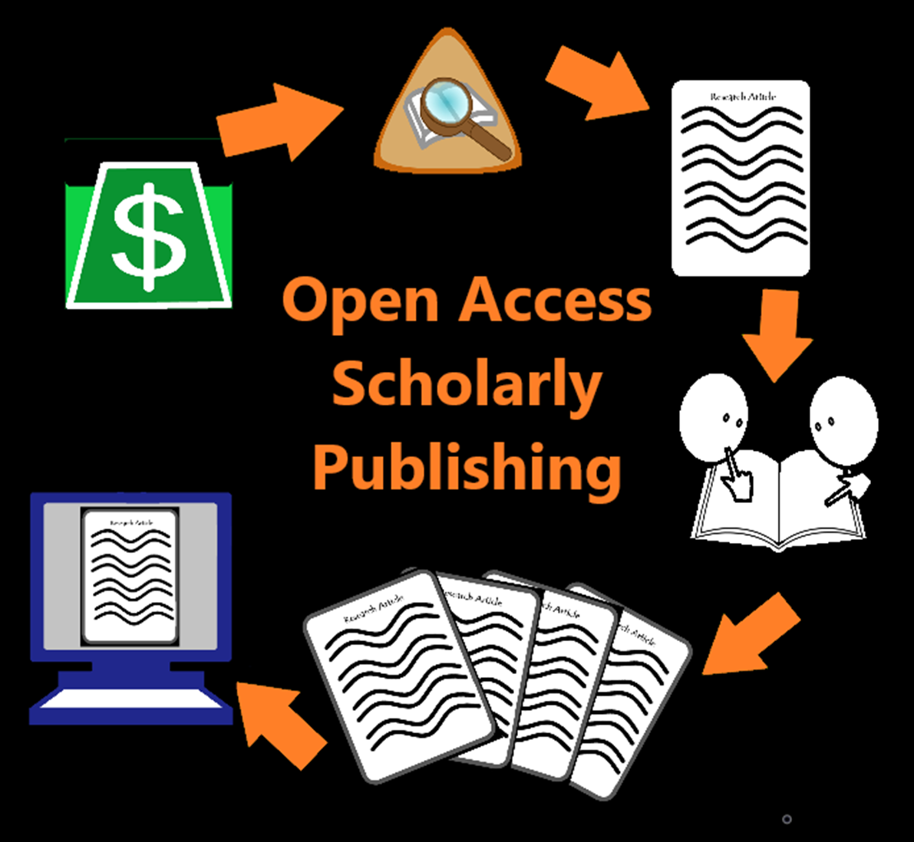
Open Access Types
Gold Open access
Usually charges APCs and openly licensed
Diamond or Platinum Open access
No APCs and openly licensed
Bronze Open Access
Not openly licensed
Green Open Access
Self-archiving
Notes:
There are four major types of open access. (click)
Gold open access is probably the best known type and can be for fully open access journals where all the articles are freely available or hybrid journals where a subscription-based journal makes certain articles freely available. Many times Gold open access requires Article Processing Charges usually called APCs in order to publish the article open access and includes open licensing such as a creative commons license. (click)
The ideal version of open access called diamond or platinum open access and is where the journal does not charge APCs for publishing, is openly licensed, and may receive outside funding to support the journal. An example of platinum open access is the University of Nebraska at Omaha’s Journal of Religion and Film which receives institutional support and currently uses the Attribution creative Commons license. (click)
Bronze Open Access is where the journal makes the publications free to read but does not apply open licensing – this restricts how the end user can re-use or share the work. It really prevents others from building on that scholarship. (click)
Green Open Access is the last model. This model uses self archiving of an article, usually the pre print or post print, in open access locations such as the author’s website, a subject or disciplinary repository, or an institutional repository like UNO’s Digital Commons. As I had mentioned earlier, DigitalCommons@UNO relies heavily on Green Open Access. Many publishers since they are the copyright holders to the article have strict guidelines that have to be followed, they may enact an embargo on the article for these open sites and usually require some type of publisher statement. Depending on the restrictions decided by the publisher these may or may not be open licensed. This model relies heavily on the author’s effort to make their work freely available on alternate sites.

Slide 9
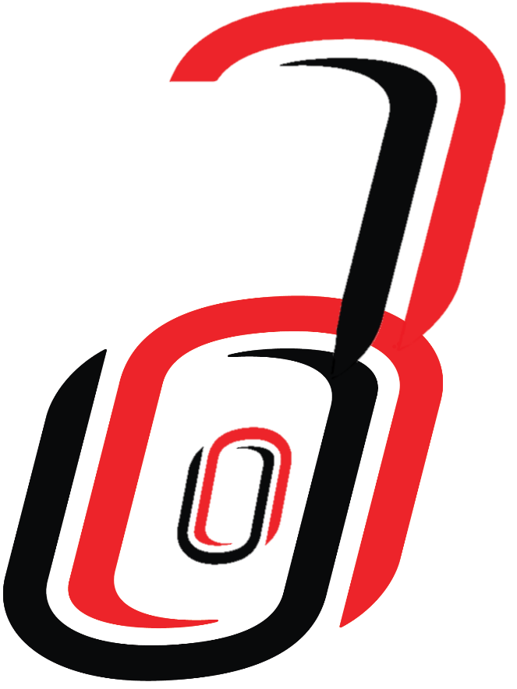
Open Access Publishing Agreements
Elsevier
Biochemical Society
PLoS
Institute of Physics (IOP)
Wiley
Cambridge University Press
Notes:
The University of Nebraska system supports open access, especially through the Big Ten Academic Alliance. Information on UNO’s Open Access Publishing agreements and any more that may be added can be found on the libraries Open Access Publishing Agreement section of our Open Access and Scholarly Publishing Guide. (click)
We have agreements with Elsevier, the Biochemical Society, PLoS, Institute of Physics, Wiley, and hopefully a renewed agreement with Cambridge University Press. All these agreements require the corresponding author to be affiliated with the University of Nebraska to be eligible. So let’s take a closer look at each agreement. (click)

Slide 10
Elsevier
10% discount on APCs
Corresponding author affiliated with UNO
Majority of Elsevier’s hybrid journals are eligible
Rights and Access step – Choose the University of Nebraska at Omaha
CC BY or CC BY NC ND
Notes:
Elsevier is our only Open Access Publishing Agreement that is not through the Big Ten Academic Alliance. (Click)
The University of Nebraska negotiated a 10% discount on article processing charges. (click)
To be eligible for the discount the corresponding author must be affiliated with the University of Nebraska – at any of the campuses such as UNO from the time of submission through the publication process. (click)
The article must be accepted into an eligible hybrid journal but this include a majority of Elsevier’s hybrid journals. (click)
When the article is accepted the corresponding author is notified and sent a link to Elsevier’s editorial management system and follow the steps. When authors get to the Rights and Access step the author will again choose the University of Nebraska as their institutional affiliation in order to apply the discount (click)
The authors then choose between a Creative Commons Attribution license or the Creative Commons Attribution NonCommercial NoDeriviatives license.
The library is then notified, we double check that you are affiliated with UNO, and approve the discount. Once the APC is paid the article appears live and open online.

Slide 11
Biochemical Society
APCs are fully covered in the 7 journals, including the gold journals
Articles must be accepted on or after January 1, 2024
Corresponding author affiliated with UNO
Validate Institution
CC BY or CC BY NC ND
Notes:
The Biochemical Society is the newest Open Access Publishing Agreement through the Big Ten Academic Alliance. (click)
This agreement covers the full article publishing charges at no cost to the author in any of the seven Biomechanical society journals including their two fully open access Gold journals. (click)
The article must be accepted on or after January 1, 2024 to be eligible (click)
The Corresponding author must be affliated with the University of Nebraska and correctly specify their affiliation as their “organization” during the article submission process. (click)
This includes clicking on “Validate Instituion” and choosing UNO from the list. This may be displayed in multiple version and as long as you choose some ideration of the University of Nebraska at Omaha you will be covered. This alerts the library where we verify your affliation and allows the article to be published Open Access. (click)
Once validate the authors choose between the Creative Commons Attribution License or the Creative Commons Attribution NonCommercial NoDerivatives license and then the article appears online.

Slide 12
PLoS
Biology and Medicine journals
Accepted for publication after January 1, 2021
Any article type
The corresponding author afflicted with UNO for full coverage
Author must identify their eligibility through UNO when submitting article
Notes:
The PLoS Open Access Agreement is part of the Community Action Publishing (CAP) program through the Big 10 Academic Alliance and was extended through 2024. (click) This covers PLoS Biology and PLoS Medicine journals . (click) The article must be accepted for publication after January 1, 2021 (click) and any article type is accepted. (click) The main corresponding author has to be affiliated with a University of Nebraska school to fully cover APCs – if the corresponding author is not, but a co author is then the APCs are discounted 25% but not fully covered. (click) The eligible author must be sure to list their institutional affiliation in the submission system during the submission process for the benefits to be applied.

Slide 13
Institute of Physics (IOP)
January 1, 2023 to December 21, 2025
Corresponding author affiliated with UNO
58 hybrid journals and 18 gold OA journals
No limit
Must use UNO email in the IOP publishing workflow from submission to publication
Notes:
The Institute of Physics agreement is also through the Big Ten. (click)
This agreement began January 1, 2023 and end on December 31, 2025 so articles must be accepted within this time frame (click)
To be eligible for the publishing costs to be covered the corresponding author must be affiliated with a University of Nebraska school. (click)
The publishing costs are covered for 58 hybrid journal and 18 fully open gold OA journals. The list of journals can be found on our open access and scholarly publishing guide or on the Big Ten Academic Alliance’s website. (click)
There is no limit to the number of articles that can be published under this agreement. (Click)
Finally, to determine eligibility the corresponding author must use their UNO email from submission through the entire IOP publishing workflow in order for the costs to be covered.

Slide 14
Wiley
January 1, 2023 through December 31, 2025
All hybrid and gold OA journals, including Hindawi
Corresponding author must be affiliated with UNO
Submitted to the institution for approval
Use UNO email address
Notes:
Wiley is our most generous publishing agreement through the Big Ten Academic Alliance (click). There was a pilot of the program in 2022 but the new agreement began January 1, 2023 and will end December 31, 2025. (click)
Articles must be accepted by Wiley hybrid journal or submitted to gold OA Journal including Hindawi journals during this time frame to apply.
There is NO cap on the number of articles per institution that will have their the publishing costs fully covered. (Click)
The corresponding author has to be affiliated with the University of Nebraska system. For hybrid journals once the article is accepted the corresponding author has to choose the option to make it open access and would identify their institutional affiliation – this has to be done before the article is officially published (click).
Once submitted, Wiley reaches out the University of Nebraska for eligibility approval – essentially they are verifying you are affiliated with UNO. [click]
It is best to use your UNO email when submitting.

Slide 15
Cambridge University Press
A corresponding author afflicted with UNO
Approved Cambridge University Press Journal
Research article, review article, rapid communications, brief report, or case reports
Choose a Creative Commons License
Notes:
The Cambridge University Press Open Access Publishing Agreement is through The Big 10 Academic alliance. The original agreement ended in 2023, but is expected to be renewed through the end of 2024. This agreement covers the APCs of Gold and hybrid journals. The requirements are (click) that a corresponding author must be affiliated with a University of Nebraska school - best way to do this is to use your UNO email so that the publisher’s editorial management system identifies your article as eligible, (click) The article must be published in one of the approved Gold or hybrid journals with the open access option selected in the hybrid journals – there are currently 40 gold open access journal and 330 hybrid journals in multiple disciplines covered under this agreement. To access a complete list check out Cambridge University Press Journals Title List accessible on their website or through the Open Access Publishing agreement section on our Research guide. (click). The types of work accepted through this agreement are research or review articles, rapid communications, brief or case reports. (click). Depending on the journal you may be required to select a creative commons licenses. Now I have mentioned that many of these agreements use Creative Commons licenses for their open access article - the library has many people, such as myself, that are certified in Creative Commons and are happy to provide more information to guide you to the right license for you. In fact I will be presenting a workshop with the CFE on February 21 that will be on Copyright and Creative Commons if you are interested in learning more.

Slide 16
Selected Bibliography
Budapest Open Access Initiative. (2022). Background. BOAI. https://www.budapestopenaccessinitiative.org/
“5.1 Open Access to Scholarship” Open Access to Scholarship by Creative Commons. CC BY 4.0
DigitalCommons@UNO. Accessed August 25, 2023. https://digitalcommons.unomaha.edu/
Ehrig-Page, K. M. (2020). The institutional repository and building your scholarly profile. [PowerPoint Slides]. Institutional repository. University of Nebraska Omaha.
​Guédon, J.C. (2017, February 23). “Open Access: Toward the Internet of the Mind.” Budapest Open Access Initiative - Open Access: Toward the Internet of the Mind. https://www.budapestopenaccessinitiative.org/open-access-toward-the-internet-of-the-mind.
Springer Nature. (2022). Benefits of open research. Springer Nature. https://www.springernature.com/gp/open-research/about/benefits
University of Nebraska Omaha Criss Library. (2022, July). Open Access and Scholarly Publishing @ UNO. https://libguides.unomaha.edu/openaccess/home
University of Nebraska Omaha Criss Library. (2022, January 22). About DigitalCommons@UNO. DigitalCommons@UNO. https://digitalcommons.unomaha.edu/about.htm
University of Nebraska Omaha Criss Library. (2022, January 22). Frequently asked questions. DigitalCommons@UNO. https://digitalcommons.unomaha.edu/faq.html
University of North Texas Libraries. Open Access Glossary. UNT. https://openaccess.unt.edu/open-access-glossary
Notes:
Here are my sources since citation is important.

Slide 17
Questions?
Jennie Tobler-Gaston
jenniegaston@unomaha.edu
UNODigitalCommons@unomaha.edu
402-554-5879
Notes:
Any questions?
Optional: While you might be thinking of some questions a few things to of interest – the guide I have mentioned also provides a lot of other useful information like how to retain your copyright as an author and even has a link for an addendum to a publishing contracts that allows you to retain your copyright.
https://libguides.unomaha.edu/openaccess

