Slide 3
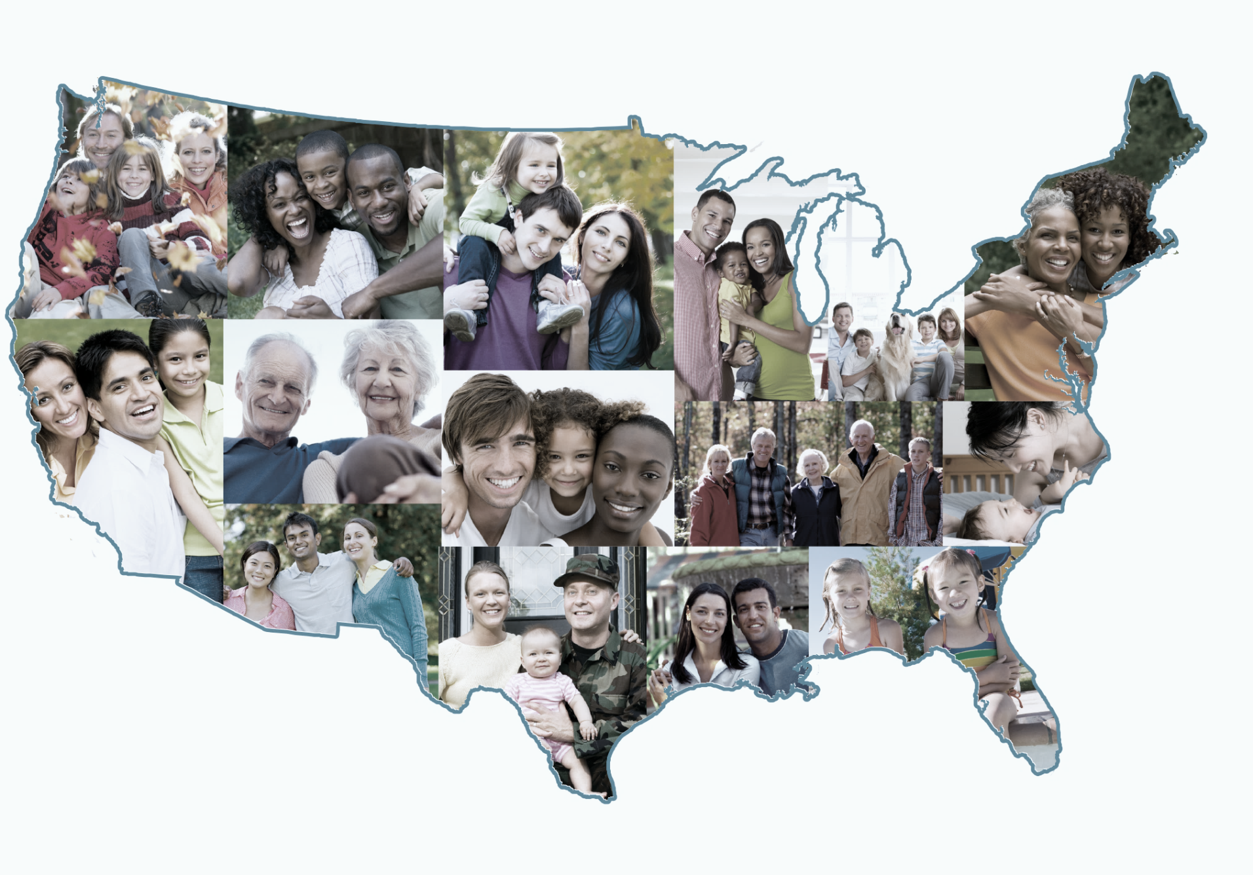
2020 Redistricting Data Program

Slide 4
Redistricting Data Program Apportionment vs. Redistricting
 |  | APPORTIONMENT | REDISTRICTING
Geography | Largest | State | State
 | Smallest | State | Census Block
Who is counted |  | Resident Population + Federally Affiliated Count Overseas | Resident Population Only
What is reported |  | Total Population only | Race, ethnicity, and select housing characteristics
Disclosure Avoidance |  | None | Differentially Private (TopDown Algorithm)
Statutory Deadlines |  | December 31, 2020 (April 30, 2021) | April 1, 2021 (July 31, 2021)

Slide 5
Redistricting Data Program Public Law 94-171
Program Mission: Provide states an opportunity to identify the geographic areas for which specific tabulations of population are needed for legislative redistricting and to deliver high quality data for those areas in a timely manner
Identified “geographic areas desired”:
Census Tabulation Blocks
Voting Districts (e.g. precincts, wards, etc.)
Legislative and Congressional Districts
Requirements:
Establish program criteria
Identify required tabulations
Conduct the program in a non-partisan manner
Deliver the tabulations to the governor and the officers or public bodies having initial responsibility for the legislative apportionment or districting of each State no later than
1 year from Census Day (April 1, 2021)*
*request for statutory extension to July 31

Slide 6
Redistricting Data Program P.L. 94-171 Redistricting Data Products Delivery Timing
Phase 3 – Prototype Data
Phase 3 – Official Data
Activity | Date
Prototype geographic support products | February 2019 (Complete)
Prototype P.L. 94-171 Redistricting Data | March 2019 (Complete)
Activity | Original Planned Dates | New Planned Date
Geographic support products | Nov. 20, 2020 – Feb. 1, 2021 | TBD
P.L. 94-171 Redistricting Data | Feb. 18, 2021 – March 31, 2021 | No later than April 1, 2021*
* Statutory deadline, planned date still TBD

Slide 7
Redistricting Data Program P.L. 94-171 Redistricting Data Geographic Products
2020 Census P.L. 94-171 Redistricting Data Geographic Products
Product Type | Census Web Address
Shapefiles | https://www.census.gov/geographies/mapping-files/time-series/geo/tiger-line-file.html
Maps | https://www.census.gov/geographies/reference-maps.html
Block Assignment Files | https://www.census.gov/geographies/reference-files.html
Block to Block Relationship Files | https://www.census.gov/geographies/reference-files/time-series/geo/relationship-files.html
Shapefiles – geographic information system geometry files
Maps (PDF only) – County Block; State Legislative with Voting District; Tract; School District
Block Assignment Files – tables identifying the blocks used to build different geographic entities
Block to Block Relationship Files – Crosswalk of 2010 blocks to 2020 blocks

Slide 8
Redistricting Data Program P.L. 94-171 Redistricting Data Tabulation Product
2020 Census P.L. 94-171 Redistricting Data Tabulations
Table P1 – Race
Table P2 – Race for the Population 18 Years and Over
Table P3 – Hispanic or Latino, and not Hispanic or Latino by Race
Table P4 – Hispanic or Latino, and not Hispanic or Latino by Race for the Population 18 and Over
Table H1 – Occupancy Status (Housing)
New Table
Table P5 – Group Quarters Population by Group Quarters Type
All tables produced at multiple geographies including census block
Group Quarter types: Correctional Institutions for Adults, Juvenile Facilities, Nursing Facilities/Skilled Nursing, Other Institutional, College/University Student Housing, Military quarters, and other non-institutional
Group quarters is total population only, no demographic breakdown

Slide 9
RACE [71]
Universe: Total population
Total:
Population of one race:
White alone
Black or African American alone
American Indian and Alaska Native alone
Asian alone
Native Hawaiian and Other Pacific Islander alone
Some Other Race alone
Two or More Races:
Population of two races:
White; Black or African American
White; American Indian and Alaska Native
White; Asian
White; Native Hawaiian and Other Pacific Islander
White; Some Other Race
Black or African American; American Indian and Alaska Native
Black or African American; Asian
Black or African American; Native Hawaiian and Other Pacific Islander
Black or African American; Some Other Race
American Indian and Alaska Native; Asian
American Indian and Alaska Native; Native Hawaiian and Other Pacific Islander
American Indian and Alaska Native; Some Other Race
Asian; Native Hawaiian and Other Pacific Islander
Asian; Some Other Race
Native Hawaiian and Other Pacific Islander; Some Other Race
Population of six races:
White; Black or African American; American Indian and Alaska Native; Asian; Native Hawaiian and Other Pacific Islander; Some Other Race
Redistricting Data Program P.L. 94-171 Redistricting Data Tabulation Product
Table P1 – Race
Universe: Total Population
Table P3 – Race for the Population 18 Years and Over
Universe: Total population 18 years and over

Slide 10
HISPANIC OR LATINO, AND NOT HISPANIC OR LATINO BY RACE [73]
Universe: Total population
Total:
Hispanic or Latino
Not Hispanic or Latino:
Population of one race:
White alone
Black or African American alone
American Indian and Alaska Native alone
Asian alone
Native Hawaiian and Other Pacific Islander alone
Some Other Race alone
Two or More Races:
Population of two races:
White; Black or African American
White; American Indian and Alaska Native
White; Asian
White; Native Hawaiian and Other Pacific Islander
White; Some Other Race
Black or African American; American Indian and Alaska Native
Black or African American; Asian
Black or African American; Native Hawaiian and Other Pacific Islander
Black or African American; Some Other Race
American Indian and Alaska Native; Asian
American Indian and Alaska Native; Native Hawaiian and Other Pacific Islander
American Indian and Alaska Native; Some Other Race
Asian; Native Hawaiian and Other Pacific Islander
Asian; Some Other Race
Native Hawaiian and Other Pacific Islander; Some Other Race
Population of six races:
White; Black or African American; American Indian and Alaska Native; Asian; Native Hawaiian and Other Pacific Islander; Some Other Race
Redistricting Data Program P.L. 94-171 Redistricting Data Tabulation Product
Table P2 – Hispanic or Latino, and Not Hispanic or Latino by Race
Universe: Total population
Table P4 – Hispanic or Latino, and Not Hispanic or Latino by Race for the Population 18 Years and Over
Universe: Total population 18 years and over

Slide 11
Redistricting Data Program P.L. 94-171 Redistricting Data Tabulation Product
Table H1 – Occupancy Status
Universe: Housing Units
Total
Occupied
Vacant
Table P5 - Group Quarters Population by Group Quarters Type
Universe: Total Population in Group Quarters
Total
Institutionalized population
Correctional facilities for adults
Juvenile facilities
Nursing facilities/Skilled-nursing facilities
Other institutional facilities
Noninstitutionalized population
College/University student housing
Military quarters
Other non-institutional facilities

Slide 12
Redistricting Data Program P.L. 94-171 Redistricting Data Tabulations Official Delivery Method
Official Recipients:
Governors
Legislative leadership
Redistricting Commissions (if they exist and have commissioners named)
Method of delivery
Physical media – DVD/Flash Drive
Embargoed access to data.census.gov
Requires pre-registration
Confirmation of data’s receipt
Web monitoring + Phone Call
Mail Tracking + Phone Call

Slide 13
Redistricting Data Program P.L. 94-171 Redistricting Data Tabulations Public Delivery Method
Public Release
Census Data Explorer – data.census.gov
Full Data Explorer functionality
Large data download
FTP
Expert users
Full P.L. 94-171 Redistricting Data Summary File
Relational tables
Geoheader + three data segments
Geoheader
File 01 (P1 & P2)
File 02 (P3, P4 & H1)
File 03 (P5)
All stored as pipe-delimited text files (including the geoheader)

Slide 14
2020 Census Data Products

Slide 15
Redistricting Data Program Citizen Voting Age Population by Race and Ethnicity (CVAP)
Annual Tabulation using the American Community Survey 5-year estimates for 2011 through 2020 publications
Typically released in the 1st week of February each year
2020 Census CVAP Special Tabulation
Calculated using administrative records and released by the P.L. 94-171 deadline
Content
Total:
Hispanic or Latino
Not Hispanic or Latino:
White alone
Black or African American alone
American Indian and Alaska Native alone
Asian alone
Native Hawaiian and Other Pacific Islander alone
Some Other Race alone*
Black or African American and White
American Indian and Alaska Native and White
Asian and White
American Indian and Alaska Native and Black or African American
Remainder of Two or More Race Responses
Geography
Nation
State
Congressional District
State Legislative District, Upper Chamber
State Legislative District, Lower Chamber
County
Minor Civil Division (for CT, MA, ME, MI, MN, NH, NJ, NY, PA, RI, VT, and WI)
Tract
Block Group
Block*
*only for the 2020 Census Special Tabulation

Slide 16
Redistricting Data Program Product Calendar
 | Data Product | 2010 Census Release Dates | 2020 Census Release Dates
 | Apportionment | 12/21/2010 | NLT 12/31/2020
Group I | PL94-171 Redistricting Data | 2/3/2011 - 3/24/2011 and 4/14/2011* | TBD
 | Demographic Profile | 5/5/2011 - 5/26/2011
 | Demographic and Housing Characteristics File (DHC) (formerly Summary File 1) | 6/16/2011 - 8/25/2011
Group II | Summary File 2 successor (Detailed DHC) | 12/15/2011 - 4/26/2012 | TBD
 | American Indian and Alaska Native Summary File | 12/13/2012
Group III | Public Use Microdata Sample (PUMS) | 11/12/2014 | Final decisions on this product will be made following analysis of Group I and II products.
 | Congressional District Demographic and Housing Characteristics File | 4/11/2013 (113th Congressional District File) 10/19/2017 (115th Congressional District File) | Spring 2023 **
 | Census Briefs | 3/24/2011 - 9/27/2012 | TBD
 | Population and Housing Tables | 9/27/2011 - 11/26/2013
 | Special Reports | 9/27/2012 - 12/10/2012
*The National Summary file released 4/14/2011 **118th Congressional Districts File

Slide 17
Differential Privacy and the
2020 Census

Slide 18
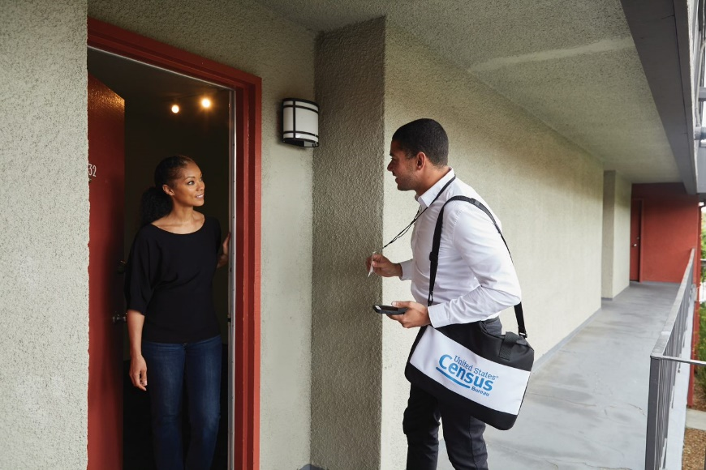
Our Commitment to Data Stewardship
Data stewardship is central to the Census Bureau’s mission to produce high-quality statistics about the people and economy of the United States.
Our commitment to protect the privacy of our respondents and the confidentiality of their data is both a legal obligation and a core component of our institutional culture.
“To stimulate public cooperation necessary for an accurate census…Congress has provided assurances that information furnished by individuals is to be treated as confidential. Title 13 U.S.C. §§ 8(b) and 9(a) explicitly provide for nondisclosure of certain census data, and no discretion is provided to the Census Bureau on whether or not to disclose such data…” (U.S. Supreme Court, Baldrige v. Shapiro, 1982)
18

Slide 19
The Privacy Challenge
Every time you release any statistic calculated from a confidential data source you “leak” a small amount of private information. If you release too many statistics, too accurately, you will eventually reveal the entire underlying confidential data source.
Dinur, Irit and Kobbi Nissim (2003) “Revealing Information while Preserving Privacy” PODS, June 9-12, 2003, San Diego, CA
More Data and Faster Computers!
In today’s digital age, there has been a proliferation of databases that could potentially be used to attempt to undermine the privacy protections of our statistical data products.
Similarly, today’s computers are able to perform complex, large-scale calculations with increasing ease.
These parallel trends represent new threats to our ability to safeguard respondents’ data.
19

Slide 20
The Census Bureau’s Privacy Protections Over Time
Throughout its history, the Census Bureau has been at the forefront of the design and implementation of statistical methods to safeguard respondent data.
Over the decades, as we have increased the number and detail of the data products we release, so too have we improved the statistical techniques we use to protect those data.
Stopped publishing small area data
Whole-table suppression
Data swapping
Formal Privacy
1930
1970
1990
2020

Slide 21
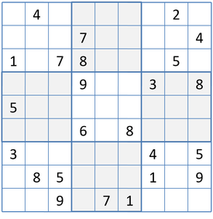
Reconstruction
The recreation of individual-level data from tabular or aggregate data.
If you release enough tables or statistics, eventually there will be a unique solution for what the underlying individual-level data were.
Computer algorithms can do this very easily.

Slide 22
Re-identification
Linking public data to external data sources to re-identify specific individuals within the data.
Name | Age | Sex
Jane Smith | 66 | Female
Joe Public | 84 | Male
John Citizen | 30 | Male
Age | Sex | Race | Relationship
66 | Female | Black | Married
84 | Male | Black | Married
30 | Male | White | Married
External Data
Confidential Data

Slide 23
In the News
Reconstruction and Re-identification are not just theoretical possibilities…they are happening!
Massachusetts Governor’s Medical Records (Sweeney, 1997)
AOL Search Queries (Barbaro and Zeller, 2006)
Netflix Prize (Narayanan and Shmatikov, 2008)
Washington State Medical Records (Sweeney, 2015)
and many more…

Slide 24
Reconstructing the 2010 Census: What Did We Find?
On the 309 million reconstructed records, census block and voting age (18+) were correctly reconstructed for all records and for all 6,207,027 inhabited blocks.
Block, sex, age (in years), race (OMB 63 categories), and ethnicity were reconstructed:
Exactly for 46% of the population (142 million individuals)
Within +/- one year for 71% of the population (219 million individuals)
Block, sex, and age were then linked to commercial data, which provided putative re-identification of 45% of the population (138 million individuals).
Name, block, sex, age, race, ethnicity were then compared to the confidential data, which yielded confirmed re-identifications for 38% of the putative re-identifications (52 million individuals).
For the confirmed re-identifications, race and ethnicity are learned correctly, though the attacker may still have uncertainty.

Slide 25
Differential Privacy
Differential privacy allows us to inject a precisely calibrated amount of noise into the data to control the privacy risk of any calculation or statistic.
aka “Formal Privacy”
-quantifies the precise amount of privacy risk…
-for all calculations/tables/data products produced…
-no matter what external data is available…
-now, or at any point in the future!
25

Slide 26
Comparing Methods
Data Accuracy
Differential Privacy is not inherently better or worse than traditional disclosure avoidance methods.
Both can have varying degrees of impact on data quality depending on the parameters selected and the methods’ implementation.
Privacy
Differential Privacy is substantially better than traditional methods for protecting privacy, insofar as it actually allows for measurement of the privacy risk.
26

Slide 27
Implications for the 2020 Decennial Census
The switch to Differential Privacy does not change the constitutional mandate to apportion the House of Representatives using the actual enumeration.
As in 2000 and 2010, the Census Bureau will apply privacy protections to the PL94-171 redistricting data.
The switch to Differential Privacy requires us to re-evaluate the quantity of statistics and tabulations that we will release, because each additional statistic uses up a fraction of the privacy-loss budget (epsilon).

Slide 28
Demonstrating Privacy, Assessing and Improving Accuracy
The DAS Team’s priorities over Fall 2019 were:
To scale up the DAS to run on a (nearly) fully-specified national histogram
To demonstrate that the DAS can effectively protect privacy at scale
To permit the evaluation and optimization of the DAS for accuracy and “fitness for use”
These initiatives were largely successful, but much more work needs to be done over the remainder of this year.
The engagement and efforts of our data users have been enormously helpful in helping to identify and prioritize this remaining work.

Slide 29
What We’ve Learned
The October vintage of the DAS falls short on ensuring “fitness for use” for several priority use cases.
Particular areas of concern:
Population counts for political geographies
Population counts for American Indian and Alaska Native Tribes and Tribal Areas
Systemic biases (e.g., urban vs. rural)
Housing statistics and vacancy rates
These issues are substantially driven by post-processing of the noisy statistics within the DAS.
There are two sources of error in the TopDown Algorithm (TDA):
Measurement error due to differential privacy noise (tunable through selection of ε)
Post-processing error due to process of creating internally consistent, non-negative integer counts from the noisy measurements
Post-processing error tends to be much larger than DP error
Improving post-processing is not constrained by DP

Slide 30
Privacy-Protected Microdata Files
To further assist with data users’ evaluations, we are also releasing “Privacy-Protected Microdata Files” (PPMFs), which are the underlying microdata files for the entire nation used to generate the Detailed Summary Metrics.
While these PPMFs are untabulated microdata records, members of the Committee on National Statistics’ expert group, through the IPUMS/NHGIS have tabulated and posted data tables to support data users’ evaluations.
https://www.census.gov/programs-surveys/decennial-census/2020-census/planning-management/2020-census-data-products/2020-das-metrics.html

Slide 31
Additional Resources
Disclosure Avoidance and the 2020 Census Website
https://www.census.gov/about/policies/privacy/statistical_safeguards/disclosure-avoidance-2020-census.html
Questions? Suggestions?
Email them to 2020DAS@census.gov

Slide 32
Thank you
James Whitehorne
Office Chief
Redistricting & Voting Rights Data Office
U.S. Census Bureau
301-763-4039
rdo@census.gov

