Slide 1
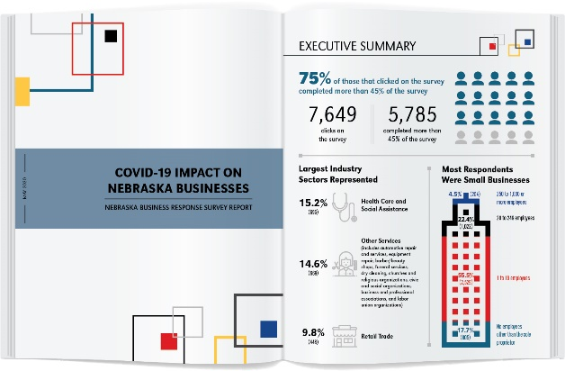
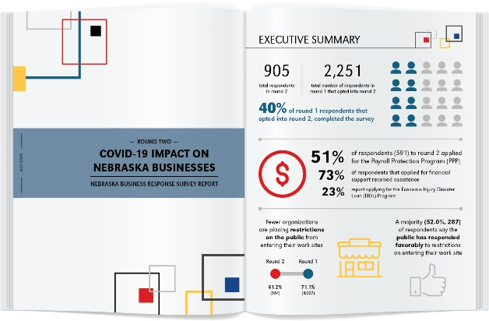
Nebraska Economic Recovery Dashboard
Governing
Website
COVID-19 Impact on Nebraska Businesses Survey Reports
cpar.unomaha.edu/
nebraskabythenumbers
cpar.unomaha.edu/policy
governing.unomaha.edu

