Slide 1
Neuroendocrine and Psychological Factors Associated with Burnout and Compassion Fatigue in Mental Health Workers
Michelle C. Huffman, PhD
Callitrichid Research Center
University of Nebraska at Omaha

Slide 2
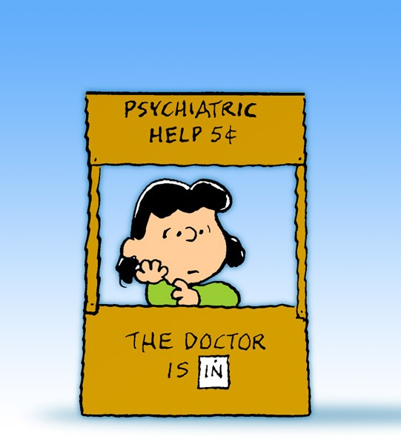
Exposure to Secondary Trauma
Mental health workers and secondary trauma
  Stories of trauma from clients
  Repeated, chronic exposure
  Recognized as trauma in DSM system
Result:
  Burnout
  Compassion fatigue
  Reduced compassion satisfaction
Picture credit: http://peanuts.wikia.com/wiki/Lucy's_psychiatry_booth
Notes:
Mental health professionals have a difficult job, They must provide compassionate and competent care while meeting regulatory requirements. High caseloads, long hours, and low pay also contribute to the stress that mental health professionals experience. One thing that makes caring professions, including mental health unique, is exposure to secondary traumatic stress. STS happens when the professional listens to or reads about the stories of trauma from their clients. This can include hearing stories of abuse, neglect, assault, severe accidents, and being the victim of a crime. Mental health professionals are repeated to this secondary trauma on a repeated basis, which makes it chronic. Because in extreme cases STS can lead to PTSD symptoms, the APA recognized STS as a source of trauma in the DSM system.
The stressors of the mental health profession, including STS, can result in burnout, compassion fatige, and reduced compassion satisfaction.

Slide 3
Burnout
(Cherniss, 1980; Maslach, 1998)
Risk Factors
Organizational
Personal
Patient-related
Notes:
Burnout can occur in any profession, but is commonly associated with caregiving professions. Burnout is characterized by three domains: emotional exhaustion, depersonalization and loss of feelings of personal accomplishment. Emotional exhaustion refers to feeling like one’s personal resources have been depleted, and is characterized by fatigue, feeling overwhelmed or frustrated with work, and increased subjective stress with patients. Depersonalization refers to no longer viewing patients as people, or dehumanizing them. Loss of personal accomplishment refers to not feeling like one’s efforts towards their clients makes a difference, or feeling cynicism regarding one’s ability to help their patients.
Burnout is the result of a combination of organizational, personal, and patient-related characteristics. Now, this study exclusively focused on personal factors, but just keep in mind that organizational and patient factors also play a large role.
I should also mention that burnout is associated with both depression and anxiety. There is some overlap with symptoms, but burnout has symptoms that are unique from either depression or anxiety and vice versa.

Slide 4
Physiological Stress Response
Hypothalamic-Pituitary-Adrenal (HPA) Axis
  Produces cortisol (CORT)
  Can be measured in saliva
    Delay of 15-20 minutes (Gordis et al., 2006)
Findings related to burnout are mixed
Notes:
The SNS allows an immediate response to a stressor. Once the SNS is activated, the HPA axis is also triggered, which allows for a sustained response to the stressor. The hypothalamus releases CRH, which triggers the anterior pituitary to release ACTH. ACTH enters the blood stream and triggers the release of cortisol from the adrenal cortex. Cortisol not only serves as a signal to sustain the stress response, such as increased blood pressure, glyconeogenesis, and suppressed immune system, but CORT also feeds back to the both the hypothalamus and pituitary to stop the release of more CORT. CORT can be measured in saliva, and there is a delay of about 15 minutes following the stressor.
Burnout and CORT levels have been examined, but the findings are pretty mixed. Some studies show increased baseline CORT or CAR, whereas others show reduced CORT functioning or CAR. There are also some studies that do not show any differences in CORT levels based on burnout symptoms. This suggests that there might be other variables that influence whether hyper or hypocortisolism is observed.
One possibility is the presence of depression or anxiety. Both of these disorder categories have been examined in relation to HPA axis functioning. For example, there is evidence for both hypercortisolism and hypocortisolism in depression patients. GAD is marked by a reduction in CORT responsiveness, whereas panic disorder patients tend to show elevated overnight CORT and a higher HPA axis response to stressors.
So because burnout and CF have some symptom overlap with depression and anxiety, and since depression and anxiety disorders are associated with SNS and HPA axis dysregulation, it may be that the equivocal findings observed in the burnout literature could depend on the presence or absence of depression and anxiety.

Slide 5
Hypotheses
  Lower burnout + lower depression/anxiety → No HPA axis dysregulation
  Higher burnout → HPA axis dysregulation
  Pattern of HPA axis dysregulation depends on presence of depression/anxiety

Slide 6
Participants
Direct care mental health professionals in Omaha
  Recruited from mental health facilities via flyer
  Exclusionary criteria
    History of direct trauma (as defined by DSM-5)
    Pregnancy
23 participants
  16 females
  7 males
Notes:
In order to test these hypotheses, mental health workers were recruited via flyer from facilities throughout the Omaha metro area. Individuals with a history of direct trauma as defined by the DSM-5 were excluded, and this was because we wanted to focus on the role of secondary trauma exposure. Because we looked at hormone levels, we also excluded pregnant women.
In the study, we asked the participants to provide this demographic information

Slide 7
Method
Psychological assessment
  Beck Depression Inventory
  State Trait Anxiety Inventory
  Maslach Burnout Inventory
Trier Social Stress Test (Kirschbaum et al., 1993)
Notes:
On to the fun part, participants were first asked to complete a psychological battery. Here are the instruments that were included.
For sAA and CORT, the area under the curve with respect to ground and with respect to increase were calculated. AUC ground refers to the total exposure of sAA or CORT over the course of the samples. AUC increase gives more fine point data regarding the reactivity and recovery following a stressor, and subtracts out the area between zero and the baseline. The ration for sAA and CORT was also calculated by dividing the AUC for sAA by the AUC for CORT.

Slide 8
Method
Cortisol (CORT) analysis
  Enzyme immunoassay (EIA)
Fekedulegn et al., 2007

Slide 9
Results – Cortisol
No correlations between CORT AUC_{G} and depression, anxiety, burnout, or compassion fatigue
No interactions between psychological variables to predict CORT AUC_{G}

Slide 10
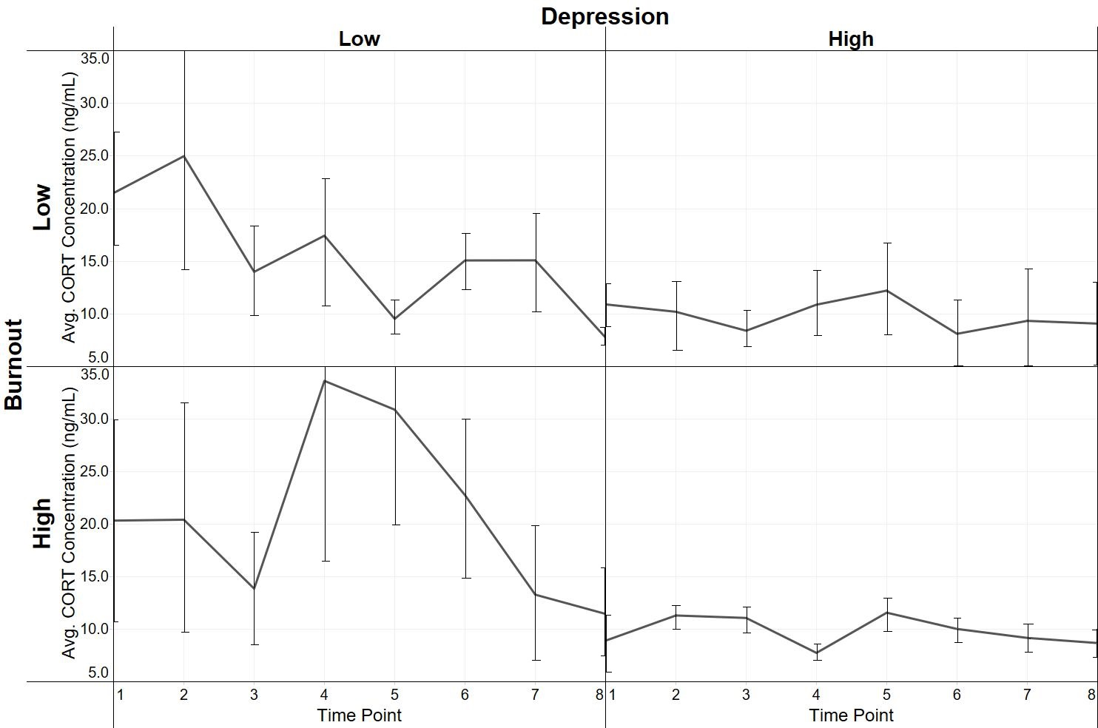
Results - Cortisol
Burnout and depression predict CORT reactivity
Notes:
No correlations or interactions with total CORT output
We also found an interaction between the emotional exhaustion and depersonalization subscales and depression as well, with a similar pattern

Slide 11
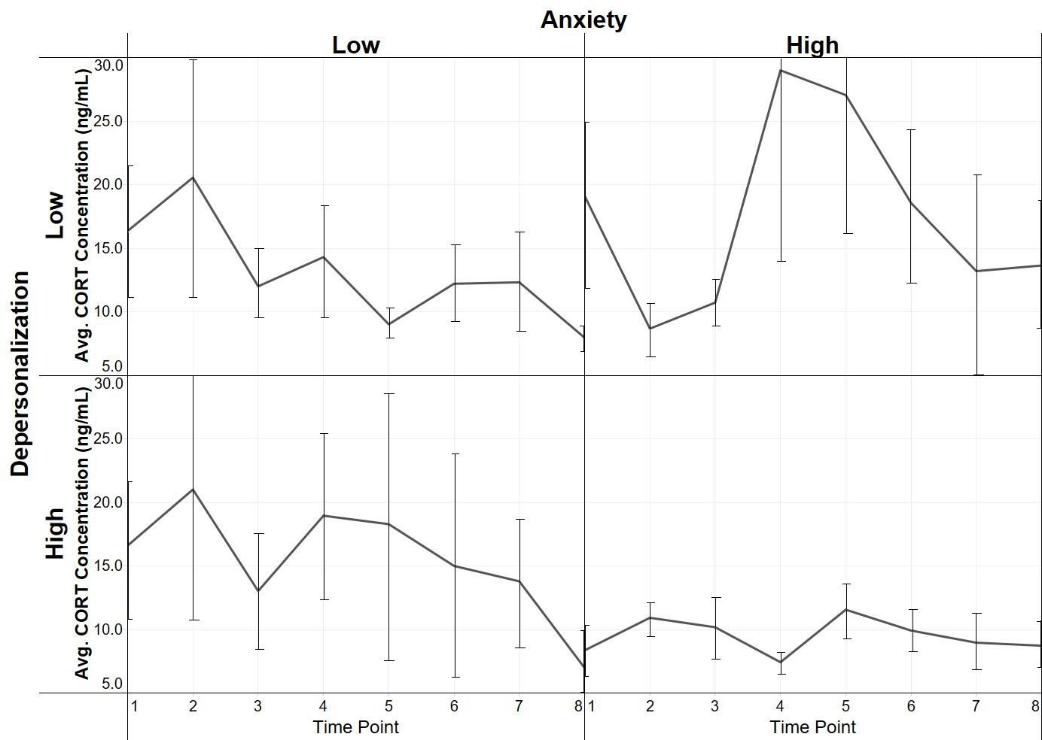
Results - Cortisol
Depersonalization and anxiety predict CORT reactivity
Notes:
We also found an interaction between burnout and anxiety to predict CORT reactivity. When examined by the burnout components, depersonalization interacted with anxiety but emotional exhaustion did not. The pattern is the same as that for depression and burnout

Slide 12
Take-Home Message
Role of depression and anxiety may clarify ambiguous findings of HPA axis functioning in burnout
Must consider individual symptom profile
    Burnout subscales
    Depression and anxiety

Slide 13
Limitations
Small sample size
  No participants with high depression
  Potential bias in professionals who participated
Needed controls
  Length of time with symptoms
    Chronic versus acute onset
  Demographic characteristics

Slide 14

Future Directions
Professionals with history of direct trauma
Melancholic versus atypical depression
Generalized versus acute anxiety
Role of genetics
Interventions
  Organizational factors
  Psychological
  Pharmacological

Slide 15
Acknowledgements
Mentor/Committee Chair
  Jeff French
Dissertation Committee
  Rose Strasser
  Joe Brown
  Carey Ryan
  Lisa Sample
French Lab
  Aaryn Mustoe
  Jon Cavanaugh
  Jack Taylor
  Sarah Carp
  Stephanie Womack
  Heather Jensen
Research Assistants
  Daphne Calhoun
  Sophie Cordova
  Ryan Glesinger
  Johanna Jones
  Ashley Nelson
Funding
  UNO Dissertation Award
  UNO UCRCA
Omaha Mental Health Community
“What doesn’t kill you gives you a lot of unhealthy coping mechanisms and a really dark sense of humor.”
–Anonymous

Slide 16
References
American Psychiatric Association. (2013). Diagnostic and statistical manual of mental disorders (5th ed.). Washington, DC: American Psychiatric Association.
Cherniss, C. (1980). Stress burnout: Job stress in the human services. New York: Praeger.
Fekedulegn, D. B., Andrew, M. E., Burchifiel, C. M., Violanti, J. M., Hartley, T. A., Charles, L. E., & Miller, D. B. (2007). Area under the curve and other summary indicators of repeated waking cortisol measurements. Psychosomatic Medicine, 69, 651-659.
Gordis, E. B., Granger, D. A., Susman, E. J., & Trickett, P. K. (2012). Salivary alpha amylase cortisol asymmetry in maltreated youth. Hormones & Behavior, 53, 96-103.
Kirschbaum, C., Pirke, K. M., & Hellhammer, D. H. (1993). The Trier Social Stress Test: A tool for investigating psychobiological stress responses in a laboratory setting. Neuropsychobiology, 28, 76-81.
Maslach, C. (1998). A multidimensional theory of burnout. In C. L. Cooper (Ed.), Theories of organizational stress (pp. 6885). Oxford, England: Oxford University Press.

