Slide 1
Creating a standard in at-home pulmonary exercise maintenance programs:
A pilot study
Casey Caniglia
Notes:
Hello. Thank you for attending my presentation.

Slide 2
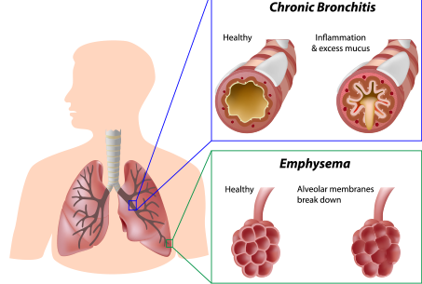
COPD
Chronic Obstructive Pulmonary Disease (COPD)
Lower respiratory chronic, progressive disorder
2-24 million in U.S.
3rd leading cause of death
Characteristics
Airflow limitation
Changing lung pathology
Leads to destruction of lung tissue
Dalal, et al. (2012) Respiratory Research
Roig, et al. (2009) Respiratory Medicine
Notes:
Chronic obstructive pulmonary disease or simply, COPD, is classified as a chronic, progressive lower (point to map) respiratory disorder characterized by airflow limitation. It is also characterized by varying degrees of changing pathology in the lungs, eventually leading to the destruction of lung tissue. Between 12 and 24 million people in the United States are affected by COPD, which is ranked third in the leading causes of death in the United States
. In addition, COPD is a leading cause of physician office visits, emergency department visits, and hospitalization in older adults

Slide 3
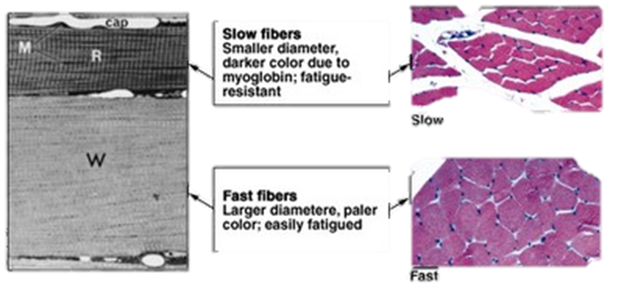
Causes and Pathology
Causes
Smoking tobacco
Occupational hazards
Environmental pollution
Genetics
Comorbidities
Cardiac episodes
Osteoporosis
Anxiety
Depression
Muscle fatigue/decrease physical activity
Pathology
Muscle fiber type shift possibility?
Type I → Type II
Mitochondria less dense
Slower metabolism
Increase in fatigue and breakdown
Roig, et al. (2009) Respiratory Medicine.
Leahy, et al. (2014) Asian Journal of Gerontology & Geriatrics
Pauwels, Romain A., et al. (2012). American journal
of respiratory and critical care medicine
Notes:
Common causes of COPD include smoking, occupational hazards, environmental pollution, and genetics.
Some people assume COPD is just a disease of the lungs. Perhaps, this is because we are bombarded with advertisements promoting better ventilation for folks with this condition. However, this pulmonary disorder is not just confined in the lungs. COPD is truly a full systemic disease, linked with other comorbidities such as cardiac events, Osteoporosis, anxiety/depression, and muscle fatigue and weakness. Symptoms include progressive dyspnea, chronic cough and the production of sputum (saliva and mucus coughed from resp. tract).
I mentioned that co-morbidities associated with COPD include a lack of physical activity and muscle weakness/fatigue. When a person is inactive, the mitochondria of the muscle cells become less condensed, leading in an inadequate conversion of ATP into energy, which slows metabolism. Thus leading to a conversion of Type 1 aerobic muscle fibers to Type II anaerobic fibers – these fibers fatigue and breakdown faster when not being used. for which they fatigue easier, as well as atrophy faster. It is likely that the increased fall risk of this population is related to these factors, however, this has not been studied completely.

Slide 4
Pulmonary Rehabilitation
Multi-disciplined evidence based tool
Doctors, nurses, physical therapists,
respiratory therapists, exercise specialists
and dieticians
Increase Independence
with individuals with COPD
Programs
Exercise training, smoking cessation,
nutrition and education
Rochester, Carolyn L., et al.(2015). American journal of respiratory and critical care medicine.
Pauwels, Romain A., et al. (2012). American journal of respiratory and critical care medicine
Length and cost of PR.
Min of 6weeks
40 sessions
Notes:
Now that we are familiar with COPD lets take a look on how to treat it with pulmonary rehabilitation(PR). PR is considered a multi-disciplined evidence based tool. This means, within the out patient program there is a variety of health care professionals to help with the rehab including: doctors, nurses, PT’s, RT’s, ES, and dietitians. Individuals with COPD increase independence with programs including: ex training, smoking cessation, nutrition counselling and ed. Insurance or Medicaid normally covers up to 36 sessions, about 12 wks. Research has shown a minimum of 6wks for positive results

Slide 5
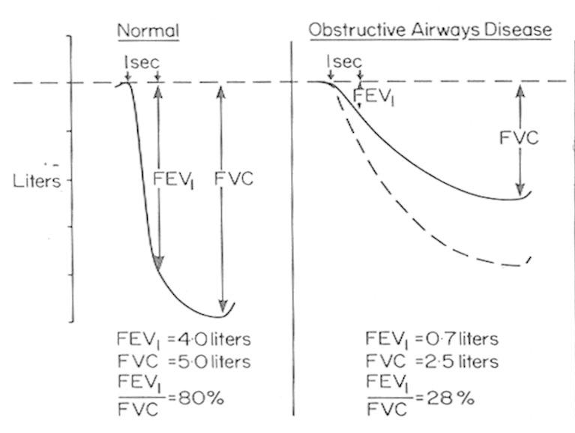
Pulmonary Rehabilitation
Enrollment
COPD
Emphysema
Asthma
Chronic bronchitis
Pulmonary fibrosis
Physicians referral
Staff contact for appointment
Diagnosis
History of associated symptoms
Spirometry FEV1/FVC < 0.70
Pauwels, Romain A., et al. (2012). American journal of respiratory and critical care medicine
Notes:
Eligibility for the Pulmonary Rehabilitation Program are for individuals diagnosed with COPD, including emphysema, asthma or chronic bronchitis, as well as pulmonary fibrosis and other respiratory ailments. Lung transplant patients also are accepted. A physician referral is required to join the program. After receiving the referral, a rehab staff member will contact the individual to arrange an appointment. Any person who has chronic cough, dyspnea, and a history of exposure to factors of the disease should get an assessment for COPD. This is done with a spirometry test. If the individual’s FEV1 (amount of air expired in 1 sec) divided by the FVC( forced vital capacity) is less than .0.70L there is a confirmation of airflow limitation, hence COPD.

Slide 6
Benefits and Limitations
Overall Benefits
Improve Ex. Capacity
Reduces intensity of breathlessness
Improves overall quality of life
Reduces hospitalization
Limitations
Once released, you’re on your own.
Positive results start declining
Reduces depression
Improves mortality
Improves recovery time after an exacerbation
Rochester, Carolyn L., et al.(2015). American journal of respiratory and critical care medicine
Notes:
PR has many valuable benefits including: improving ex. Capacity, reduces breathlessness, improves quality of life,…
One might think, with all of these benefits how could there possibly be limitations. Well there are. Once you’re released from pulmonary rehab it’s up to you to continue to improve your quality of living. Current research shows a decline in baseline assessment after being released from rehab.

Slide 7
Maintenance Programs
Recommended
Literature on Ex. and nutrition
Continue exercise on your own
Disappointment = $\frac{Expectation}{Reality}$
Post- Care Declination
Low self confidence
Lack of infrastructure
Pauwels, Romain A., et al. (2012). American journal of respiratory and critical care medicine
Notes:
When you are released from Pulmonary rehab, more often than not you are qualified to continue to exercise at the clinic at an out of pocket expense. If you cannot afford this or do not have transportation, literature on exercise and nutrition is given out and the patient is to exercise on their own. This information is subject to change from clinic to clinic. Once at home, there may not be any guidance, education, motivation, and/or equipment.
New research states, lack of confidence and infrastructure are major causes of reduced activity in COPD patients regarding at-home fitness

Slide 8
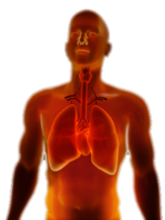
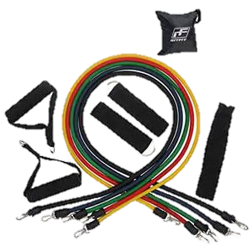
Novel Approach
Pilot study
Exercise manual
Focus on individual prescription
including balance and agility
Incorporate Activity tracker
Resistance band kit
Pulse/O2
Daily exercise log
Modified Pulmonary Rehabilitation
Exercise Program
Fitness Manual
Casey Caniglia
Notes:
That is why I have proposed a novel concept in at-home rehabilitation. I have created a modified at –home pulmonary rehabilitation exercise maintenance kit to be individually prescribed to each individual after dismissal from outpatient rehabilitation. With more focus on muscular strength, balance, and flexibility, rather than more cardio. Included are 15-20 strength exercises as well , balance, flexibility, and breathing exercises. The kit will also include resistance bands. I’ve also included an activity tracker that measures heart rate and 02 consumption plus a daily exercise log to help with the desire to keep exercising through easily read progress. Continuous motivation is a key ingredient with rehabilitation procedures with this population.
In order to test the feasibility of this kit I will enroll 10 COPD diagnosed subjects (ages 60-85 years) for whom have just been released from an outpatient pulmonary rehabilitation clinic at Fremont Medicine and are eligible for an at-home pulmonary rehabilitation exercise maintenance program. For this 8-week pilot project, subjects will be randomized into one of two groups: the standard of care (control) or a modified pulmonary rehabilitation exercise maintenance program (mPREMP) done at home. Five control subjects will receive the Nebraska Medicine standard of care program and guidelines. The mPREMP group will receive a modified exercise program. All 10 subjects will start their maintenance exercise programs at the same level and intensity as they completed from outpatient pulmonary rehabilitation. Blood pressure, heart rate, physical activity, and oxygen saturation will be recorded prior to starting and again at the end of the 8-week project.

Slide 9
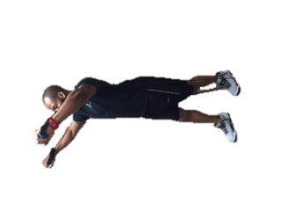
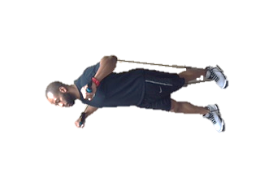
Fitness Training
Muscular strength and endurance
15-20 different exercises(ex)
Circuit
(4-6)(8-12) x 1-3
3 x week @ 20-30 min
Chest Press
Deadlift
Overhead triceps
Extension
Chair Squat
Lateral Band
Walk
Standing
Biceps Curl
Notes:
The strength routine will total 15-20 exercises using resistance bands containing both upper and lower body exercises formatted into a full body circuit training plan. Each circuit will contain 4-6 exercises done consecutively for 8-12 repetitions. One strength session will consist of three separate circuits to be completed 1-3 times. Resting times may vary depending upon the progress and condition of each subject. All strength exercises will be done every other day, 3 times per week at 20-30 minutes per session.

Slide 10
Fitness Training
Cardio
Moderate
↑ Breath and HR
Individualized
Any activity
3 x wk @ 5-30min
Notes:
The cardiorespiratory or “endurance” portion will consist of any aerobic activity to increase breathing and heart rate to a moderate level. This routine will be strictly individualized depending upon accessibility and level of aerobic capacity, with ranges between 5-30 minutes and applied every other day, 3 days per week, only during non-strength days.

Slide 11
Fitness Training
Balance and Flexibility
Balance
10-15min.
3x wk. following resistance
Flexibility
10-15min
3 x wk. following cardio activity
Balance
Side Lunge
Toe Stands
Heel to Toe
Flexibility
Gluteal and hip abductors
Shoulders/Rhomboids
Notes:
The balance exercises will be done in circuit style, three times per week following strength training. Exercises in this section would include, but not limited to: stance exercises (standing on one foot) to more advanced gait exercises (tandem walk).
Flexibility exercises will consist of full body static stretching positions, 3 times per week for 15 minutes following endurance sessions. Diaphragmatic and pursed lip breathing techniques will be practiced throughout the day until naturally implemented into daily life. In addition, there will be a 15 minute breathing routine following the flexibility exercises consisting of coordinating, deep, diaphragmatic, Huff cough, and pursed lip breathing techniques.

Slide 12
Enrollment
Current Enrollment
1. subject
Week 3
2. Verbal commit
Notes:
As of date I have one subject currently enrolled and data is in the process of being collected. Two individuals are finishing up their out-patient PR. Once dismissed, they can start mine. I wish I had some results to share, unfortunately, our subject is in her third week of her 8 week fitness program and scheduled to be completed by mid April.

Slide 13
Thank you!
Notes:
Thank you! Are there any questions or comments?

Slide 14
References
Dalal, et al. (2012) Respiratory Research, 13(1), 41.
Saey, et al. (2003) Am.J.Respir.Crit.Care Med, 168, 425-430.
Roig, et al. (2009) Respiratory Medicine, 103(9), 1257 1269.
Shrikrishna, et al. (2009) Quadriceps weakness in Gold Stage II COPD: Data from the ECLIPSE study. 2009
Smith, et al. (2010) Gait & Posture, 31(4), 456-60.
Leahy, et al. (2014) Asian Journal of Gerontology & Geriatrics, 9(2), 67-70
Image References
Imhospital.org
Blf.uk.org
Cvh. On.ca
Heathinaging.org
Albawellness.net
Wholehealthinsider.com
Healthcentral.com
Rehabsmarter.com
Papermasters.com
Nerdreactor.com
Dibibloomquist.com
Huffingtonpost.com

