Slide 1
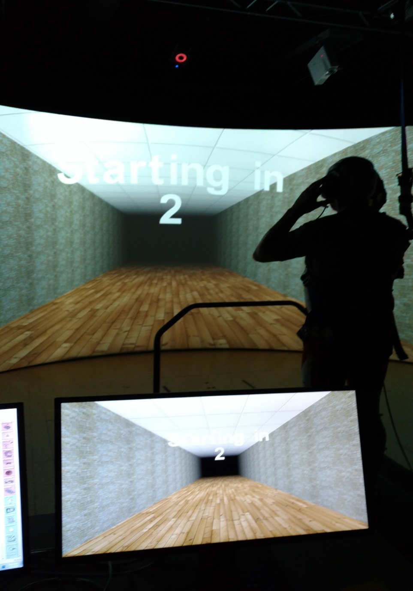
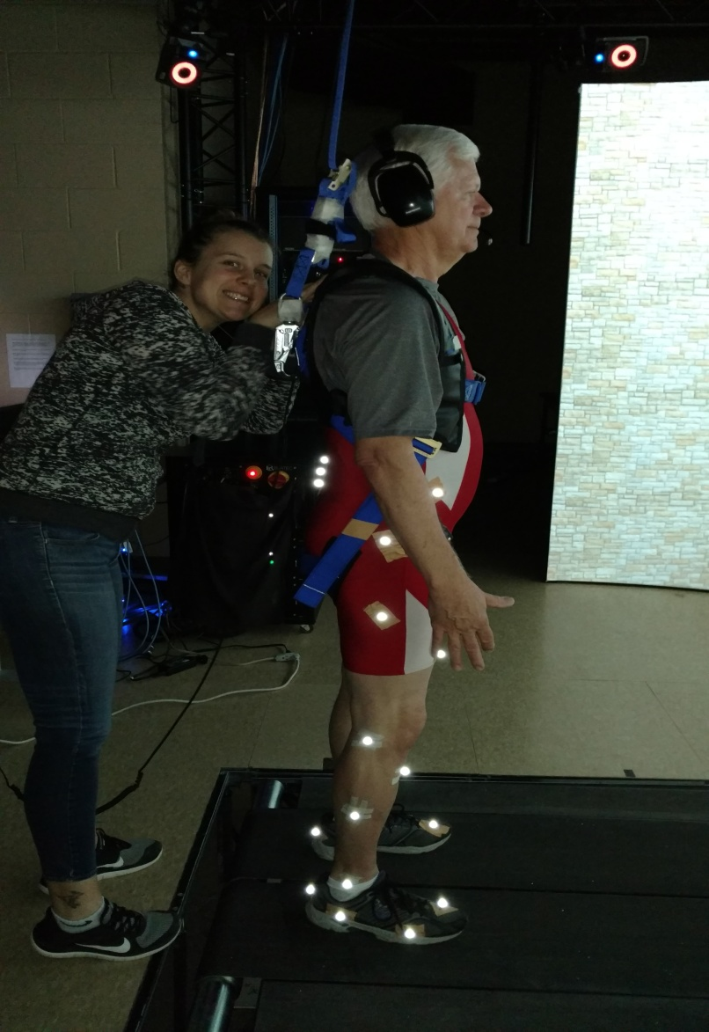
Table 1: Averages for Right Step Time.
Table 2: Averages for Left Step Time.
Table 1: Marginal Means for Conditions and Step Time.
Table 1: Marginal Means for Conditions and Step Time.
Table 1: Averages for Right Step Time.
Dual Tasking in a Virtual Reality Environment:
Does Auditory Selective Attention Impact Gait?
Angie Helseth Roth^{a,b}, Taylor Leeder^{b,c}, Sara Myers^{b,c}, Molly Scheiber^{b,c}, Julie Boron^{a,b}
Department of Gerontology, University of Nebraska at Omaha, Omaha, NE 68182
Center for Research on Human Movement Variability, University of Nebraska at Omaha
Department of Biomechanics, University of Nebraska at Omaha
INTRODUCTION
Figure 1: Environment for NVR and VR sessions Figure 2: Subjects wearing reflective markers
Attention demanding tasks requiring simultaneous cognitive and physical functions create challenges for balance maintenance, which is important for fall prevention¹.
During dual-task walking slower step time may be an attempt by individuals to feel more stable.
The overall goal of this project is to investigate dual task costs of an auditory selective attention task compared to a controlled walking only condition by examining variability in step time in Non Virtual Reality (NVR) and Virtual Reality (VR) environments (see Figures 1 and 2) .
Table 1: Averages in standard deviation for Right Step Time
METHODS
 | Walking | Dichotic Listening Non Forced | Dichotic Listening Forced Right | Dichotic Listening Forced Left
Optic Flow | .0211±.004 | .0129±.330 | .021±.005* | .025±.009
Non Optic Flow | .024±.006 | .023±.008 | .023±.007 | .017±.006
• Seventeen healthy older adults (74 + 6 years) completed weekly sessions
for 3 weeks (Session 1: Baseline; Sessions 2 & 3: DT VR/NVR sessions.) • Dichotic listening tasks included non forced (NF), right forced (RF), and left
forced (LF).
• DV: Variability in right and left step time (RST, LST) within three different
dichotic listening tasks compared to a controlled walking condition (WK). • Step time variability was assessed in standard deviations (SD; see Tables 1
& 2 between four conditions (WK, NF, RF, LF) in VR & NVR environments.)
• Analyses: A repeated measures ANOVA (p=0.05) was utilized.
Adjustments for multiple comparisons: Bonferroni correction.
Table 2: Averages in standard deviation for Left Step Time
 | Walking | Dichotic Listening Non Forced | Dichotic Listening Forced Right | Dichotic Listening Forced Left
Optic Flow | .022±.005 | .0158±.396 | .023±.009 | .034±.023
Non Optic Flow | .026±.007 | .026±.009 | .024±.009 | .020±.008
SUMMARY
• These preliminary results indicate that while a significant main effect was
not achieved in all dichotic listening variables, LF conditions in a VR
environment would likely be significant with a larger sample size.
• The NF condition in VR and NVR environments is furthest from a
significant main effect, possibly due to lack of task specificity for subjects.
RESULTS
• A significant main effect (p<0.05) was found for RST in the VR environment.
Figure 3: RST Marginal Means
Figure 4: LST Marginal Means
CONCLUSIONS
• Future research is needed to investigate how auditory selective attention
tasks impact gait in real world settings. This may be informative as to the
types of auditory dual tasks that may increase fall risk.
• Future research is needed to investigate how step time may differ in each
decade in order to understand gait changes throughout life and provide
sufficient and thorough fall prevention programming.
• Based on our findings, we can conclude that a VR environment may help
decrease the effect of a cognitive dual task and possibly help decrease
fall risk.
REFERENCES
Note: Table 1 data is represented in Figure 3 for RST means throughout the 4 conditions;
similarly, Table 2 data is represented in the Figure 4 for LST.
1 Smith-Ray, RL, et al. Journals of Gero, 70(3), 357-366, 2015.
ACKNOWLEDGEMENTS
Funding by the COBRE Pilot Grant Program NIH grant P20GM109090.

