Slide 1
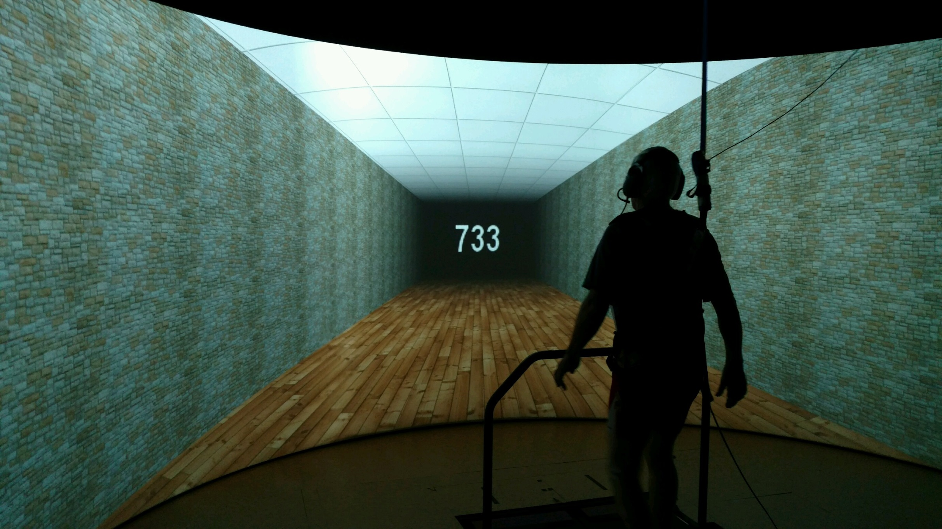
Effects of Serial Subtractions on Elderly Gait Speed in a Virtual Reality Setting
Taylor Leederª, Angeline Helseth Roth^{b}, Molly Schieberª, Sara Myersª, Julie Boron^{b}
Department of Biomechanics, University of Nebraska at Omaha, Omaha, NE 68182
Department of Gerontology, University of Nebraska at Omaha, Omaha, NE 68182
INTRODUCTION
RESULTS
Older persons have an increased risk of falling with nearly one-third experiencing a fall every year.¹
Gait variability, which can be indexed by standard deviations (SE), is correlated with increased fall risk in the elderly.¹
Optic flow (OF) is a type of virtual reality environment (VR), it provides a visual flow to the subject that is similar to the visual stimuli received when walking over-ground. Optic flow may make walking on a treadmill more realistic than a static treadmill environment.
Depending on the type of dual-task (DT), gait variability increases.²
Purpose: To assess the differences in gait using speed averages standard deviation values of elderly walkers: 1) While dual-tasking; 2) Between a virtual reality environment and non-virtual reality environment.
Figure 1. Subjects were more variable in the SS condition, significantly so in the Non-Optic Flow session (p=.048).
Figure 2. On average, subjects walked slower in the SS condition. There was a significant difference in walking speed in the SS Non-Optic Flow session (p=.024)
METHODS
19 subjects (13 F/ 6 M) all 65 or older completed one baseline cognitive session (single task) and two dual-task walking sessions (one with and without virtual reality.)
Seven cognitive tasks were assessed. Serial Subtraction (SS) is the focus of the current project.
Serial Subtraction
Version | A | B | C
Numbers | 233, 650, 502 | 805, 297, 483 | 733, 369, 922
Subjects completed one of these versions in each session (randomized)
Instructions: A 3-digit number will appear on the screen. Please subtract by 3 from this number continuously until a new number appears on the screen.
Scored: Correct number of subtractions
Figure 3. Subjects who were 71 and older scored significantly worse (p=.003) across sessions than those who were younger than 71.
Figure 1: Serial subtraction table explaining the task that the subjects completed at each visit.
DISCUSSION
Gait: assessed by walking speed
Variability: assessed by standard deviations
Analyses: Paired t-tests were used to compare conditions (DT-OF Vs NDT-OF and DT-NONOF Vs NDT-NONOF). ANOVAs were used to compared SS scores across sessions and age
Those below 71 years of age are referred to as young-old and those 71 years and older are referred to as old-old.
Previous literature has shown that older adults will slow their gait in order to deal with a cognitive task, our results support this trend. Subjects tended to walk slower in both the OF and NONOF settings while dual-tasking with DT being significantly slower (p=.024) and more variable (p=.048) in the NONOF condition.
Perhaps the discontinuity of a static environment while dual-tasking had an even greater impact than a more naturalistic flow
At first comparison there were no differences in correct subtractions between conditions for the subjects, however, after grouping them into young-old and old-old, we saw significant differences (p=.003) between the two groups. It seems that older participants performed poorly on cognitive tasks regardless of the session or condition. However, the young-old group tended to have more subtractions in the DT sessions suggesting a positive impact for movement on cognition.
Figure 2: Subject performing the serial subtraction task in the VR lab. Responses were recorded using a speech analysis software program. Gait data was collected at 100 Hz using an eight camera motion capture system.
REFERENCES
1. Kang HG, et al. Gait Posture, 27(4), 572-577, 2008.
2. Hausdorff, J., et al. J Gerontol A Biol Sci Med Sci, 63(12), 1335-1343, 2011.
3. Owings, T., Grabiner, M. D., Journal of Biomechanics, 37, 935-938, 2004.
ACKNOWLEDGEMENTS
Funding provided by the COBRE Pilot Grant (P20GM109090).

