Slide 1
A Wellness Approach to Investigating Student Veterans’ Academic and Career Goals
Thomas Seguin
Department: Counseling
Clinical Mental Health
Faculty Advisor: Abby Bjornsen-Ramig, Ph.D.

Slide 2
Who are Student Veterans?
For the purposes of this study:
Prior service (active duty, guard, reserve)
In higher education to earn a degree
My focus:
Undergraduates
Non-retirees
Notes:
Photo credit: http://www.smc.edu/StudentServices/VeteransResourceCenter/Pages/New-Student-Veterans-to-SMC.aspx

Slide 3
Student Veteran Career Counseling, Explained
Pre-separation counseling
  Mandatory, DoL sponsored
Academic counseling
  Success in school
Veteran-specific services
  Office of Military and Veteran Services
  Student Veteran Organization

Slide 4
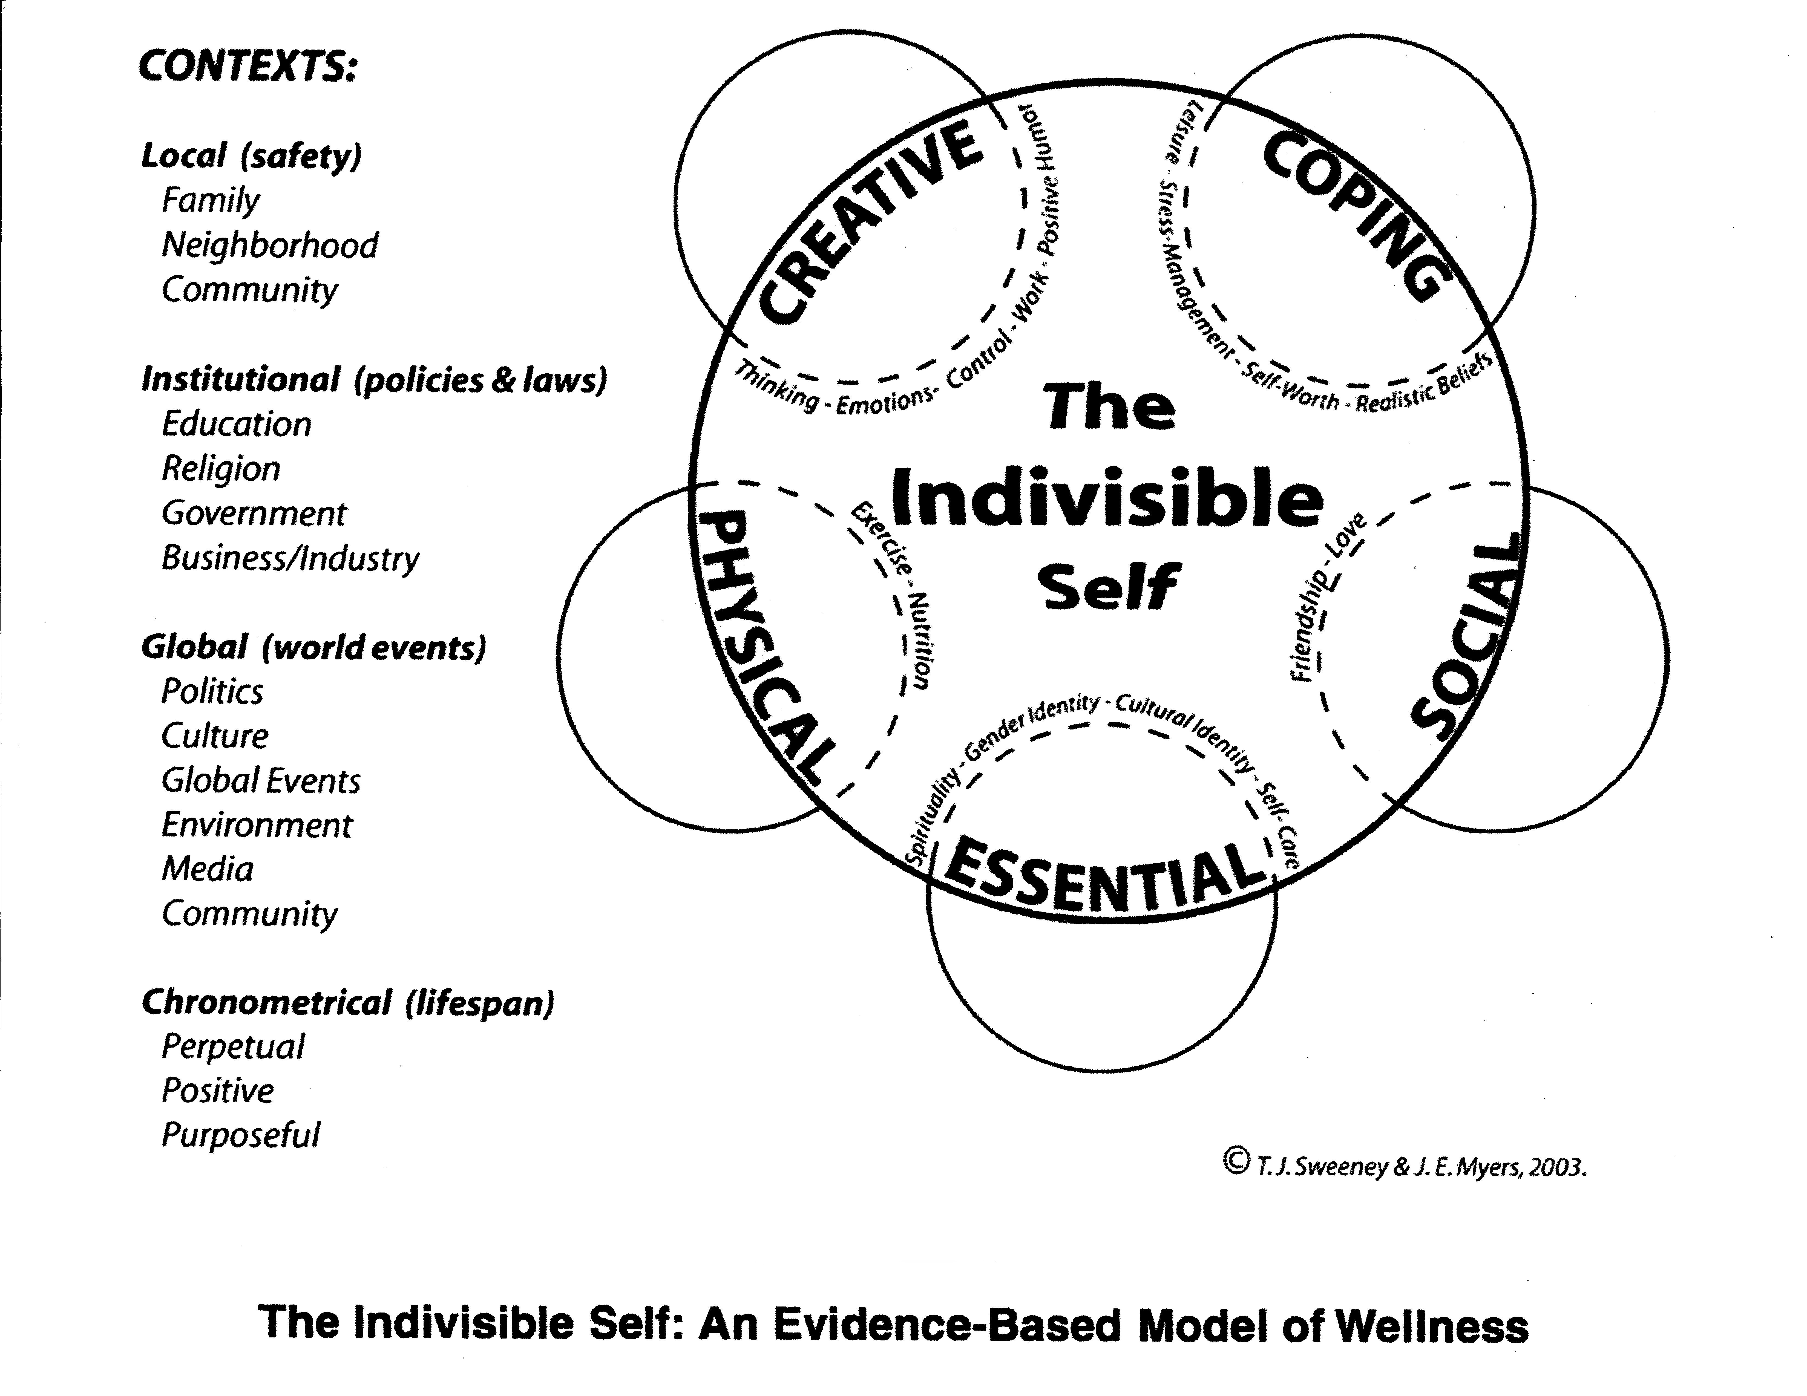
Wellness is the New Paradigm
Holistic modern approach to career counseling (Zikic & Franklin, 2010)
Wellness in career counseling is linked to overall wellness (Smith, Myers, & Hensley, 2002; Berríos-Allison, 2011, Lawson & Myers, 2011)
The Indivisible Self Model of Wellness (IS-Wel) is an evidence-based model (Myers & Sweeney, 2005b)
  5-Factor Wellness Inventory (5F-Wel)– Assessment based on IS-Wel (Myers & Sweeney, 2005a)

Slide 5
Wellness is the New Paradigm
Little research exists on veterans and evidence-based wellness (Heath, 2014)
Despite services, there is limited literature about student veterans’ career decision making (Ghosh & Fouad, 2016)

Slide 6
Tying it All Together
Exploratory study – qualitative
Research-based wellness assessment – quantitative
Mixed methods approach:
  Questionnaire distributed to all student veterans for demographic data and intentional sampling (quantitative)
  Schedule interviews with smaller sample (n=18)
  Administer 5F-Wel assessment (quantitative) and conduct semi-structured interviews (qualitative)

Slide 7
Findings So Far
37% of respondents said they are mostly attending college in order to receive education benefits (e.g. GI Bill)
17% of respondents said they have not thought about their future careers or are not fairly certain they know what they want to do after graduation
10% of respondents disagreed that their degree will help them attain a specific career goal
80% of respondents are willing to participate in a follow-up interview
Notes:
☺

Slide 8
References
Berríos-Allison, A. C. (2011). Career support group for Latino/a college students. Journal Of College Counseling, 14(1), 80-95. doi:10.1002/j.2161-1882.2011.tb00065.x
Ghosh, A., & Fouad, N. A. (2016). Career transitions of student veterans. Journal of Career Assessment, 24(1), 99-111. doi:10.1177/1069072714568752
Heath, W. M. (2014). A wellness profile of student-veterans at 4-year higher education institutions: The role of gender, combat tours, and deployment (order no. 3665855) (Doctor of Philosophy). Available from Proquest Dissertations and Theses Global. (1640906481).
Lawson, G., & Myers, J. E. (2011). Wellness, professional quality of life, and career-sustaining behaviors: What keeps us well? Journal of Counseling & Development, 89(2), 163-171.
Myers, J. E., & Sweeney, T. J. (2005). Five Factor Wellness Inventory. Palo Alto, CA: Mind Garden.
Myers, J. E., & Sweeney, T. J. (2005). The indivisible self: An evidence-based model of wellness (reprint). The Journal of Individual Psychology, 61(3), 269-279.
Smith, S. L., Myers, J. E., & Hensley, L. G. (2002). Putting more life into life career courses: The benefits of a holistic wellness model. Journal of College Counseling, 5(1), 90.
Zikic, J., & Franklin, M. (2010). Enriching careers and lives: Introducing a positive, holistic, and narrative career counseling method that bridges theory and practice. Journal of Employment Counseling, 47(4), 180-189.

Slide 9
Next Steps
March – April
  Purchase wellness assessments
  Schedule interviews
May – June
  Conduct interviews
  Transcribe and code interviews
July – August
  Create results, discussion, conclusion sections
  Finalize thesis document
September – October
  Defend thesis
  Prepare manuscript for journal submission
December 2017
  Graduation!

Slide 10
Questions
Contact: Thomas Seguin, B.A.
tseguin@unomaha.edu

