Slide 1
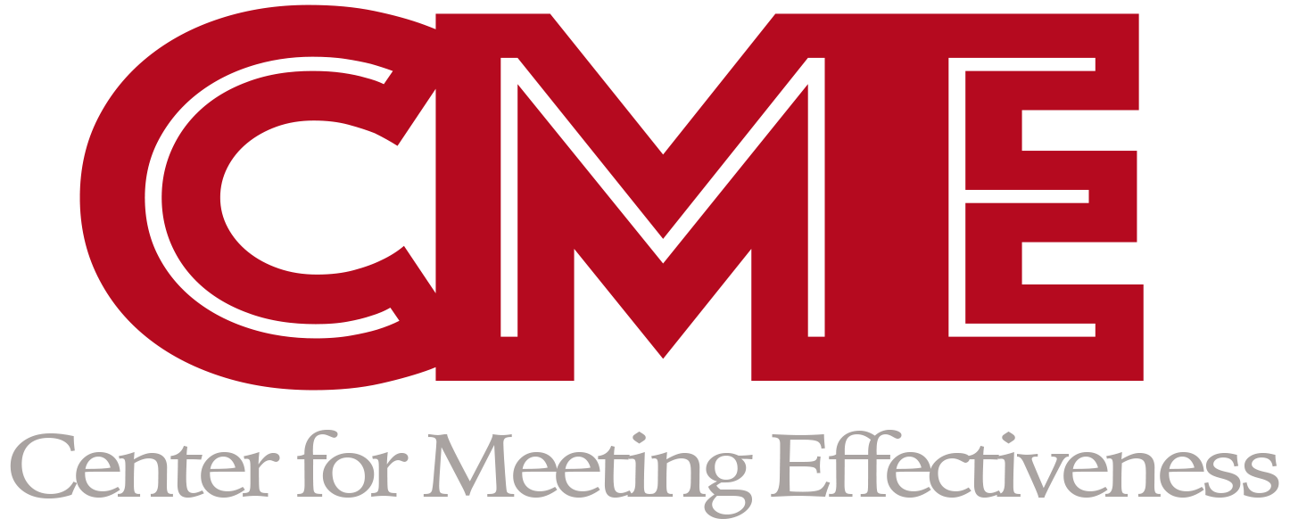
Meeting Madness: Counterproductive Meeting Behaviors and Personality Traits
Kathleen Stibbs, Michael Yoerger, John Crowe, & Joseph Allen
University of Nebraska at Omaha
Abstract
Methods
This research focuses on the impact of professionalism in workplace meetings on meeting frustration and stress, as well at the moderating influence of negative affectivity.
The primary finding of this study is that there is a negative relationship between perceived meeting professionalism and attendee frustration/stress. Furthermore, this relationship was found to be more strongly negative for individuals possessing high levels of negative affectivity.
This research is among the first to examine the importance of professionalism in the context of workplace meetings and how it might impact attendee attitudes, and how the relationship may differ based on level of negative affectivity.
Recruited participants through the SONA research participation system.
The sample consisted of 68 groups, consisting of between 3-6 individuals in each meeting group.
These individuals were given 25 minutes to discuss changes to the general education curriculum.
Methods
Figure 2. Result of probing the proposed interaction between meeting professionalism and meeting frustration/stress. Individuals reporting a high level of negative demonstrated a more negative relationship.
Introduction
Discussion
When used effectively, meetings serve as an invaluable opportunity for coworkers to achieve organizational objectives.
However, they can be a source of frustration and stress among employees if they are not run properly.
In an attempt to understand the sources of meeting frustration and stress, we focused our attention on meeting professionalism.
Meeting professionalism may be described as the degree to which meeting attendees show consideration for the interests of others, approach their responsibilities with professionalism, respond constructively and caringly when problems are shared, and demonstrate that others can rely on them.
In addition to examining the impact of meeting professionalism on stress, we also investigated how an individual’s degree of negative affectivity can influence the relationship.
Hypothesis 1: Meeting professionalism is negatively related to meeting frustration/stress.
Hypothesis 2: The negative relationship between meeting professionalism and meeting frustration/stress will be moderated by negative affectivity, such that the negative relationship is stronger when negative affectivity is high.
The finding that meeting professionalism is negatively related to meeting frustration and stress suggests that holding meeting attendees to certain behavioral standards can reduce the degree to which the meeting is perceived as a stressor.
Given that the meeting was with a temporary group, this study’s generalizability to the traditional work environment may be limited.
Further research may investigate meeting professionalism with a more objective measure than self report, to determine if individuals possessing low negative affectivity are less likely to perceive a lack of meeting professionalism.
Discussion
Figure 1. Negative affectivity moderates the relationship between meeting professionalism and meeting frustration/stress, such that the positive relationship is stronger for those high in negative affectivity.
Results
Hypothesis 1 and 2 were tested by conducting a hierarchical regression analysis
Hypothesis 1 was supported. Meeting professionalism accounted for a significant amount of variance in meeting frustration/stress (ΔR² = .10; β = -.32, p < .05).
Hypothesis 2 was supported. Negative affectivity (β = .26, p < .05) was found to significantly relate to meeting frustration/stress
The interaction term was tested and negative affectivity was found to moderate the relationship between meeting professionalism and meeting frustration/stress (ΔR² = .11; β = -.18, p < .05)
References
References
Allen, J. A., Yoerger, M. A., Lehmann-Willenbrock, N., & Jones, J. (2015). Would you please stop that!?: The relationship
between counterproductive meeting behaviors, employee voice, and trust. Journal of Management Development, 34,
1272-1287. doi:10.1108/JMD-02-2015-0032
Kauffeld, S., & Lehmann-Willenbrock, N. (2012). Meetings matter: Effects of team meetings on team and organizational
success. Small Group Research, 43, 130-158. doi:10.1177/1046496411429599
Luyckx, K., Teppers, E., Klimstra, T. A., & Rassart, J. (2014). Identity processes and personality traits and types in
adolescence: Directionality of effects and developmental trajectories. Developmental Psychology, 50, 2144-2153.
doi:10.1037/a0037256
Minton, E., Gurel-Atay, E., Kahle, L., & Ring, K. (2013). Comparing data collection alternatives: Amazon Mturk, college
students, and secondary data analysis. AMA Winter Educators' Conference Proceedings, 24, 36-37.
Simons, D. J., & Chabris, C. F. (2011). What people believe about how memory works: A representative survey of the U.S.
population. Plos ONE, 6, 1-7. doi:10.1371/journal.pone.0022757

