Slide 1
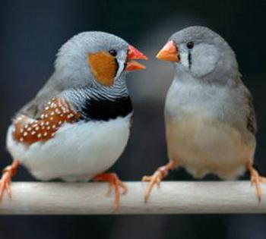
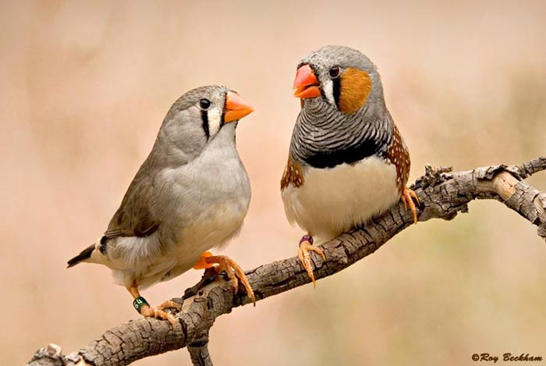
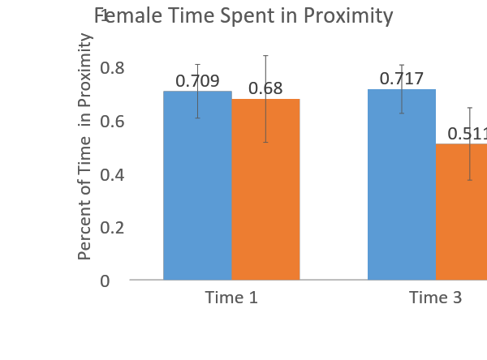
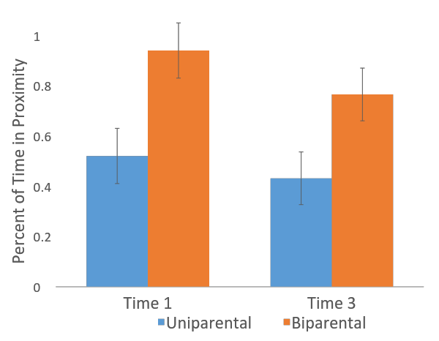
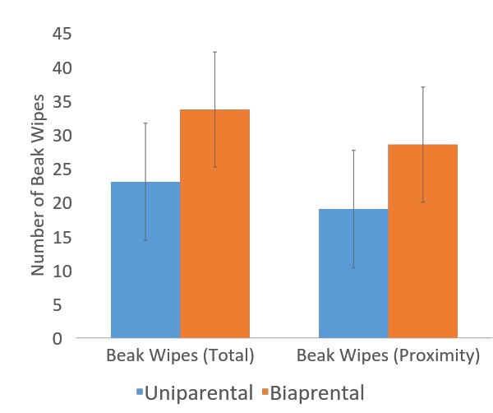
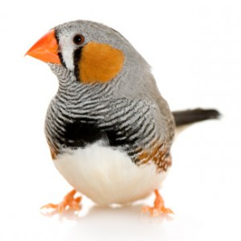
Courting Behavior Among Biparentally and Uniparentally Raised Zebra Finches
Angela K. Adams, Zachary L. Darwish, and Rosemary Strasser
Department of Psychology, University of Nebraska at Omaha, Omaha, NE 68182
ABSTRACT
Results
Discussion
Zebra Finch are a monogamous pair bonded species, and a commonly studied animal due to their complex social behavior. Chicks were raised in a biparental (raised by two parents) or uniparental (raised by the female alone) rearing condition. This study was done to test our hypothesis of differences in parental care and how rearing conditions may affect mate choice for the male finch. Through this study we have found that time spent in proximity to the female differed between a uniparentally raised and biparentally raised male finch.
This study was done to test the hypothesis of differences in parental care and rearing conditions that would affect courtship behavior among zebra finch. Our findings were significant with differences in time spent in proximity to uniparental versus biparental males. This means that the female does not have a preference naturally toward any of the male finches compared to one another, no matter what care regime they were raised in. There were no differences in amount of courting behaviors from the males. We did find however, that there was a significant difference across rearing conditions in relation to time spent in proximity to the female, with biparentally raised chicks spending more time than uniparentally raised chicks in proximity to the female. These findings may suggest that females may have preferred biparental males because they were demonstrating more interest by spending more time in proximity. This may suggest that the differences are due to behavior and not physical attractiveness. For future studies, I would also examine male song and dance toward the female as well as tale flicks from the female to further examine any more potential differences in courting behavior and mate selection.
Figure 1: represents the plexiglass houses that a male and female were paired in. Each line within the box represents a perch. The red highlighted portion represents the proximity zone.
Denotes are scored as proximity
*
Male Time Spent in Proximity
Objective
It is unclear what effects that different types of rearing conditions (biparental vs. uniparental) may have on male finch social behavior later in life. The purpose of this project is to determine the effect of different rearing conditions with interactions of an opposite sex stranger.
x
Acknowledgements
A huge thanks to Dr. Rose Strasser, Zachary Darwish, and Heather Jensen for all their help with this research project.
Figure 2: There were no significant differences in female time spent in proximity to uniparental or biparental males (F(1,4) = 0.428, p = 0.549) at either time point (F(1, 4) = 0.006, p = 0.942). There was no significant condition by time interaction (F(1,4) = 0.763, p = 0.432).
Figure 3: Biparental males spent significantly more time in proximity zones than uniparental males (F(1,9) = 8.731, p = 0.016). There was no significant time (F(1,9) = 0.009, p = 0.926) or time by condition interaction (F(1,9) = 0.268, p = 0.617) effect.
Methods
For this project we used twelve males and six females, all raised to sexual maturity from Dr. Strasser’s previous lab.
Females were used twice each for this project in order to reduce the total number of animals used.
Males and females were randomly assigned. For each session, one female was placed in a plexi-glass observation cage, and a male, either from a bi-parental regime or in a uniparental regime, was placed in another plexi-glass observation cage directly next the female with a clear divider between them.
They were then recorded for three consecutive thirty minute sessions.
The observations taken during these thirty minute videos were some male courting behaviors: beak wipes and where they were in proximity to the female.
Females were also recorded by how much they were also in proximity to the male finch.
References
Number of Beak Wipes Between Males
Bolund, E., Schielzeth, H., & Forstmeier, W. (2008). Compensatory investment in zebra finches: females
lay larger eggs when paired to sexually unattractive males. The Royal Society, 707-715. Retrieved
February 15, 2016.
Royle, N., Hartley, I., & Parker, G. (2006). Consequences of biparental care for begging and growth in
zebra finches, taenipygia guttata. Elsevier, 123-129. Retrieved February 15, 2016.
Royle, N., Hartley, I., & Parker, G. (2002). Sexual conflict reduces offspring fitness in zebra finches.
Macmillan Magazines,416, 733-736. Retrieved February 15, 2016.
Ruploh, T., Henning, M., Bischof., H., & von Engelhardt., N. (2015). Effects of social conditions during
adolescence on courtship and aggressive behavior are not abolished by adult social experience.
Developmental Psychology, 57(1). 73-82. Doi:10.1002/dev.21262.
Ullrich, R., Norton, P., & Scharff, C. (2015). Waltzing Taeniopygia: Integration of courtship song and
dance in the domesticated Australian zebra finch. Elsevier, 285-293. Retrieved February 15, 2016.
Photography:
All rights reserved to Two Generations of Veterinarians Caring & Working for the Health of Your Pet Birds ™
© 2017 Lafeber Company. Retrieved from https://lafeber.com/pet-birds/species/zebra-finch/
Beckham, R. (photographer). All rights reserved to Animalia Life Copyright © 2016-2017. Retrieved from http://animalia-life.club/birds/zebra-finch.html
Ray Beckham (photographer). Retrieved from http://www.efinch.com/species/zebra.htm
Figure 4: represents the number of beak wipes given from biparental males and uniparental males in proximity, compared to the total amount of beak wipes.

