Slide 1
Augmenting Human Muscle Performance through Added Foot Stiffness
Thesis proposal
Sam Ray
December 13, 2016

Slide 2
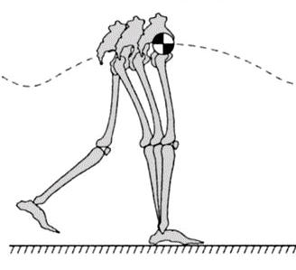
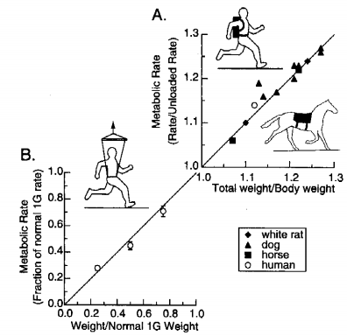
Expending energy to perform tasks
Mechanical Work^{[1]}
Producing Force^{[2]}
[1] Kuo AD et al. Exer Sport Sci Rev. 33(2):88-97 (2005)
[2] Kram R. Exerc Sport Sci Rev. 28(3): 138-43 (2000)

Slide 3
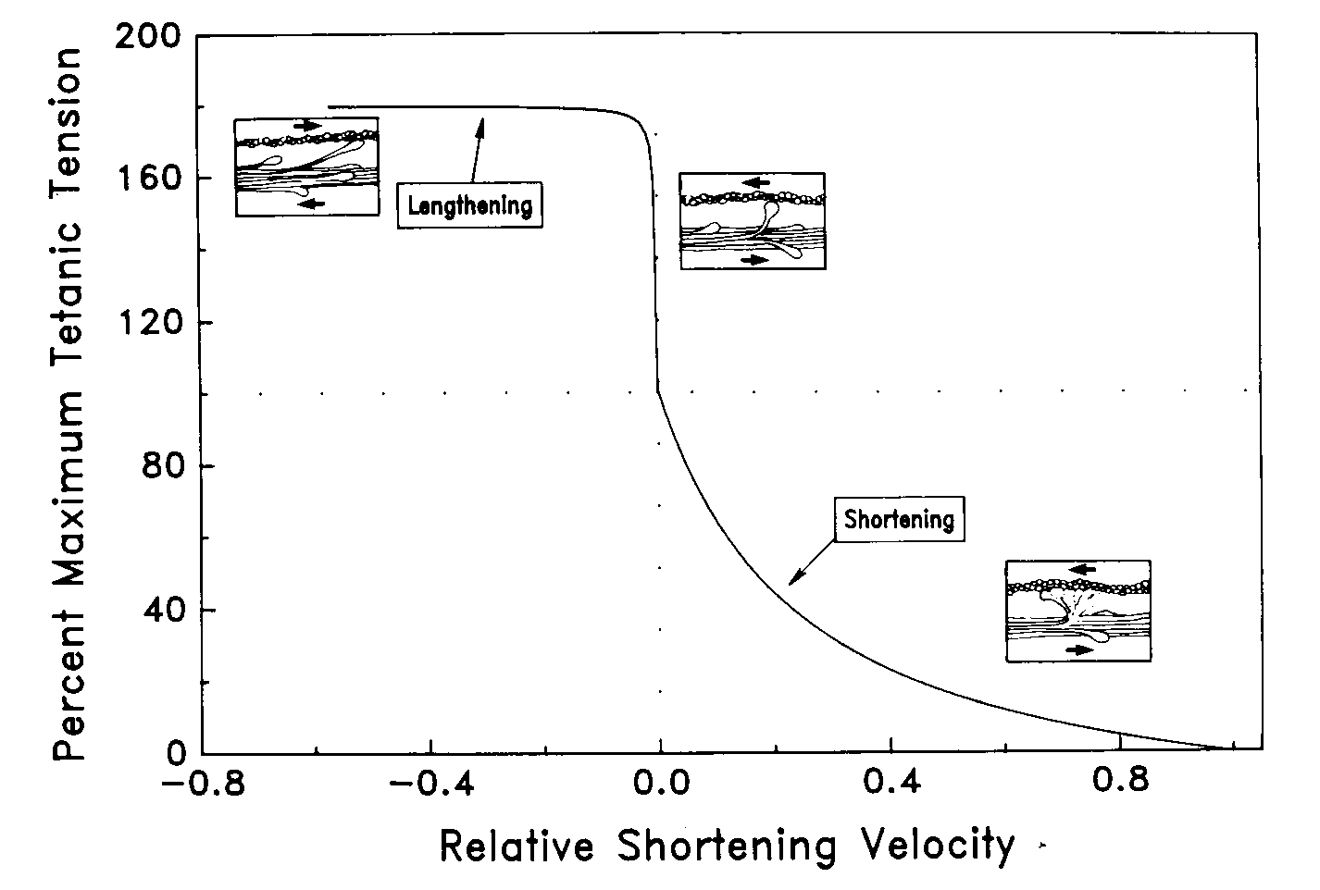
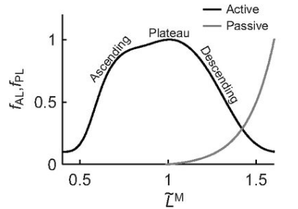
Operating conditions alter force output
Force-Length^{[1]}
Force-Velocity^{[2]}
Arnold et al., 2013
http://web.mit.edu/16.423/www/MuscleSumm.html
[1] Arnold EM et al. J Exp Biol. 216(11):2150-60 (2013)
[2] Hill AV. Proc Roy Soc B 126(843):136-195 (1938)

Slide 4
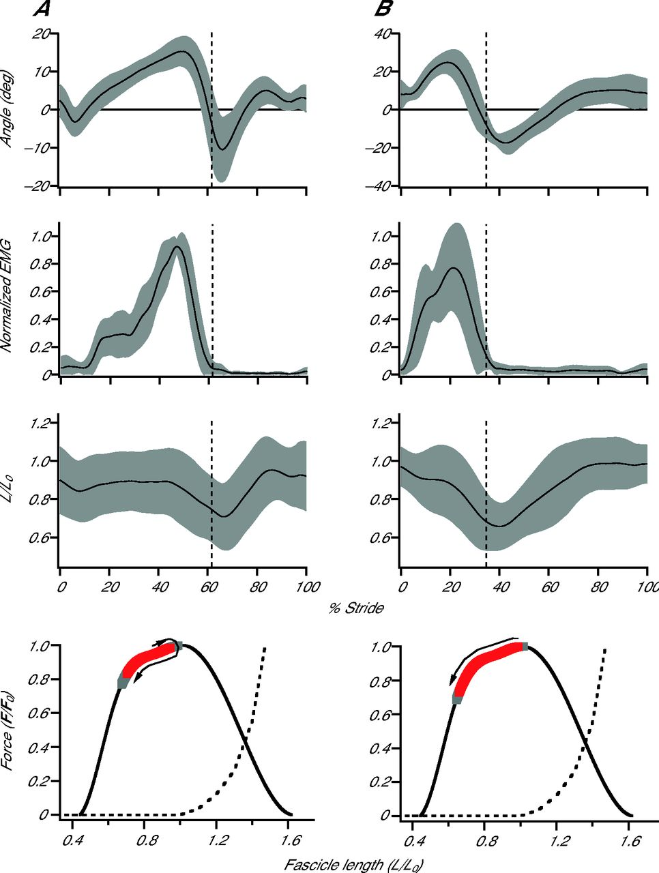
Plantarflexors operate in favorable regions
Soleus Force-Length^{[1]}
Force-Velocity^{[2]}
http://web.mit.edu/16.423/www/MuscleSumm.html
[1] Rubenson J et al. J Exp Biol. 215(20):3539-51 (2012)
[2] Ishikawa M et al. J Appl Physiol. 99(2):603-8 (2005)
Notes:
Mention here:

Slide 5
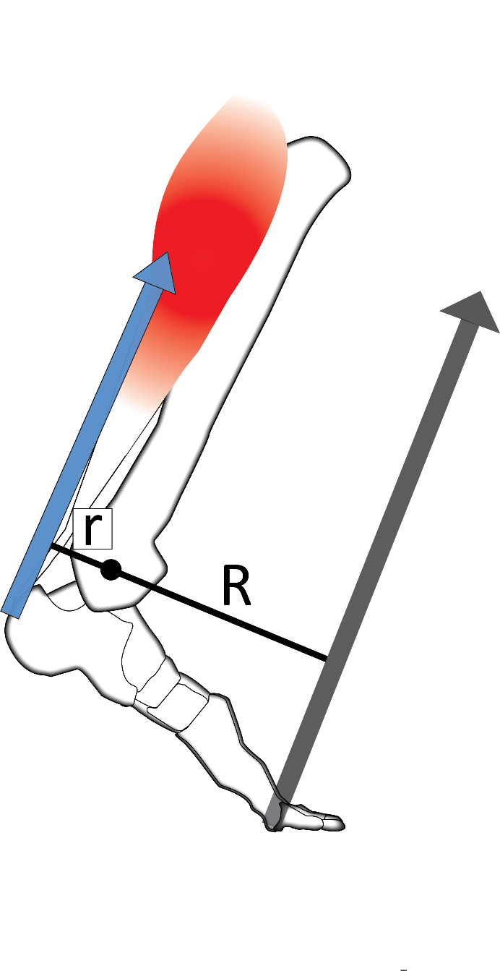
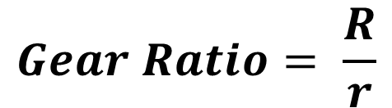
Gear Ratio is a way to maintain optimality
Maintains favorable force-velocity relationships
Ankle-foot gear ratio = transmission of a car
$$Gear Ratio= \frac{R}{r}$$
[3] Carrier DR et al. Science 265(5172):651-3 (1994)

Slide 6

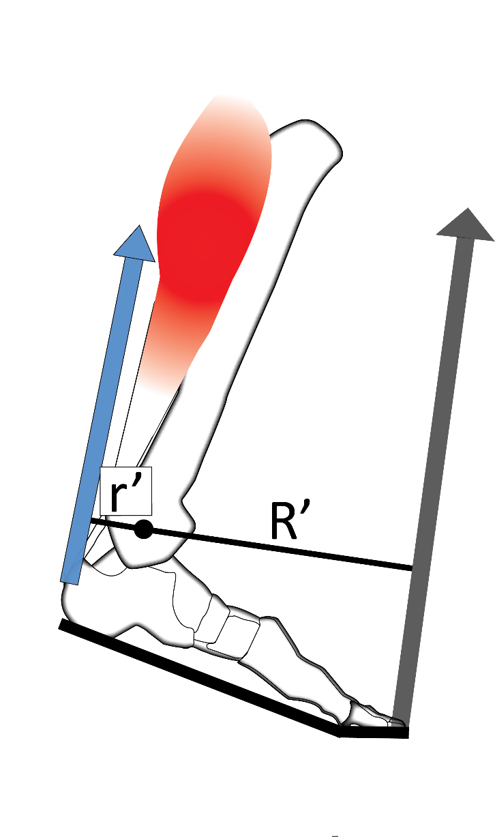

Added shoe stiffness increases gear ratio
Lengthened GRF moment arm^{[1]}
Increases force, decreases velocity^{[2]}
$$\frac{R}{r}<\frac{R′}{r′}$$
[1] Willwacher S et al. Gait Posture 40(3):386-90 (2014)
[2] Takahashi KZ et al. Sci Rep. 6:29870 (2016)
Notes:
Articulate here that minimizing extension of the metatarsophalangeal joint increases the lever arm by putting the COP farther away from ankle joint center
Also mention here that in theory, this should lead to increased force / dec. velocity, then pop up graph

Slide 7
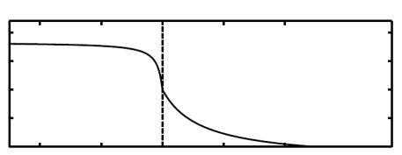
Added shoe stiffness increases gear ratio
Soleus Muscle
Lengthened GRF moment arm[1]
Increases force, decreases velocity[2]
Force-Velocity
Peak Force (Newtons)
stiffer feet
$$\frac{R}{r}<\frac{R′}{r′}$$
Velocity at Peak Force (mm/s)
[1] Willwacher S et al. Gait Posture 40(3):386-90 (2014)
[2] Takahashi KZ et al. Sci Rep. 6:29870 (2016)

Slide 8
“Favorable” shift in Soleus Force-Velocity relationship led to no metabolic benefit

Slide 9
Force effect outweighed Velocity?
↑ gear ratio:
Harmful↑ force output
Beneficial ↓ fasc. velocity
↓V_{fasc.}
↑Force
metabolic
cost increase
Preferred Walking Speed
(Takahashi et al, 2016)
[1] Takahashi KZ et al. Sci Rep. 6:29870 (2016)
Notes:
Spell out “metabolic cost” here… and maybe name this the “metabolic cost seesaw”
Change title to impactful statement

Slide 10
Could this Soleus Force-Velocity shift be
beneficial in other tasks?

Slide 11
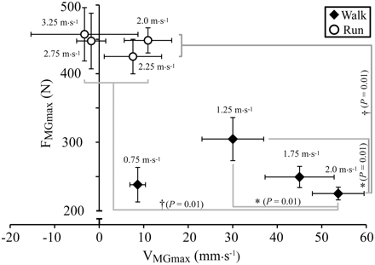
Fast walking is rather inefficient
High force production, fast-shortening muscles produce force inefficiently
Diminishing returns of plantarflexors w/ walk speed^{[1-3]}
[1]
+ speed
[1] Farris DJ & Sawicki GS. Proc Natl Acad Sci 109(3):977-82 (2012) [2] Arnold EM et al. J Exp Biol. 216(11):2150-60 (2013) [3] Neptune RR & Sasaki K. J Exp Biol. 208(5):799-808 (2005)
Notes:
Make sure to specify this is medial gastrocnemius data

Slide 12
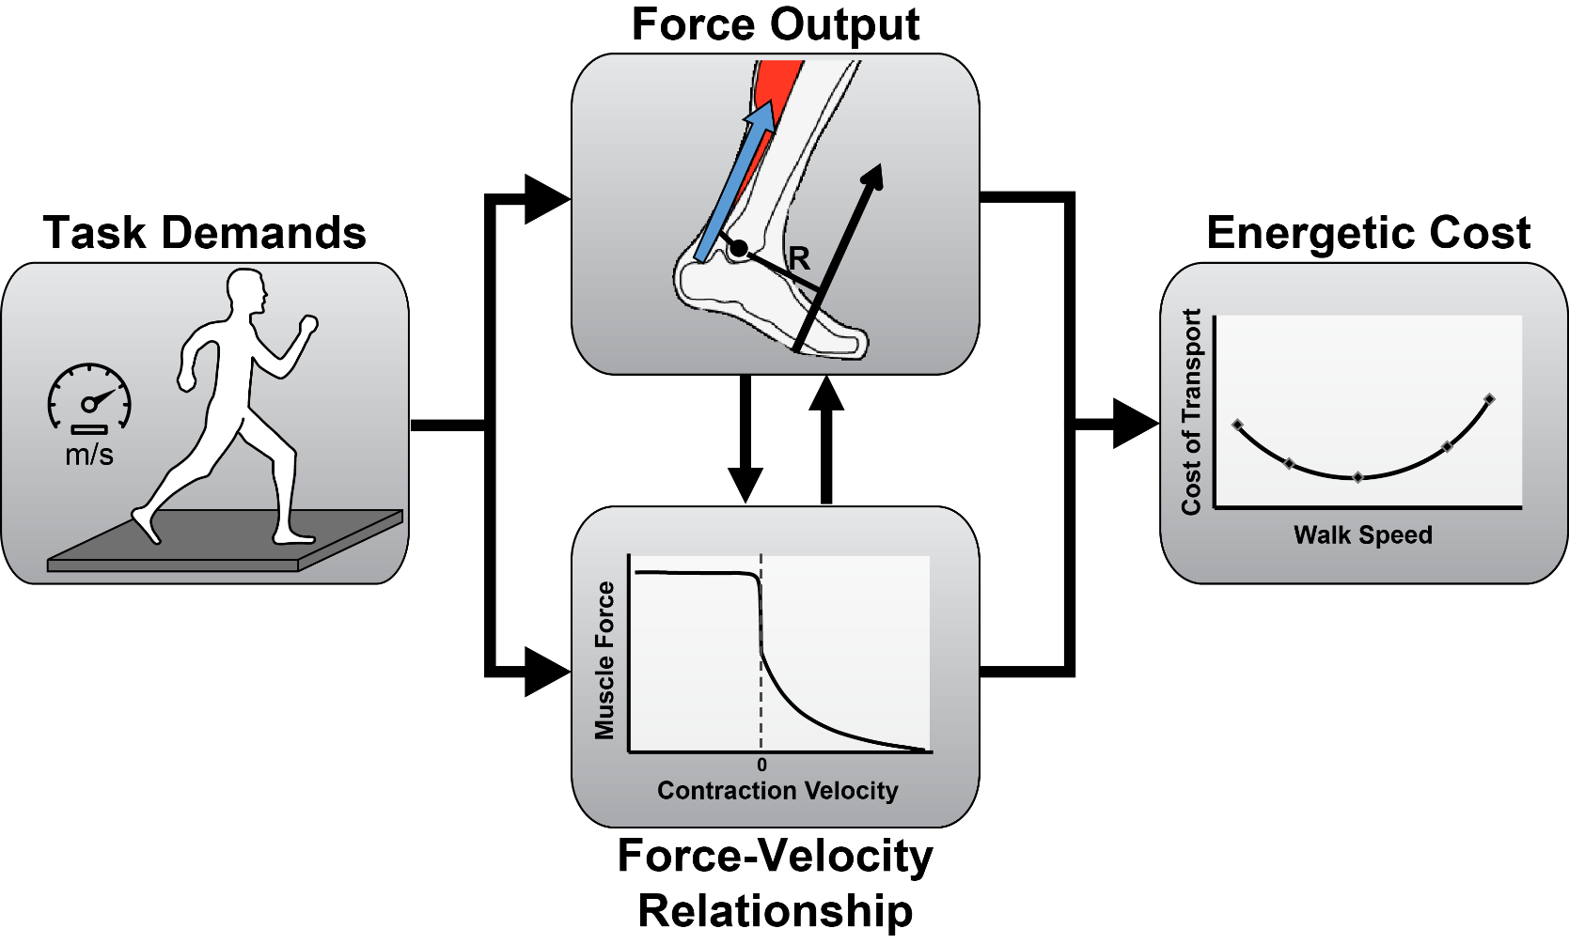
Fast walking is rather inefficient
High force production, fast-shortening muscles produce force inefficiently
Diminishing returns of plantarflexors w/ walk speed^{[1-3]}
[1] Farris DJ & Sawicki GS. Proc Natl Acad Sci 109(3):977-82 (2012) [2] Arnold EM et al. J Exp Biol. 216(11):2150-60 (2013) [3] Neptune RR & Sasaki K. J Exp Biol. 208(5):799-808 (2005)
Notes:
Make sure to specify this is medial gastrocnemius data

Slide 13
Purpose
See if added foot stiffness can be used to reduce metabolic cost of fast walking
Determine the effects of shifting force-velocity operating range on energetics of locomotion

Slide 14
Impact
Model for any condition with impaired muscle mechanics
  Pes Equinus
  Orthotics
Very few studies can reduce metabolic cost of walking
  Increasing efficiency is difficult

Slide 15
Metabolic Cost “Seesaw”
Metabolic increase
↓V_{fasc.}
↑Force
M.C.
Added Stiffness, normal Walking

Slide 16
Central Hypothesis
Metabolic decrease?
↑Force
↓V_{fasc.}
M.C.
Added Stiffness, Fast Walking

Slide 17
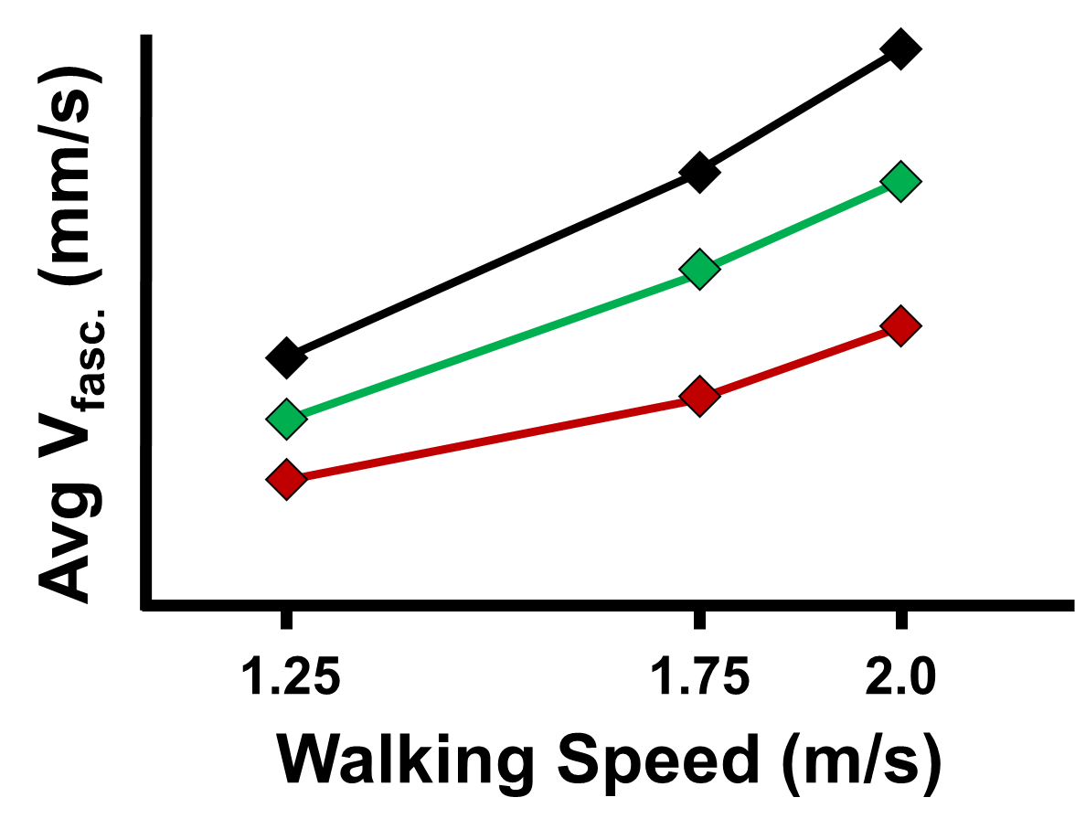
Hypotheses
H1: Across all walking speeds, Soleus fascicle shortening velocity will be reduced (slower) during the added foot stiffness conditions.
+ stiffness
Normal stiffness
Med. stiffness
High stiffness

Slide 18
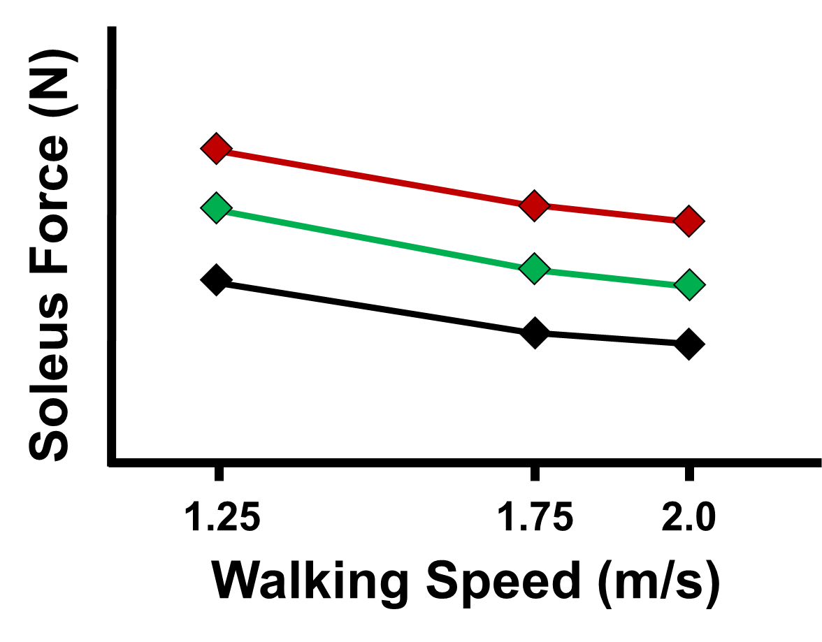
Hypotheses
H2: Across all walking speeds, force output of the Soleus muscle will be increased in added foot stiffness conditions.
+ stiffness
Normal stiffness
Med. stiffness
High stiffness

Slide 19
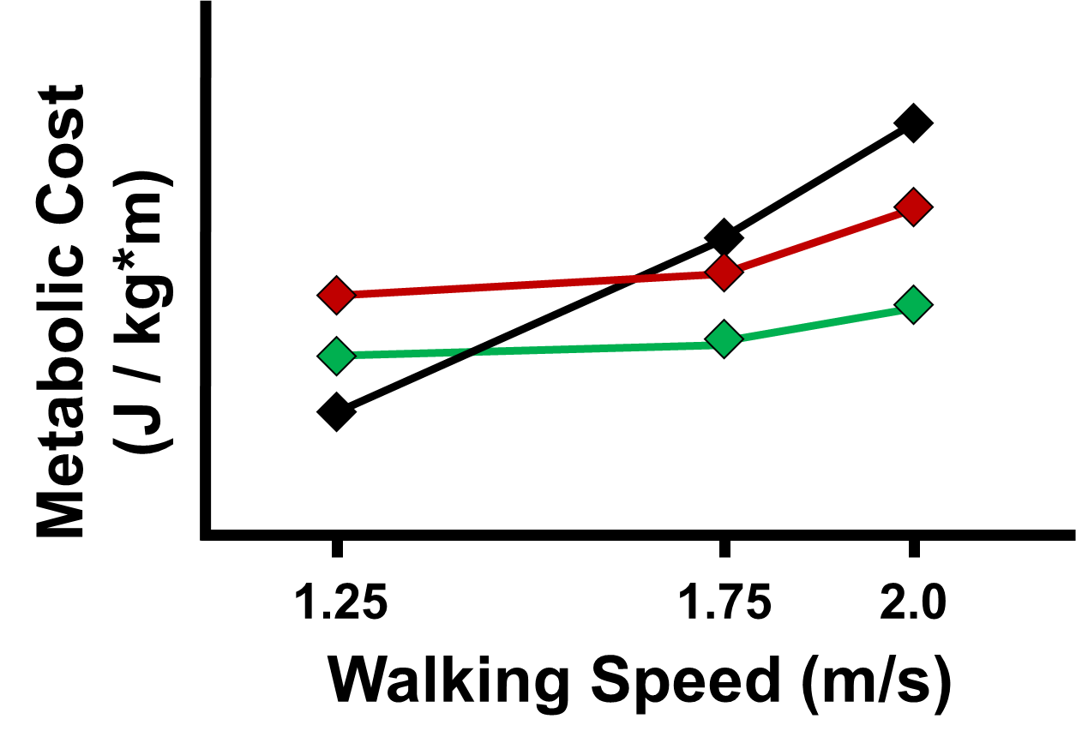
Hypotheses
H3: There will be a fast walking speed where overall metabolic cost will be lower with added foot stiffness than without.
Normal stiffness
Med. stiffness
High stiffness

Slide 20
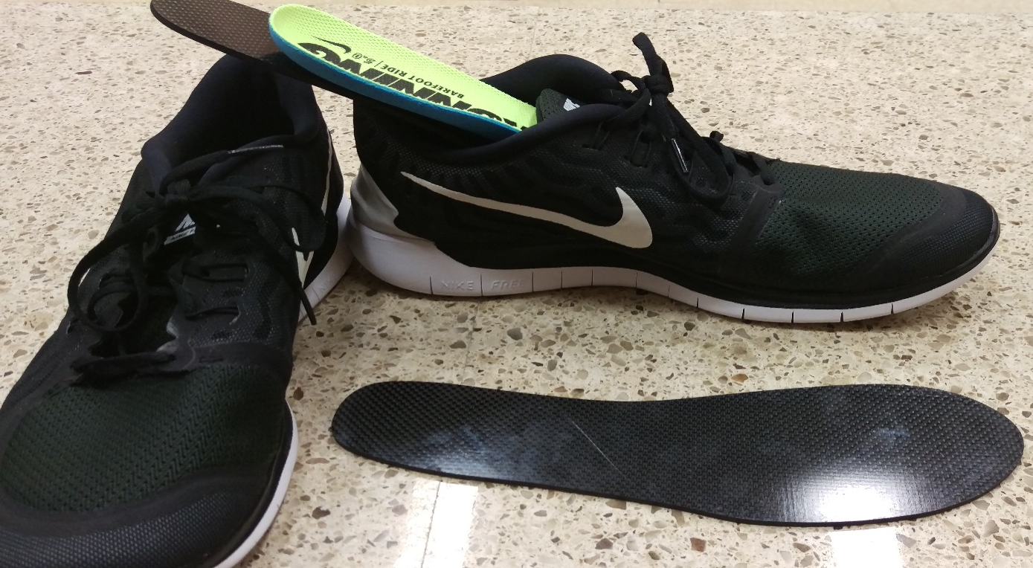
Methods: Subjects and Insoles
20 healthy subjects, 19-35 years old
3 visits to BRB
  Training, Metabolics, Mechanics
9 pairs of carbon fiber insoles
  Women’s EU 37, 38, 39;
  Men’s EU 42, 43, 43.5, 44, 45, 46
  Controlled for added mass

Slide 21
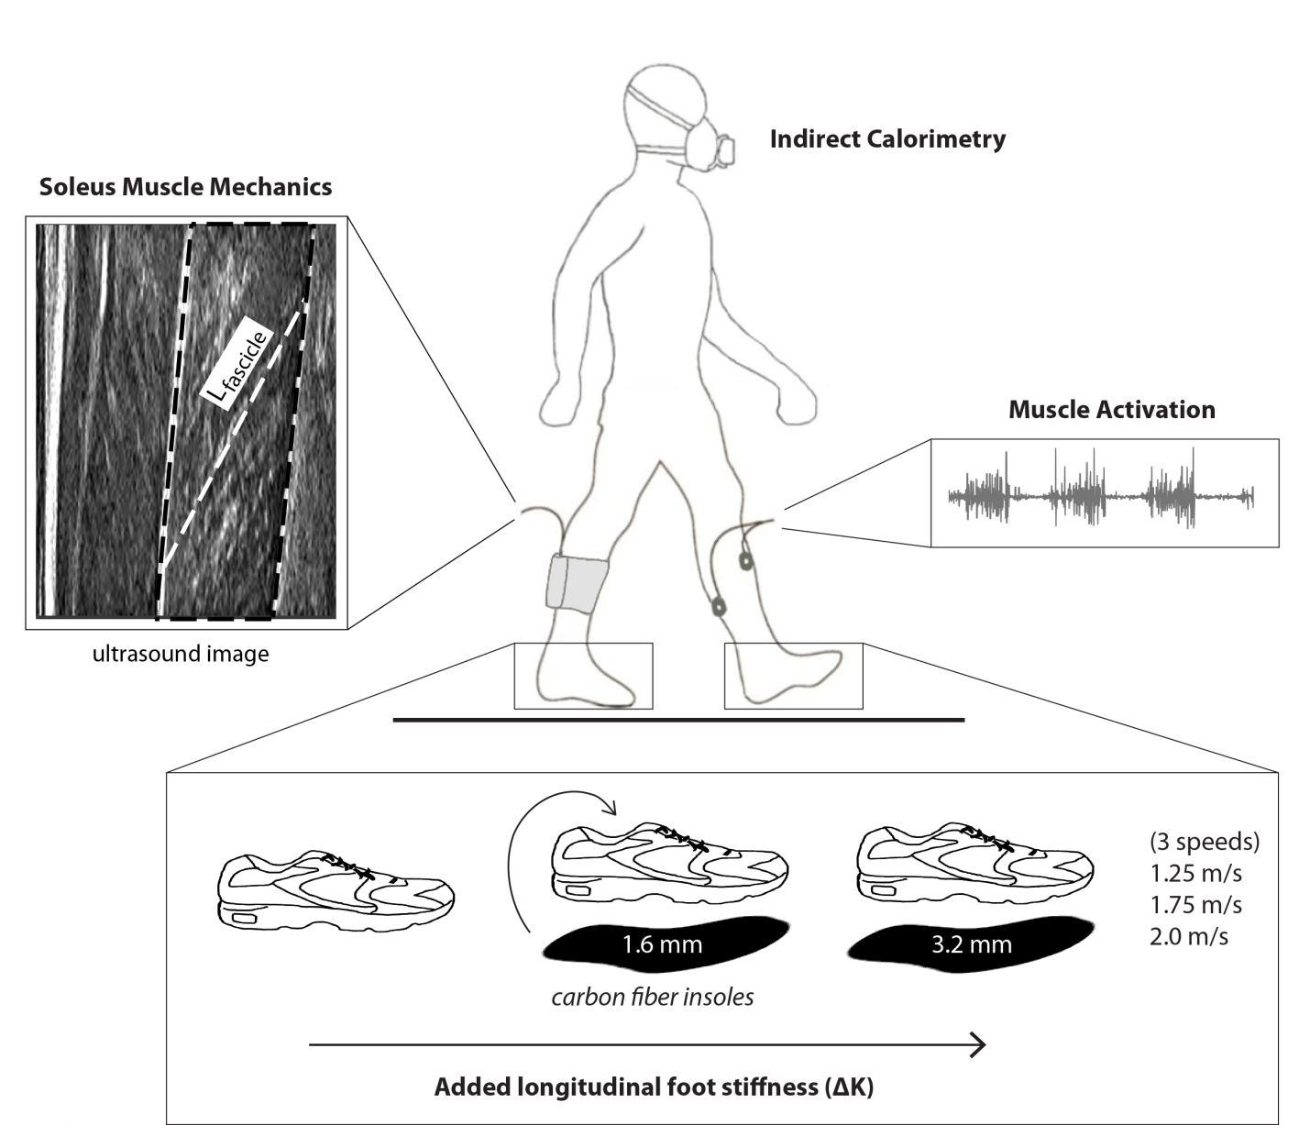
Data to be collected
Metabolics Visit:
  Indirect Calorimetry
Mechanics Visit:
  Ultrasound
  Kinetics
  Kinematics
  EMG (secondary analysis)
Adapted from Takahashi et al., 2016

Slide 22
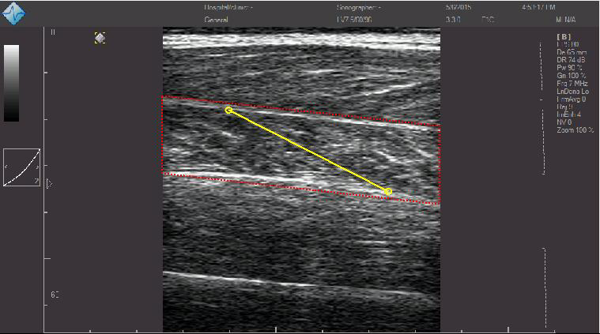
Analysis of ultrasound
UltraTrack MATLAB software
+ manual corrections[1]
Track white fascicle lines
over trial length
Record fascicle length,
pennation angle over time
Notes:
Cite Dom’s 2016 manual on UltraTrack

Slide 23

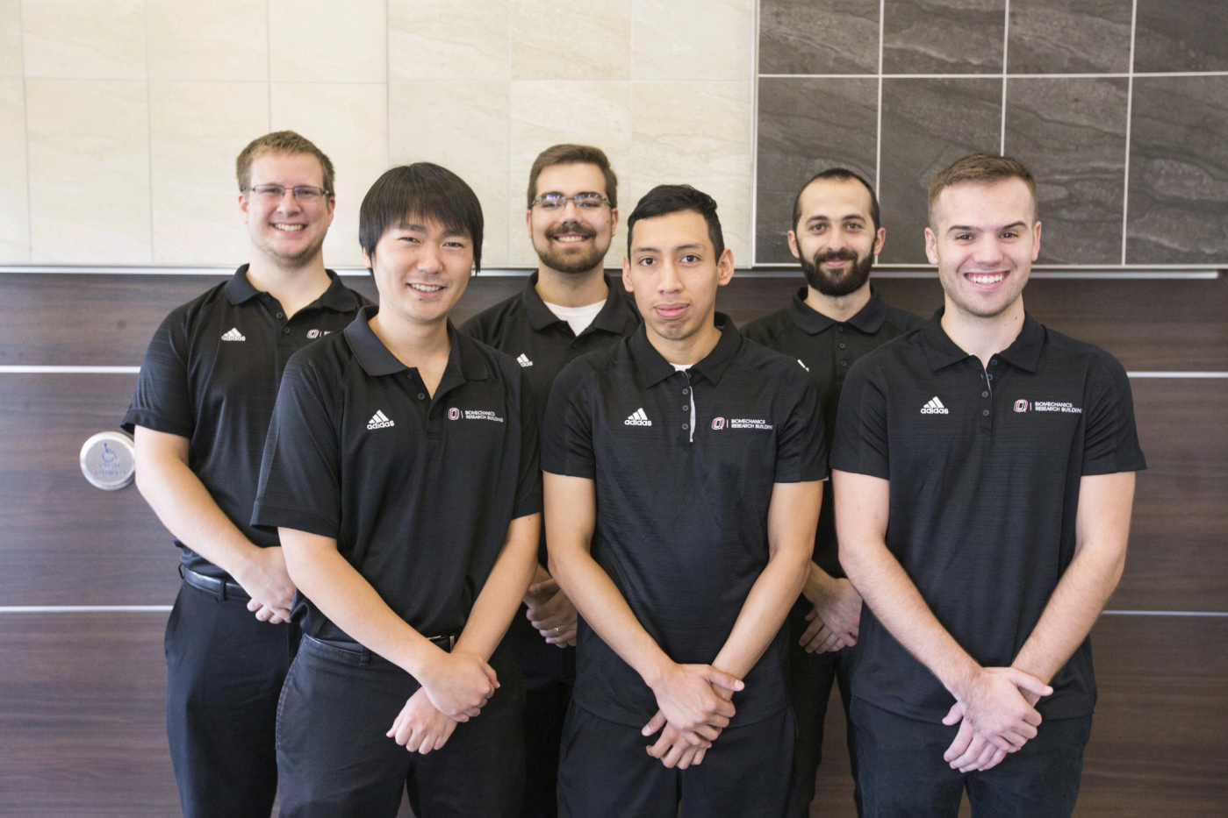



Fin.
Thank you everyone!
Questions?

Slide 24
DON’T USE AFTER THIS SLIDE

Slide 25
Calculation of Soleus force^{[1]}
Ankle Moment
Plantarflexor Force
Soleus Force
Fascicle Force
Divide by
Multiply by
Divide by
AT moment arm
Soleus relative cross-sectional area (0.54)^{[2]}
Cosine of Pennation angle
[1] Farris et al. J Appl Physiol 115(5):579-85 (2013)
[2] Fukunaga T et al. J Orthop Res 10(6):928-34 (1992)
Notes:
We will monitor soleus and gastroc activation, to make sure that the two muscles are activating in parallel and not drastically different from one another (which would invalidate the .54 assumption) and also monitor TA activation

Slide 26
Stats slide
2x3 Repeated measures ANOVA
  Outcome variables Velocity, Force, Metabolic Cost
One-way repeated measures ANOVA at each speed
  Determine which stiffness produces lowest/highest outcome variables

Slide 27
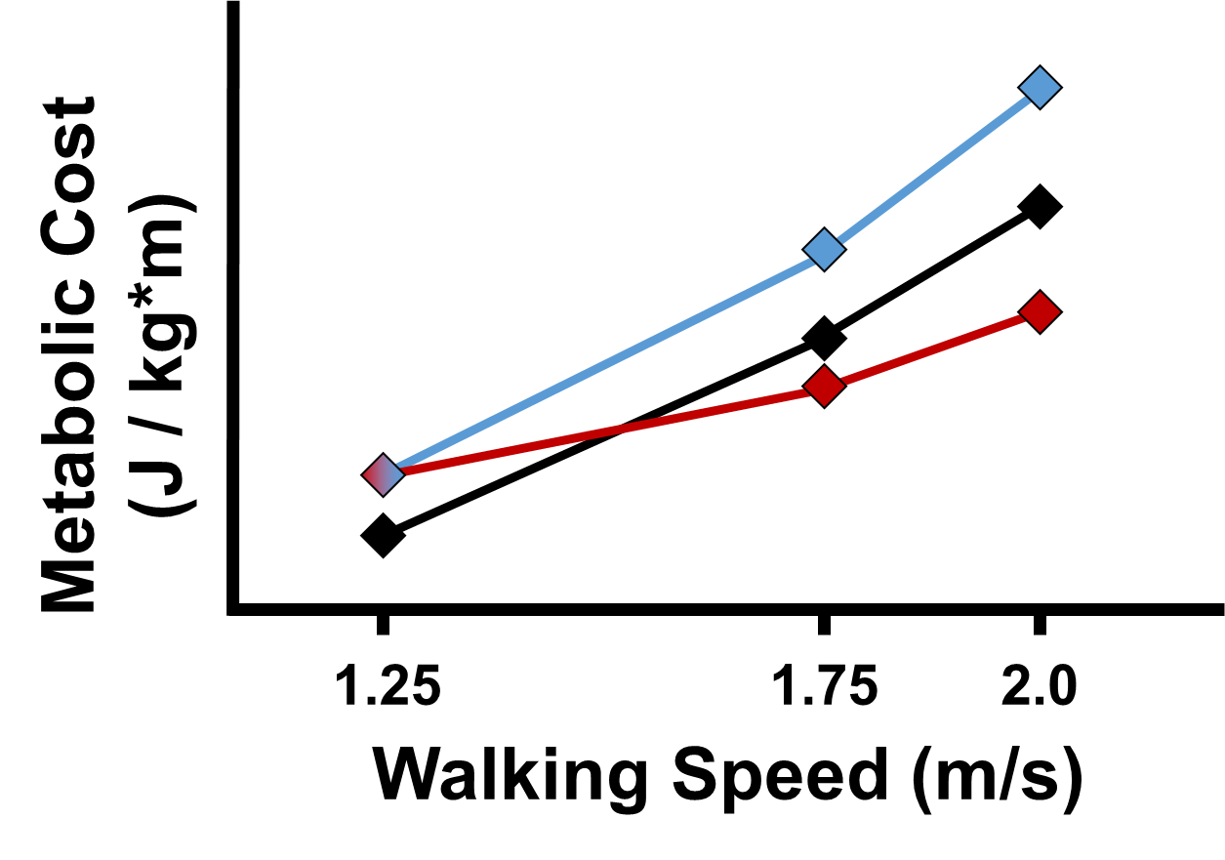
Hypotheses
H3: There will be a fast walking speed where overall metabolic cost will be lower with added foot stiffness than without.
Normal stiffness
Increased stiffness
(H3 supported)
Increased stiffness
(H3 unsupported)

Slide 28
Calculating MCOT
Take quiet standing trial
Metabolic power of trial - standing

Slide 29
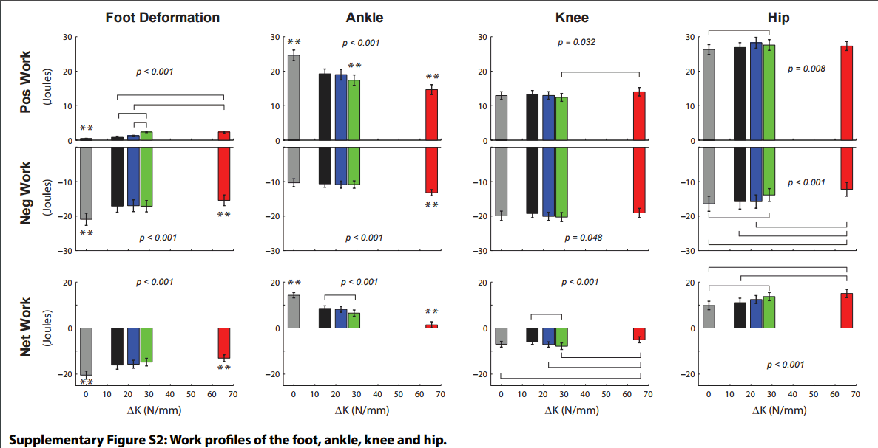
Supplementary: changes in other joints

Slide 30
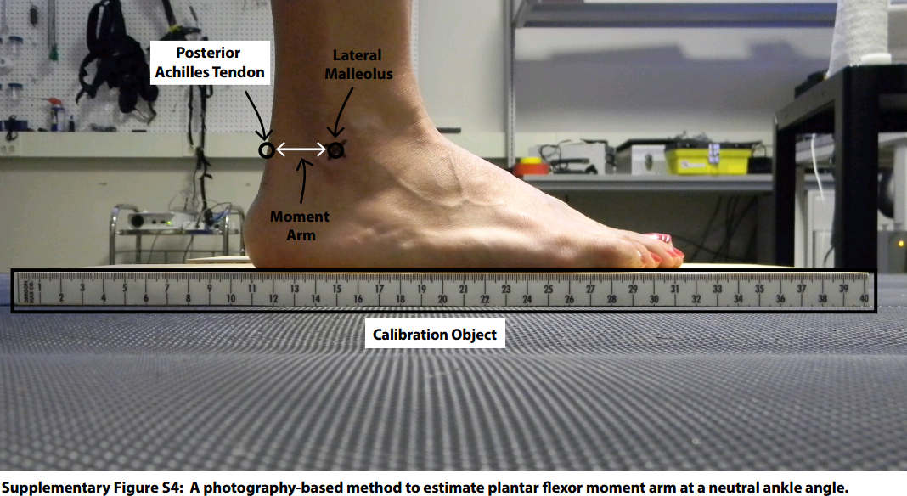
Determining AT moment arm

Slide 31
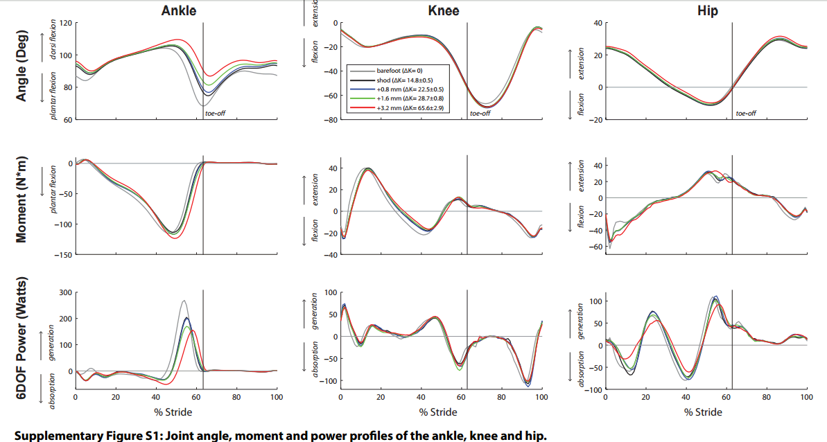
Kinematics

Slide 32
Extra slides: Potential Hypotheses?
Possibly add supplementary data from Takahashi 2016
UD power explanation

Slide 33
Muscle metabolic cost arises from multiple factors
Mechanical work output^{[1]}
Force output^{[2]}
Force-Velocity relationship^{[3]}
Force-Length relationship^{[4]}
Designated by task demands
[1] Farris DJ & Sawicki GS. J R Soc Interface. 9(66):110-8 (2012)
[2] Kram R & Taylor CR. Nature. 346(6281):265-7 (1990)
[3] Hill AV. Proc Roy Soc B 126(843):136-195 (1938)
[4] Hill AV. Proc Roy Soc B 141(902):104-117 (1953)

Slide 34
Metabolic Cost
(J / kg*m)
1.25
1.75
2.0
Walking Speed (m/s)

