Slide 1
Optimizing Campus Mobility with a focus on Sustainability: A Graph Theory Approach to Intra-Campus Transportation Networks
Quinn Nelson, Donald Steffensmeier, Sachin Pawaskar

Slide 2
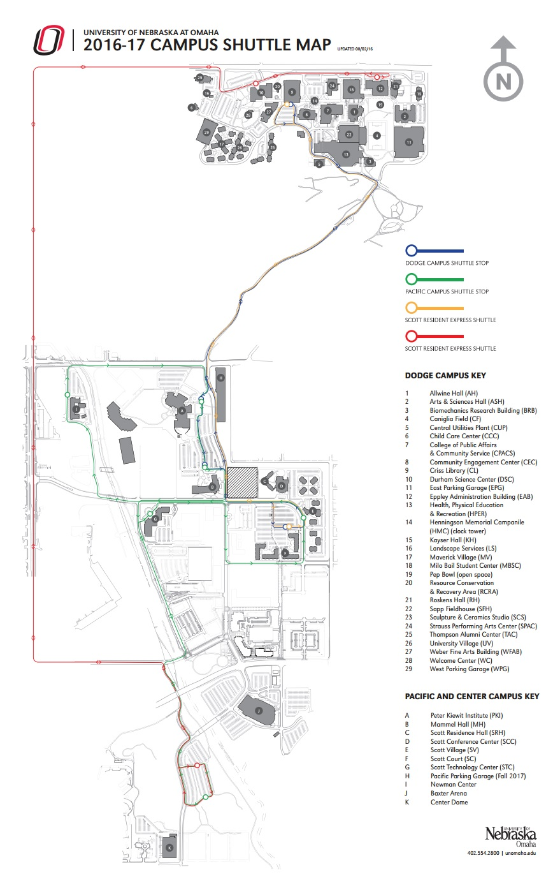
The Problem
Common Tensions related to Public Transportation
UNO’s growing student population 20,000 by 2020
Parking limitations on UNO campus

Slide 3
Problem Definition
UNO campus spans 3 major streets in Omaha: Dodge, Pacific, and Center
Weekday population of 17,702
Intra-campus kinesis is needed daily for class, meals, parking, etc.
Need to optimize intra-campus transportation in environmentally stable way

Slide 4
Proposed Solution
Create an algorithm to model shuttle routes using graph theory.
Uses:
Optimize Shuttle Transport
Alleviate user tension
Decrease carbon footprint of transportation networks

Slide 5
Terminology
Graph = (V,E), V is set of vertices and E is set of edges between vertices.
Weighted Graphs – graphs for which each edge has an associated weight, represented by a weight function w : E -> R.
Adjacency-matrix Representation - of a graph G = (V,E), vertices are numbered in an arbitrary manner composing a matrix of |V| x |V|.

Slide 6
Why Graph Theory?
Solution can be scalable to a high degree: can handle extreme data set or matrix size.
Generic implementation in programming – so similar problems (matrices) can be handled with the same solution.

Slide 7
Proposed Solution
Eliminate one node from Dodge-Pacific Campus shuttle line – optimizing transportation with one less stop.
Node (Bus Stop) will be positioned between PKI and MH
One less stop should result in an optimized shuttle solution

Slide 8
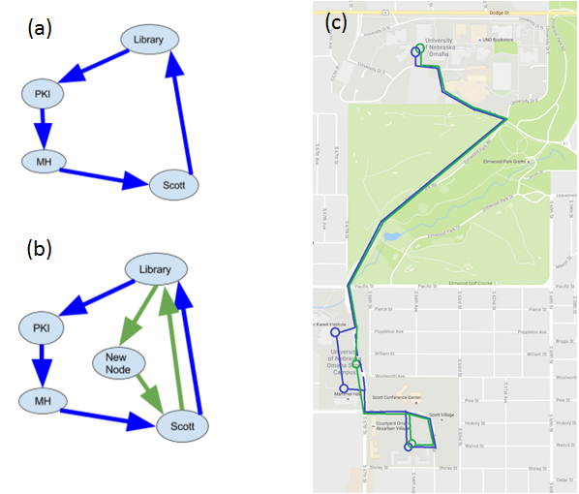
Graph Theory Representation of UNO Shuttle System

Slide 9
Methodology
TestFileGenerator : custom program developed to generate test files containing matrices of data and Boolean penalty constraints for data modeling and simulation.
Test File Format: time stamp, T/F penalty, T/F weather, T/F Elmwood, T/F traffic, number of vertices, start and end vertices, and a matrix of values depicting the edges. Penalties add 60 seconds to overall time.
8:39, true, false, true, true
verts=5
startPT=0, endPT=4
0, 11.58, 0, 11.58, 0
0, 0, 1.72, 0, 0
0, 0, 0, 0, 2.58
0, 0, 0, 0, 2.72
12.68, 0, 0, 0, 0
Example of Test File created

Slide 10
Time Variance Table
Start Node | End Node | Time Variance
Library | PKI | 4-8 mins
PKI | MH | 0.5-2 mins
MH | Scott | 0.5-2.5 mins
Scott | Library | 4-8 mins
Library | New Node | 4-8 mins
New Node | Scott | 0.5-2 mins

Slide 11
Methodology cont.
TestFiles are generated and then read by custom program implementing Graph Theory solution
Written in Java
Dijkstra’s Shortest Path Algorithm
Shortest path, lowest cost, least effort through graph

Slide 12
Psuedocode
Make arrays (dist, parent, shortest path...)
Initialize arrays
Loop through all nodes
Set each node to false in shortest path
Set each node distance to infinity
Set dist of first node to 0 and parent to -1
Loop through all instances
Set min dist var to infinity and index -1
Loop through all nodes
Find min dist and index of next not in path
Add index to shortest path set
Loop through neighbors
Update shortest dist to each
Set parent of each

Slide 13
Implementation and Results
Modeled 257 shuttle runs per day, 5 sets, 1285 total shuttle runs per week
Proposed Solution had 1057 out of 1285 times, resulting in an 90% choice rate rather than 228 out of 1280 choices for the current route, a mere 10% choice rate

Slide 14
Implementation and Results
5 day average, our model depicts an average savings of 1.20 minutes per shuttle run
Savings of 308.4 minutes per day and 1542 minutes per week

Slide 15
Implementation and Results
2 semesters that each run 17 weeks long within a typical university fiscal year, this savings can then be extended to a total of 52,428 minutes (or 873.8 hours) over the duration
Shuttle system runs at half rate during summer
Adds another 10,794 minutes, or 179.9 hours

Slide 16
Implementation and Results
Let’s project that each shuttle costs the university 38 dollars per hour
At this rate, the new shuttle node would save an average of 40,040.6 dollars per year
1053.7 hours * 38 $/hr = $40,040.60

Slide 17
Implementation and Results
Over the course of a year, it can be estimated that the entire shuttle fleet is operating at 25 mph for 75% of the time and sitting idle for the other 25%.
To operate the shuttle at 25 mph for a period of 750.77 extra hours requires 1,681,724.80 grams of CO₂
To let the fleet sit idle for the other 25% of the time requires an extra 259,264.18 grams of CO₂

Slide 18
Conclusions
Graph Theory model of UNO shuttle system shows the following:
Accurate depiction of roughly 15-16 minute shuttle run
Proposed solution containing one less node is more beneficial in terms of cost, time, and CO₂ emissions
Average savings of 40,040.6 dollars per year
1053.7 hours of run time saved
1,940,988.98 grams of CO₂ saved

