Slide 1
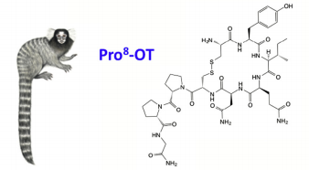
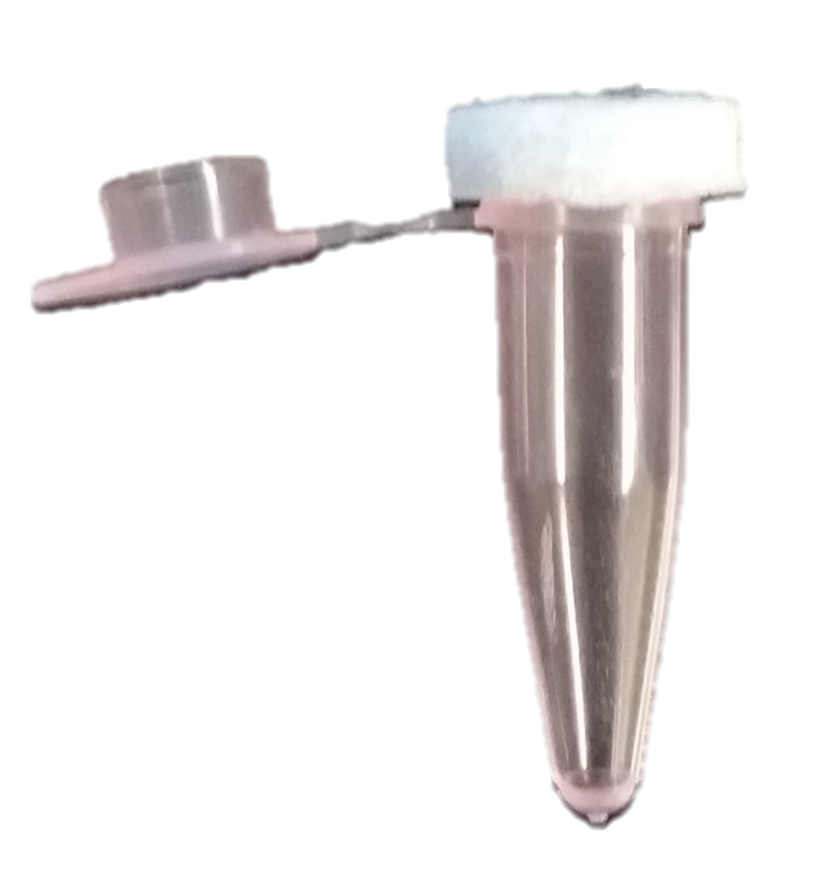
Assessment of olfactory-based social recognition: designing a paradigm for marmosets
Stephanie L. Womack, Jeffrey A. French
University of Nebraska Omaha Callitrichid Research Center
Introduction
Results
Background
Social recognition - ability to recognize, remember, and differentiate individuals¹
Social recognition provides the foundation for social relationships
Olfaction is the dominant sense across most mammals²
Few paradigms exist to assess olfactory performance in non-human primates
Limited to two-choice discrimination task
Goals of design
Assess olfactory-based social recognition in marmosets
Ecological significance
Shape learning via positive and negative reward
Figure 2. Average percentage of tubes opened during first exposure and last exposure to OLFACT. P-value <0.05.
Figure 3. Average percentage of tubes opened by males and females. P-value >0.05.
Design
Habituate
Performance
Olfactory-guided
Food
Aversion
Conditioning
Task
a
b
Effects of oxytocin on the salience of social olfactory stimuli
Figure 4. Correlation between the percentage of tubes opened and (a) latency to approach tree; (b) duration of contact with tree. P-values >0.05.
Methods
Conclusions
Design
Final design based on foraging tree³
Habituate
9 marmosets
Performance
Video recorded
Ability to add food aversion⁴
4 M, 5 F
Video recorded
Tubes only
Tree alone
Tubes in tree
Interacted with:
Assessed time spent on tree, # tubes opened, attempts to open (duration, latency, counts)
Given until completion or 30 minutes
Analyzed males vs females (fig 3), age (np), improvement (fig 2), and correlations (fig 4)
0.1mL simple syrup in each tube
Covered with felt pad
Improvement seen between first and most recent trials
88.9% of monkeys tested have mastered task (8 of 9)
No difference in learning between male and females
Addition of urine cue and positive punishment as next phase
Acknowledgements & References
Thanks to: Tyler Boverhuis and Indigo Carroll for their assistance in this study; Ryan Gunning for video scoring; Heather Jensen for her invaluable care of the animals; Aaryn Mustoe for feedback and support throughout the project.
Grant support: Provided in part by NIH HD089147 awarded to Jeffrey French and intramural support by UNO GRACA.
Ferguson, J. N., Young, L. J., & Insel, T. R. (2002). The Neuroendocrine Basis of Social Recognition. Frontiers in Neuroendocrinology, 23(2), 200–224. https://doi.org/10.1006/frne.2002.0229
Wyatt, T. D. (2014). Pheromones and Animal Behavior: Chemical Signals and Signatures. Pheromones and Animal Behavior: Chemical Signals and Signatures. https://doi.org/10.1017/CBO9781139030748
Hudson, R., Laska, M., & Ploog, D. (1992). A New Method for Testing Perceptual and Learning Capacities in Unrestrained Small Primates.pdf. Folia Primatologica, 59(1), 56–60.
Laska, M., & Metzker, K. (1998). Food Avoidance Learning in Squirrel Monkeys and Common Marmosets. Learning & Memory, 5(3), 193–203. https://doi.org/10.1101/lm.5.3.193
Figure 1. OLFACT tube. PCR tube (0.2mL) with adhesive felt cover.

