Slide 1
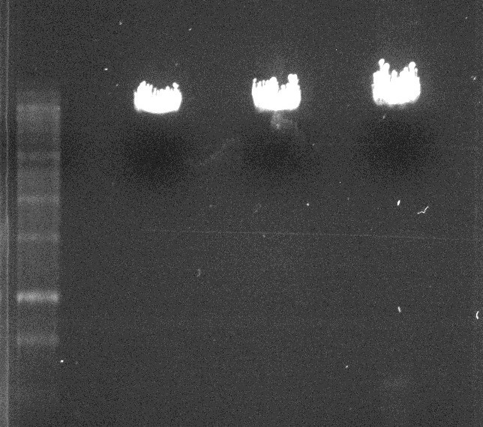
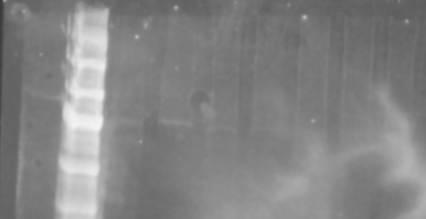
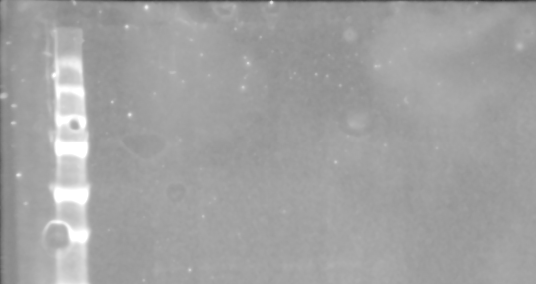
Characterization of the Mannose-6-Phosphate/Insulin-like Growth Factor II Receptor Using 1-3MH
Authors: Zechariah Craig and Dr. Jodi Kreiling
University of Nebraska at Omaha, Department of Chemistry, Omaha, NE
Abstract
Methods
Results Cont.
The mannose-6-phosphate/insulin-like growth factor 2 receptor (M6P/IGF2R), a recombinant triplet protein receptor for studies involving receptor dimerization, plays a pivotal role in mediating cellular growth. This receptor is comprised of fifteen similar units that fold into five triplet subunits. The goal of this experiment is to investigate how to make the 1-3MH protein more stable at the DNA level and generate a larger yield from DNA extractions for more effective transfections. This was accomplished by minorly changing the protocols for the DNA purification. Instead of using a standard column DNA purification kit, a crude DNA purification was done instead. This increased the DNA yield from less than 1 μg/μL to approximately 4-5 μg/μL. Western blot analysis ultimately showed that the increase in DNA concentration prior to transfection did not improve the expression of protein.
DNA Purification
A flask of LB-amp was inoculated with E. coli. cells containing 1-3MH plasmid and was agitated overnight at 250 RPM at 37 °C . The DNA was purified using two different protocols. The first method purified the DNA from the bacterial cells using the Qiagen Maxi Prep purification kit according to the manufacturer's protocol. The second protocol purified the DNA from bacterial cells using a crude prep purification, or purification without the use of a column. A restriction enzyme digest using EcoRI was prepared to linearize the DNA. The samples were run on a 1% (w/v) agarose gel. An image was then acquired.
Transfection
A 20 μg per 100 mm dish concentration of each DNA dimer pair was prepared. The DNA was then transfected into HEK 293 mammalian cells using a standard calcium phosphate transfection protocol. The cells were then incubated at 37 °C for 72 hours. The cells were then lysed following a standard lysing protocol.
Western Blot
All lysates were run on a SDS-PAGE gel and transferred to a nitrocellulose membrane. The membranes were then washed with a LiCor Blocking Buffer and incubated in a primary antibody wash with either anti-His and anti-Flag antibodies. The membranes were then washed in a fluorescent secondary antibody. Images were taken using a fluorescent detecting Odyssey instrument.
Figure 1 shows that the DNA purification for Colony of each sample was successful. There appears to be little differences in the intensities of the bands but, this is likely due to samples being overloaded. Figure 2 shows the results of the Western blots with both the anti-Flag antibody and the anti-His antibody. From these images, we can determine that the transfection of bacterial DNA containing the 1-3MH construct with the various other triplets into the HEK 293 mammalian cells was not successful. Faint bands can be seen in each lane of Myc-His western blot indicating that each sample may have a MH tag being expressed in the cells. However, these bands are so faint that they are most likely noise. Also, there were no bands in any of the FLAG samples representing little to no expression of the FLAG tagged protein.
Results
Introduction
Figure 1
Results from the restriction enzyme digest using EcoRI. Samples were run on a 1% (w/v) agarose gel at 150V. Lane 1 contains the standard kB ladder. Lane 2,4, 6 and 8 are blank lanes. Lane 3 contains DNA purified using a standard Qiagen kit with a yield of 0.9 μg/μL. Lane 5 contains DNA purified using a standard Qiagen kit with a yield of approximately 3.0 μg/μL. Lane 7 contains DNA from the crude DNA preparation technique with a concentration of 5.0 μg/μL. From this figure, we can determine that there is a difference in the concentration; however, the DNA appears to overloaded.
0.9 μg/μL
3.0 μg/μL
5.0 μg/μL
Conclusions
The mannose-6-phosphate/insulin like growth factor 2 receptor (M6P/IGF2R) is a receptor that plays a pivotal role in mediating cellular growth, lysosomal activation, and tumor suppression. This receptor binds proteins that contain mannose-6-phosphate (M6P) as well as insulin like growth factor 2 (IGF2). The M6P/IGF2 receptor is made up of fifteen different binding domains that are responsible for most of the binding functions in the receptor. Structural studies have shown that these fifteen domains likely form triplet subdomains. We have shown that each triplet can form a dimer with another triplet. However, depending on which two triplets are interacting, you will have different strengths of association. We have synthesized all of these triplet domains with the FLAG (F) tag added for purification and isolation purposes. To be able to study the triplets’ association for each other, we needed to have a separate tag to tell the two molecules apart in their dimerized form. For this, we generated the Myc-Histidine (MH) tag. However, The 1-3MH protein tagged triplet was flawed. The problem seems to be at a DNA level, and the transfected mammalian cells only express a small amount of protein for a brief amount of time. The aim of this project is to investigate how to make the 1-3MH protein more stable at the DNA level and generate a larger yield. This in turn may lead to a transfection with more abundant protein expression.
The goal of this experiment was to produce a functional 1-3MH construct that could be used for effective transfections. The changes into the DNA purification protocol led to a large increase in the average concentration and volume of the DNA yield. These results however did not have an impact of the quality of transfections. The proteins did not express any better than previous experiments. To maybe use a higher mass of DNA per dish with the transfection or explore other transfection protocols.
CMV5
1-3F
4-6F
7-9F
10-12F
13-15F
Figure 2
Results of the anti-His Western blot analysis of the crude DNA purification. All samples were run on an SDS-PAGE gel and transferred to a nitrocellulose membrane. The membranes were then blocked, incubated in primary anti-His or anti-FLAG antibodied. The samples were then washed and exposed to secondary antibodies. An image was then acquired using and Odyssey Fc Imager. Lane 1 contains the molecular weight protein standards. Lane 3 and 9-12 contain blank samples. Lane 2 contains the standard 1-3MH/PCMVF DNA construct. Lanes 4-8 contain the different triplet dimers 1-3MH/1-3F,1-3MH/4-6F,1-3MH/7-9F,1-3MH/10-12F and 1-3MH/13-15F respectively. The anti-His image shows very faint bands; however, this has been determined to most likely be noise. The anti-FLAG image shows no bands at all. These results indicate that the transfection using the crude DNA preparation was unsuccessful.
References
(1) Byrd, J. C., and MacDonald, R. G. (2000) Mechanisms for high affinity mannose 6‐ phosphate ligand binding to the insulin‐like growth factor II/mannose 6‐phosphate receptor. J Biol Chem 275, 18638‐46.
(2) Byrd, J. C., Park, J. H., Schaffer, B. S., Garmroudi, F., and MacDonald, R. G. (2000) Dimerization of the insulin‐like growth factor II/mannose 6‐phosphate receptor. J Biol Chem 275, 18647‐56.
(3) Hartman, M. A., Kreiling, J. L., Byrd, J. C., and MacDonald, R. G. (2009) High‐affinity ligand binding by wild‐type/mutant heteromeric complexes of the mannose 6‐ phosphate/insulin‐like growth factor II receptor. Febs J 276, 1915‐29.
(4) York, S. J., Arneson, L. S., Gregory, W. T., Dahms, N. M., and Kornfeld, S. (1999) The rate of internalization of the mannose 6‐phosphate/insulin‐like growth factor II receptor is enhanced by multivalent ligand binding. J Biol Chem 274, 1164‐71.
(5) Brown, J., Delaine, C., Zaccheo, O. J., Siebold, C., Gilbert, R. J., van Boxel, G., Denley, A., Wallace, J. C., Hassan, A. B., Forbes, B. E., and Jones, E. Y. (2008) Structure and functional analysis of the IGF‐II/IGF2R interaction. Embo J 27, 265‐76.
(6) Brown, J., Esnouf, R. M., Jones, M. A., Linnell, J., Harlos, K., Hassan, A. B., and Jones, E. Y. (2002) Structure of a functional IGF2R fragment determined from the anomalous scattering of sulfur. Embo J 21, 1054‐62.
(7) Olson, L. J., Zhang, J., Dahms, N. M., and Kim, J. J. (2002) Twists and turns of the cation‐dependent mannose 6‐phosphate receptor. Ligand‐bound versus ligand‐free receptor. J Biol Chem 277, 10156‐61.
Anti-His
Anti-FLAG

