Slide 1
Contemporary Flute Music by Argentine Composers
Presenter: Erica Nightengale Faculty Advisor: Dr. Christine Beard

Slide 2
Abstract
Aside from Alberto Ginastera and Astor Piazzolla there are very few known composers from Argentina. Both Ginastera and Piazzolla have written well-known pieces for flute; however, the known flute repertoire from Argentina is small in comparison to other countries. This is due to a number of factors including the high cost of publication in Argentina; because of this composers aren’t able to circulate their works. Pieces are discovered by word of mouth and rarely make it outside of the country. This research aims to collect and expose contemporary flute works by Argentine composers. The works collected represent a variety of different styles while still representing the current compositional trends in Argentina.

Slide 3
Project Overview
Project Purpose
Inspiration
Attend World Flutes Festival in Mendoza, Argentina
UNO GRACA
Discover and catalogue flute music by living Argentine composers
Visit from Valentina Galaz and Paulo Muñoz
Noh

Slide 4
Types of Music Collected
Non-dance
Dance
Chamber, Flute & Piano, Solo Flute
Avestruz
Ensayo No. 2
Vientos de Plata
Tangoes, milongas, chacarera
Chamber, Flute & Piano
Compañia
La Chancha
Milonga Camarga

Slide 5
Ensayo No. 2 for Solo Flute
Composer Information
Composer: Octavio Cerùsico
Born in 1993
Studies composition at the National University of Cuyo in Mendoza, Argentina
Currently working on an essay for solo piccolo

Slide 6
Ensayo No. 2 for Solo Flute
Piece Information
Composed in 2015
Experiment with the concept of “campos ritmicos” (rhythmic configurations)
Extended techniques

Slide 7
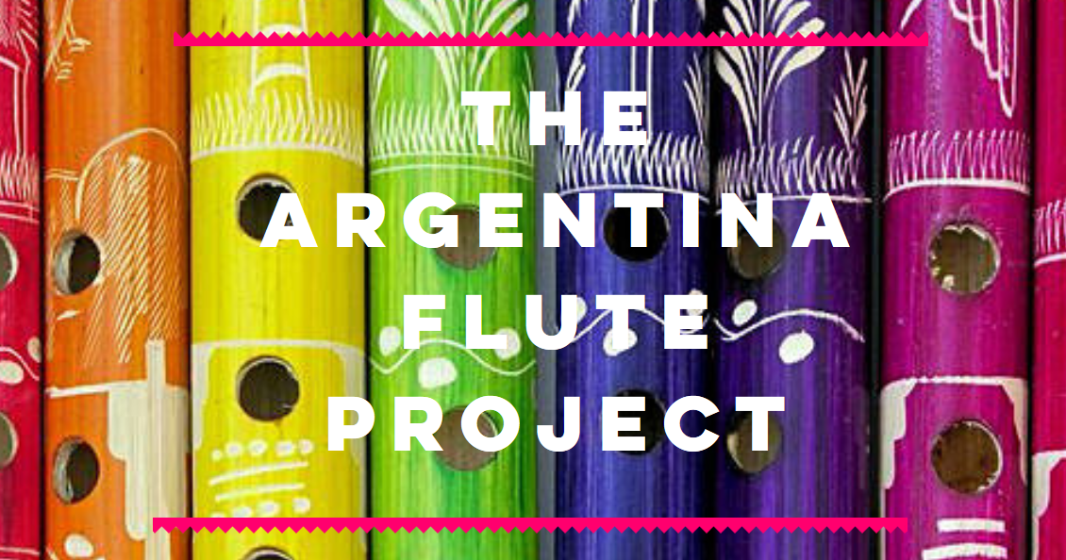
www.argentinafluteproject.com

