Slide 1
A Hierarchical Learning Model for Extracting Public Health Data from Social Media
Elham Rastegari
University of Nebraska at Omaha
College of IS&T

Slide 2

Background and Motivation
Decision making and importance of each piece of information
Healthcare
Lack of consensus between healthcare specialists
Lack of knowledge among individuals
Treatments that need precious resources (e.g., money and time)

Slide 3

Research Questions
Can we identify mostly taken treatments by Twiiter users associated with a specific disease?
How to extract people’s opinions regarding various treatments for a specific disease?
What is the role of professional parties in public health communications inside Twitter network

Slide 4
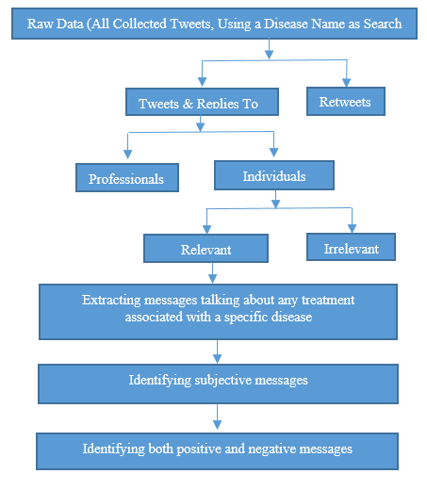
Hierarchical Learning Model

Slide 5




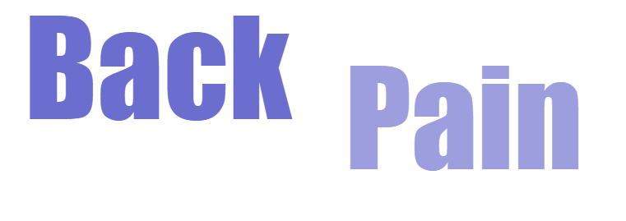

Data Collection

Slide 6
Data Pre-Processing
HAPPY → happy
@Eli → USERNAME
http://www.health.com/fitness/prevent-back-pain → URL
Happpppppy → happy
I’ll → I will
Tokenization
N-grams
LIWC
Not good → Notgood

Slide 7
Individuals vs Professionals and Relevance of Messages
Supervised learning technique (linear logistic classifier)
sigF_{1,2} = (NF₁ – NF₂) / (NF₁ + NF₂)
  Usernames, emotion category, word count, personal pronoun, netspeak and informal
cross fold validation technique → Accuracy:90.5 %
Individual category → 2908
“I wish we could get back together. I am in pain”
Supervised learning technique (SVM)
LIWC features → no difference
Using unigrams and bigrams → Accuracy → 87%
related messages posted by individuals → 1882

Slide 8
Finding Disease-Specific Treatment (Back Pain)
Treatments | Search words and phrases
Physical therapy | Physical therapy
Chiropractic therapy | Chiropractic
Exercise/yoga | Exercise, exercises, stretches, stretching, stretch, walking, walk, swimming, work out , yoga
Massage therapy | Massage
Drugs (eg, gabapentin) | Anti-inflammatory drug, pain killers, pain meds, anti-inflammatory drug, anti-inflammatory drugs, advil, gabapentin, hydrocodone, flexeril, ibuprofen, acetaminophen, cyclobenzaprine, tramadol, muscle relaxer, hydrocodone-acetaminophen, oxycodone
Heat/ cold therapy | Heat, heat pack, heat pad, heat therapy, heating pad Ice, ice pad, ice pack, ice therapy, cold pad, cold pack, cold

Slide 9
What is the role of Professionals in Public Health Communications in Twitter Network
Prevention-related messages were remove
“Prevent back pain”, “preventing back pain”, “avoid back pain”
72 % of messages posted by professionals were related to the treatments
Only 28% of messages posted by professionals were related to Prevention

Slide 10
Number of treatment-related messages posted by individuals

Slide 11
A Comparison between our Results and PatientsLikeMe Website Data

Slide 12
A Comparison between our Results and PatientsLikeMe Website Data

Slide 13
Subjective vs Neutral messages
Supervised learning
  Subjective messages → more adverb and adjective, more comparing words, less personal pronoun
  Unigrams (presence of verbs such as heal, recover, increase, decrease, ease)
  Bigrams (“back pain is killing me! Need help! Going to physical therapy”)
  Exclude the name of treatments (increasing accuracy)
Non-binary features were scaled to [0 1]
SVM → 201 subjective messages

Slide 14
Mining User’s Opinion Regarding Treatments less effective vs more effective
No trade off between false positive and false negative
Keep high precision and recall by consistently optimizing the area under the ROC curve
We had only 200 messages and it was easy to identify positive vs negative
Corpus of 80 tweets labeled by three reviewers
C_{Pos}
Corpus of 2000 tweets extracted using positive and negative emoticons
Top 15% predicted by C_{Pos}
Corpus of Positive Tweets
Final Corpus
Bottom 15% predicted by C_{Neg}
Corpus of Negative Tweets
C_{Neg}
C_{Final}

Slide 15
Example of positive and negative features found from our classifier
Positive Features | Negative Features
Feeling better | Notprovide reliefe
Relief | Notfeeling better
Can help | Nothelful
Alleviate | Nothelp
Ease | Noteffective
Relieve | Notgood
effective | ineffective
Eliminated | Increased pain
Increase strength | Feel Worst

Slide 16
Examples of Neutral, Positive, and Negative Tweets about Treatments
Neutral | Positive (more effective) | Negative (less effective)
This back pain is super freaking me out. Picking up the muscle relaxer tomorrow and setting up appointment with my chiropractor Saturday X. | Watch this! exercises that made me feel better | I thought getting a massage would help me with my back pain but it only made it 10x worse
Back pain is killing me. Gonna make an appointment with a chiropractor ☹ | Absolutely loving this back brace that relieves my back pain! | Chiropractor made me feel sever back pain again
good morning! Back pain is back! Going to get a massage. Does it help? | For low back pain, stretching your hamstrings twice daily can help relieve your pain. | Opioids do not provide relief compared to natural method

Slide 17
Number of Neutral, Positive, and Negative Sentiments Posted about Each Treatment
Treatment | Neutral | Positive (more effective) | Negative (less effective)
Yoga | 85 | 30 | 6
Massage | 40 | 27 | 11
Exercise/stretching | 41 | 32 | 9
Physical Therapy | 26 | 21 | 5
Chiropractic | 27 | 20 | 6
Drugs | 23 | 18 | 0
Surgery | 5 | 2 | 1
Acupuncture | 2 | 3 | 3
Spinal Injection | 6 | 0 | 0
Heat/ cold pad | 5 | 4 | 3
Opioids | 0 | 0 | 2
Osteopathy | 4 | 2 | 0
Back brace | 6 | 0 | 0

Slide 18
Conclusion
This Model is not limited to our case study
Social Media is a good supplementary source of information
Professionals post less messages about preventive approaches rather than treatment approaches
It is somehow possible to find the mostly taken disease-specific treatments by people
A sentiment analysis of the treatment-associated messages can reveal useful information for both physicians and patients

Slide 19


Slide 20
LIWC
Applying LIWC (Language Inquiry and Word Count)
  personal concerns process (e.g., leisure, money, home and work)
  Psychological process (e.g., affective process, and cognitive process)
  Spoken process (e.g., assent, non-fluencies and fillers)
  Linguistic process (e.g., word count, pronouns, and numbers)

