Slide 1
On Utilizing Big Data to Assess Health Levels and Diagnose Diseases in the Early Stages
Elham Rastegari
University of Nebraska at Omaha

Slide 2
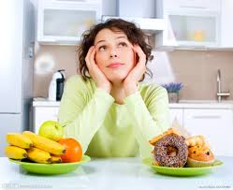
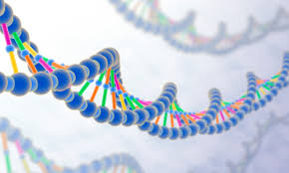
Motivation

Slide 3
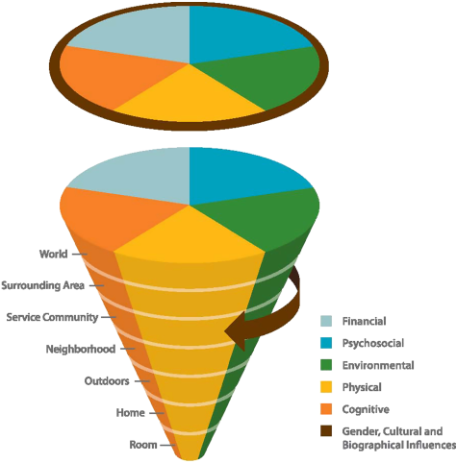
Health and Mobility
Mobility → the ability to move oneself
Health→ "a state of complete physical, mental, and social well-being.“ WHO

Slide 4
Big Data Problem? Need Population Analysis?
Big volume of data
Variety of data
Velocity of data
Health of an individual can be assessed based on population
Assessing health based on common symptoms in a specific population
Blood pressure!

Slide 5
Health ←→ Physical Activity
High granularity
Mental health (e.g., Depression) ← ? → less activity
Physical Health (e.g., PD) ← ? → less activity
Aging ← ? → less activity
Lower granularity
Aging → higher step time
PD →higher stride-to-stride fluctuation
MS → less power generation at joints

Slide 6
Towards Better Health
Activity classification (sedentary and active times)
Suddenly increase (in rehab period)or decrease in the physical activity level → danger
making interventions.
A uniform measure such as EE
monitoring patients’ condition remotely and continuously.
Monitoring the impact of treatments and medication on specific population
early stages diagnosis of disease by analyzing gait patterns.
predicting some health issues

Slide 7
Research Focus
Data analytics
Machine learning
Correlation networks
Prediction
Population analysis
Data Integration
Unrestricted environments

Slide 8
Differentiating between Healthy and Unhealthy Individuals First Step Towards Diagnosis in Early Stages and Prediction
Groups with movement disorders
Identifying discriminating features
Gait features
Age
Gender
BMI
Genetic background
Classification
machine learning techniques
Issues Causing Movement Disorders
Parkinson’s Disease
Geriatrics
Multiple Sclerosis
Amyotrophic Lateral Sclerosis
Alzheimer's
Cerebral palsy
Stroke

Slide 9
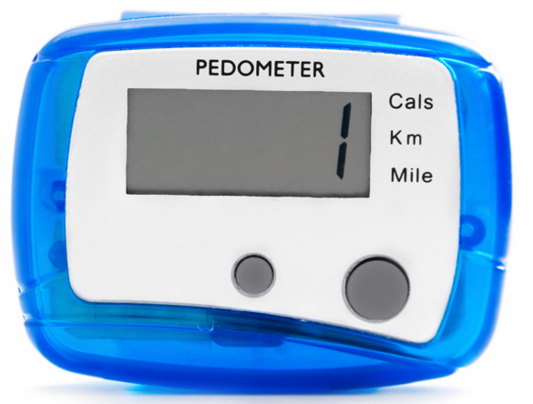
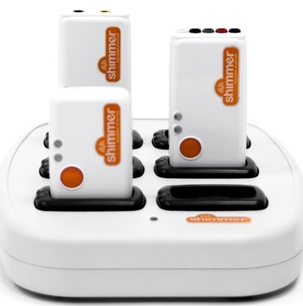
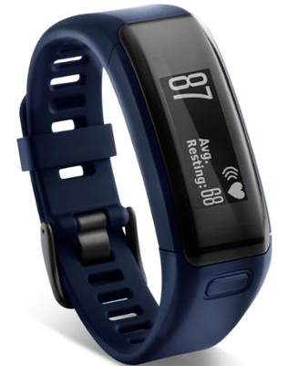
wearable monitoring devices
Six main categories of wearable monitors:
Pedometer
Load transducer/foot-contact monitors
accelerometers
HR monitors
Combined accelerometer and HR monitors
Multiple sensor system
Using one of these wearable devices or a combination of them depends on the purpose of research

Slide 10
Data Set and Pan Tompkins Algorithm
 | Control |  | Parkinson Patients |  | Geriatric Patients
Test | 40 m | free walk | 40 m | free walk | 40 m | free walk
Subjects | 10 | 5 | 10 | 5 | 10 | 5
Gender | 5:5 | 3:2 | 5:5 | 3:2 | 4:6 | 2:3
Age | 64 | 64 | 63 | 72 | 81 | 80
Data | Acc & Gyro |  | Acc & Gyro |  | Acc & Gyro
Strides | 485 1286 |  | 496 1619 |  | 795 1249
Low-pass Filter
Differentiator
Squaring
Moving Window Integration
Peak Search

Slide 11
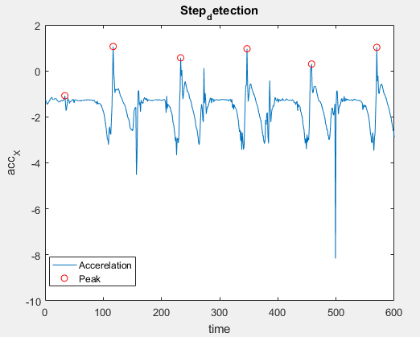
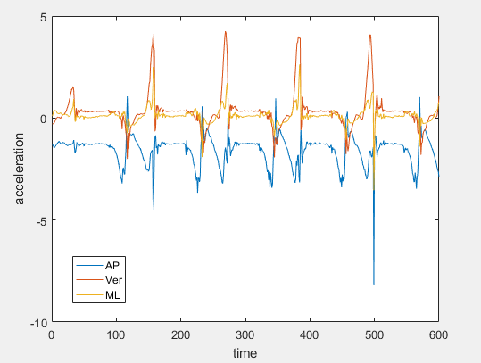
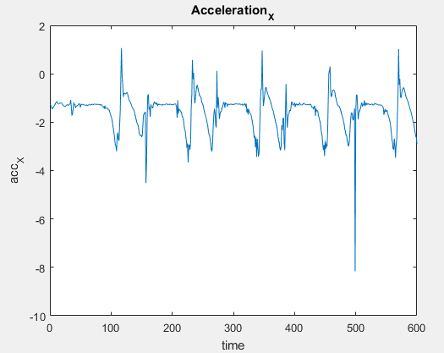
Step Detection

Slide 12
Features
Feature ID | Feature Name | Descriptions
1 | Step Time | Average step time
2 | Cadence | Number of steps per min
3 | RMS_{Ver} | RMS in the vertical direction
4 | RMS_{ML} | RMS in the ML direction
5 | RMS_{AP} | RMS in the AP direction
6 | Sym_{ver} | Symmetry in the vertical direction
7 | Sym_{AP} | Symmetry in the AP direction
8 | Sym_{ML} | Symmetry in the ML direction

Slide 13
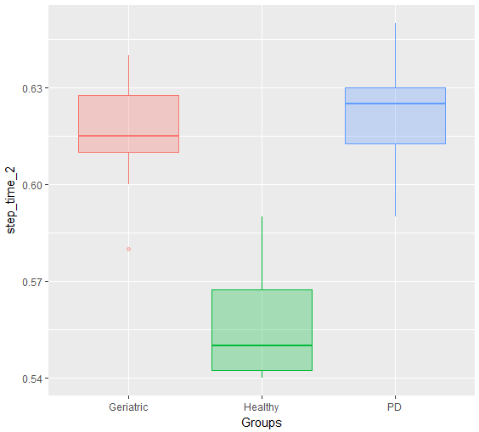
Step Time (Free Walk & 40 M)

Slide 14
Symmetry
Difference between all left steps average values and all right steps average values | Difference between each left and right step values
SYM_AVG_StepTime | SYM_LR_StepTime
SYM_AVG_VecMag | SYM_LR_VecMag
SYM_AVG_RMSX | SYM_LR_RMSX
SYM_AVG_RMSY | SYM_LR_RMSY
SYM_AVG_RMSZ | SYM_LR_RMSZ

Slide 15
Variability
Variability Measures
SD of Step Time (CV)
SD of Vector Magnitude (CV)
SD of Root Mean Square in Vertical Direction
SD of Root Mean Square in AP Direction
SD of Root Mean Square in ML Direction

Slide 16
Next Steps
Finding one set of discriminating features
Symmetry
Variability
Collecting more data from people with movement disorders
Data Integration (gait, age, gender, genetic backgrounds,…)
Making a profile for each individual
Classification

