Slide 1
Correlation Networks:
Causative Relationships from Gene Expression Data
Grogan W. Huff University of Nebraska at Omaha
Fund for Undergraduate Scholarly Experiences - 2016
Notes:
Welcome!
Grogan Huff
Senior in the Bioinformatics Undergraduate Program
University of Nebraska at Omaha
How I got started in database design for research
Paper will introduce intelligent database design practices and the graph database model.

Slide 2
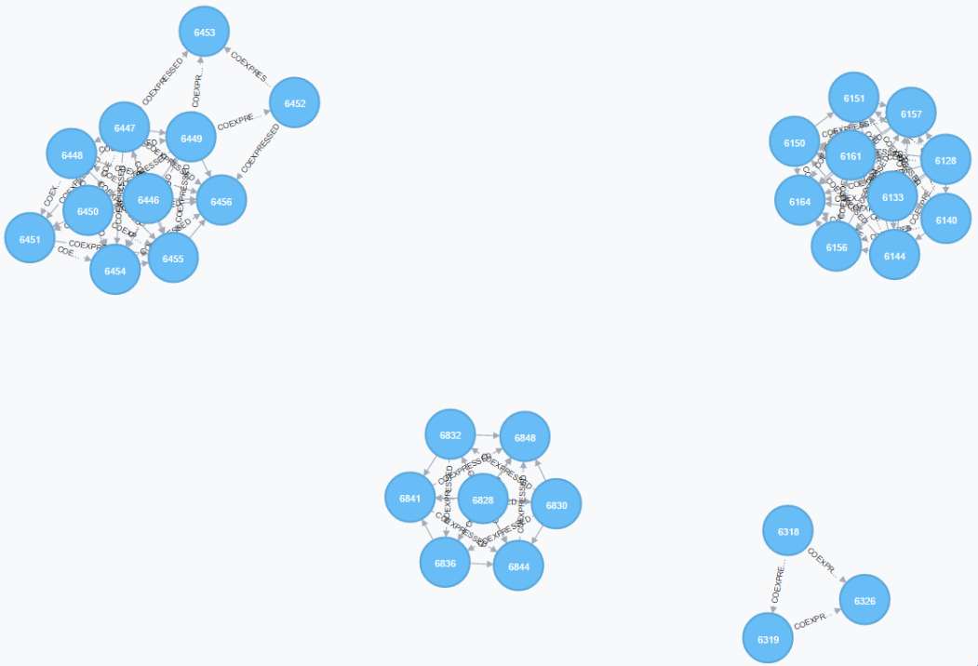
Agenda
Background
The Problem
The Motivation
Methods
Results
Discussion
References
Notes:
Introduce each section

Slide 3
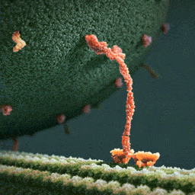
Background – The Problem
Proteins:
carry out nearly every activity necessary for life
are encoded for in genes
Genes:
are regulated by proteins called transcription factors
Transcription Factors:
respond to signals, like stress, to regulate a set of genes
“Well, You Can Tell by the Way I Use My Walk” (Art of the Cell)
Notes:
Introduce each section

Slide 4
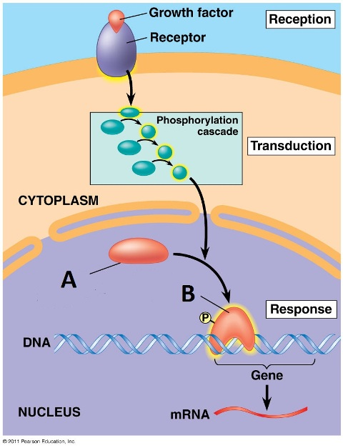
Background – The Problem
Therefore, related genes will often share a transcription factor.
We can:
measure gene expression
calculate correlation
We have shown:
graph theory and network analysis are effective tools
We don’t know:
if correlation networks are an appropriate model
Signal Transduction Pathway (Pearson Education)
Notes:
Introduce each section

Slide 5
Background – The Motivation
Gene expression data is already being measured
This data is freely available
Correlation networks are easily generated from this data
Hypothesis:
Correlation networks can guide the prediction of transcription factor co-regulation from gene expression and upstream sequence data with higher sensitivity and specificity than from this data alone.
Notes:
Introduce each section

Slide 6
Methods
Retrieve gene expression datasets (NCBI GEO)
Calculate Pearson correlation values
Construct a correlation network
Collect upstream sequence data (YeastMine)
Identify shared motifs
Make predictions
Novel Source Code:
all source code detailed ahead is available at this project’s GitHub:
https://github.com/Yerasho/FUSE2016
Notes:
Introduce each section

Slide 7
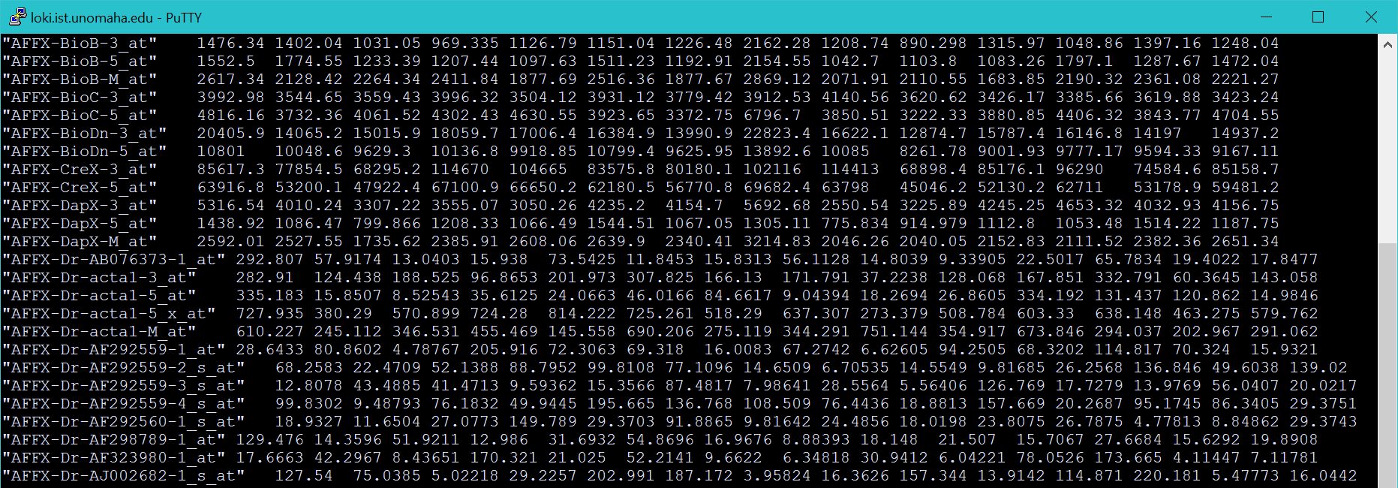
Methods – Datasets
GEO Series GSE8542 – BY4742 Quiescent and Non-quiescent Replicates
Novel Source Code:
GoFetchGEO.java – retrieve raw GEO series matrix file
ProcessSeriesGEO.java – process into format designed for this experiment
Notes:
Introduce each section

Slide 8
Methods – Correlation values
HCC Tusker Supercomputer – ‘manec’ software
Notes:
Introduce each section

Slide 9
Methods – Correlation Network
Construction in Neo4j database
k3 ‘triangle’ cliques
Novel Source Code:
CYPHER LOAD CSV – network construction
CYPHER MATCH triangles – k3 triangle extraction
Notes:
Introduce each section

Slide 10
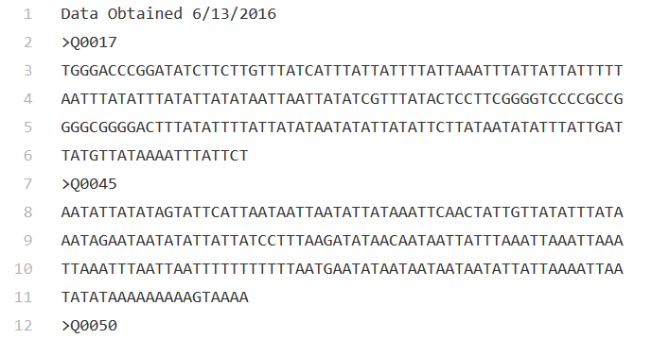
Methods – Upstream Sequence
YeastMine API
Novel Source Code:
requestYeastMine.py – connection and data retrieval through YeastMine
Notes:
Introduce each section

Slide 11
Methods – Shared Motifs
MEME Suite Software
meme –text –dna –nmotifs 1 –mod zoops –minw 6 –maxw 20 -nostatus
Novel Source Code:
ProcessCompletek3.java – formats rows of data into FASTA format
MEMEfiles.py – automated, sequential MEME analysis and output
Notes:
Introduce each section

Slide 12
Results
k3 triangles, 200bp upstream, MEME only
Notes:
Introduce each section

Slide 13
Results
k3 triangles, 1000bp upstream†, MEME only
† as identified in Ying-Zhe Hsu and Yuh-Jyh Hu, 2003.
Notes:
Introduce each section

Slide 14
Results
k3 triangles, 1000bp upstream, Shared Regulators within MEME Output
Novel Source Code:
keyvalueTF.py – returns the intersection of regulators between gene sets
Notes:
Introduce each section

Slide 15
Discussion
At this time:
the model does not differentiate significantly from the randomized control
What this means:
raw correlation networks built in this way are not representative of a co-expression network
Notes:
Introduce each section

Slide 16
Discussion
Areas of uncertainty:
Lack of normalization during network construction
Small k3 cliques
Steps for the future:
Uncover normalization to bring correlation closer to true co-expression
Expand exploration with advanced structures and larger cliques
Notes:
Introduce each section

Slide 17
questions
Also feel free to direct any outside questions or comments to gwhuff@unomaha.edu
Notes:
Provide an avenue for questions.

Slide 18
Thank You
Notes:
Thank you!

Slide 19
References
Aragon AD, Rodriguez AL, Meirelles O, Roy S et al. Characterization of differentiated quiescent and nonquiescent cells in yeast stationary-phase cultures. Mol Biol Cell 2008 Mar;19(3):1271-80. PMID: 18199684
Art of the Cell. (2014, May 9). "Well, You Can Tell by the Way I Use My Walk" [Digital image]. Retrieved April 24, 2016. Kinesin Motor Protein
Balakrishnan, Rama et al. “YeastMine—an Integrated Data Warehouse for Saccharomyces Cerevisiae Data as a Multipurpose Tool-Kit.” Database: The Journal of Biological Databases and Curation 2012 (2012): bar062. PMC. Web. 1 Mar. 2017.
Barrett T, Wilhite SE, Ledoux P, Evangelista C, Kim IF, Tomashevsky M, Marshall KA, Phillippy KH, Sherman PM, Holko M, Yefanov A, Lee H, Zhang N, Robertson CL, Serova N, Davis S, Soboleva A. NCBI GEO: archive for functional genomics data sets--update. Nucleic Acids Res. 2013 Jan;41(Database issue):D991-5.
Cherry JM, Hong EL, Amundsen C, Balakrishnan R, Binkley G, Chan ET, Christie KR, Costanzo MC, Dwight SS, Engel SR, Fisk DG, Hirschman JE, Hitz BC, Karra K, Krieger CJ, Miyasato SR, Nash RS, Park J, Skrzypek MS, Simison M, Weng S, Wong ED (2012) Saccharomyces Genome Database: the genomics resource of budding yeast. Nucleic Acids Res. Jan;40(Database issue):D700-5. [PMID:22110037]
Dempsey K, Ali H. (2014) Identifying aging-related genes in mouse hippocampus using gateway nodes. BMC Systems Biology. Available http://www.biomedcentral.com/1752-0509/8/62. Accessed February 9, 2016.
Dorsam G, Hoselton S, Sandy A, Samarasinghe A, Vomhof-DeKrey E, Dorsam S, Schuh J. (2010) Gene expression profiling and network analysis of peripheral blood monocytes in a chronic model of allergic asthma. Microbiology and Immunology 54: 558-563.
Ebell M, Barry H. (2008) Sensitivity and Specificity. Evidence-Based Diagnosis. Available http://omerad.msu.edu/ebm/Diagnosis/Diagnosis4.html. Accessed February 10, 2016.
GenBank : Public Nucleic Acid Sequence Repository. NCBI. U.S. National Library of Medicine. Available http://www.ncbi.nlm.nih.gov/genbank/. Accessed February 11, 2016.
Miguel C. Teixeira, Pedro Monteiro, Pooja Jain, Sandra Tenreiro, Alexandra R. Fernandes, Nuno P. Mira, Marta Alenquer, Ana T. Freitas, Arlindo L. Oliveira, and Isabel Sá-Correia (2006) The YEASTRACT database: a tool for the analysis of transcription regulatory associations in Saccharomyces cerevisiae Nucl. Acids Res., 34: D446-D451, Oxford University Press
Neo4j. Available https://neo4j.com
Pearson Education, Inc. (2011) "Figure 11.15" [Digital image]. Retrieved April 24, 2016. Nuclear and Cytoplasmic Response
Proteins Are the Body's Worker Molecules. (2011) The Structures of Life. Available https://publications.nigms.nih.gov/structlife/. Accessed February 11, 2016
Stuart, J. M., Segal, E., Koller, D., & Kim, S. K. (2003, October 10). A gene-coexpression network for global discovery of conserved genetic modules. Science.
Timothy L. Bailey and Charles Elkan, "Fitting a mixture model by expectation maximization to discover motifs in biopolymers", Proceedings of the Second International Conference on Intelligent Systems for Molecular Biology, pp. 28-36, AAAI Press, Menlo Park, California, 1994.
Ying-Zhe Hsu and Yuh-Jyh Hu, "Reconstruct transcription networks by combining gene expression correlations with TF binding sites," Fifth International Symposium on Multimedia Software Engineering, 2003. Proceedings., Taichung, Taiwan, 2003, pp. 257-264. doi: 10.1109/MMSE.2003.1254450
Notes:
Make a call to the list of references
All pictures were created by me, I retain all the copyrights.

