Slide 1


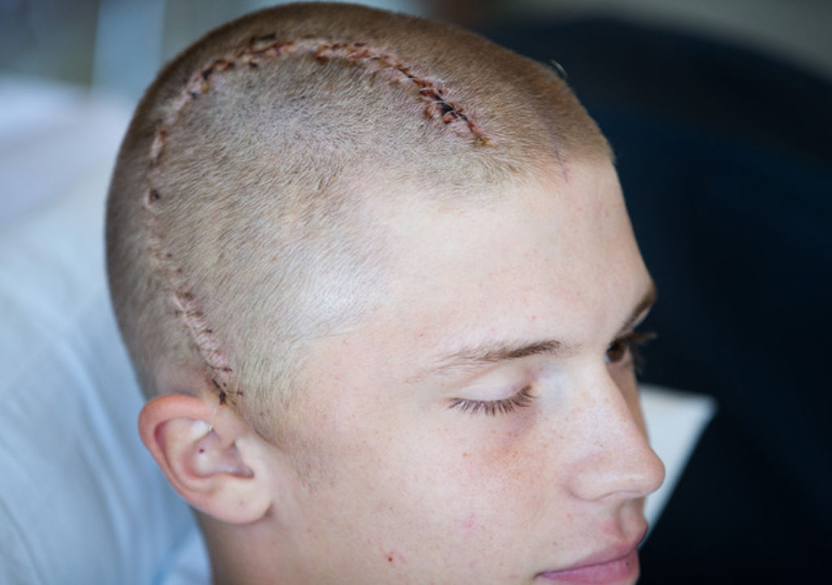
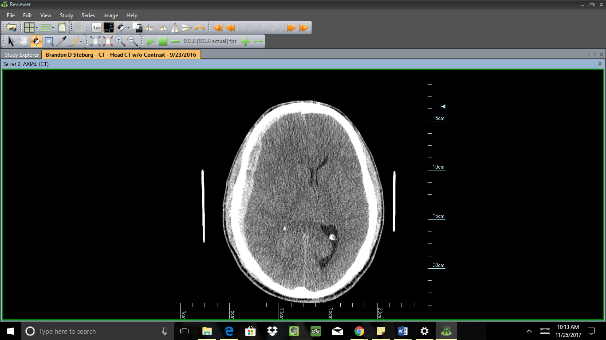
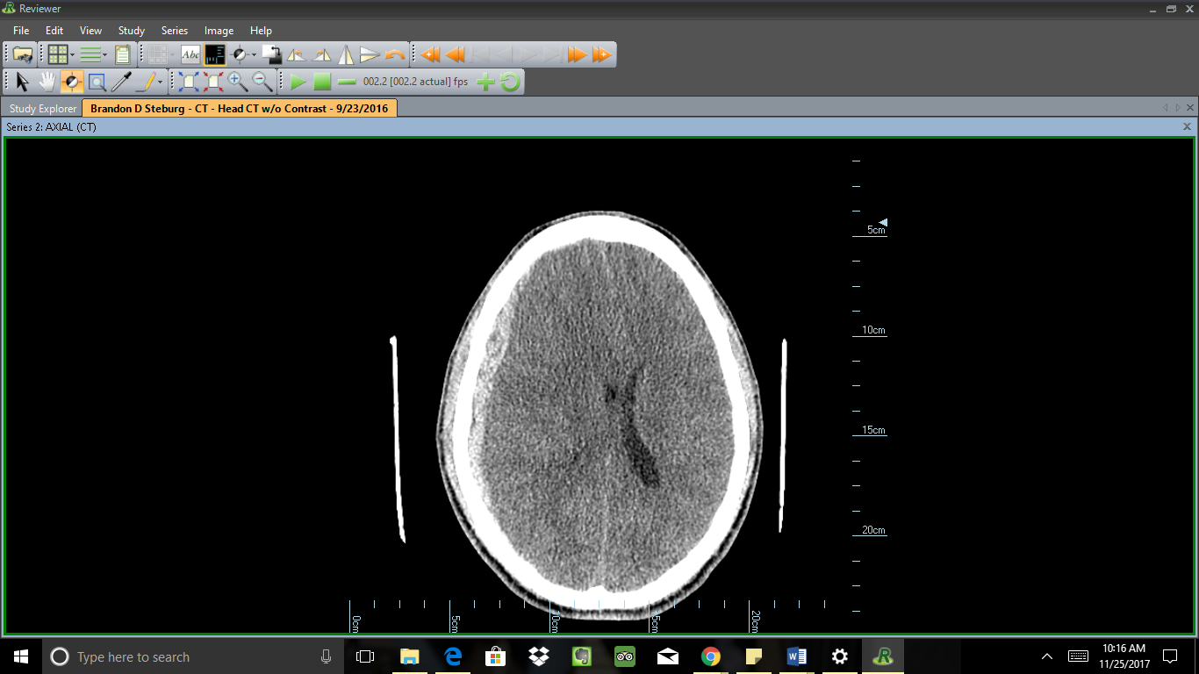
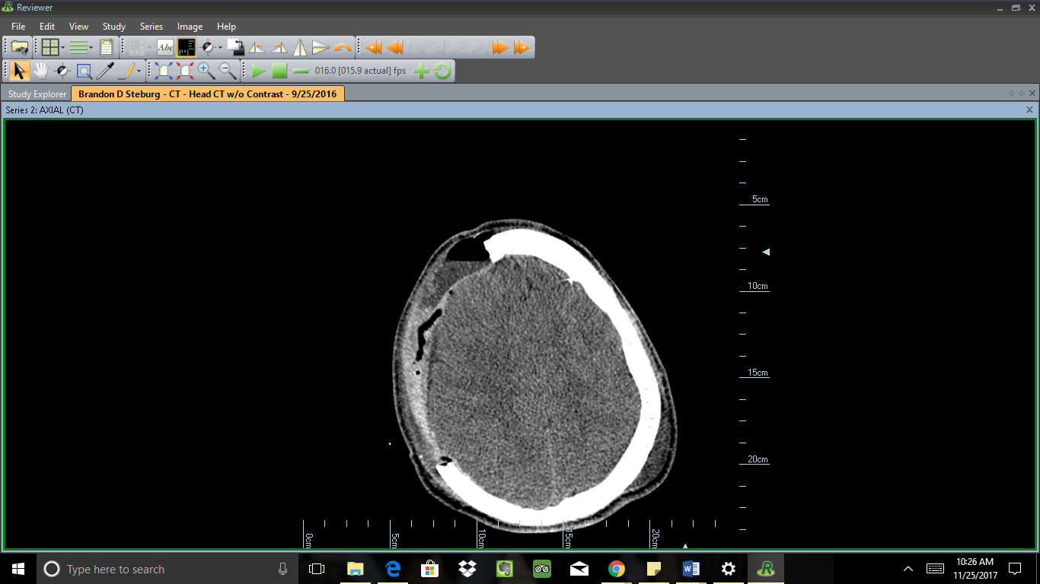
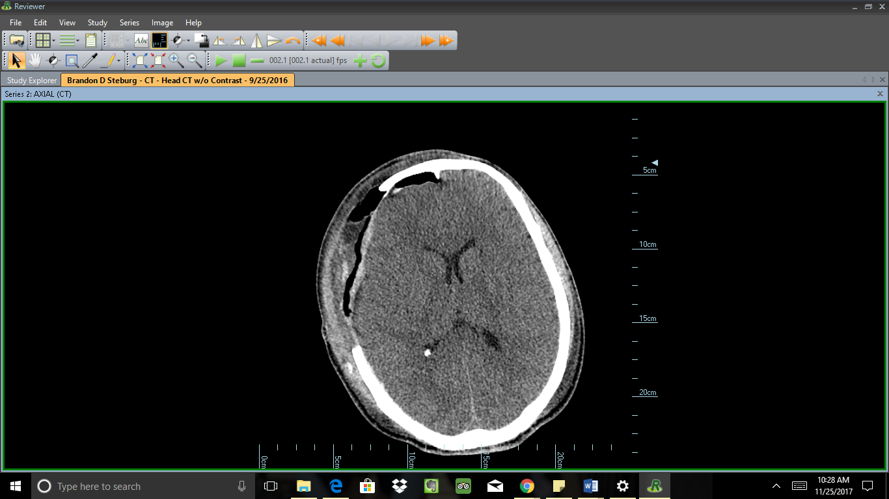
Acute subdural hematoma in a high school football player requiring emergent decompressive craniectomy
Christine C. Center
*University of Nebraska at Omaha, Athletic Training Program, Omaha, NE
Surgery 9/23 -9/24
  Emergent decompressive craniectomy
  Frontal intracranial pressure monitor placement
      Figure: 3 Post-surgical scars
Acute SDH is very serious and rare in high school football.
Decompressive craniectomy is a procedure performed as last resort by neurosurgeons.
The patient responded well to treatment, and has few lasting deficits.
Knowing signs and symptoms to identify TBI and well rehearsed EAPs specific to each venue are key to prompt diagnosis and timely advanced medical care.
This life-threatening case, recognizes not only the benefits of an AT for early identification of critical injury, but the necessity of AT services to save lives.
The National Federation of State High School Association. (2016). 2015-16 High school athletics participation. Retrieved from http://www.nfhs.org/ParticipationStatistics/PDF/2015-16_Sports_Participation_Survey.pdf
Kucera, K. L., Yau, R. K., Register-Mihalik, J., Marshall, S. W., Thomas, L. C., Wolf, S., . . . Guskiewicz, K. M. (2017). Traumatic brain and spinal cord fatalities among high school and college football players - united states, 2005-2014. Mmwr-Morbidity and Mortality Weekly Report, 65(52), 1465-1469.
Context
Imaging
Treatment
Close to 1.1 million athletes play high school football each year in the United States.¹
From 2005-2014, the average number of high school football deaths was 2.4±2.2 per year.²
Subdural hematomas are the most common diagnosis (46%), of high school football fatalities.²
Senior High School Class A varsity football defensive end.
18-year-old caucasian male, 1.80m, 82.5kg.
Healthy and an active athlete, with no prior history of significant head trauma.
Football game 9/23/16, @ 19:00.
Sacked the quarterback, not a particularly hard hit.
After a few more plays, realized something was wrong, and went to sideline to see AT.
After tackle he felt dizzy and “off”.
Vomiting.
Right decorticate and left decerebrate posturing.
Dilated pupils, right nonreactive.
Loss of consciousness.
Respiratory distress.
Skull fracture
Epidural hematoma
Cervical spine trauma
Computerized Axial Tomography (CAT) scan revealed:
  A subdural hemorrhage (1.4cm diameter).
  Left midline shift with mass effect on the right lateral ventricle.
Figure 1. Non-contrast head CAT pre-surgery 9/23/16
Figure 2. Non-contrast head CAT post-surgery 9/25/16
Anterior
Anterior
Background
Uniqueness
R
L
R
L
Posterior
Posterior
Signs and Symptoms
Anterior Posterior
Conclusion
Anterior
Anterior
R
L
R
L
Differential Diagnosis
References
Medial Lateral
Medial Lateral
Posterior
Posterior
university of Nebraska at Omaha

