Slide 1
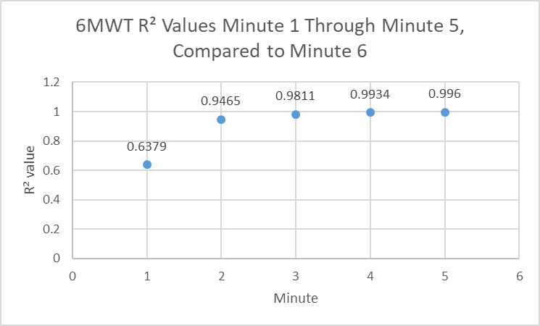
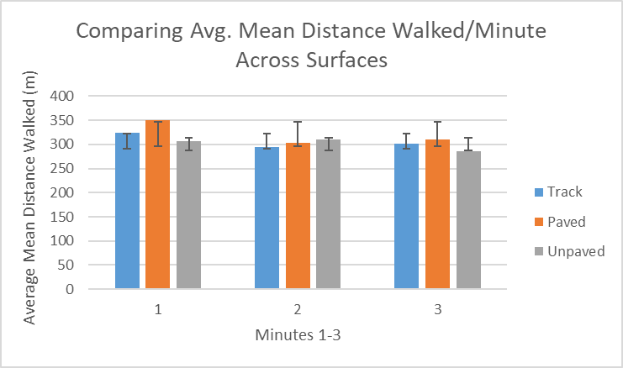
Examining the minute to minute predictability of walking distance across multiple terrains
Tyler Hamer, Abderrahman Ouattas, Katlyn Nimtz, & Brian A. Knarr
Department of Biomechanics, University of Nebraska at Omaha, Omaha, NE 68182
INTRODUCTION
RESULTS
The 6-minute walk test (6MWT) is useful for longitudinal assessment as well as monitoring treatment response and is considered a simple method for assessing exercise capacity at a submaximal level¹. In recent years, we have begun to shorten the duration of clinical walking tests as correlations between duration of the test and findings become more apparent². With findings that the 6MWT is more efficient than the original 12-minute walk test (12MWT), perhaps it can be evident that even the 6MWT can be shortened to examine its effects in a shorter duration that can be more beneficial to the participant.
The objective of this study is to examine the outcomes of each minute throughout the 6MWT trials and to see if functional measures can be obtained at an early mark to facilitate the effects of movement variability throughout the trial. We hypothesize that there are strong correlations between walking distances during the first three minutes to distances in the last three minutes of the test. Additionally, we hypothesize that individuals who walk farther will have less minute to minute variability.
Figure 1: Minute to minute correlations of distance walked
METHODS
Linear regression revealed that distance within the first few minutes significantly predicted performance around the 6-minute mark.
Results indicated that very strong correlations between the mean distances walked across minutes appeared around the 2-minute mark, with an R² value of .95.
This shows that the first minute is unreliable of 6 minute findings yet by the second minute, you can highly predict results that you would find at the end of the 6MWT.
When observing between total distance walked and the minute-to-minute variability in distance amongst participants, it was found that no correlation between the two variables exists.
Subjects
Healthy adults between the age of 40 and 85 years old.
Exclusion criteria pertained to those who have:
self-reported maximal joint pain >3/10 of the hip, knee, or foot
doctor-diagnosed hip or knee osteoarthritis.
having already been diagnosed with a neurological disorder including stroke, traumatic brain injury, or any other neurological condition that
affects their decision-making or
ability to move normally
A total of 18 healthy older adults
participated within this study. Age, height,
weight, and BMI were recorded for each
individual (Table 1).
​
​Functional Testing
Subjects completed three walking trials
on the same day on three different surfaces:
An indoor track
An outdoor paved surface
An outdoor unpaved surface
Subjects were first asked to cover as much distance as possible on an indoor track during a six minute span.
Upon completion, a short break was given and subjects proceeded outside onto a nearby circular sidewalk path outside of the research building.
The sidewalk path was chosen to preclude any stepping or turning patterns not typical of a standard 6MWT.
Subjects were then instructed to walk as far as possible on this surface within a three-minute span of time.
Lastly, subjects conducted the same three minute walk test directly off from the sidewalk surface on the grass.
To maintain consistency between subjects for the grass surface, collections did not take place within 24 hours of heavy precipitation.
Throughout all trials, the total distance walked was measured using a rolling measuring wheel alongside the participant.
Data Analysis​
Linear regressions were performed to measure predictability of data from minute to minute. R² values were recorded to signify predictive trends amongst each minute within the trials.
 | Mean (SD)
Age | 65.1 (10.1)
Mass (kg) | 74.8 (17.7)
Height (m) | 1.6 (.1)
BMI | 27.7 (6.3)
Table 1: Subject Information
DISCUSSION
Shortening the 6MWT can help patients who struggle with various walking deficiencies as well as shortening exam research protocol altogether.
While these findings prove highly relevant for healthy populations, further research needs to be conducted to elaborate on shortening the 6MWT in consideration to injured populations. Additionally, future investigation into possible changes in kinematics from minute to minute is planned.
REFERENCES
1. Lammers AE et al. Arch Dis Child. 2008;93(6):464-468.
2. Enright PL. The six-minute walk test. Respir Care. 2003;48(8):783-785.
3. Connelly DM, et al. Physiother Can. 2009;61(2):78-87.
4. Leung AS et al. Chest. 2006;130(1):119-125.
ACKNOWLEDGMENTS
NIH (P20GM109090)
This work was supported by the Center for Research in Human Movement Variability of University of Nebraska at Omaha, NIH (P20GM109090).

