Slide 1
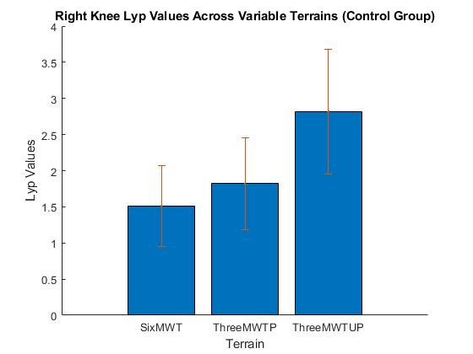
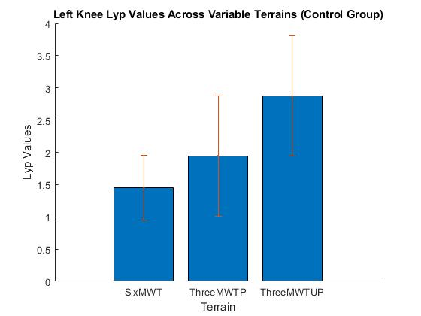
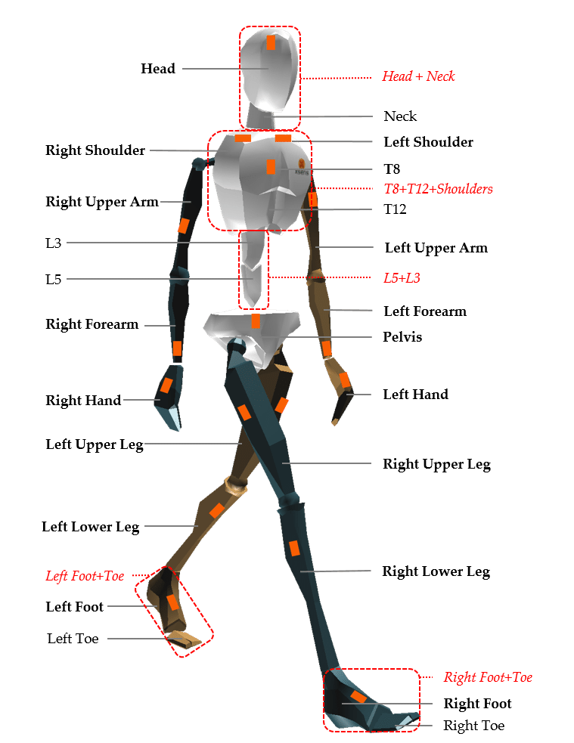
IMPACT OF REAL WORLD ENVIRONMENTS ON MOVEMENT VARIABLITY
Matt Harrisonª, Brian A. Knarrª
Department of Biomechanics, University of Nebraska at Omaha, Omaha, NE 68182
INTRODUCTION
Osteoarthritis (OA) is a leading cause of disability in the U.S. and total knee arthroplasty (TKA) is the hallmark for treatment of osteoarthritis (OA). [1] More than 700,000 TKAs are performed annually and while pain is improved in general, the functional performance and activity levels often do not return to those of healthy individuals. [2] Additionally, almost 50% of TKA patients will need another TKA procedure. [4]
While joint angles, loading patterns, and coordination have been collected in laboratory settings, this data needs to be collected in real-world environments to be an accurate comparison to real-world performance. Furthermore, to provide an accurate comparison to post-TKA patients, health individuals were collected to be used as the standard in functional performance and activity.
The purpose of this study is to compare the real-world performance to movement and joint angles in healthy individuals. We hypothesize that the variability in real-world environments will better represent healthy gait patterns, and the differences in movement variability will be seen when walking on different surfaces. The smallest walking variability being on the indoor track, while the largest walking variability being on the unpaved surface.
Figure 4: Calculated Lyapunov exponent (LyE) for joint angle in healthy individuals gait on indoor track, paved and unpaved surfaces. With standard deviation being represented as well.
Figure 5: Shows the mean, standard deviation, t-test, and p-values for the indoor track vs. the outdoor paved walk test and the outdoor paved vs. the outdoor unpaved walk test.
METHODS
Six participants (22±2 years, 2M, 4F) were recruited for this study.
​
Data Collection​
Session 1: Dynamic 6 minute walking trial on an indoor track at self-selected speed​. Then a dynamic 6 minute (3 minutes on paved and unpaved terrain) at self-selected speed.
Accelerometers (Noraxon U.S.A., Inc., AZ) were mounted bilaterally above the lateral malleoli using Velcrostraps​.
Accelerometers measured joint angle, as well as several other factors.
Data Analysis​
Data was imported to MATLAB where a custom MATLAB code was used to run analysis on all 6 participants
The maximum Lyapunov exponent (LyE) was calculated to discover the difference in joint angle variations on different terrains.
These results are from the 6 collected subjects.
The results show a significantly higher LyE value on the 3 minute unpaved walk test compared to that of the 6 minute indoor track walk test.
The standard deviation was calculated for each LyE: For the 6 minute walk test was ±0.56, 3 minute paved walk test was ±0.63, and 3 minute unpaved walk test was ±0.86.
The p-value of .001 shows that this is significant.
DISCUSSION
Figure 1: XSENS BIOMECH System
Figure 2: XSENS BIOMECH IMU [3]
The data collected so far shows that collecting data in real-world environments is a valid option.
The data collected across the six subjects shows that there is a significant difference in gait and joint angles when going from an indoor track to outdoor paved, and outdoor paved to unpaved terrain.
This data will provide a standard in functional performance in healthy individuals compared to the post-TKA patients.
REFERENCES
[1] Theis KA, Murphy L, Hootman JM, Helmick CG, Yelin E. 2007;57(3):355-363.
[2] National Institutes of Health. 2003;20(1):1-34. doi:10.1097/00128360-199804000- 00015.
[3] XSENS [Digital image]. (n.d.). Retrieved October 5, 2016, from https://www.xsens.com/products/mvn-biomech
[4] Shao Y, Zhang C, Charron KD, MacDonald SJ, McCalden RW, Bourne RB. The fate of the remaining knee(s) or hip(s) in osteoarthritic patients undergoing a primary TKA or THA. J. Arthroplasty 2013;28(10):1842-1845. doi:10.1016/j.arth.2012.10.008.
RESULTS
ACKNOWLEDGMENTS
Figure 3: Subject demographics and selected information.
University of Nebraska at Omaha, NIH (P20GM109090)
This work was supported by the Center for Research in Human Movement Variability of University of Nebraska at Omaha, NIH (P20GM109090).

