Slide 1
An Evolutionary Approach for managing Heterogeneous IoT Networks YARA MAHFOOD HADDAD UNO Research Fair March 2, 2018

Slide 2
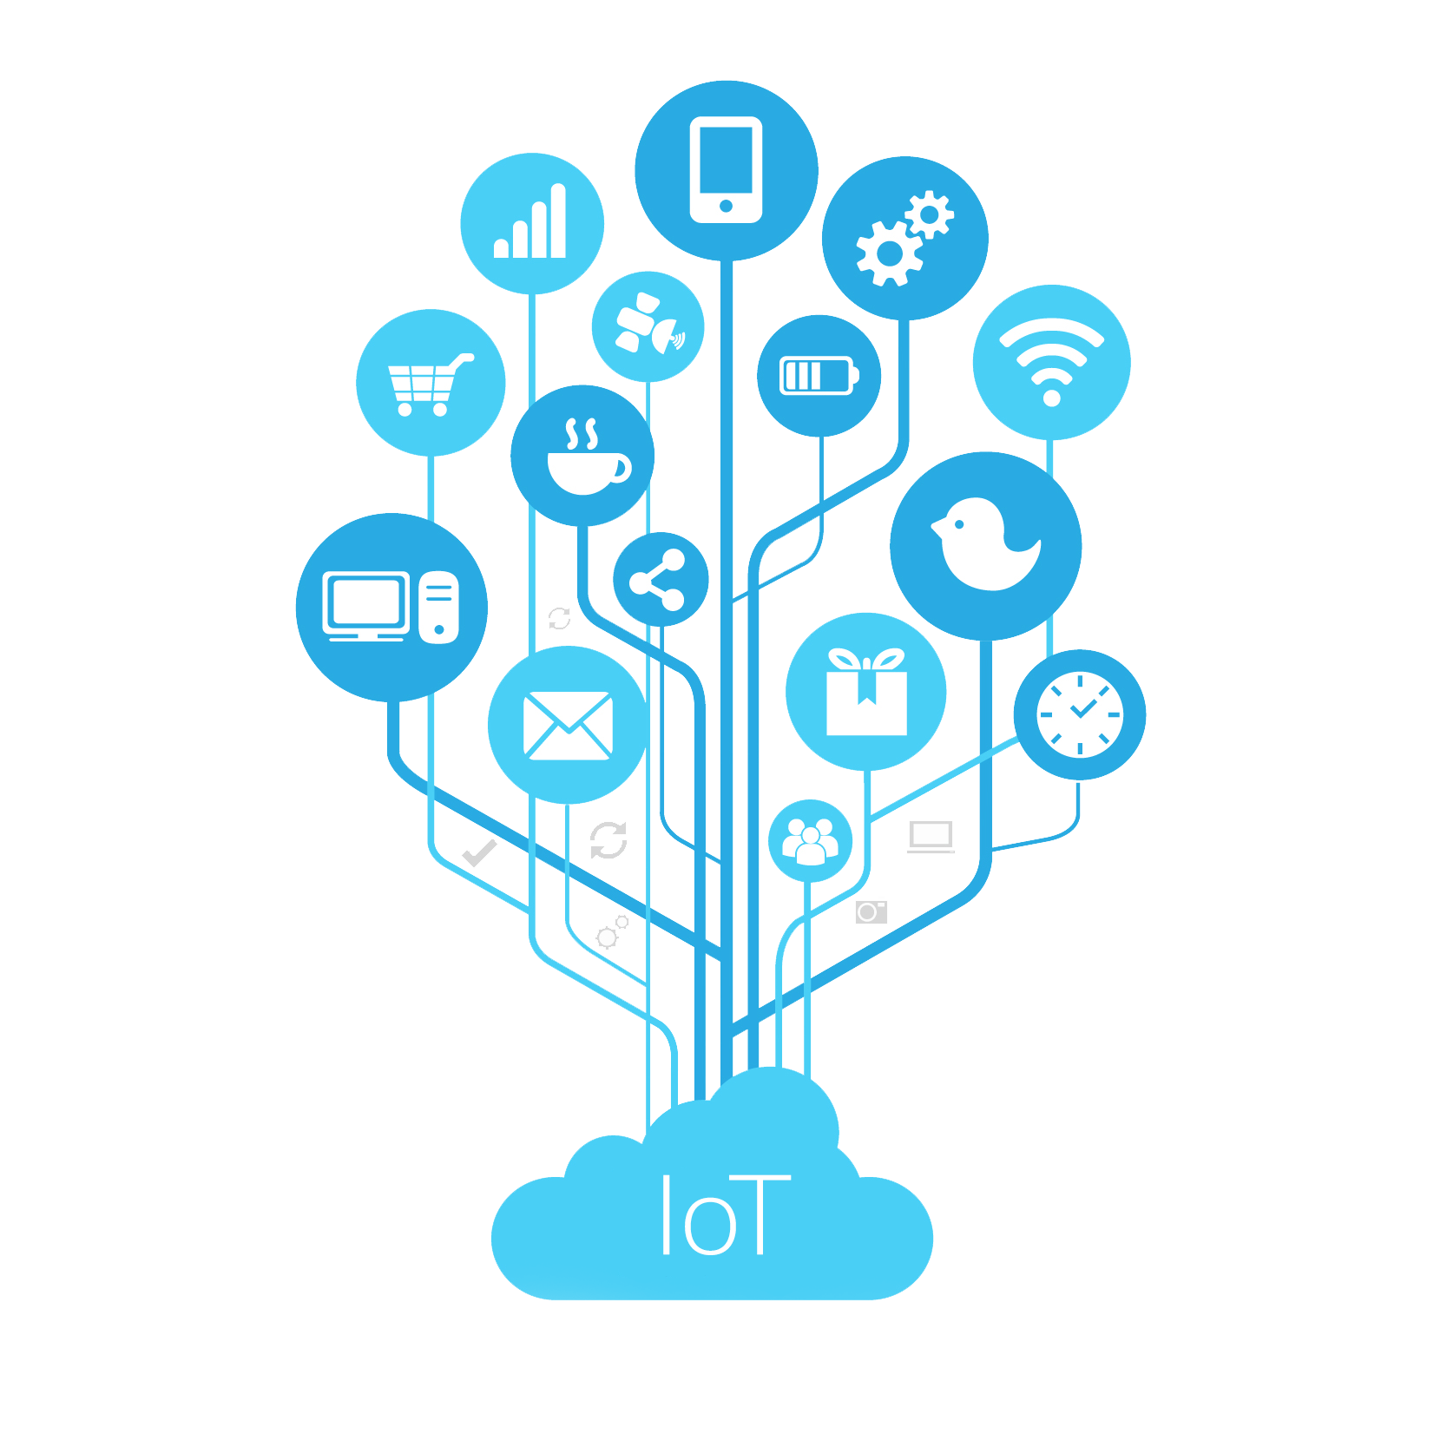
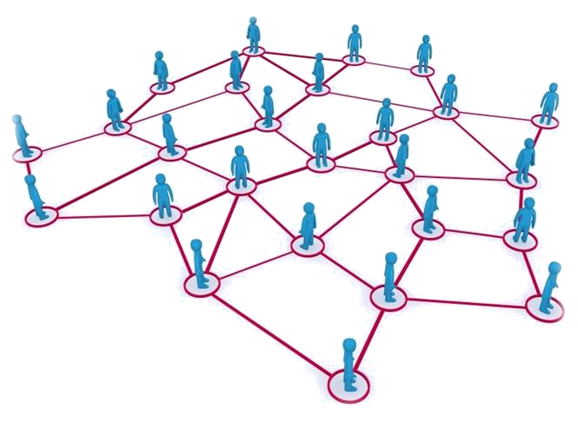
Introduction
Internet of Things (IoT)
Self Organizing Networks –
Dynamically organized
Wireless Sensor Networks
Homogenous
Heterogeneous

Slide 3
Background
Transport: enormous impact practically and environmentally on the way we travel
Infrastructure management: street lighting
Building automation: turning on heating 30 minutes before people get in the office
Health: remote monitoring of patients and emergency notification systems
Notes:
but do we need it? Dozens of future scenarios tell us how great life will be when every object is connected. But what is the real value, and to what extent is it a solution in search of a problem?
Transport: especially with the advent of smart and autonomous vehicles and supporting infrastructures (V2V, new generation ITS) that can have an enormous impact practically and environmentally on the way we travel
Infrastructure management: especially intelligent maintenance with devices that ‘phone home’ preventatively: great to avoid disruption and reduce costs (especially true for distributed public equipment like street lighting or infrastructure)
Building automation: this integrates in IOT the long existing notion of a ‘smart building’ (since the 1980s) that automatically adjusts environmental conditions based on learned usage patterns (turn on the heating 30 minutes before people get in the office) and/or on physical occupation of the rooms
Health: with remote monitoring of patients and emergency notification systems.

Slide 4
Motivation and Challenges
Motivation
Improve quality of life, security, and efficiencies
Most research in this field thus far focuses on homogenous, more needs to be done for heterogenous networks
Challenges
Form the network on simple identical sensors to complex different things
Manage Iot networks to improve the efficiency
Optimizing more than one feature (Tradeoff)
Notes:
Cognitive (intelligent ) they are embedded into any device, they are not a separate device

Slide 5
Goals Of the Project
Managing sophisticated heterogeneous WSNs
Managing a simpler version of IoT networks
Study more realistic scenarios
Optimizing three parameters (coverage, redundancy and energy saved) at the same time to improve the performance
Using the genetic algorithm in dynamic networks
Notes:
Implement these techniques into real life applications
Optimize couple parameters depending on the application. For example, power saving, percentage of coverage, redundancy of coverage
localization for the best drop area, as well as choosing the best scheduling set of active and passive sensors

Slide 6
Research Questions
How to utilize diverse objects in IoT Networks to facilitate data collection while optimizing Coverage, redundancy and energy consumption?
What is the ideal number and combination of different types of sensors to enable a higher level of coverage and redundancy with lower power consumption?
How to develop flexible techniques for more efficient and reliable self-organized networks that can optimize multiple objective functions?
Notes:
What is the impact of having a diverse set of sensors on the functionality and performance of the overall networks?
How to utilize different types of devices in IoT Networks to facilitate data collection while optimizing speed and energy consumption?
What is the ideal number and combination of different types of sensors to have higher level of coverage with lower power consumption?

Slide 7
The Proposed Method
The Evolutionary algorithm
Is used to generate high-quality solutions that improve every generation
It solves a variety of optimization problems that are not well suited for standard optimization algorithms
It tries to get the best values for the three parameters ( Coverage-redundancy and Energy saved) -multi object optimization-
It is dynamic which means it could be applied on dynamic networks like IoT or the simple version of it which is the heterogeneous WSN
Notes:
What is the impact of having a diverse set of sensors on the functionality and performance of the overall networks?
How to utilize different types of devices in IoT Networks to facilitate data collection while optimizing speed and energy consumption?
What is the ideal number and combination of different types of sensors to have higher level of coverage with lower power consumption?

Slide 8
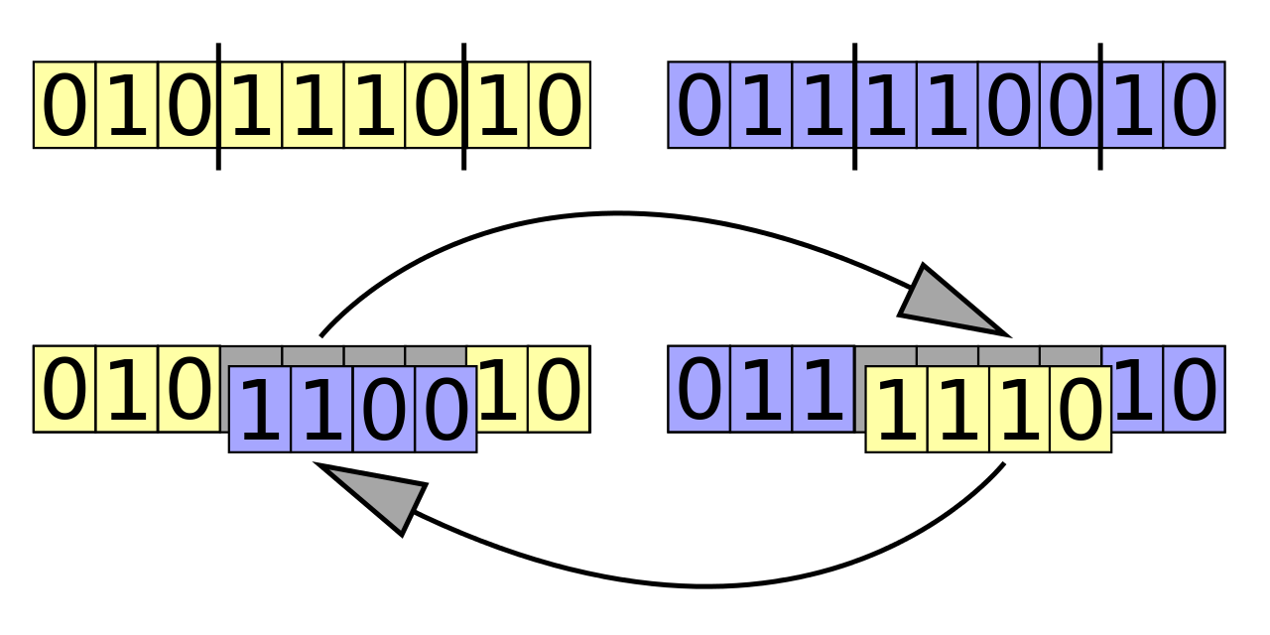
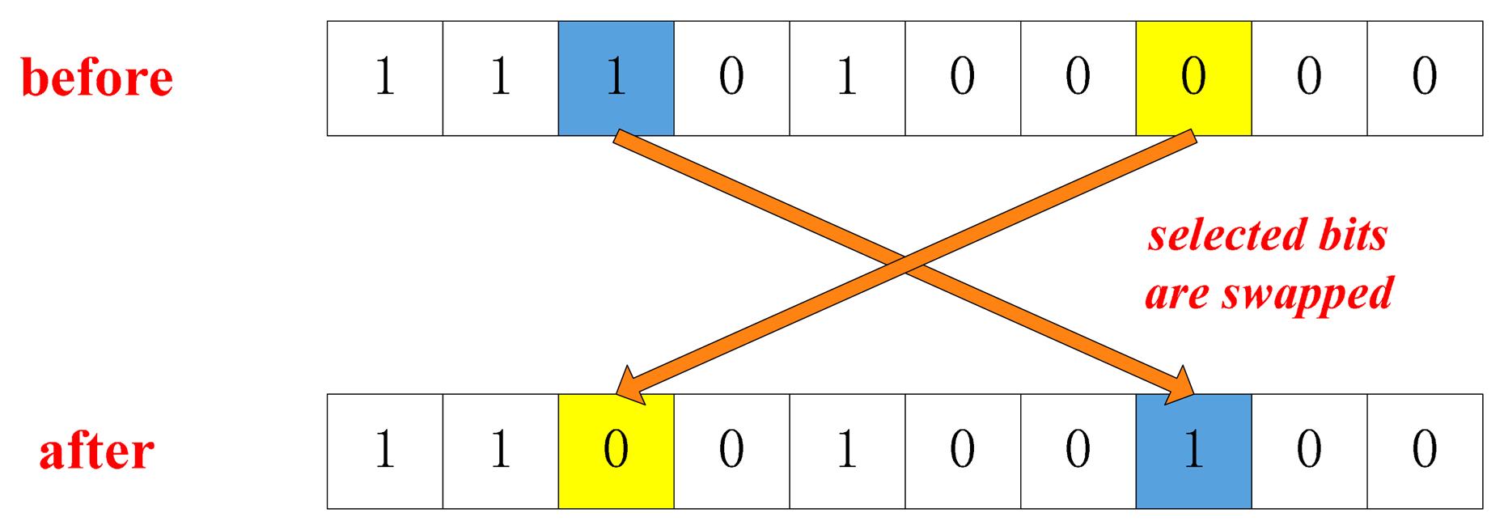
The Proposed Method
The genetic algorithm repeatedly modifies a population of individual solutions
At each step, the genetic algorithm selects individuals at random from the current population to be parents and uses them to produce the children for the next generation
It uses the mutation and crossover operation to recreate the new generations
Over successive generations, the population "evolves" toward an optimal solution
Notes:
What is the impact of having a diverse set of sensors on the functionality and performance of the overall networks?
How to utilize different types of devices in IoT Networks to facilitate data collection while optimizing speed and energy consumption?
What is the ideal number and combination of different types of sensors to have higher level of coverage with lower power consumption?

Slide 9
Multi Object Optimization The Studied Parameters
The Fitness function: f = 𝛼 𝑃+ 𝛽 𝑄+ 𝛾 𝑅
The Tuning parameters: 𝛼, 𝛽 and 𝑅
The Percentage of Coverage (P): the percentage of covered subareas divided on the number of total subareas.
The Redundancy (Q)the percentage of the covered subareas with more or equal to 2 active sensors divided on the number of total subareas.
The Percentage of Energy Saved (R): vary depending on the type of sensors and if the sensor is connected to a power supplies or not and if it is on or off

Slide 10
Simulation Scenarios
Scenario 1:
There are two types of sensors (rechargeable-non rechargeable)
There Are 25 sensors covering the network (finding which one is active and which is passive will be after applying this algorithm)
Each sensor has a range equal to one of the following: 5,15,25,40
Finding the best solution will be for this moment only
Notes:
Input parameters: tuning parameters, number of sensors, size of substrings for crossover, number of strings for selection as input for simple GA and an additional number of strings for partial elitism for modified GA

Slide 11
Simulation Scenarios
Scenario 2:
There are two types of sensors (rechargeable-non rechargeable)
There Are 25 sensors covering the network (finding which one is active and which is passive will be after applying this algorithm)
Each sensor has a range equal to one of the following: 1,3,6,9
Finding the best solution will be for this moment only
Notes:
Input parameters: tuning parameters, number of sensors, size of substrings for crossover, number of strings for selection as input for simple GA and an additional number of strings for partial elitism for modified GA

Slide 12
Simulation Scenarios
Scenario 1,2:
Notes:
Input parameters: tuning parameters, number of sensors, size of substrings for crossover, number of strings for selection as input for simple GA and an additional number of strings for partial elitism for modified GA

Slide 13
Simulation Scenarios
Scenario 3:
Performance of the genetic algorithm when network lifetime is zero/ Energy is needed to recharge:
There are two types of sensors (rechargeable-non rechargeable)
There are 25 sensors covering the network (finding which one is active and which is passive will be after applying the algorithm)
Each sensor has a range equal to one of the following: 5,10,15,20
Applying the algorithm will be on continues moments until one moment after recharging
8 moments until applying recharging
Recharging consider part of the calculated energy consumed
Notes:
Input parameters: tuning parameters, number of sensors, size of substrings for crossover, number of strings for selection as input for simple GA and an additional number of strings for partial elitism for modified GA

Slide 14
Simulation Scenarios
Scenario 4:
Performance of the genetic algorithm when network lifetime is zero/ Energy is not needed to recharge
There are two types of sensors (rechargeable-non rechargeable)
There are 25 sensors covering the network (finding which one is active and which is passive will be after applying the algorithm)
Each sensor has a range equal to one of the following: 5,10,15,20
Applying the algorithm will be on continues moments until one moment after recharging
8 moments until applying recharging
Recharging is not considered part of the calculated energy consumed
Notes:
Input parameters: tuning parameters, number of sensors, size of substrings for crossover, number of strings for selection as input for simple GA and an additional number of strings for partial elitism for modified GA

Slide 15
Simulation Scenarios
Scenario 3,4:
Notes:
Input parameters: tuning parameters, number of sensors, size of substrings for crossover, number of strings for selection as input for simple GA and an additional number of strings for partial elitism for modified GA

Slide 16
GA vs Greedy
Scenario 5:
Each sensor has a range equal to one of the following: 5,10,15,20
There are two types of sensors (rechargeable-non rechargeable)

Slide 17
GA vs Greedy
Scenario 6:
There are 1 type of sensors (rechargeable) / we don’t care about the type
Each sensor has a range equal to one of the following: 5,15,25,40

Slide 18
GA vs Greedy
Scenario 7:
There are 1 type of sensors (rechargeable) / we don’t care about the type
Each sensor has a range equal to one of the following: 5,15,25,40

Slide 19
Next Steps
More different scenarios to validate this algorithm
finding a good valent to compere with the performance of our algorithm
Implementing a web app to automate the work of this algorithm with different simulation scenarios

Slide 20
Conclusions
Internet of Things is going to grow significantly in the next few years
Self-organized IoT is emerging to be a major challenging yet exciting IT problem
Traditional Self Organized network protocols need to be significantly modified to be applied to IoT in urban environments
Evolutionary techniques represent a good approach to address the varied nature of IoT instances or environments due to the heterogeneity and dynamicity of such environments
Smart derives and Cognitive environments are here to stay

Slide 21
Thank you for your attention

