Slide 1
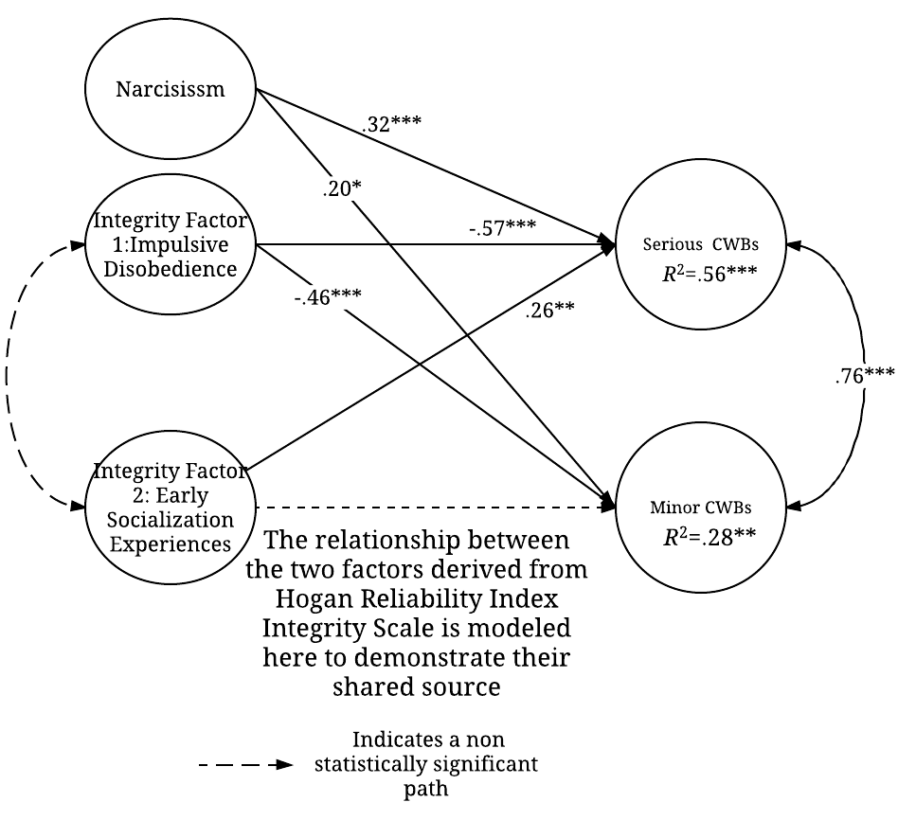
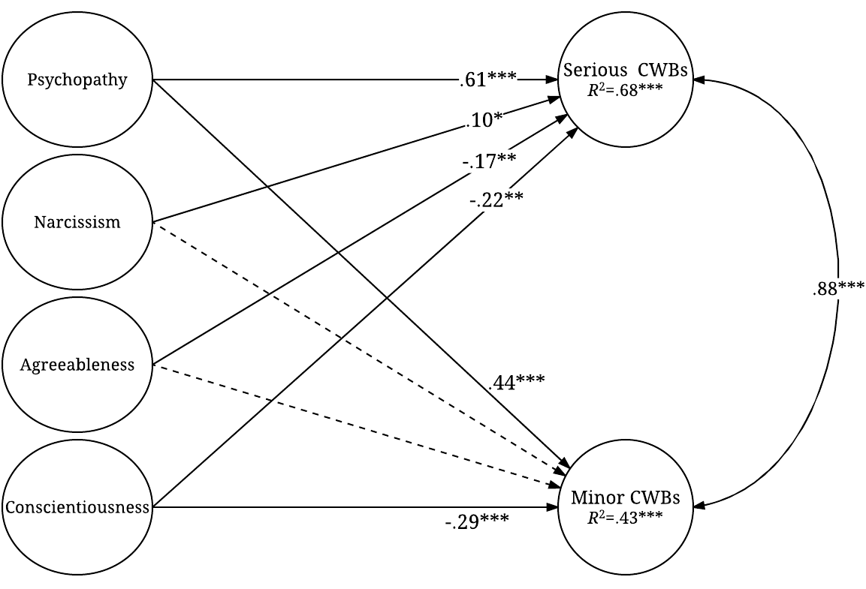
Modeling and Predicting Infrequent, Serious CWBs Using Improved Analytic Methods
Benjamin Thomas & Kyle Kercher
University of Nebraska Omaha
Abstract
Discussion and Implications
Scales (All Measures Hosted Online)
Predictor Scales: HRI¹ (Hogan & Hogan, 1992); NPI-16¹ (Ames, Rose, & Anderson, 2006). SD3² (Jones & Paulhus, 2009); HEXACO-PI-R (Ashton & Lee, 2009)
CWB Scales: CWB Checklist¹ (Fox, Spector, & Miles, 2001); CWB-C² (Spector et al., 2006)
Participants
N = 172¹ American College Students; N = 454² American employed adults
Data Analysis Procedure
Trichotomize CWB Item response data, due to non-normality (Muthén et al., 2015)
Construct Good-fitting Measurement models for Predictors and CWBs using E-SEM & CFA techniques (Muthén & Muthén, 2011)
Compare Model Fit for WLSMV-based models to ML-based models
Compare 1-factor CWB Model to 2-Factor CWB Model
Construct structural model regressing CWB Factors onto Predictors
Note
¹Denotes Methods for Study 1; ²Denotes Methods for Study 2
Method
The results support the use of polychoric correlation-based analytic methods in modeling and predicting infrequently occurring, serious CWBs. These techniques yielded noticeable improvements in measurement models and explained variance for CWB outcomes, compared to previous research. These improvements support the usefulness of alternative, appropriate methods as a tool for studying and predicting serious CWBs. Higher-fidelity criteria, specifically matched with predictors, offer a valuable tool for practitioners and researchers hoping to improve selection efforts (Hogan & Roberts, 1996). This research indicates a higher-fidelity definition of serious CWBs can be sustained as part of an effort to minimize the risks of these behavior, despite non-normal response data. To that end, our results support this model of serious CWBs, such that predictors (e.g., psychopathy) most likely to predict serious (cf., minor) CWBs yielded predictive paths in that manner.
The dramatic human and organizational costs of severe types of counterproductive work behaviors (CWBs) demand more research into this specific area of workplace performance. However, items and scales assessing serious CWBs often result in non-normal data without meaningful variance, raising difficulties for researchers relying on conventional analytic methods. In two studies (N = 172; N = 454), we used analytic methods based on polychoric (cf. Pearson) correlations to address the issues of response variance and normality to create a measurement model of serious and minor CWBs. In both studies we regressed these workplace performance criteria onto factors derived from relevant personality scales. In Study 1 we included a narcissism scale and a commercial integrity scale. Study 2 featured measures of agreeableness, conscientiousness, narcissism, and psychopathy. Our results support the use of polychoric correlation-based methods to broaden the research possibilities on infrequently occurring, high-consequence deviant workplace behaviors.
Introduction
Structural Models
Results
In trying to explain and predict workplace behaviors, one faces the criterion problem of defining a behavior, conceptually and operationally (Parrott & Giancola, 2007). Counterproductive Work Behaviors (CWBs) are no exception, and efforts to categorize and measure the more serious varieties of these misdeeds has faced a problem: low rates of report and incidence (Spector et al., 2006), which undermine analytic efforts based on traditional estimation methods (i.e., Pearson correlations). An analytic solution to this methodological obstacle exists in Polychoric correlation-based methods of analysis (e.g., weighted least squares estimation methods; WLSMV). These methods are much more appropriate for non-normal response data generated from Likert-type scales (Holgado-Tello et al., 2010), like those data generated by CWB scales. We used these analytic methods in 2 studies. Both studies gathered responses to CWB scales and ubiquitous personality scales used to predict those most likely to misbehave at work. We predicted that WLSMV-based methods would yield a good-fitting measurement model of Serious CWBs, and these methods would improve Structural models of CWBs regressed onto personality predictors.
Study 1¹: Model Fit Statistics for Measurement and Structural Models
Measurement Models | χ² | df | CFI | TLI | RMSEA [90% CI]
Model 1: Narcissism | 66.93* | 53 | .958 | .947 | .040 [.000, .066]
Model 2: Integrity | 77.041* | 52 | .966 | .956 | .054 [.025, .078]
Model 3: 2-factor CWBs | 255.62*** | 169 | .988 | .987 | .055 [.041, .069]
Model 4: 1-factor CWBs | 342.30*** | 170 | .977 | .974 | .078 [.066, .090]
Structural Models | χ² | df | CFI | TLI | RMSEA [90% CI] | R² for CWBs^
 |  |  |  |  |  | Serious |  | Minor
Model 5a: (ML estimation) | 1527.28*** | 892 | .759 | .745 | .065 [.060, .071] | .20* |  | .17*
Model 5b: (WLSMV estimation) | 1188.56*** | 892 | .952 | .949 | .044 [.038, .051] | .48*** |  | .28**
Study 2²: Model Fit Statistics for Measurement and Structural Models
Measurement Models | χ² | df | CFI | TLI | RMSEA [90% CI]
Model 6: Agreeableness | 23.89** | 9 | .946 | .910 | .062 [.032, .092]
Model 7: Conscientiousness | 124.06*** | 27 | .905 | .873 | .089 [.073, .105]
Model 8: Psychopathy | 169.45*** | 27 | .975 | .967 | .108 [ .093, .124]
Model 9: Narcissism
Model 10: 2-factor CWBs | 462.30*** | 151 | .993 | .992 | .067 [.061, .075]
Model 11: 1-factor CWBs | 530.453*** | 152 | .991 | .990 | .074 [.067, .081]
Structural Models | χ² | df | CFI | TLI | RMSEA [90% CI] | R² for CWBs^
 |  |  |  |  |  | Serious |  | Minor
Model 12a (ML estimation) | 3227.28*** | 1260 | .863 | .856 | .059 [.056, .061] | .54*** |  | .51***
Model 12b (WLSMV estimation) | 2078.71*** | 1260 | .976 | .974 | .038 [.035, .041] | .68*** |  | .43***
Note. ¹N =172 ²N = 454 *p < .01, **p < .05, *** p < .001 ^ Standardized Estimate
Study 1
Study 2
Conclusions
WLSMV Methods of Estimation Improve
Model Fit
Stability of Estimates
Effect Size for Explaining Serious CWBs
References
Ames, D. R., Rose, P., & Anderson, C. P. (2006). The NPI-16 as a short measure of narcissism. Journal of Research in Personality, 40(4), 440-450.
Ashton, M. C., & Lee, K. (2009). The HEXACO-60: A short measure of the major dimensions of personality. Journal of Personality Assessment, 91, 340-345.
Hogan, R., & Hogan, J. (1992). Hogan Personality Inventory. Psyctests.
Hogan, J., & Roberts, B. W. (1996). Issues and non-issues in the fidelity-bandwidth tradeoff. Journal of Organizational Behavior, 17, 627-637.
Holgado–Tello, F. P., Chacón–Moscoso, S., Barbero–García, I., & Vila–Abad, E. (2010). Polychoric versus Pearson correlations in exploratory and confirmatory factor analysis of ordinal variables. Quality & Quantity, 44(1), 153-166.
Jones, D. N., & Paulhus, D. L. (2014). Introducing the short dark triad (SD3) a brief measure of dark personality traits. Assessment, 21(1), 28-41.
Muthén, L. K., & Muthén, B. O. (1998-2011). Mplus User's Guide. Sixth Edition. Los Angeles, CA: Muthén & Muthén.
Muthén, B. O. Muthén, L. K., & Asparouhov, T. (2015). Estimator choices with categorical outcomes. Mplus and Mplus.
Parrott, D. J., & Giancola, P. R. (2007). Addressing “The criterion problem” in the assessment of aggressive behavior: Development of a new taxonomic system. Aggression and Violent Behavior, 12(3), 280-299.
Spector, P. E., Fox, S., Penney, L. M., Bruursema, K., Goh, A., & Kessler, S. (2006). The dimensionality of counterproductivity: Are all counterproductive behaviors created equal?. Journal of Vocational Behavior, 68(3), 446-460.
Notes:
The important issue there is that many studies confound test administration and proctoring (paper and pencil are always proctored, and web is always unproctored)

