Slide 1
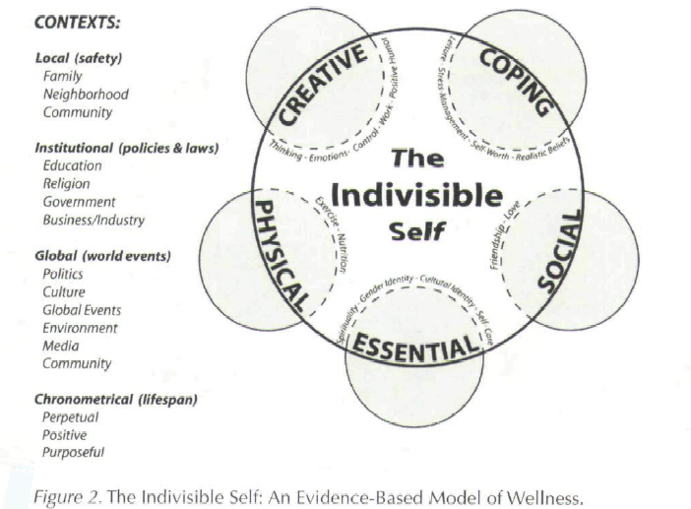
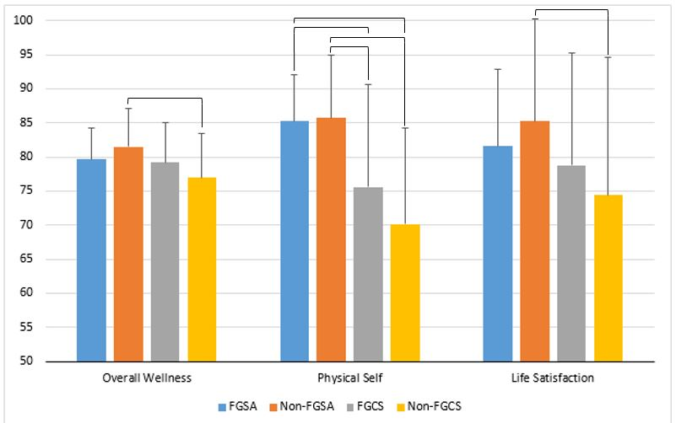
Overall Wellness of First-Generation College Student-Athletes
Shane Warehime, MS; Danae Dinkel, PhD University of Nebraska at Omaha, Omaha, NE
School of Health & Kinesiology
Abstract
Methods
Results
.
Participants (n=157) were full-time college students between the ages of 19-24 from a mid-sized, NCAA Division I university in the Midwest.
Overall wellness was assessed using the Five-Factor Wellness Inventory, a 91-item survey based on the Indivisible Self Model (Myers & Sweeney, 2004). The Five-Factor Wellness Inventory calculated one overall wellness score based on values from nine subscales: five wellness factors (coping self, creative self, social self, physical self, and essential self), three contexts (local, institutional, and global), and one life satisfaction measure. A one-way ANOVA was conducted to compare mean scores for overall wellness and each subscale.
Non-FGSA had the highest mean scores on overall wellness and 7 of the 10 subscales.
Creative self, coping self, social self, physical self, institutional context, chronometrical context, and life satisfaction.
Non-FGSA had significantly (p<0.05) higher scores than non-FGCS in overall wellness and life satisfaction.
Non-FGSA and FGSA both had significantly (p<0.05) higher scores in the physical self than non-FGCS and FGCS.
The present study examined the overall wellness of first-generation student-athletes (FGSA) in comparison to non-first generation student-athletes (non-FGSA), first-generation college students (FGCS), and non-first generation college students (non-FGCS). Overall wellness was assessed using the Five-Factor Wellness Inventory. Non-FGSA scored significantly higher than non-FGCS in overall wellness and life satisfaction. Non-FGSA and FGSA scored significantly higher than non-FGCS and FGCS in the physical self subscale (i.e., diet, exercise). In sum, athletics may play an important role in the wellness of student-athletes, which could be enough to mitigate any challenges that first-generation college students face.
Introduction
Results
Conclusion
The unique experiences and characteristics of student-athletes may boost specific areas of wellness that are enough to improve the overall wellness of student-athletes.
Physical wellness is a major component of student-athletes’ overall wellness.
For FGSA, athletics may mitigate, rather than compound, the challenges associated with being a first-generation college student.
Future research is needed to:
Explore the causal mechanisms that lead to elevated levels of wellness in student- athletes.
Examine the impact of injury and athletic retirement on student-athletes’ overall wellness.
For 16% of student-athletes, the challenges associated with college and participation in intercollegiate athletics may be amplified by being a first-generation college student (National Collegiate Athletic Association [NCAA], 2016). Student-athletes that are first-generation college students (FGSA) are more likely to be male and identify with a racial/ethnic minority group - characteristics that have been linked to issues such as over emphasizing athletics, lower graduation rates, career immaturity, marginalization, and stigmatization (Beamon, 2014; NCAA, 2016; Stone, Harrison, & Mottley, 2012). Additionally, the parents/families of FGSA are twice as likely to expect their children to become a professional or Olympic athlete than the parents/families of student-athletes that are not first-generation college students (non-FGSA) (NCAA, 2016). An emphasis on athletics from parents/families is linked to poor academic performance and increased behavioral problems in college (Beamon & Bell, 2006). Further, FGSA are more likely to receive need-based aid, take out loans, receive a Pell Grant, and pay for college themselves or have a job (NCAA, 2016). Financial stress in college is linked to reductions in academic performance and an increased risk of dropping out (Joo, Durband, & Grable, 2008; Xiao, Tang, & Shim, 2008). Despite these challenges, research examining FGSAs is limited (Warner, 2016). It is critical to gain insight into FGSA overall, holistic wellness to improve their academic and social experiences in college. The present study aimed to answer the following research question: How does the wellness of FGSA compare to non-FGSA, FGCS, and non-FGCS?
Acknowledgement
The present study was funded by the University of Nebraska at Omaha’s Graduate Research and Creative Activity funding mechanism.

