Slide 1
Is Poverty Color Blind?
Implications of Imagery Used by International Nongovernmental Organizations (INGOs) in the United States
Abhishek Bhati
Doctoral Candidate
School of Public Administration
Department of Public Administration
Binghamton University
February 19th 2018

Slide 2
Plan of Presentation
Background & Research Motivation
Research Presentation
Ongoing & Future Research
Comments & Discussion

Slide 3
Research Questions
How are people from developing countries portrayed or represented in the United States by INGOs working in the area of international development in their fundraising/advocacy materials?
Does the portrayal or representation of people in developing countries by INGOs in their fundraising/advocacy materials lead to stereotyping and racial bias?
Do racial biases affect the willingness to give to people living to the developing countries?
Notes:
I answer three research questions: how are people from developing countries represented in the US
Second question, does the representation lead to any stereotyping and racial bias
And finally how does racial biases affect willingness to give more from nonprofit fundraising sense.

Slide 4
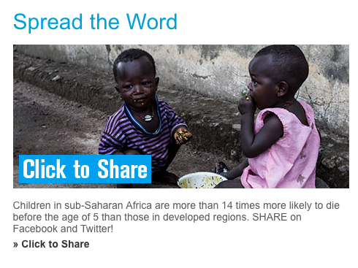
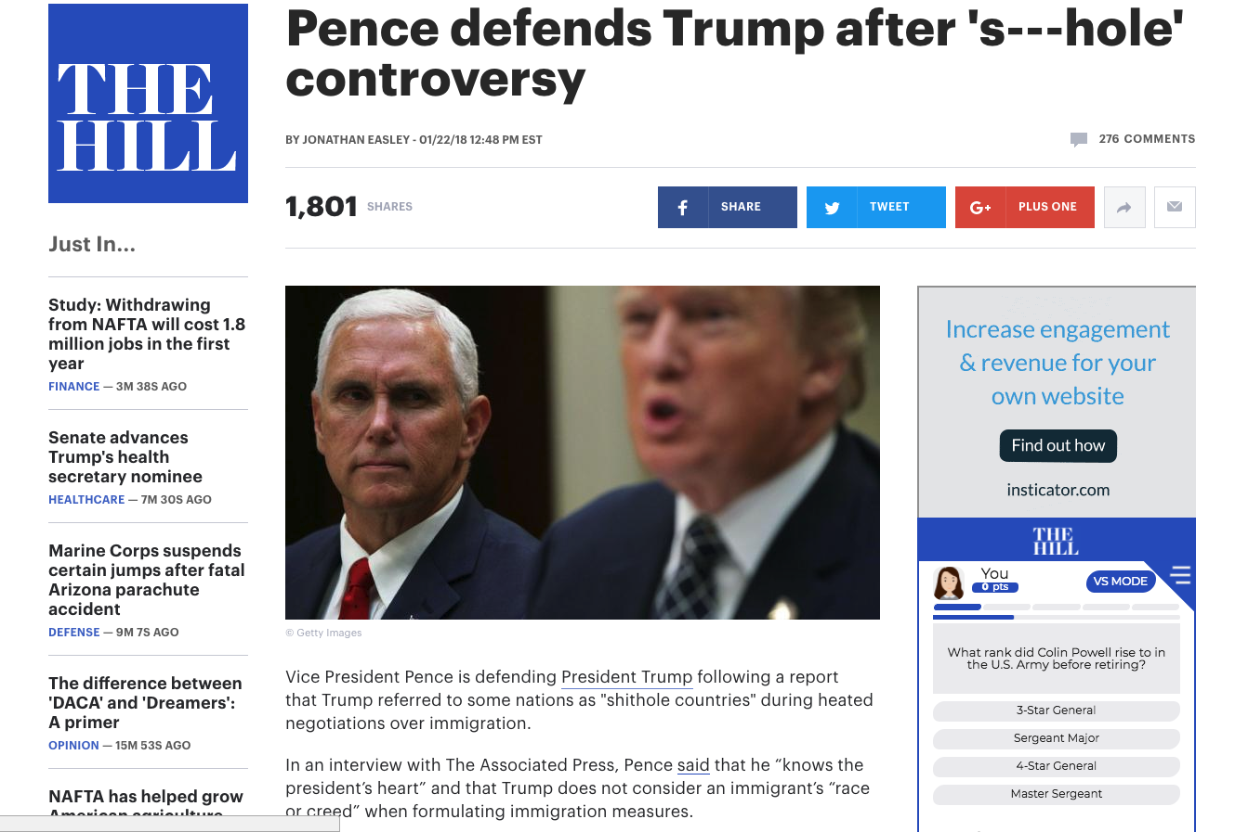
Source: https://www.sos-usa.org/our-impact/
childrens-statistics/africa
Source: http://thehill.com/homenews/administration
/370112-pence-defends-trump-after-s-hole-controversy
Notes:
Fast forward few years, I see images of poor from developing countries circulating in the media both television and social media.
[give few seconds to look at the images]
At the same time, political narrative in the developed countries such as United States is we don’t want these people who are sick or dirty in our countries.
Essentially, I am interested in exploring if these image of poverty contribute to racial biases.

Slide 5
Background
Growth in nonprofit sector with simultaneously decrease in government funding, leading to greater competition in the sector (Eikenberry & Kluver, 2004).
Weakening of beneficiaries’ position as donors are taking central role in philanthropy (Ostrander, 2007).
Increasingly, International NGOs harness the power of media to showcase need or generate funds (Vestergaard, 2013).
Most often INGOs use either negative or “ideal victim” images such as of children and women (Lissner, 1981; Dogra, 2012).
Notes:
There are four important themes emerging in nonprofit literature.
First, growth in the nonprofit sector by number of organizations and simultaneously decrease in the government spending. This is leading to growing dependence of organizations on donors for donations. This is further leading to growing importance of donors in philanthropy and at the same time organizations using media to reach out to more donors to showcase need or generate funds.
Finally, since the organizations are using media techniques of “branding” they often show images that capture audiences attention such as children and women.
So bottom line is that role of beneficiaries in fundraising is reduced to getting more donations rather than representing them with dignity and respect.

Slide 6
Literature Areas
Growing dependence of INGOs
towards donors, pushes organizations
to act more “businesslike.”
Donor centric philanthropy, INGOs showcasing their work using “ideal victim” to solicit donations.
Public Administration & Nonprofit Studies
Social Psychology
Sociology, Media Studies, Political Science, Development Studies
Representation
of Poor & Fundraising
Debates about power, perception,
social equity, global justice of the
marginalized.
Explicit (conscious) and Implicit
Biases using empirical tools such as
IAT.
Notes:
I arrange the literature in three broad areas or themes.
First, discussing growth in number of organization, reduce in government support and growing competation among organizations to attract more funds. This is leading to growing importance of donors and organizations showcasing their work using ideal victims such as children and women to gather more donations.
Second important theme is debate about power from more economic and political sense. Issues related to marginalization of poor within international and domestic context and discussions related to global justice and social equity.
Finally, empirical theories around biases using tools such implicit association test.
This study focuses on the center of these areas linking representation of the poor to dollar amount raised.

Slide 7
Research Gap
Beneficiaries
Developing Countries
Developed Countries
Donors
Fundraising ($)
Why people give?
Notes:
There is good amount of research on why donors give hence the empirical research is well established between donors and fundraising. However, there is quite less research between relationship of beneficiaries in fundraising and also within international context. Most research focuses in domestic context.

Slide 8
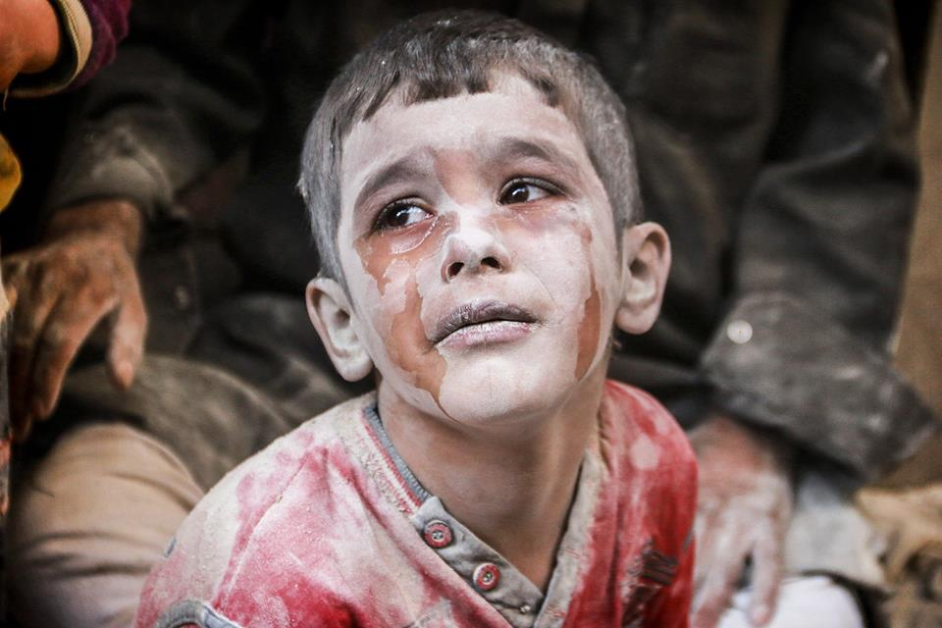
Images of Poverty
International NGOs (INGOs) stereotype poor by showing only images of children and women as they seem more “ideal victims” (Batson et al., 2005; Dean, 2015).
Several scholars and practitioners have criticized INGOs for using negative images of beneficiaries (Cohen, 2001).
INGOs often portray problems of the poor as simplistic and out of context. (Dogra, 2012)
Notes:
Research as suggest that INGOs show negative and stereotypical images to solicit donations. Some scholars have gone to the extend that it is pornographic and simplify the complicated and multi-dimensional problem of poverty into an emotional issue such as in this image boy is crying.
The question I am interested in how does these images effect perception of the donors and fundraising.

Slide 9
Research Questions
How are people from developing countries portrayed or represented in the United States by INGOs working in the area of international development in their fundraising/advocacy materials?
Does the portrayal or representation of people in developing countries by INGOs in their fundraising/advocacy materials lead to stereotyping and racial bias?
Do racial biases affect the willingness to give to people living to the developing countries?
Notes:
I answer three research questions: how are people from developing countries represented in the US
Second question, does the representation lead to any stereotyping and racial bias
And finally how does racial biases affect willingness to give more from nonprofit fundraising sense.

Slide 10
Mixed Methods Approach
Content analysis and semiotics of 320 Images
Measuring change in biases by positive/happy and negative/sad images on explicit biases and regression analysis.
Categorization of images into positive/happy or negative/sad
Face-ism (Ratio of face to body)
Research Question 1
Research Question 2
Research Question 3
Notes:
To answer these questions, I use mixed method approach. Qualitative tools of understanding overall context of the images. Using survey instruments get rate each image into positive and negative. Use Quantitative techniques such as measuring ratio of face to body and also regression analysis to see effect of implicit biases on willingness to give.

Slide 11
Data Collection Process
Step I
Forbes list of 32 largest INGOS in the U.S.
Collected 10 images from each Facebook account (totaling 320 images)

Slide 12
List of International NGOs
1. Task Force for Global Health | 12. Good 360 | 23. Brothers Brother Foundation
2. Food for the Poor | 13. Catholic Relief Services | 24. ChildFund International
3. Habitat for Humanity International | 14. Doctors Without Borders USA | 25. International Rescue Committee
4. World Vision | 15. Bill, Hillary and Chelsea Clinton Foundation | 26. Helen Keller International
5. Compassion International | 16. Cross International | 27. Children International
6. Direct Relief | 17. Catholic Medical Mission Board | 28. Matthew 25: Ministries
7. Americares Foundation | 18. Population Services International | 29. Medical Teams International
8. MAP International | 19. Rotary Foundation of Rotary International | 30. Project Orbis International
9. United States Fund for UNICEF | 20. Operation Blessing International Relief & Development | 31. PATH
10. Save the Children Federation | 21. American Jewish Joint Distribution Committee | 32. Smile Train
11. CARE USA | 22. Project HOPE
Collected 10 images from each Facebook account (totaling 320 images)

Slide 13
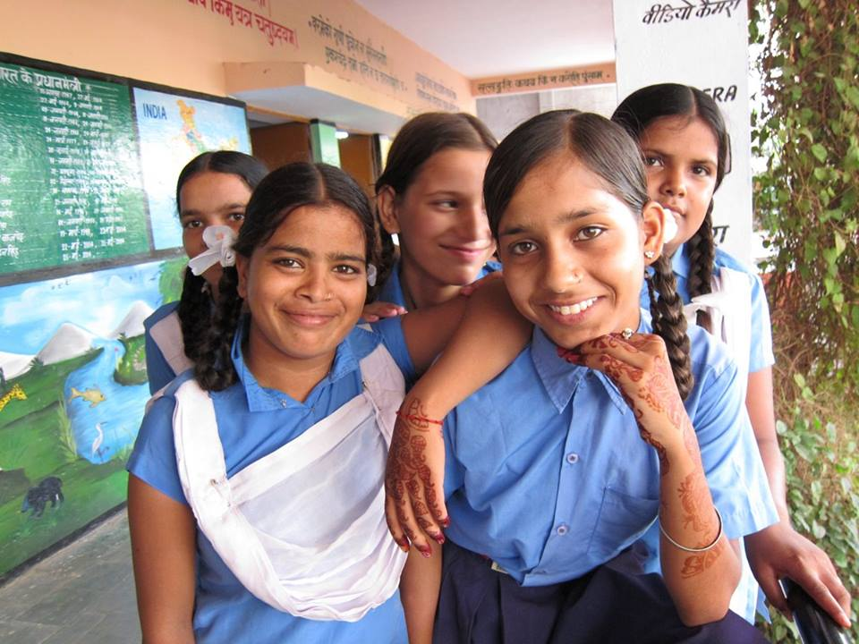
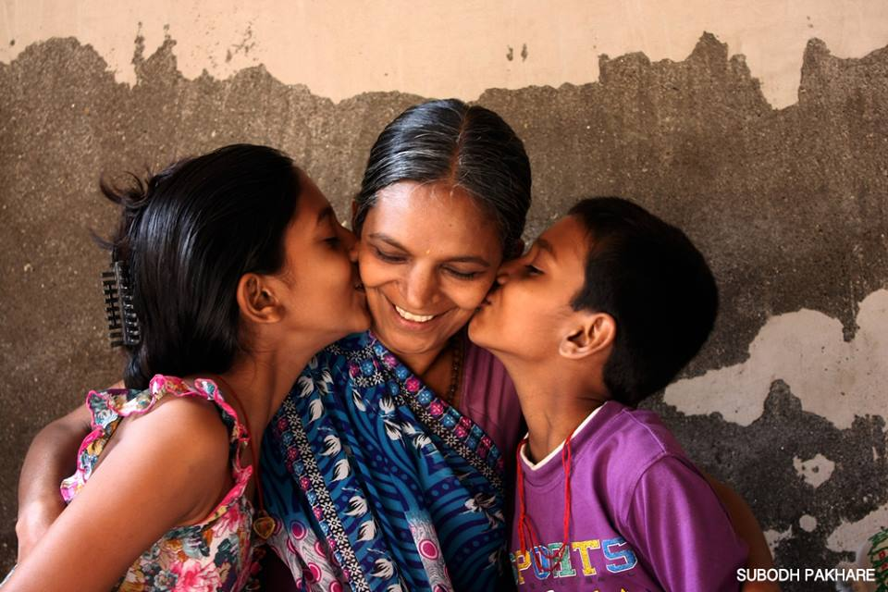
Data Collection Process
Step II
Semiotics and content analysis of 320 images.
Who is represented? (boy, girl, man, woman etc.)
Where are they represented? (house, outside, slum, etc.)
How are they represented? (active versus passive)
Message from the image
(a)
(b)
Notes:
Where does face-ism come into play here?

Slide 14

Data Collection Process
Step III
Collected data from 910 observations using Amazon’s Mechanical Turk (MTURK).
Participants rate each image on a Likert scale from extremely bad (rated 1 point) to extremely good (rated 5 points)

Slide 15
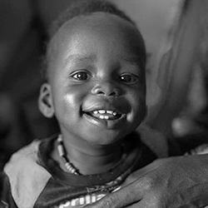
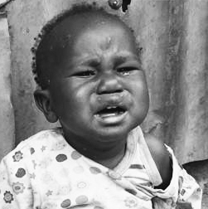
Data Collection Process
Step IV
Used one positive/happy image and one negative/sad image as representative categories to conduct the IAT survey experiment.
(a) Happy/Positive Image
(b) Sad/Negative Image

Slide 16
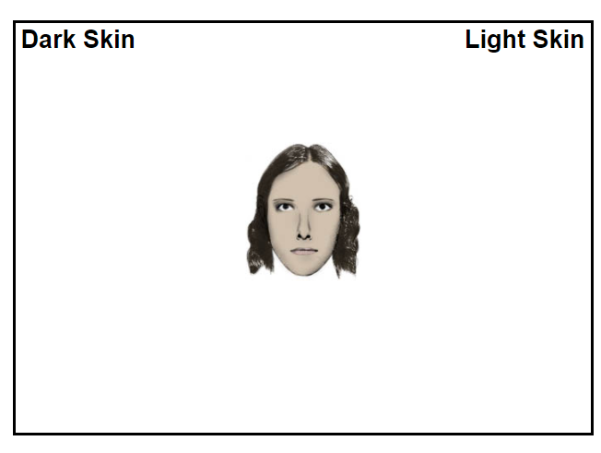
Data Collection Process
Step V
Collected data from 700 participants measuring the effect of biases and “willingness to give”
Skin-tone Implicit Association Test (IAT)

Slide 17
Data Collection Process
Rating of images and further analysis
Representative categories of images
Analysis of images
Testing biases on “willingness to give”
Collection of images
1
I1
I1I
IV
V

Slide 18
Research Questions
How are people from developing countries portrayed or represented in the United States by INGOs working in the area of international development in their fundraising/advocacy materials?
Does the portrayal or representation of people in developing countries by INGOs in their fundraising/advocacy materials lead to stereotyping and racial bias?
Do racial biases affect the willingness to give to people living to the developing countries?

Slide 19
“Infantilization” of Poverty/Ideal Victim
Images focusing girls, women and children – 190
Images focusing on men and family - 21

Slide 20
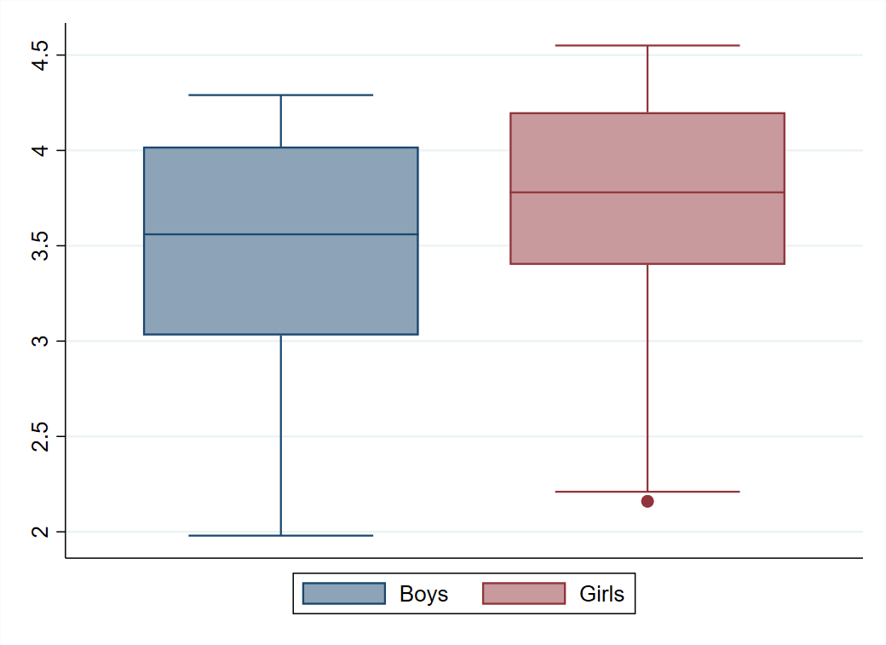
“Infantilization” of Poverty/Ideal Victim
Cohen’s d = 0.37
Participants rated girls images as
more positive

Slide 21
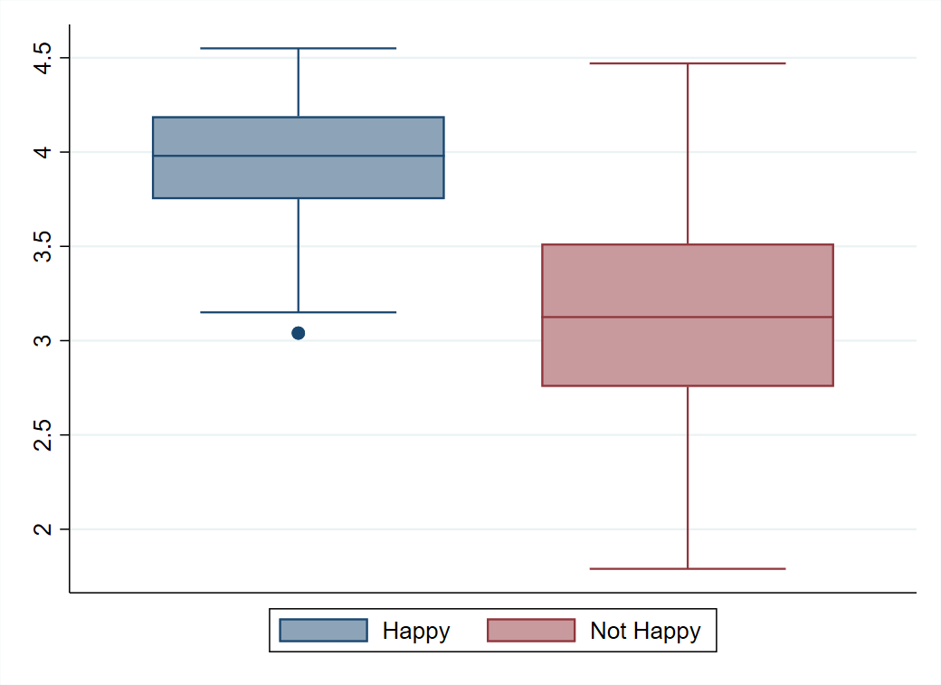
“Infantilization” of Poverty/Ideal Victim
Cohen’s d = 1.7
Participants rated happy images as
more positive

Slide 22
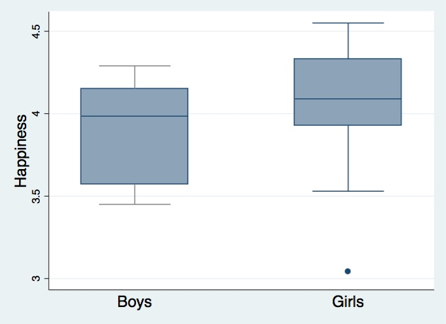
“Infantilization” of Poverty/Ideal Victim
Cohen’s d = 0.52
Participants rated girls
happier than boys

Slide 23
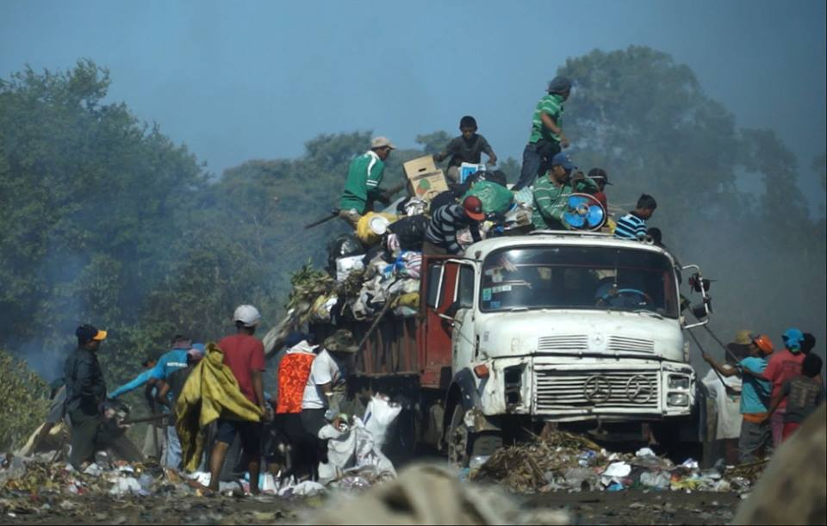
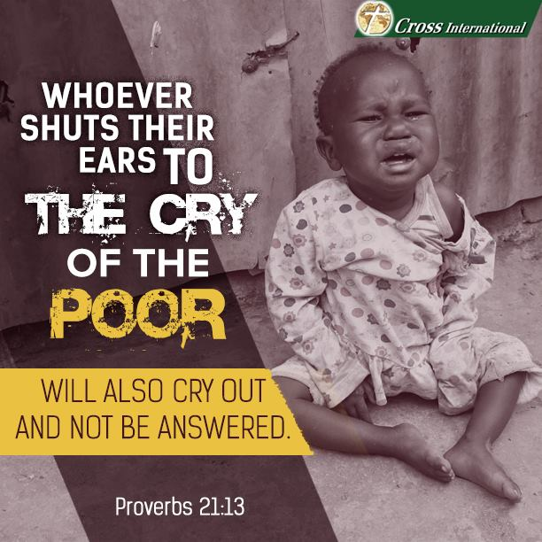
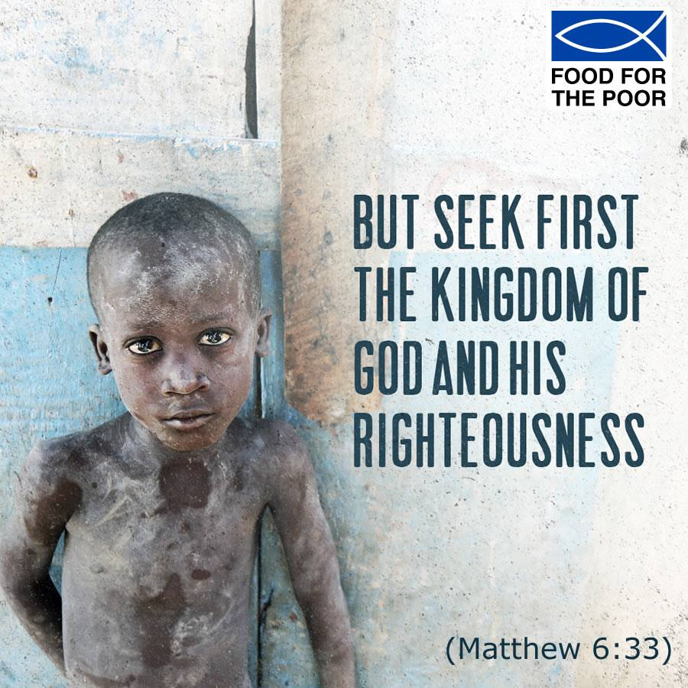
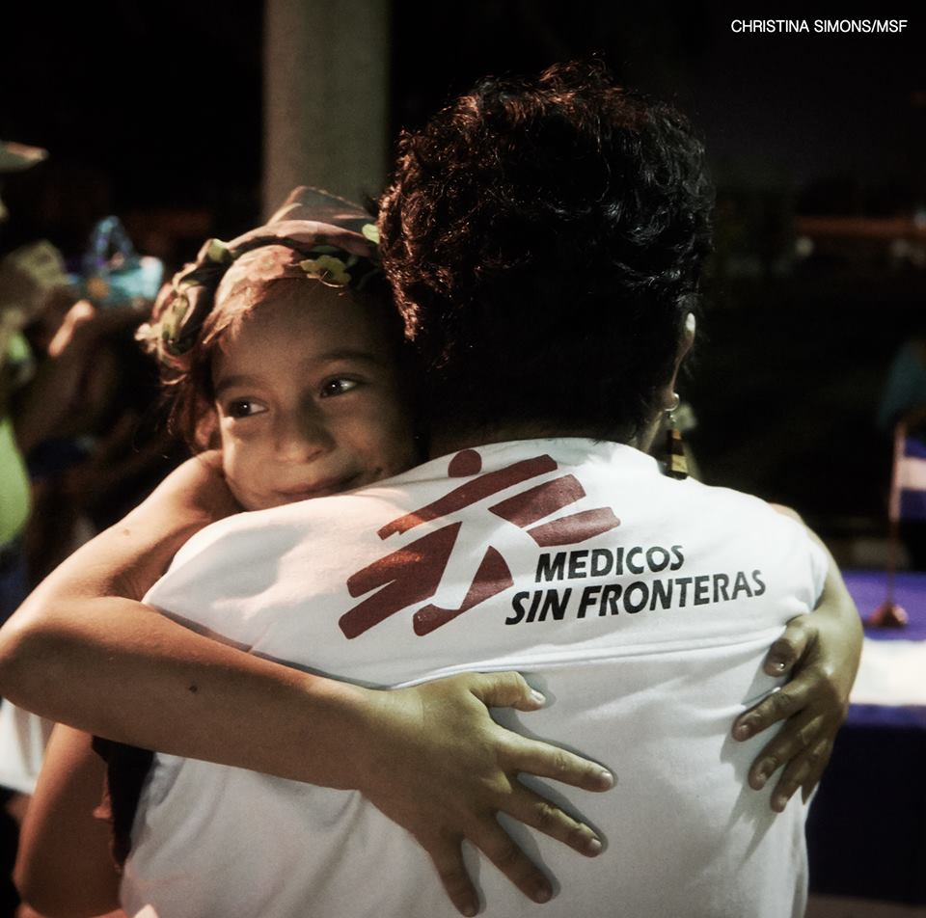
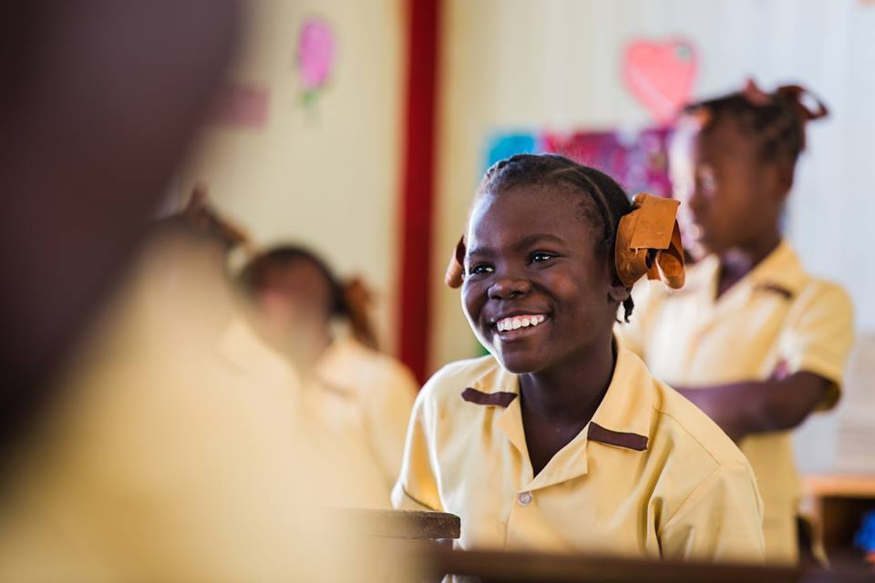
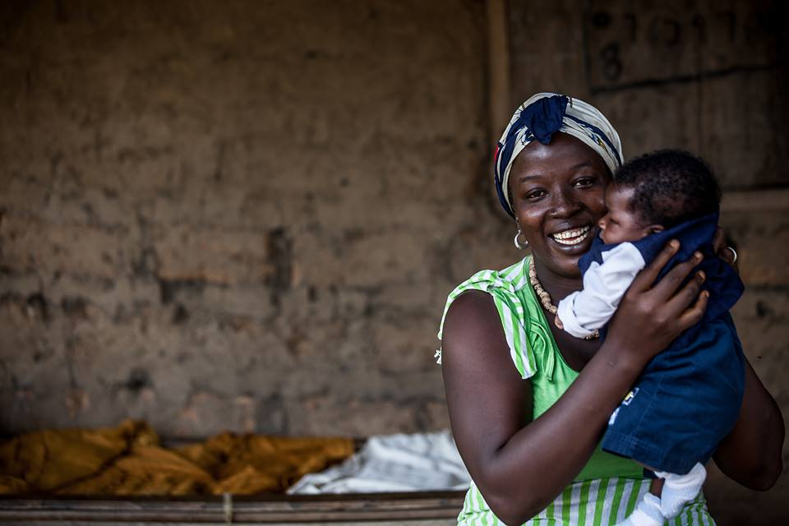


Stereotyping Poverty
(a)
(b)
(c)
$\text{L}\text{ow}\text{/}\text{negative} \text{rated} \text{images}\text{ (}\text{x}\text{̅}$ < 2)
(d)
(e)
(f)
$H\text{igh}\text{/}\text{positive} \text{rated} \text{images} \text{(}\text{x}\text{̅}$ $≥$ 4.5)

Slide 24
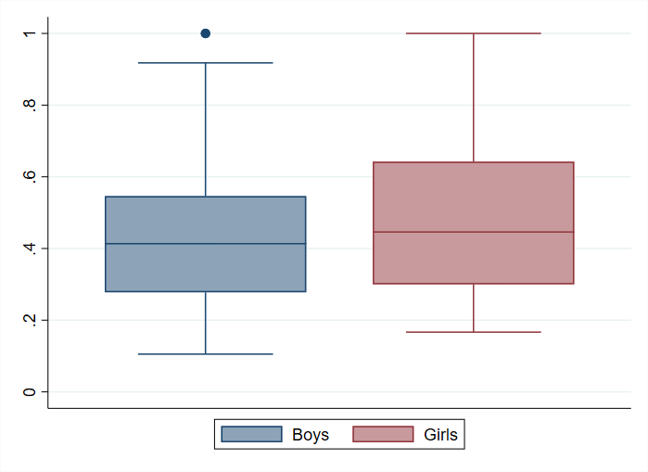
“Face-ism” and Objectification of Women
Across different media, cultures, men are portrayed with more facial prominence than women in visual representation (Konrath & Schwarz, 2007).
Research suggests that higher facial prominence increases positive impressions and likeability.
Recent research continues to suggest a focus women’s bodies still receives more focus than men’s. Example, “sex sells” approach in PETA advertisement.
Face Prominence = Measure of Face
Length of Body
(Cohen’s d = 0.37)
Notes:
Are you going to explain what this is referring to further? I didn't understand this reference in the presentation

Slide 25
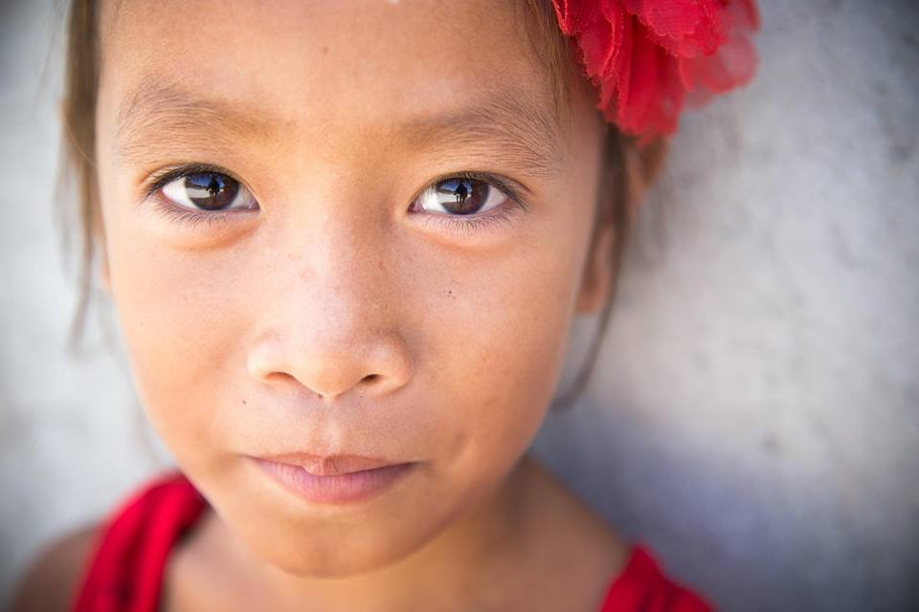
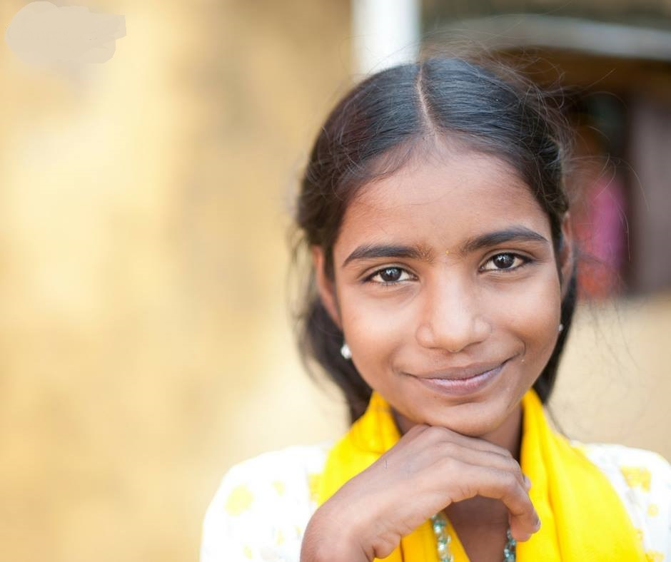
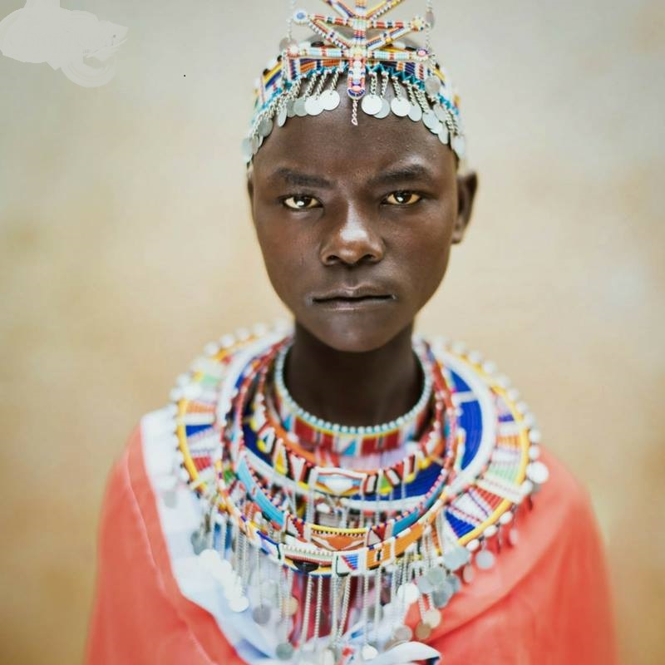
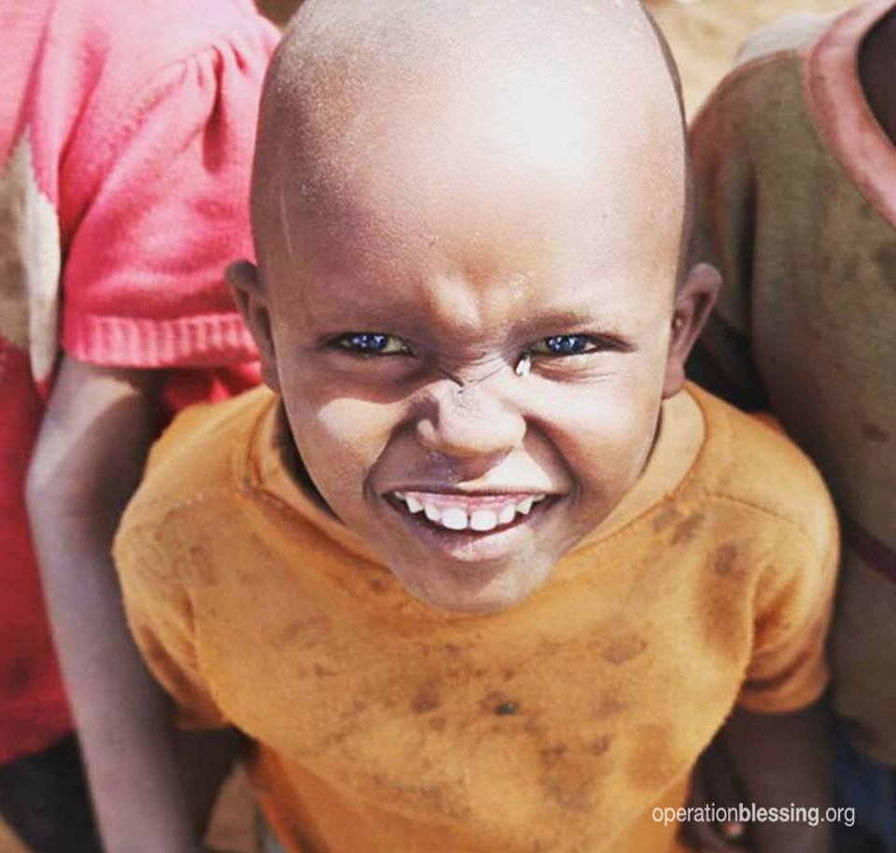
‘Face-ism’ and Desire to Help
(a)
(b)
(c)
(d)

Slide 26
Research Questions
How are people from developing countries portrayed or represented in the United States by INGOs working in the area of international development in their fundraising/advocacy materials?
Does the portrayal or representation of people in developing countries by INGOs in their fundraising/advocacy materials lead to stereotyping and racial bias?
Do racial biases affect the willingness to give to people living to the developing countries?

Slide 27
Data Collection Process
Collection of images
Rating of images and further analysis
Representative categories of images
Analysis of images
Testing biases on “willingness to give”
1
I1
I1I
IV
V

Slide 28
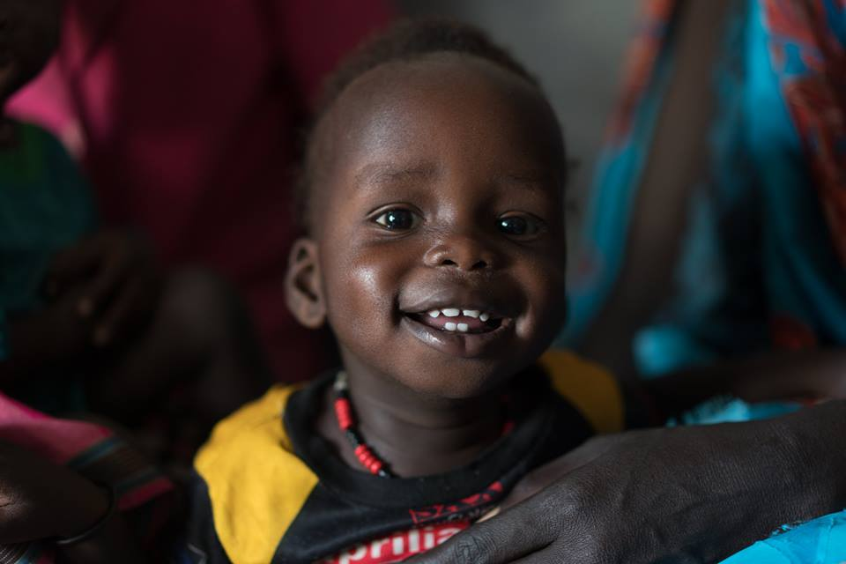
Data Sources
(a) Original Image (Positively rated)
(b) Original Image (Negatively rated)
(c) Happy/Positive Image
(d) Sad/Negative Image

Slide 29
Measuring Biases
  Explicit Biases (Conscious Self Report Biases)
    How comfortable do you feel if a Person of Color (POC) lives in your neighborhood?
      Participants rated their opinions using a 7 point Likert scale – (1) Extremely uncomfortable to (7) Extremely comfortable.
    How warm or cold you feel towards a POC?
  Implicit Biases (Unconscious Representations)

Slide 30
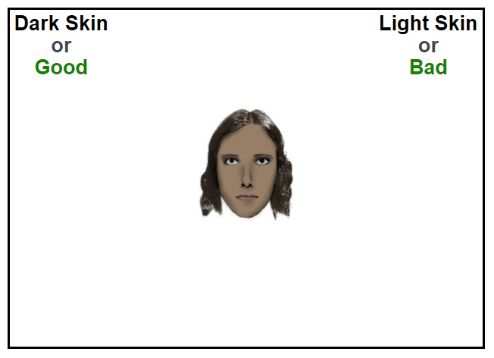
Measuring Implicit Biases
(a)
(b)
Skin-tone Implicit Association Test (IAT)

Slide 31
Data Sources
Three experiments by changing happy/positive and sad/negative images and message.
  Tested effect of happy/sad images on individuals’ explicit and implicit bias.
  Measured implicit bias using Implicit Association Test (IAT).
Collected data from 700 participants using Amazon’s MTURK.

Slide 32
Experiment Design
Model I
No Info
Demographics
Explicit Biases
IAT
Happy
Measure Giving
Sad
Model II
No Info
Demographics
Happy
Explicit Biases
IAT
Measure Giving
Sad
Model III
Demographics
No Info
Happy
Measure Giving
Explicit Biases
IAT
Sad
Notes:
All these three models measure demographic variables, explicit and explicit biases and finally willingness to give.
All the models are essentially the same but there is some sort of information manipulation. The reason for doing three experiments is to see if there is any effect of changing the local of happy and sad image changes explicit baises.
Ideally it should not change the implicit biases as implicit biases takes much long time to change with constinous education as it is deep rooted.

Slide 33
Descriptive Statistics
 | Experiment I |  | Experiment II |  | Experiment III
 | Freq | % | Freq | % | Freq | %
Gender
Male | 37 | 36.3% | 115 | 44.6% | 192 | 49.2%
Female | 64 | 62.7% | 142 | 55.0% | 196 | 50.3%
Education
High school graduate | 7 | 6.9% | 11 | 4.3% | 43 | 11.0%
Some college | 28 | 27.5% | 63 | 24.4% | 95 | 24.4%
4 year degree | 39 | 38.2% | 107 | 41.5% | 152 | 39.0%
Professional degree | 13 | 12.7% | 44 | 17.1% | 45 | 11.5%
Race
White | 81 | 79.4% | 191 | 74.0% | 286 | 73.3%
African-American | 9 | 8.8% | 25 | 9.7% | 44 | 11.3%
Asian | 7 | 6.9% | 26 | 10.1% | 32 | 8.2%
Other | 3 | 2.9% | 13 | 5.0% | 20 | 5.1%
Income
Less than $50,000 | 49 | 48.0% | 126 | 48.8% | 205 | 52.6%
$50,000 - $100,000 | 43 | 42.2% | 90 | 34.9% | 139 | 35.6%
More than $100,000 | 10 | 9.8% | 40 | 15.5% | 45 | 11.5%
Age
Less than 34 years | 45 | 44.1% | 135 | 52.3% | 184 | 47.2%
35 - 54 years | 46 | 45.1% | 94 | 36.4% | 154 | 39.5%
More than 55 years | 11 | 10.8% | 29 | 11.2% | 50 | 12.8%

Slide 34
Descriptive Statistics
 | Experiment I |  | Experiment II |  | Experiment III
 | Freq | % | Freq | % | Freq | %
Religiousness
Slightly Religious | 22 | 21.6% | 59 | 22.9% | 82 | 21.0%
Moderately Religious | 30 | 29.4% | 73 | 28.3% | 109 | 27.9%
Strongly Religious | 11 | 10.8% | 34 | 13.2% | 47 | 12.1%
Not at all Religious | 39 | 38.2% | 91 | 35.3% | 149 | 38.2%
Party ID
Democrat | 50 | 49.0% | 115 | 44.6% | 147 | 37.7%
Republican | 20 | 19.6% | 62 | 24.0% | 101 | 25.9%
Independent | 29 | 28.4% | 66 | 25.6% | 123 | 31.5%
Other | 2 | 2.0% | 14 | 5.4% | 17 | 4.4%
Ideology
Strongly Liberal | 11 | 10.8% | 41 | 15.9% | 56 | 14.4%
Moderately Liberal | 27 | 26.5% | 56 | 21.7% | 78 | 20.0%
Slightly Liberal | 13 | 12.7% | 34 | 13.2% | 45 | 11.5%
Neutral | 25 | 24.5% | 44 | 17.1% | 85 | 21.8%
Slightly Conservative | 11 | 10.8% | 40 | 15.5% | 46 | 11.8%
Moderately Conservative | 12 | 11.8% | 33 | 12.8% | 57 | 14.6%
Strongly Conservative | 3 | 2.9% | 10 | 3.9% | 23 | 5.9%
 | Mean | SD | Mean | SD | Mean | SD
IAT Score | 0.54 | 0.37 | 0.46 | 0.43 | 0.54 | 0.40
Observations | 102 |  | 258 |  | 390

Slide 35
Results
 | Sad/Negative |  | Happy/Positive
Experiment I | Mean | SD | Mean | SD
Explicit Biases
POC living in neighborhood | 5.46 | 1.75 | 5.78 | 1.25
Feeling towards POC | 5.03 | 1.37 | 5.18 | 1.18
Implicit Biases
D score (IAT) | 0.57 | 0.34 | 0.50 | 0.45
Experiment II
Explicit Biases
POC living in neighborhood | 5.57 | 1.55 | 5.87 | 1.67
Feeling towards POC | 5.08 | 1.38 | 5.19 | 1.59
Implicit Biases
D score (IAT) | 0.42 | 0.45 | 0.40 | 0.39
Experiment III
Explicit Biases
POC living in neighborhood | 5.47 | 1.66 | 5.60 | 1.53
Feeling towards POC | 5.09 | 1.30 | 5.15 | 1.36
Implicit Biases
D score (IAT) | 0.55 | 0.40 | 0.54 | 0.40
Higher score = less
Explicit bias
Higher score = more
Implicit bias

Slide 36
Research Questions
How are people from developing countries portrayed or represented in the United States by INGOs working in the area of ‘international development and need’ in their fundraising/advocacy materials?
Does the portrayal or representation of people in developing countries by INGOs in their fundraising/advocacy materials lead to stereotyping and racial bias?
Do racial biases affect the willingness to give to people living in the developing countries?

Slide 38
Note: Controls for education, gender, race, religiosity, income, age, party identification,
type of image, and past donation behavior
Notes:
Since the effect is not same across the five thresholds (this is intuitive since people’s giving behavior will vary depending on whether they are losing $10 out of their pocket or $1000), this is a violation of parallel odds assumption (crudely saying the effect is parallel across the thresholds).

Slide 39
Key Takeaways
Though representation of the beneficiaries has become “positive.” Still, INGOs fundraising imagery simplifies poverty into a binary, taking it out of context.
Further, INGOs show negative or stereotypical images to evoke emotional reaction thereby fostering racial attitudes. This runs counter to the mission of several INGOs promoting global social justice.
Negative/sad imagery stereotypes poor people, thereby increasing implicit biases and may have an effect on future giving. Thereby, INGOs are potentially hurting their long-term fundraising success.
Notes:
Add [images] to drive takeaways.
Point 1 – INGOs simplify poverty into a binary taking it out of context. For instance, we saw from the findings there were no images of men or family. Most of the images were of children and mothers. Further, INGOs focus on symptom of poverty (that is child) is crying but leaves several unanswered questions.
Second, INGOs show negative or stereotypical images to evoke emotional reaction thereby fostering racial attitudes. This runs counter to mission of several ingos promoting global social justice.
Finally, negative/sad images increases baises and has an effect on future giving. Thereby, INGOs are potentially hurting their long-term fundraising success.

Slide 40
(a)
(b)

Slide 41
Future Research Agenda
Domestic
Nonprofit Management
Supply (Donors)
Demand (Beneficiaries)
Fundraising
Philanthropy
Public Administration
Social Equity
International

Slide 42
Beneficiaries Portrayal and Fundraising
Journal Articles
Faces of the Needy: The Portrayal of Destitute Children in the Fundraising Campaigns of NGOs in India. With Angela M. Eikenberry. International Journal of Nonprofit and Voluntary Sector Marketing 21(1):31-43.
Book Chapter
A Critical Fundraising Perspectives: Understanding the Beneficiaries Experience. With Angela M. Eikenberry. Reframing Nonprofit Management: Democracy, Inclusion, and Social Change (Forthcoming).
Future Research Question
How does beneficiaries portrayal effect donors perceptions about people living in the developing countries?
  Further investigating the relationship between representation and fundraising success such as large sample, field experiments etc.

Slide 43
Social Media Use and Fundraising
Under Review
Success in an Online Giving Day: The Role of Social Media and Budget Size in Fundraising. Nonprofit Voluntary Sector Quarterly (NVSQ). Revise & Resubmitted.
What is the role of social media in fundraising?
  Continue to work in exploring the relationship between social media usage by nonprofits and success in giving days.
  Giving days such as #GivingTuesday and Omaha Gives.
What is the role of social media in advocacy organizations such as climate change or feminist organizations?
  How are advocacy organizations use social media to engage general public?
  Does social media engagement (social network) by advocacy organizations leads to successful fundraising?

Slide 44
Work in Process
Dissertation papers
Is Poverty Color-Blind: Implications of Imagery on Implicit Association Test. Plan for submission to Nonprofit Voluntary Sector Quarterly (NVSQ).
Race, Gender, and Poverty: Semiological Analysis of Representation of Poor in Fundraising Campaigns by INGOs. Plan for submission to Third World Quarterly.
Transition of Fundraising Strategies by INGOs: Towards Deliberate Positivism. Plan for submission to Voluntas: International Journal of Voluntary and Nonprofit Organizations.
Other Project
A Meta-Analysis of Place-Based Giving Days in the United States: The Landscape and Effects. With Catherine Humphries-Brown and Angela M. Eikenberry. Plan for submission to Journal of Public and Nonprofit Affairs.
Notes:
These are not other projects, they are presentatinos of your worki in your dissertation or giving days work. I suggest you describe project areas rather than focus on past presentations.

Slide 45
Thank you!
Abhishek Bhati
abhati@unomaha.edu

Slide 46
S. No. | Task | Higher numbers reflect association between | Observations: Implicit (Explicit)
1. | Age attitude | Young + Good/Old + Bad | 351, 204 (356,308)
2. | Race attitude | White + Good/Black + Bad | 732,881 (759,566)
3. | Skin-tone attitude | Light skin + Good/Dark skin + Bad | 122,988 (72,735)
4. | Child-race attitude | White + Good/Black + Bad | 28,816 (41,886)
5. | Arab-Muslim attitude | Other Peoples + Good/Arab Muslims + Bad | 77,254 (37,499)
6. | Religion attitude | Christian + Good/Jewish + Bad | 66,092 (43,711)
7. | Disability attitude | Abled + Good/Disabled + Bad | 38,544 (23,120)
8. | Sexuality attitude | Straight People + Good/Gay People + Bad | 269,683 (168,498)
9. | Weight attitude | Thin + Good/Obese + Bad | 199,329(110,548)
10. | Race-weapons stereotype | White + Harmless Objects/Black + Weapons | 85,742 (91,771)
11. | American-native stereotype | White Am. + American/Native Am. + Foreign | 44,878 (41,966)
12. | American-Asian stereotype | White + American/ Asian + Foreign | 57,569 (27,734)
13. | Gender-science stereotype | Male + Science/Female + Liberal Arts | 299,298 (139,182)
14. | Gender-career stereotype | Male + Career/Female + Family | 83,084 (82,550)
15. | Presidential attitude | Bush + Good/Other President + Bad | 68,123 (73,595)
16. | Election 2004 attitude | Bush + Good/Gore + Bad | 22,904 (21,421)
17. | Election 2000 attitude | Bush + Good/Kerry + Bad | 27,146 (29,925)

Slide 47
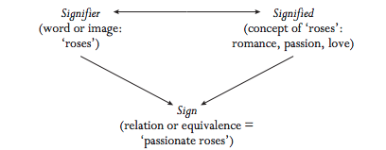
Semiotics

Slide 48
 | Pr(No Giving) | Pr(<$10) | Pr($10-$100) | Pr($100-$1000) | Pr(>$1000)
Implicit Bias
IAT Score | 0.074*** | 0.017*** | -0.031** | -0.039*** | -0.020***
 | (0.027) | (0.007) | (0.012) | (0.015) | (0.008)
Education
More than 4 years | 0.018 | 0.005 | -0.006 | -0.011 | -0.005
 | (0.022) | (0.006) | (0.007) | (0.014) | (0.007)
Gender
Male | 0.066** | -0.044* | -0.040 | -0.016 | 0.034**
 | (0.029) | (0.026) | (0.037) | (0.026) | (0.017)
Race
White | -0.011 | -0.003 | 0.004 | 0.007 | 0.003
 | (0.025) | (0.007) | (0.009) | (0.016) | (0.007)
Religiosity
Slightly Religious | -0.057** | -0.015* | 0.024** | 0.034** | 0.014*
 | (0.028) | (0.008) | (0.012) | (0.017) | (0.008)
Moderately/Strongly Religious | -0.097*** (0.025) | -0.029*** (0.009) | 0.034*** (0.011) | 0.062*** (0.017) | 0.029*** (0.009)
Income
$50,000 - $$99,999 | -0.087*** | -0.026*** | 0.031*** | 0.055*** | 0.026***
 | (0.022) | (0.008) | (0.010) | (0.015) | (0.008)
More than $100,000 | -0.085*** | -0.025** | 0.031*** | 0.054** | 0.025**
 | (0.031) | (0.011) | (0.011) | (0.022) | (0.012)

Slide 49
 | Pr(NoGiving) | Pr(<$10) | Pr($10-$100) | Pr($100-$1000) | Pr(>$1000)
Age
35 - 54 years | 0.066*** | 0.021*** | -0.023** | -0.044*** | -0.020***
 | (0.023) | (0.008) | (0.009) | (0.015) | (0.007)
More than 54 years | 0.103*** | 0.030*** | -0.041** | -0.064*** | -0.028***
 | (0.036) | (0.010) | (0.019) | (0.021) | (0.009)
Political ID
Republican | 0.157*** | 0.043*** | -0.071*** | -0.093*** | -0.036***
 | (0.031) | (0.011) | (0.019) | (0.018) | (0.009)
Independent | 0.055** | 0.020** | -0.017* | -0.040** | -0.018**
 | (0.024) | (0.009) | (0.009) | (0.017) | (0.008)
Other | 0.070 | 0.027 | -0.197** | 0.025 | 0.075
 | (0.069) | (0.059) | (0.079) | (0.070) | (0.058)
Past Giving Behavior
Donated outside US | -0.298*** | -0.072*** | 0.110*** | 0.194*** | 0.067***
 | (0.024) | (0.027) | (0.039) | (0.031) | (0.019)
Condition
Happy/Positive Image | 0.042* | 0.012* | -0.016* | -0.026* | -0.012*
 | (0.022) | (0.006) | (0.009) | (0.014) | (0.006)
Observations | 678 | 678 | 678 | 678 | 678
Standard errors in parentheses *** p<0.01, ** p<0.05, * p<0.1

