Slide 1
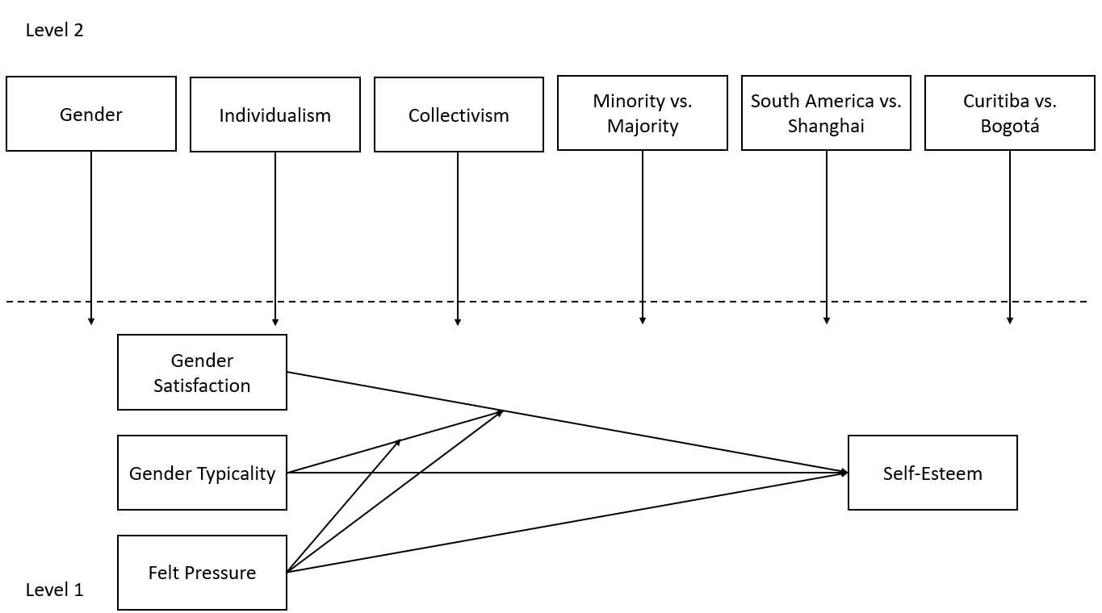
Gender Identity and Self-Esteem Within the Contexts of the Same-Sex Peer Group, Nation, and Group Individualism and Collectivism
Mithra H. Pirooz, Michelle E. Tully, Jonathan Bruce Santo, Lina Maria Saldarriaga, Josafá Moreira da Cunha, Bin-Bin Chen, & William M. Bukowski
Department of Psychology, University of Nebraska at Omaha
Background
Results
Adolescence is a period of development during which needs and relationships shift (Sebastian, Burnett, & Blakemore, 2008). Issues of gender also become more salient, and gender identity has been related to different areas of psychosocial adjustment, such as self-esteem (Egan & Perry, 2001). The current study examined predictors of self-esteem among early adolescents in the context of a multilevel model. We considered felt pressure to conform to gender norms, gender typicality, and gender satisfaction as individual-level predictors within the contexts of the same-sex peer group, nation, and group levels of individualism and collectivism. Multilevel modeling was employed to account for nonindependence between groups.
Hypothesis testing was conducted using multilevel modeling in HLM. The final model was a good fit to the data. A conceptual model of results is provided in Figure 1.
Multiple interactions were found to be statistically significant. Particularly noteworthy was the three-way interaction between gender satisfaction, felt pressure, and the country differences on self-esteem (Figure 2). Specifically, in Montreal, the effect of gender satisfaction on self-esteem was not significantly stronger or weaker if individuals experienced high felt pressure to conform to gender norms. In Shanghai, however, the effect of gender satisfaction on self-esteem was negative in cases where high felt pressure was experienced, but weakly positive in cases with low felt pressure. In other words, in Shanghai, if individuals reported high felt pressure, higher levels of gender satisfaction were associated with lower levels of self-esteem. However, if they reported low felt pressure, higher levels of gender satisfaction were associated with higher levels of self-esteem. In Curitiba, the effect of gender satisfaction was stronger if an individual felt high pressure to conform, meaning that in contexts with felt high pressure, individuals with high gender satisfaction were more likely to experience high self-esteem than in contexts with low felt pressure. In Bogotá, the relationship between gender satisfaction and self-esteem was only slightly stronger in contexts with high felt pressure.
Figure 1. The final model. Values represent the standardized factor loadings, regression coefficients, correlations between the variables. R² values are also included.
Method
Participants included early adolescents from Brazil (n = 320), Canada (n = 184), China (n = 74), and Colombia (n = 236), with 814 in total (Mage = 11.01, SD = 1.24; 54% male) who completed self-reports of gender identity and perceived gender norms.
Specifically, we measured self-esteem (α = .75) using a revised Perceived Competence Scale for Children (Harter, 1982). Further, felt pressure to conform to gender norms (α = .75), gender typicality (α = .71), and gender satisfaction (α = .90) were measured using a revised gender identity scale (Egan & Perry, 2001). A classroom norms measure of individualism (α = .80) and collectivism (α = .83) was also used.
We employed multilevel modeling to account for the nested nature of the same-sex peer group data. Self-esteem was the dependent variable with felt pressure, gender typicality, and gender satisfaction as individual-level predictors. At the level of the same-sex peer group, we tested for differences in the associations as a function of gender and individualism and collectivism. Differences across the samples were also explored.
.
Figure 1. Conceptual model.
Figure 2. Interaction between gender satisfaction, felt pressure, and country differences on self-esteem.
Conclusions
The current findings illustrate some differences in how gender role norms were associated with self-esteem. Moreover, differences across same sex peer groups were observed based on gender, individualism/collectivism and across samples. The results of the present study illustrate the strong role that gender role norms play in adolescents’ overall self-esteem.
Future directions of research may further focus on the relationships among the variables of interest. Specifically, researchers may explore other groups variables regarding gender norms and expectations. Additionally, the adoption of an emic perspective may allow for researchers to tease apart some of the more nuanced cultural factors that may be influencing gender identity and psychosocial adjustment. Consideration of additional cultural contexts may also reveal fascinating conclusions.
References
Egan, S. K., & Perry, D. G. (2001). Gender identity: A multidimensional analysis with implications for psychosocial adjustment. Developmental Psychology, 37, 451-463. doi:10.1037/0012-1649.37.4.451
Harter, S. (1982). The perceived competence scale for children. Child Development, 53, 87-97. doi:10.2307/1129640
Sebastian, C., Burnett, S., & Blakemore, S. (2008). Development of the self-concept during adolescence. Trends In Cognitive Sciences, 12, 441-446. doi:10.1016/j.tics.2008.07.008

