Slide 1
Big Mouth as Comprehensive Sexuality Education
By: Kristina Medero

Slide 2
Outline
Sex Education
Development in the US
Current Trends in Research
Entertainment-Education
Theoretical Expectations
SIECUS (2008) analytical guide
Normative Theory
Research Questions
Method
Variables
Analysis

Slide 3
Sex Education
Development in the US (Irvine, 2002, Jensen, 2007)
1913 Chicago Experiment
1964 SIECUS
2002 Talk About Sex
Current Trends
Knowledge Gaps (Marques et al., 2015)
Entertainment-Education (Moyer-Guse, Mahood, & Brookes, 2011)
one of the most used behavior change methods of sex education

Slide 4
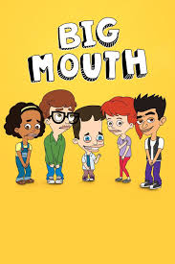
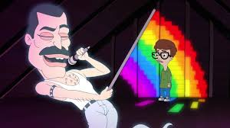
Entertainment-Education
Drama (Booker, Miller, & Ngure, 2016)
Narrative
Reduced Counterarguing
Humor (Mckee et al., 2014, Moyer-Guse et al., 2011)
Males
Relevance
Social Script (Clair et al., 2014)
Inclusivity

Slide 5
Theoretical Expectations
SIECUS (2008)
Specific to US values
Six components: human development, relationships, personal skills, sexual behavior, sexual health, and society & culture
Normative Theory:
Normative theory explains “how a media system should be structured and operated in order to conform to or realize a set of ideal social values” (Baran & Davis, 2015, p. 16)

Slide 6
Research Questions
RQ1: To what extent does the Netflix series Big Mouth meet the SIECUS ideal
comprehensive sexuality education?
RQ1a: To what extent does the Netflix series Big Mouth present inclusive
sexuality education?
RQ1b: To what extent does the Netflix series Big Mouth present relevant sexuality education?
RQ2: To what extent is the Netflix series Big Mouth a potential source for sexuality
education?

Slide 7
Method: Content Analysis
Since this study aims to summarize the series to see if it aligns with SIECUS (2008) standards, a content analysis will be appropriate to examine extent of comprehensive material.
Train second coder
Intercoder reliability
Identify scenes (Kunkel et al., 2003)
516 minutes of coding material
Two seasons

Slide 8
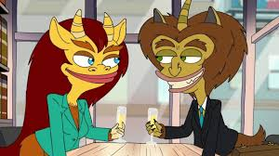
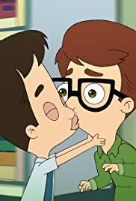
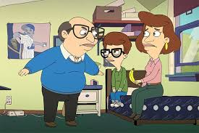
Variables
Independent Variables:
Comprehensive Sex Education
Present
Inclusive
Relevant
Dependent Variable:
Big Mouth scenes
Normative Sex Education

Slide 9
Comprehensive Knowledge
Six Components of Comprehensive Sex Education (SIECUS 2008)
Topic | Sub-Topic | Definition of Topic: Information specific to...
Human Development | Sexual Anatomy Puberty Reproduction Body Image | Male and female anatomy and reproductive systems Hormonal body changes Biological reproduction and conception processes How body change relates to self-esteem
Relationships | Families Friendship Romantic Relationships Raising Children | Talking to parents or caregiver about sexuality Talking to friends about sexuality Healthy and happy relationships with partners Discussing teen parenthood

Slide 10
Social Relevance
Social Context (Ivinson, 2007)
Information Type | Definition
Scientific Knowledge | Value-neutral information that presents information solely with a scientific definition. Ex. Narrator- The uterus is the center of female reproductive system. (Big Mouth, s01e01)
Common-Sense Knowledge | Value-base information that presents topics in regards to a social contexts. Ex. Jessi- Just go to the gift shop and see if they have any feminine products. Nick- Okay, great. Should I keep a receipt, and you reimburse me later? Jess - Blood is coming out of my vagina! (Big Mouth, s01e02_)

Slide 11
Inclusive
Inclusivity with information specific to males, LGBTQ+, and Females (SIECUS, 2008)
Group | Definition
Male | Sexuality information pertaining to SIECUS six components that is specific to heterosexual males Ex. Sexual behavior that depicts heterosexual male masturbation
LQBTQ+ | Sexuality information pertaining to SIECUS six components that is specific to LGBTQ+ members Ex. Sexuality topics which depict the difficulty of LGBTQ+ marriage and/or adoption
Female | Sexuality information pertaining to SIECUS six components that is specific to heterosexual females Ex. Abortion topic information specific to the female choice and experience

Slide 12
Analysis: One-way ANOVA
 |  | Present | Relevant | Inclusive
Topic | Sub-Topic | Scene # Topic Info | Scene # Social Context | Scene # Male Info | Scene # LGBT+ Info | Scene # Female Info
Human Development | Sexual Anatomy Puberty Reproduction Body Image
Relationships | Families Friendship Romantic Relationships Raising Children
 | Totals

Slide 13
Conclusion
This Study will identify if the Netflix series Big Mouth is a viable source for comprehensive sex education. With adolescents increasingly using the internet for sex education, understanding this online streaming series will add to the cumulative knowledge of health communication attempting to optimize sexuality information dispensed through entertainment to promote positive behavior change.
QUESTIONS?

Slide 14
References
Baran, S. J., & Davis, D. K. (2015) Mass communication theory: Foundations, ferment, and future. Stamford, CT: Cengage Learning.
Booker, N. A., Miller A. N., & Ngure, P. (2016). Heavy sexual content versus safer sex content: A content analysis of entertainment education
drama shuga. Health Communication, 31(12), 1437-1446.
Clair, R. P., Carlo, S., Lam, C., Nussman, J., Phillips, C., Sánchez, V., & ... Yakova, L. (2014).Narrative theory and criticism: An overview toward
clusters and empathy. Review Of Communication, 14(1), 1-18.
Ivinson, G. (2007). Pedagogic discourse and sex education: Myths, science, and subversion. SexEducation, 7(2), 201-216.
Irvine, J. M. (2002). Talk About Sex: The Battles over Sex Education in the United States. Berkley, CA: University of California Press
Jensen, R. E. (2007). Using science to argue for sexual education in U.S. public schools Dr. Ella Flagg Young and the 1913 ‘Chicago Experiment’.
Science Communication, 29(2), 217-241.
Kunkel, D., Biely, E., Eyal, K., Cope-Farrar, K., Donnerstein, E., & Fandrich, R. (2003). Sex on TV 3: Content and context. Menlo Park, CA:
Kaiser Family Foundation.
Moran, J. P. (2003). Sex education and the rise of the new right. Review in American History,31(2), 283-289.
Moyer-Gusé, E. (2008). Toward a theory of entertainment persuasion: Explaining the persuasive effects of entertainment-education messages.
Communication Theory, 18, 407–425
Moyer-Gusé, E. Mahood, C., & Brookes, S. (2011). Entertainment-education in the context of humor: Effects on safer sex intentions and risk
perceptions. Health Communication, 26, 765–77.
The Sexuality Information and Education Council of the United States,Community Action Kit: What Is Comprehensive Sexuality Education
(2008), available at http://www.communityactionkit.org/index.cfm?pageld=888.
Zhou S, & Sloan, W.M.D (2015). Research Methods in Communication. Northport, AL: Vision Press

