Slide 1


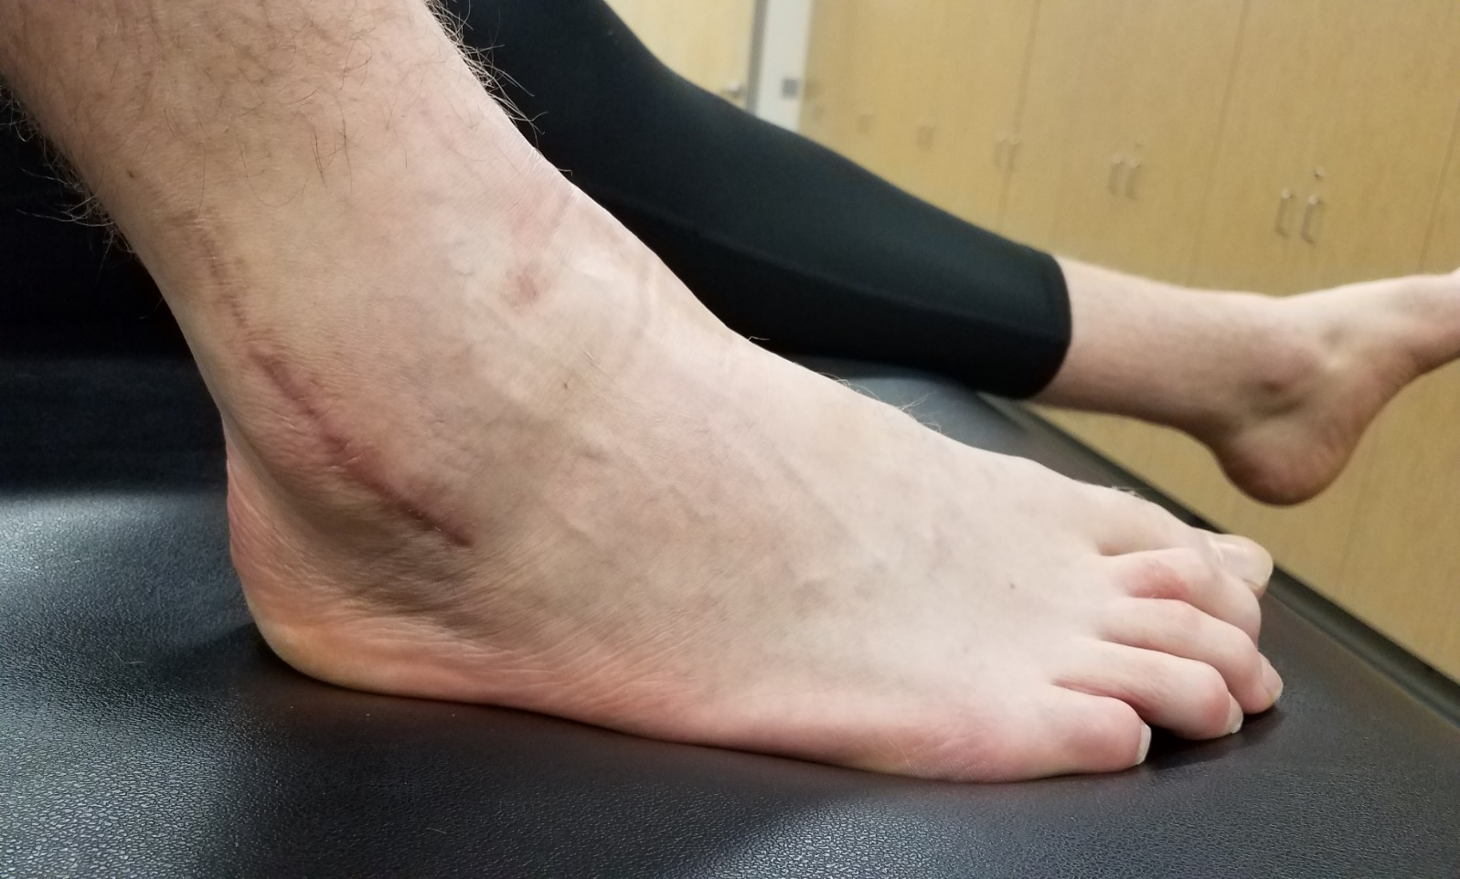
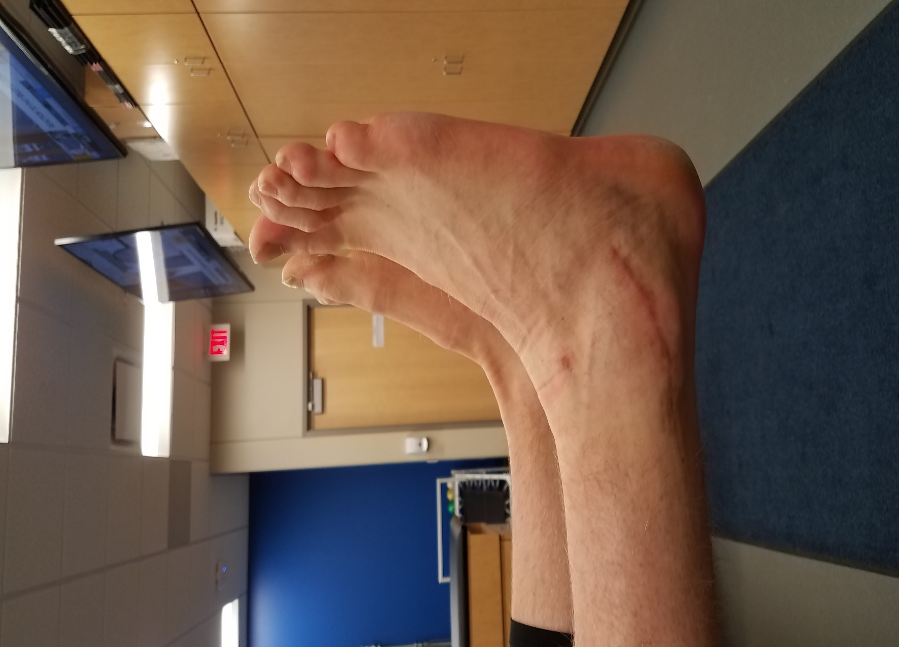
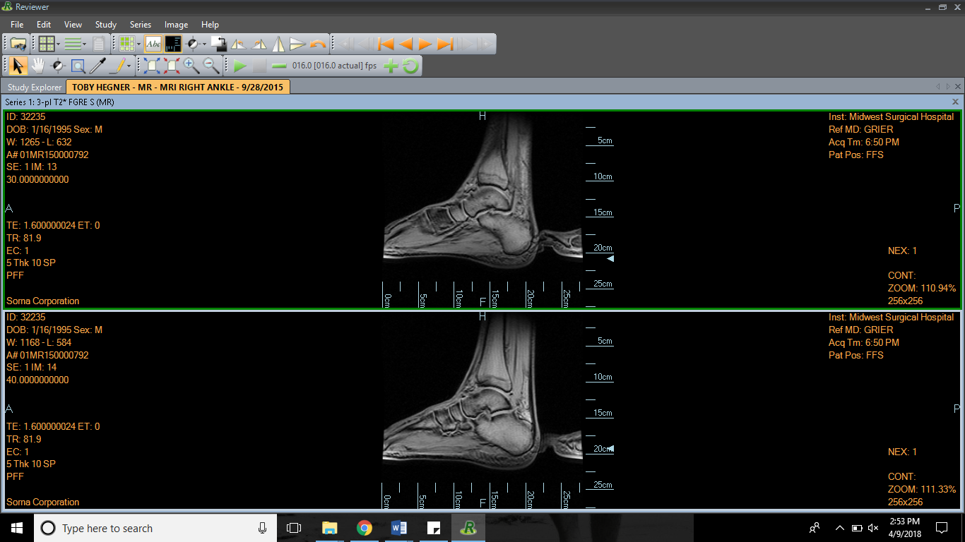
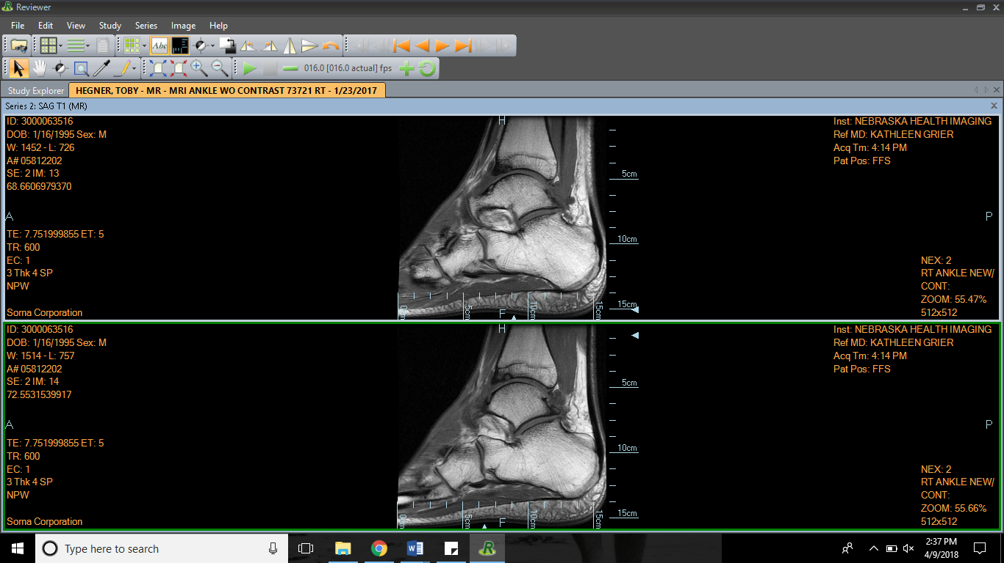
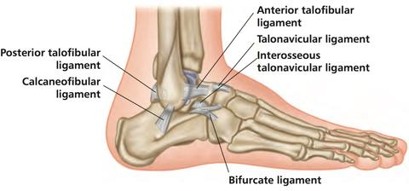
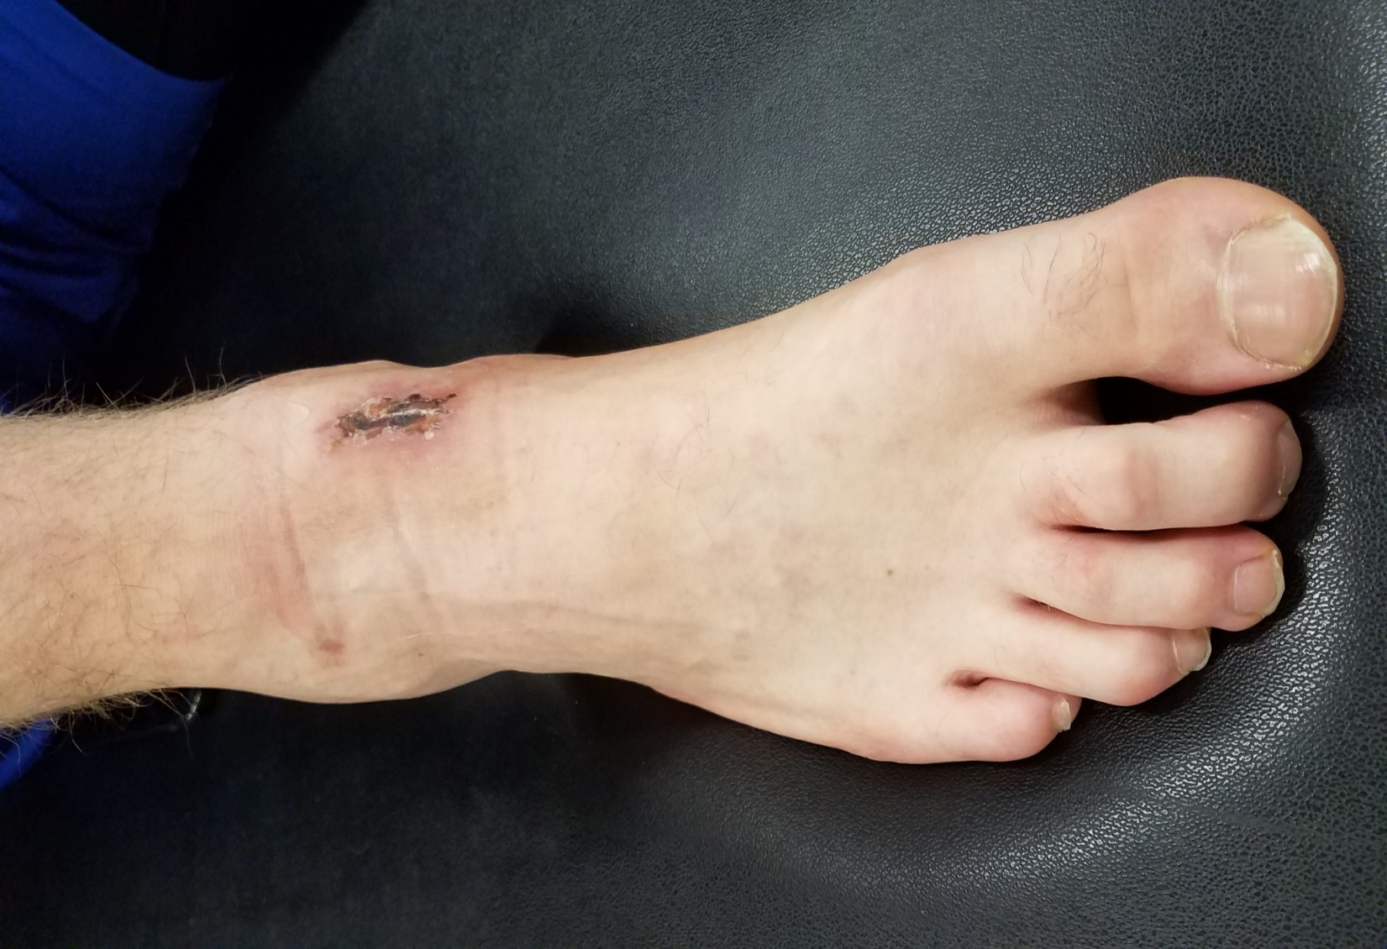
Division I Collegiate Male Basketball Player Post-Surgical CAI with Bone Spur Excision: A Case Report
Gutierrez, J., † Wilkins,S. *University of Nebraska at Omaha, Omaha, NE
Context
Signs and Symptoms
Uniqueness
Ankle sprains are the most common injury to occur in collegiate athletics.¹
Repetitive sprains to the same ankle can eventually cause functional instability, chronic instability, and residual instability.²
NCAA Division I basketball player (22 year old male, 108.2kg, 208cm).
Repeated ankle sprains to both ankles over athletic career. Right ankle is considered the worse of the two.
Patient went to hedge a ball screen and felt his ankle shift during a game on January 21, 2017.
Patient was evaluated during the game, taped, returned to finish game, and immobilized in a walking boot after the game.
Patient was referred for imaging the next day.
Imaging revealed anterior distal tibial osteophyte, anterior talar osteophyte, talar osteochondritis dissecans, right ankle arthritis, and instability.
Right lateral talar dome fracture
Right lateral malleolus fracture
Initial treatment of right ankle sprain consisted of rest, ice, compression, elevation, and naproxen for inflammation.
Brostrom surgical repair with micropicking and extensive debridement of the right lateral ankle.
Conservative post-surgical rehabilitation with a specialized return to play protocol:
    Control swelling, underwater walking, running, jumping, balance exercises, strengthening, and stretching.
Lidocaine patches
Iontophoresis with combination of lidocaine and Marcaine.
Injections of Lidocaine into joint prior to every game.
Secondary surgery to excise anterior distal tibial osteophyte.
Deviations from conventional protocol consist of a quick return to play protocol and entering a “maintenance period” to decrease pain enough for patient to play in games.
Patient required more than just a ligamentous repair at the joint.
One osteophyte was not excised due to risk of vascular compromise. The physician elected to leave behind the anterior talar osteophyte because it was too close to the dorsalis pedis artery to excise.
Brostrom surgical procedure is an adequate way to decrease symptoms of CAI.⁴
This procedure was successful in this case; however, the patient still suffered residual pain and lack of range of motion which can be attributed to the secondary injuries that have occurred at the joint.
After secondary surgery, the remaining osteophyte was removed. Patient exhibited increase range of motion, decrease in pain, and general decrease in all symptoms.
References
Roos, K. G., Kerr, Z. Y., Mauntel, T. C., Djoko, A., Dompier, T. P., & Wikstrom, E. A. (2017). The epidemiology of lateral ligament complex ankle sprains in national collegiate athletic association sports. American Journal of Sports Medicine, 45(1), 201-209. doi:10.1177/0363546516660980
Hertel, J. (2002). Functional anatomy, pathomechanics, and pathophysiology of lateral ankle instability. Journal of Athletic Training, 37(4), 364-375. Retrieved from https://search-proquest-com.leo.lib.unomaha.edu/docview/206647721?accountid=14692
https://www.pinterest.co.uk/pin/493214596682817191/
Hu. (2013). Comparison of bone tunnel and suture anchor techniques in the modified broström procedure for chronic lateral ankle instability. American Journal of Sports Medicine, 41(8), 1877-1884
Constant pain, dull ache
Swelling
Discoloration
Tender upon palpation of Anterior Talofibular ligament
Stiffness
Pain walking, jumping, running
Decreased range of motion
Feeling of instability
Background
Differential Diagnosis
Treatment
Conclusion
Anterior Posterior
Figure 5: surgical scars and arthroscopic portals.
Figure 6: Range of motion compared bilaterally.
Medial Lateral
Figure 1: MRI of right ankle osteophyte.
Figure 2: right ankle OCD.
Figure 3: Lateral ankle complex.³
Figure 4: arthroscopic portals and excision site of osteophyte.
SPORTS MEDICINE RESEARCH LAB

