Slide 1
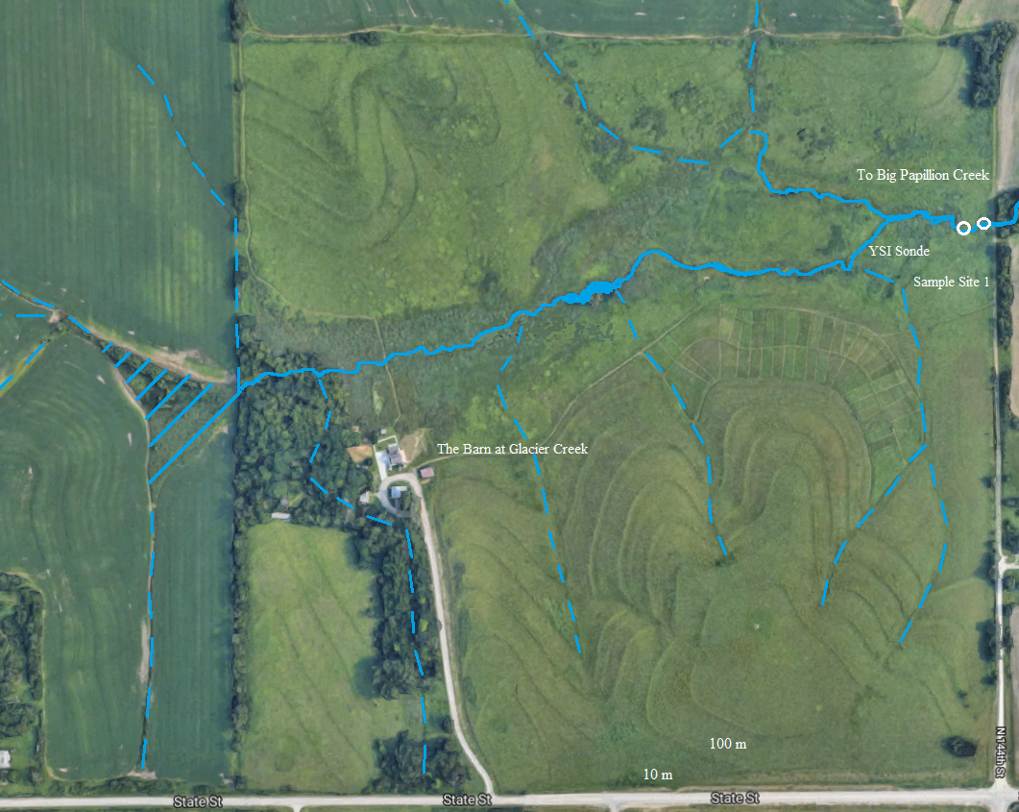
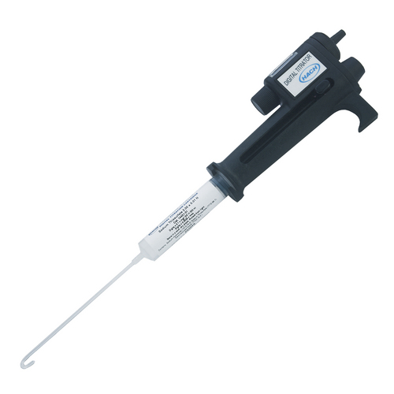
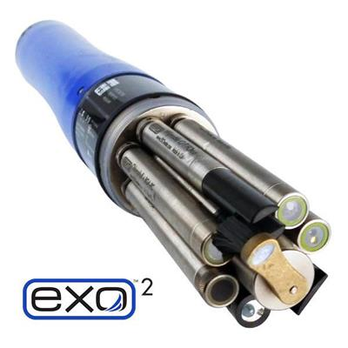
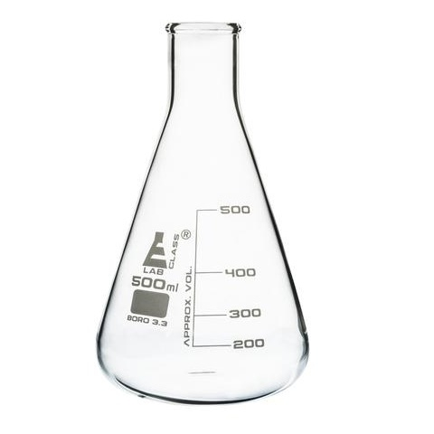
Investigating Daily Variation in Lotic Prairie Ecosystems
Dominick Caniglia and Dr. Andrew Miller
University of Nebraska at Omaha Department of Chemistry
Durham Science Center
Omaha, NE 68182-0109 Telephone (402) 554-2651
Introduction
Data
Glacier Creek Preserve (GCP) is a 172 hectare (425 acre) plot surrounding the 57 hectare (141 acre) Allwine Prairie. The prairie has been restored, owned and maintained by the University since 1970. The preserve also encompasses a large watershed basin which drains into Glacier Creek. Physical and chemical characterization of the hydrologic and geologic network of the preserve have been previously conducted by Dr. Andrew Miller and Dr. Ashlee Dere.
Figure 1: Glacier Creek Preserve Watershed.
Dashed lines represent seasonal drainage. Hatching represents wetland.
Purpose
Figure 2: Alkalinity variability of Glacier Creek Sampling Site 1 water samples. Error bars represent standard error.
Figure 4: Daily temperature and dissolved oxygen fluctuation, as measured by the sonde on September 12, 2018.
The dynamic relationships between the hydrologic, geologic, and biologic characteristics of this lotic prairie system are of interest; specifically the effects that each characteristic has on water quality. Spatial sampling of water and soil has revealed statistically significant differences between the agricultural and prairie influenced areas of the watershed. Temporal sampling has revealed daily, monthly, and annual trends that are not completely understood. An increased understanding of the interplay between the physical/chemical processes governing this system requires higher frequency spatial and temporal data collection.
Discussion
• September 12, 2018
□ November 15, 2018
• September 12, 2018
□ November 15, 2018
Alkalinity at sampling site 1 was observed to decrease over the course of a day. This trend is supported by data collected on Sept. 12th and Nov. 15th.
Dissolved ion content revealed convincing cyclic behaviors for September. This trend was not observed during November.
September 12th sonde data revealed a relatively stable pH range of 7.50 to 7.53, while the November 15th data revealed a pH range of 7.57 to 7.60.
Dissolved oxygen data revealed a temperature dependent atmospheric exchange.
PHREEQC calculated partial pressures of CO₂ did not change significantly over a 12 hr period. Calculated dissolved CO₂ remained constant at about 0.012 atm in September and about 0.008 atm in November.
- Implies underlying mechanisms governing the sequestration/release
of CO₂ are more kinetically hindered than those governing O₂ solvation
and speciation. This is supported by relative abundance/ease of
speciation of carbon dioxide linked compounds (such as carbonates and
bicarbonates) when compared to oxides as calculated by PHREEQC.
Materials and Methods
High Frequency Data
Obtained via YSI Inc. EXO2 © Radio-Sonde
Located ~10 m from sampling site 1.
Measurements obtained automatically every 15 minutes.
Measured Parameters:
- Temperature
- pH
- Turbidity
- Conductivity
- Dissolved Oxygen
- Dissolved Organic Matter
- Flow Rate.
GCP Site 1 Water Samples
Onsite
Grab sample acquired hourly.
Samples filtered through a 0.45 μm filter.
Initial alkalinity measured with Hach © Manual-Digital Titrator.
Laboratory
Samples destined for cation analysis acidified with 0.1M HCl.
Alkalinity determined via Hanna-Instruments © Auto-Titrator.
Ion concentrations determined via Aligent Technologies © HPLC.
United States Geological Survey (USGS) “PHREEQC” © Version 3 software utilized for speciation analysis.
• September 12, 2018
□ November 15, 2018
• September 12, 2018
□ November 15, 2018
Future Work
High-frequency temporal sampling will help to:
Confirm ion concentration trends.
Increase confidence in the validity of trends and our ability to model them.
Identify what factor(s) are responsible for the observed patterns, especially the seasonal effects upon their daily variability.
• September 12, 2018
□ November 15, 2018
• September 12, 2018
□ November 15, 2018
Acknowledgements
Dr. Andrew Miller, Dr. Ashlee Dere, and Prof. Thomas Bragg.
References
Dunbar, Stephen R. “Fitting a Sine Curve to Data.” www.math.unl.edu/~sdunbar1/sinefit.html
Sonde photo courtesy of YSI Inc.
Handheld titrator photo courtesy of Cole-Parmer Inc.
Glacier Creek Preserve Satellite Photo courtesy of Google Earth.
Figure 3: GCP ion concentrations at sample site 1. Trendlines represent sinusoidal regressions. Error bars represent standard error obtained from HPLC calibration curves.

