Slide 1
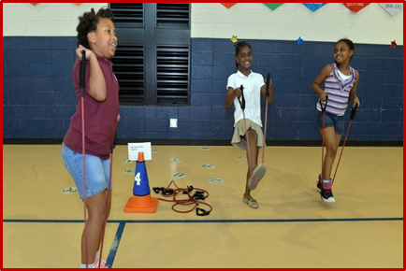
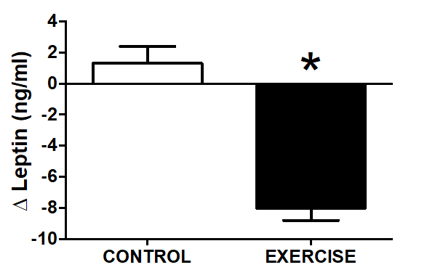
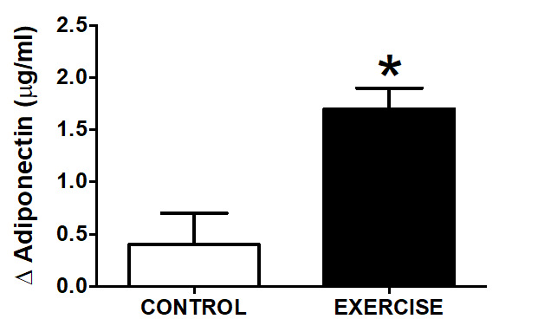
Combined Resistance and Aerobic Exercise Training Reduces Insulin Resistance and Central Adiposity in Obese Adolescent Females
Michael D. Shukis, Elizabeth J. Pekas, Steven D. Scott, Ronald J. Headid III, Jeonghwa Shin, Jiwon Song, Song-Young Park
University of Nebraska at Omaha, School of Health and Kinesiology, Omaha, NE
ABSTRACT
METHODS
RESULTS
Exercise training is recommended for health maintenance and reducing the risk of developing metabolic and cardiovascular pathologies. Combined resistance and aerobic exercise (CRAE) training decreases metabolic risk factors in obese adults.
PURPOSE: To determine the effects of CRAE on obese adolescent females with hyperinsulinemia. METHODS: Forty obese adolescent females aged 14.7 ± 1 years (BMI 30 ± 2 kg/m²) were randomly assigned to the exercise group (n = 20) or the control group (n = 20). The exercise group performed a CRAE workout 5 days a week for 12 weeks. The intensity gradually increased by 10% every 4 weeks, from 40 – 70% of their heart rate reserve (HRR). Body composition, blood pressure (BP), heart rate (HR), brachial-ankle pulse wave velocity (BaPWV), blood leptin, adiponectin, glucose, and insulin were measured pre- and post-training. Both groups maintained their regular diet and the control group maintained their normal activity level. RESULTS: CRAE reduced the body fat percentage, body weight, and waist circumference of the exercise group (p < 0.05) compared to the control group. The exercise group maintained appropriate levels of blood leptin and adiponectin while their insulin, glucose, and insulin resistant parameters decreased compared to their baseline and the control group (p < 0.05). CONCLUSION: These data show that CRAE is a safe and useful method to improving the metabolic risk factors of obese adolescent females with hyperinsulinemia.
CRAE training for 5 days a week for 12 weeks consisted of 20 min resistance band exercises for upper & lower body and 30 min treadmill walking.
Venous blood samples, waist circumference measurements, and body composition via BIA were taken pre- and post-training.
Plasma insulin concentration was measured in duplicate using radioimmunoassay kits.
Insulin resistance (IR) was estimated using the homeostasis model assessment of IR (HOMA-IR).
Plasma leptin and adiponectin concentrations were analyzed via enzyme-linked immunosorbent assay (ELISA).
Vascular function was measured via brachial artery pulse wave velocity (baPWV) using a applanation tonometer.
Results were analyzed using a two-way ANOVA (group x time) with repeated measures, paired t-tests for post hoc comparisons, and a significance set at p < 0.05.
INTRODUCTION
Obesity has doubled in children and quadrupled in adolescents in recent decades. Obesity leads to cardiovascular complications, high blood pressure, high cholesterol, type 2 diabetes, and metabolic syndrome. Combined resistance and aerobic exercise (CRAE) training promotes additional cardiovascular autonomic benefits when compared to resistance training alone. It also improves weight loss, fat loss, and cardiovascular fitness when compared to aerobic or resistance training alone. In previous studies, CRAE training reduced percent body fat, waist circumference, and blood pressure in young adults. CRAE also improved arterial stiffness, blood pressure, functional capacity, and body composition in post-menopausal women. The purpose of this study was to determine the effect of CRAE training on obese hyperinsulinemic adolescent females.
RESULTS
CONCLUSIONS
CRAE training positively effects the satiety hormones leptin and adiponectin.
CRAE training effectively reduces percent body fat, body weight, waist circumference, and significantly reduces HOMA-IR which reduces risks for metabolic syndrome.
12 weeks of CRAE training balances insulin and glucose levels.
CRAE training that incorporates modes other than resistance bands and a walking protocol may prove to induce similar or greater results.
Future studies can determine the effect of CRAE training on females and males of different age groups with varying levels of health and fitness.
Forty sedentary adolescent females (14.7 ± 1 yrs) who were obese (BMI ≥ 30 kg/m²), with hyperinsulinemia (> 12.0 µU/ml), and abdominal obesity (waist > 80 cm) participated in this study.
Figure 1. Change in Leptin
Post-Training
Figure 2. Change in Adiponectin
Post-Training

