Slide 1
UNIVERSITY OF NEBRASKA-OMAHA
DETERRING IRANIAN SPONSORED TERRORISM
LAUREN ZIMMERMAN AND AMANDA URICK

Slide 2
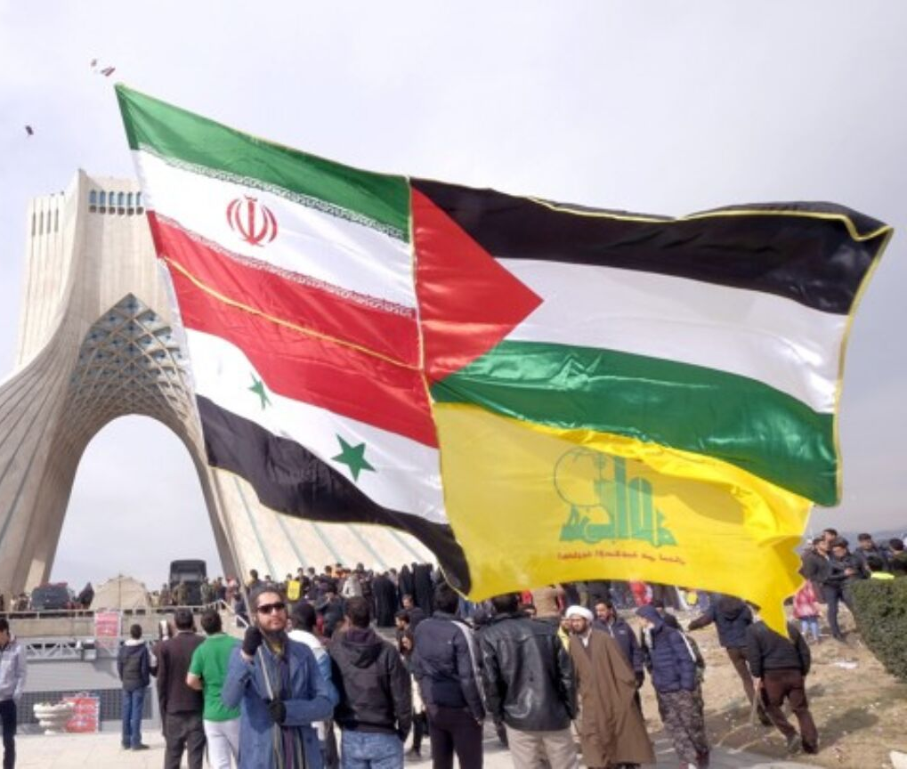
OVERVIEW OF PRESENTATION
Major Points to Discuss
What are gray zones?
The current state of Iran
Iranian sponsored groups
Policy recommendations
UNO STUDENT RESEARCH FAIR | MARCH 2019

Slide 3
GRAY ZONES
Middle ground between war and peace
The use of unconventional methods of warfare to stay below the threshold of what the world previously has defined as warfare tactics
Te
UNO STUDENT RESEARCH FAIR | MARCH 2019

Slide 4
WHERE DOES IRAN STAND CURRENTLY?
Economically strained due to sanctions
Social stress due high prices and social oppression from the regime
Forming more diverse and complex relationships with Russia and China
Seeking to find new ways to deter and threaten their adversaries in the region while simultaneously increasing their own influence in the region
Economic, Social, and Political Stress
UNO STUDENT RESEARCH FAIR | MARCH 2019

Slide 5
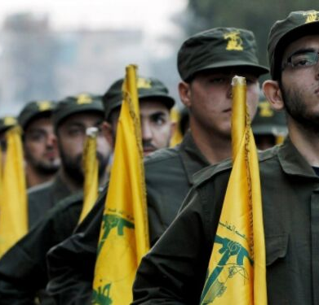
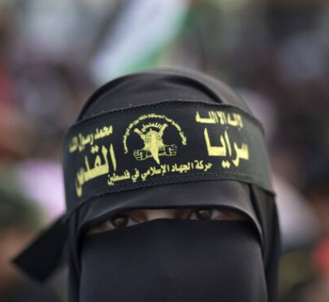
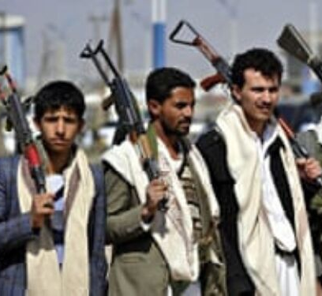
State-Sponsored Terrorism
GROUPS KNOWN TO BE SPONSORED BY IRAN
Hezbollah (Lebanon)
Palestinian Islamic Jihad (Palestine)
Houthi Extremists (Yemen)
UNO STUDENT RESEARCH FAIR | MARCH 2019

Slide 6
Gray Zones
THE U.S. APPROACH [TO CONFLICT] RESEMBLES GOLIATH AND RIVALS HAVE ADOPTED APPROACHES RESEMBLING DAVID
U.S. SPECIAL OPERATIONS COMMAND (2019)

Slide 7
POLICY RECOMMENDATIONS
Major adversaries are using non-traditional, non-kinetic strategies
The US needs to begin encouraging creative and collaborative conflict that utilize non-kinetic strategies
One example of this is Stuxnet and Iran
Playing on Iranian economic stresses could help turn back Iranian encroachment into Syria
Destabilizing the Gaza Strip could weaken Hamas' control over the area
Exploiting growing cynicism, specifically using social media
Utilizing allies
UNO STUDENT RESEARCH FAIR | MARCH 2019

Slide 8
CONTACT INFORMATION
Lauren Zimmerman
lzimmerman@unomaha.edu
Amanda Urick
aurick@unomaha.edu

