Slide 1
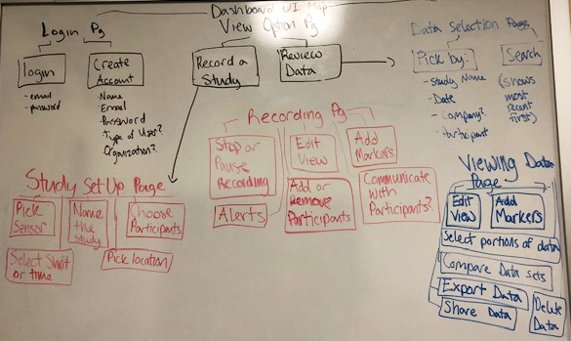
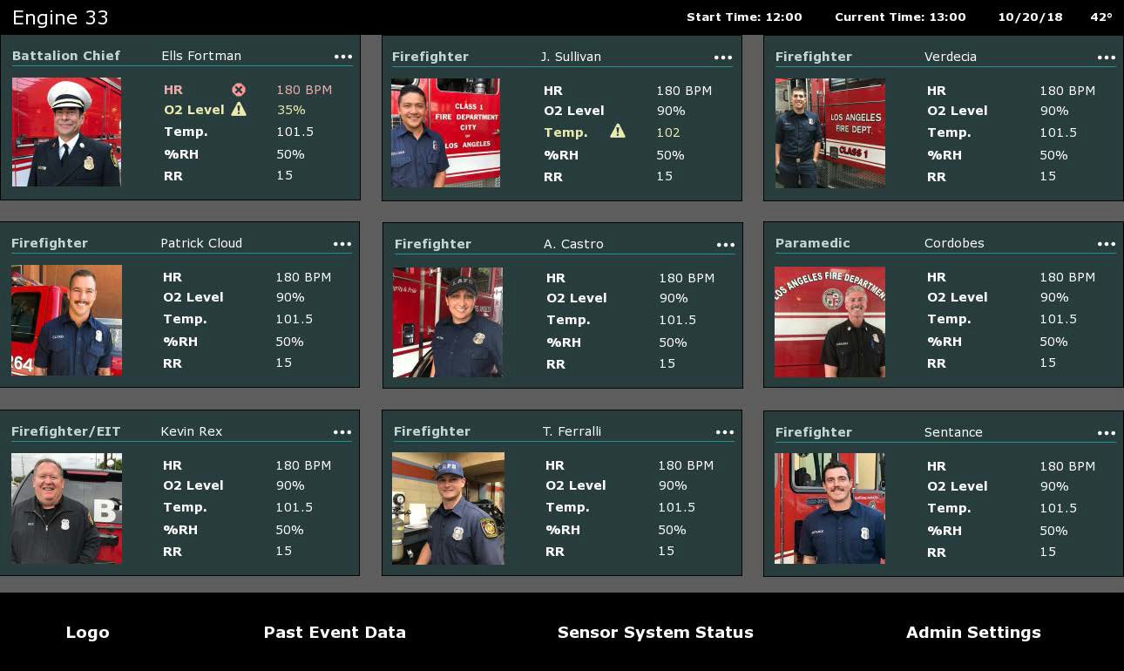
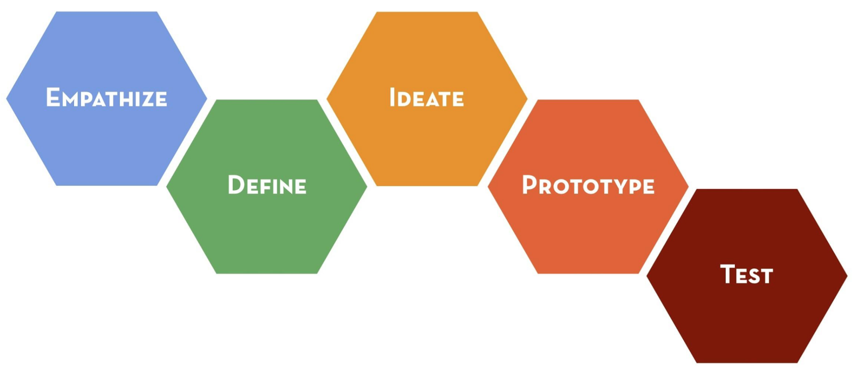
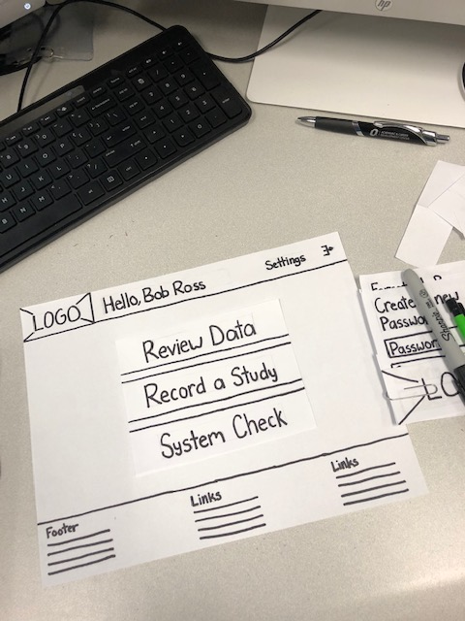
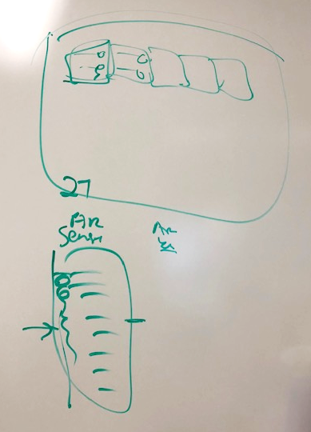
Design for Safety: Decreasing First Responder Health Risks
Through Real-Time Bio-Sensor Alerts
Suzy Fendrick, Ann Fruhling PhD
College of Information Science & Technology, University of Nebraska at Omaha, Omaha, NE 68182
Introduction
Empathize and Define
High-Fidelity Prototype
The focus of this research project is using the Design Thinking process to create an informative dashboard for first responders. Design Thinking involves empathizing with the user, defining the problems to be solved, ideation, creating prototypes, and testing. This iterate process focuses on the user, resulting in the most effective product possible. The dashboard will display real-time biosensor data from sensors in the first responders’ uniforms. This project is part of a larger project with the goal of vastly improving the safety of first responders during emergency hazardous material incidents. This project is funded by U.S. Department of Transportation.
Design Thinking Process
Figure 2
The first step of the process is Empathize. This involved researching current first responder technology, emergency response dashboards and iconography, and communication with local firefighters. After researching, the Define process began. Displayed here in Figure 2 is a map of all the potential web pages needed for the dashboard. The needs of the user need to be defined before designing.
Figure 5
After creating low-fidelity paper prototypes, high fidelity prototypes were created, as seen in Figure 5. They were made on the computer to seem more real and are easier to test on the user. Preparation for the Test phase has begun. So far, these high fidelity mock-ups have been tested out in once with the firefighter leads.
Requirements
Ideate and Low-Fidelity Prototype
Next Steps and Assessment
Figure 1
The next steps in this research would be:
Completing all design work and mockups
Completing all development work of the actual website
Testing all work with real users
An assessment of the effectiveness of the Design Thinking Process would be the conclusion of this project. This would validate if the system met the user’s needs.
The Design Thinking Process is an iterative process for creative problem solving, as displayed in Figure 1. ^{(1,2)}
Empathize: getting to know who the user is, learning and researching their needs.
Define: begin analyzation of research and define a problem statement. The problem statement is written from the prospective of the user, not yourself or the company.
Ideate: brainstorming, coming up with as many solutions to the problem as possible.
Prototype: narrow down the best possible solution for the problem and defining how
it will work.
Test: see how the potential user will interact with the product created, identifies
problems in the design, and what needs to be altered.
Figure 3
Figure 4
References and Acknowledgements
Benefits of the Design Thinking Process
Usability problems found early
Takes less time, improvements are made early
Saves money, improvements are made when work is cheap to produce
After defining the problem and the user’s needs, the ideation process can begin. Ideate involved making simple designs on a whiteboard as displayed in Figure 3. Many ideas were sketched on the whiteboard before moving to Prototype phase displayed in Figure 4. These paper prototypes are low-fidelity and the first step in the prototyping process. They underwent critiques with the HazMat team to alter the design until it was solidified. After making paper prototypes, the next step was creating high-fidelity prototypes and prepare for testing.
I would like to acknowledge the U.S. Department of Transportation, Region VII Grant: UTC 25-1121-0005-110 for funding my research.
1. Design Thinking Process [Digital image]. (n.d.). Retrieved February 21, 2019, from http://longevity3.stanford.edu/designchallenge/design-thinking-process/
2. Dam, R., & Siang, T. (2019, February). 5 Stages in the Design Thinking Process. Retrieved February 21, 2019, from https://www.interaction-design.org/literature/article/5-stages-in-the-design-thinking-process

