Slide 1
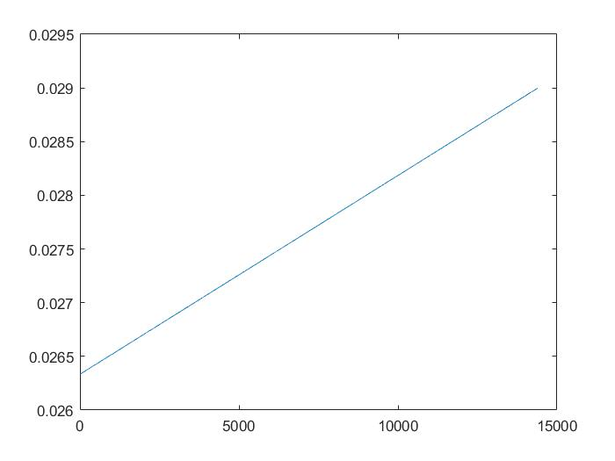
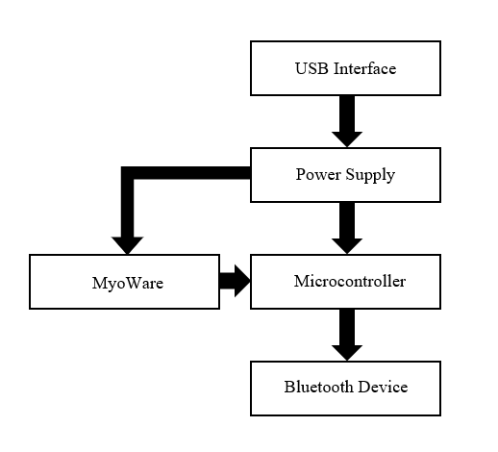
An Electrooculography Prosthetic Control System
Walker Arce^{1,2}, Jorge Zuniga Ph.D.¹
¹Department of Biomechanics, University of Omaha, NE, USA
²Department of Electrical and Computer Engineering, University of Omaha, NE, USA
ABSTRACT
METHODS
RESULTS
For many surface EMG (sEMG) prosthetic control systems, the muscles on the affected limb are used to trigger the control system. This can lead to fatigue in the user as they have to maintain continuous muscle activation and coactivation in order to achieve prosthetic control [3]. The crux of any prosthetic control system is the human machine interface that is developed, and at present many control systems have complicated interfaces that limit the degrees of freedom of the prosthetics. This study focuses on the development of a low-cost prosthetic control peripheral that is compatible with the prosthetics developed by Dr. Zuniga and his research team.
To simplify this interface, a simple, low-cost, low-profile, wearable platform was developed with an off-the-shelf MyoWare Muscle Sensor to allow for custom commands to be sent to a prosthetic control board. The printed circuit board (PCB) was designed using EAGLE EDA and incorporates a battery, with charging circuit, dedicated power supply, microcontroller, and a MyoWare. This is shown in figures one and two.
The power consumption of the device was measured and the battery life was calculated for six different battery sizes over a twelve hour period. A standard battery life equation was used for this.
Printed Circuit Board: A printed circuit board that fits the footprint of the MyoWare Muscle Sensor was developed utilizing EAGLE EDA that incorporates all necessary components from the block diagram for the system. The PCB is a two layer board that measures 0.82x2.06 inches.
Software: The Arduino development environment was used to develop the software as the ATmega328P was compatible with this software. AVR Studio 7 and an AVR ISP MKII was used to program the microcontroller.
Power Testing: A 30V 10A power supply was used to perform power testing along with a TekPower USB multimeter to collect the current measurement results. A Matlab script was developed to simulate multiple grip events over a period of time to be able to capture the battery life of the device over a period of use. In addition the battery life of the device on multiple sized lithium polymer batteries was calculated using this script.
Cost: The developed device was designed to use low cost components that can be easily integrated into a small footprint. The components were also sourced to allow for easy purchase of the bill of materials in the United States.
The data collected during this study is shown below and was analyzed using the aforementioned Matlab script.
Battery Life (Hours)
Number of Trigger Events in a Twelve Hour Period
Battery Sizes (mAh) | 250 | 500 | 1000 | 2000 | 3000 | 4000 | 5000 | 6000 | 7000
250 | 6.62 | 6.60 | 6.55 | 6.46 | 6.38 | 6.29 | 6.21 | 6.13 | 6.05
400 | 10.59 | 10.56 | 10.49 | 10.34 | 10.20 | 10.06 | 9.93 | 9.81 | 9.68
500 | 13.24 | 13.20 | 13.11 | 12.93 | 12.76 | 12.58 | 12.42 | 12.26 | 12.10
1200 | 31.78 | 31.67 | 31.46 | 31.03 | 30.61 | 30.19 | 29.80 | 29.42 | 29.04
2000 | 52.97 | 52.79 | 52.43 | 51.72 | 51.02 | 50.32 | 49.66 | 49.04 | 48.39
2500 | 66.21 | 65.99 | 65.54 | 64.65 | 63.78 | 62.90 | 62.08 | 61.30 | 60.49
Trigger Events | Average Current (mA)
500 | 26.43
1000 | 26.52
2000 | 26.7
4000 | 27.07
6000 | 27.44
8000 | 27.82
10000 | 28.19
12000 | 28.55
14000 | 28.93
INTRODUCTION
MATERIALS
With the development of low-cost biometric sensors and accessible microcontroller platforms on the market, the options for prosthetic control systems increases significantly [1]. Unfortunately, electronic prosthetic devices are too expensive for most prosthetic users to afford, which has lead to the creation of 3D printed prosthetic devices such as the ones from Dr. Zuniga et al [2].
Surface EMG (sEMG) remains one of the pivotal control mechanisms for prosthetic control systems, but using the affected limb’s muscle activation for the control system can lead to fatigue [3]. To prevent this, electrooculography (EOG) can be used to send actuation controls to a prosthetic control board [4]. To be comfortable for a user to wear, the electrodes need to be discrete and the device needs to be lightweight.
The purpose of this study was to create a simple daughter board for the MyoWare that can fulfill these requirements. To this end, a low-cost, sEMG peripheral was developed that acts as a full processing front-end for the MyoWare Muscle Sensor.
The developed PCB was ordered from JLCPCB (JLCPCB, Shenzhen, China) and were populated by hand for the study. The prosthesis this control board was designed to interface with is the hybrid actuation prosthetic arm with two PQ12 motors integrated into the socket. The motors were driven at 12V to optimize the torque produced for each motor. In addition, a 500mAh lithium polymer battery was used for testing the device.
The low-cost 3D printers used in this study were the Ultimaker 2 Extended+ (Ultimaker B.V., Geldermalsen, The Netherlands). The materials for printing the prostheses were polylactic acid (PLA) and acrylonitrile butadiene styrene (ABS). Other components of the prostheses included: 1 mm nylon lift cord, 1.5 mm diameter elastic cord, Velcro, medical-grade firm padded foam, a protective skin sock, and a BOA dial tensioner system.
The final completed system is compatible with
any control board that utilizes Bluetooth as a
communication protocol.
The data generated for this study was completed
using a dedicated power supply to test the
Operating requirements of the device.
Figure 3: The graphed results of the Matlab processing script.
CONCLUSION
The device developed in this study was promising and warrants future study as an alternative prosthetic mode of control.
REFERENCES
Lake, Christopher & Miguelez, John M., 2003, ‘Evolution of microprocessor based control systems in upper extremity prosthetics,’ Technology and Disability 15, Advanced Arm Dynamics of Texas, Dallas, TX.
Zuniga, J, et al. (2015), doi:10.1186/s13104-015-0971-9
Zecca, M., et al. (2017). Control of Multifunctional Prosthetic Hands by Processing the Electromyographic Signal. Critical Reviews in Biomedical Engineering, 45(1-6), 383-410. doi:10.1615/critrevbiomedeng.v45.i1-6.150
Duvinage, M., Castermans, T., & Dutoit, T. (2011). Control of a lower limb active prosthesis with eye movement sequences. 2011 IEEE Symposium on Computational Intelligence, Cognitive Algorithms, Mind, and Brain (CCMB). doi:10.1109/ccmb.2011.5952116
Figure 1: Block diagram of the EOG control system. The USB interface is used to reprogram the on-board microcontroller and provide charge to the battery. The power supply is achieved using a 2A low PSRR LDO. The microcontroller was satisfied with an ATmega328P that interfaced to the MyoWare Muscle Sensor. The Bluetooth device used was an HM-11 for sending signal to a remote device.
Figure 2: The developed custom control board.

