Slide 1
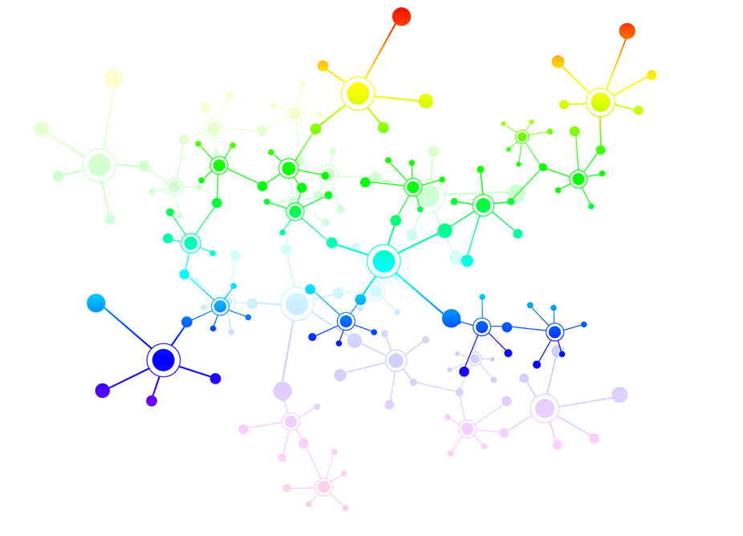
A Network-Based Compartmental Model For The Spread Of Whooping Cough In Nebraska
Kimia Ameri

Slide 2
Learning Objectives
After participating in this session the learner should be better able to:
Use scale-free network to find a better estimation for the number of infected individuals in epidemiology diseases.
This information can be used to quickly inform public health preparedness and prevention in states with low adherence to recommended vaccine schedules.

Slide 3
Whooping cough or pertussis
A highly epidemic bacterial disease
Caused by the bacterium Bordetella pertussis
lives in the mouth, nose, and throat.
Easily spread via air by cough and sneeze of an infected individual.
Infectious to others on average for a period of three weeks.
Vaccination: best way to prevent spreading of whooping cough according to the centers for disease control and prevention (CDC)

Slide 4
Whooping cough vaccination
The vaccination against whooping cough was started in the 1940s, when the number of reported cases exceeded 100000 per year.
Number of infected cases decrees dramatically to fewer than 1000 by 1965.
During 1980s number of whooping cough reported cases increases gradually despite more than 90% coverage of vaccination

Slide 5
Total number of infected per year in Nebraska from January 2000 to December 2017 data retrieved and aggregated from CDC, HealthMap.org, and the TYCHO project by the University of Pittsburg
America’s Health Rankings ranked Nebraska as 34st for percentage of vaccination
Immunized adolescents aged(13:17) (82.2%)
Nebraska is as 32nd in number of pertussis cases overall (12.5)per (100,000)population compared to 9.1 nationally

Slide 6
Contagious disease epidemiology
Pathogen and host environment
Bordetella pertussis evolution is Considered as a possible cause of resurgence of pertussis
Burns, D.L., Meade, B.D. and Messionnier, N.E., 2014. Pertussis resurgence: perspectives from the Working Group Meeting on pertussis on the causes, possible paths forward, and gaps in our knowledge. The Journal of infectious diseases, 209(suppl_1), pp.S32-S35.
Belcher, T. and Preston, A., 2015. Bordetella pertussis evolution in the (functional)genomics era. Pathogens and disease, 73(8). [7] Warfel, J.M. and Edwards, K.M., 2015.Pertussis vaccines and the challenge of inducing durable immunity. Current opinion inimmunology, 35, pp.48-54.
Weigand, Michael R., Yanhui Peng, Vladimir Loparev, Dhwani Batra, Katherine E.Bowden, Mark Burroughs, Pamela K. Cassiday et al. "The history of Bordetella pertussis genome evolution includes structural rearrangement." Journal of bacteriology 199, no. 8(2017): e00806-16.
Exposed population and their social activities

Slide 7
Compartmental model in epidemiology:
SEIR Model
model the flows of people between four states: susceptible (S), exposed (E), infected (I), and recovered (R).
$β$ rate
$σ$ rate
ϒ rate
Susceptible
Exposed
Infected
Recovered
$β$ is the susceptible transmission to exposed
$σ$ is the exposed transmission to infected
$γ$ is the infected transmission to recovered

Slide 8
Standard Compartmental Model: SEIR
(A)
(B)
β rate
$σ$ rate
Infected=1
Infected=1
Infected=1
Infected=2
Exposed =0
Exposed =4
Exposed =5
Exposed =4
Susceptible=13
Susceptible=9
Susceptible=8
Susceptible=8
Any susceptible can be exposed by rate of β per contact
(C)
$γ$ rate
$σ$ rate
Infected=4
Infected =2
Infected=1
Infected=3
Exposed =6
Exposed =6
Exposed =5
Exposed =4
Susceptible=4
Susceptible=4
Susceptible=8
Susceptible=7
Recovered=2
Any Infected can be recovered by rate of $γ$
Any exposed can be infected by rate of $σ$ per contact

Slide 9
Standard SEIR model equation
$μ is the population death rate$
$β$ is the susceptible transmission to exposed
$σ$ is the exposed transmission to infected
$γ$ is the infected transmission to recovered
V is the vaccination rate v=86.8
N= population
I= reported cases for each week
R=recovered
S = (population – infected for first week – recovered)*0.9
E= (population – infected for first week – recovered)*0.1
$μ$= 0.85
$β$ = 0.9
$\frac{dS}{dt}= μ\left(N−S\right)−β\frac{SI}{N}−vS$
$\frac{dE}{dt}= β\frac{SI}{N}−\left(μ+σ\right)E$
$\frac{dI}{dt}= σE−\left(μ+γ\right)I$
$\frac{dR}{dt}= γI−μR+vS$
$σ$ =0.5
ϒ=2.2
Magpantay FM, De Cellès MD, Rohani P, King AA. Pertussis immunity and epidemiology: mode and duration of vaccine-induced immunity. Parasitology. 2016 Jun;143(7):835-49.
Forgoston E, Schwartz IB. Predicting unobserved exposures from seasonal epidemic data. Bulletin of mathematical biology. 2013 Sep 1;75(9):1450-71.
Althouse BM, Scarpino SV. Asymptomatic transmission and the resurgence of Bordetella pertussis. BMC medicine. 2015 Dec;13(1):146.

Slide 10
SEIR Results

Slide 11
Evaluation of the model
Root-mean-square error (RMSE)
measure of the differences between values (sample and population values) predicted by a model or an estimator and the values actually observed.
A measure of accuracy
RMSE$=\sqrt{\frac{\sum_{i=1}^{n}{{(x^{′}−x)}^{2}}}{n}}$
Mean error(ME)
Measures the average of errors or deviations.
A measure of the quality of an estimator
ME= $\frac{1}{n}\sum_{i=1}^{n}{{(x^{′}−x)}^{2}}$
Values closer to zero are better for both RMSE and ME.

Slide 12
year | Real number of infected | SEIR prediction | ME | RMSE
2000 | 16 | 1047320 | -19760.45 | 38104.7
2001 | 5 | 1050132 | -19813.72 | 38207.07
2002 | 9 | 1054499 | -19896.04 | 38365.82
2003 | 12 | 1059749 | -19995.04 | 38556.98
2004 | 85 | 1064950 | -20091.79 | 38746.15
2005 | 177 | 1070793 | -20200.3 | 38956.26
2006 | 37 | 1076106 | -20303.19 | 39151.73
2007 | 45 | 1081896 | -20412.28 | 39362.65
2008 | 170 | 1089267 | -20549 | 39630.31
2009 | 91 | 1098240 | -20719.79 | 39955.66
2010 | 163 | 1118684 | -21104.17 | 40700.53
2011 | 42 | 1126189 | -21248.06 | 40973.21
2012 | 90 | 1134354 | -21401.21 | 41270.93
2013 | 117 | 1142198 | -21548.7 | 41556.19
2014 | 243 | 1149967 | -21692.91 | 41837.8
2015 | 393 | 1157907 | -21839.89 | 42113.29
2016 | 100 | 1165820 | -21994.72 | 42414.11
2017 | 45 | 1176623 | -22199.58 | 42808.61

Slide 13
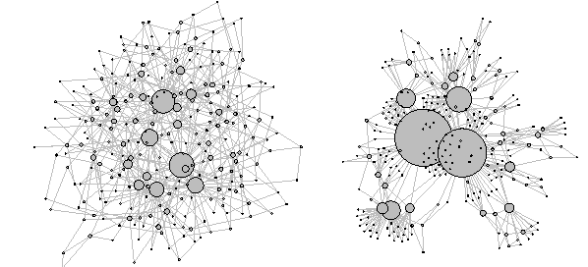
Epidemiology contact patterns
Number of studies consider the epidemiologically contact patterns of diseases as a scale-free network
Bansal, S., Grenfell, B.T. and Meyers, L.A., 2007. When individual behaviour matters: homogeneous and network models in epidemiology. Journal of the Royal Society Interface, 4(16), pp.879-891.
Dezső, Z. and Barabási, A.L., 2002. Halting viruses in scale-free networks. Physical Review E, 65(5), p.055103.
Liljeros, F., Edling, C.R., Amaral, L.A.N., Stanley, H.E. and Åberg, Y., 2001. The web of human sexual contacts. Nature, 411(6840), p.907.
A number of authors claimed that epidemic of whooping cough is based on randomness and may arise due to nonlinear spread in transmission and seasonal change in contact rate
Hethcote, H.W., 1998. Oscillations in an endemic model for pertussis. Can. Appl. Math. Quart, 6, pp.61-88.
Dalziel, B.D., Bjørnstad, O.N., van Panhuis, W.G., Burke, D.S., Metcalf, C.J.E. and Grenfell, B.T., 2016. Persistent chaos of measles epidemics in the prevaccination United States caused by a small change in seasonal transmission patterns. PLoS computational biology, 12(2), p.e1004655.
Rohani, P., Keeling, M.J. and Grenfell, B.T., 2002. The interplay between determinism and stochasticity in childhood diseases. The American Naturalist, 159(5), pp.469-481.
Keeling, M.J., Rohani, P. and Grenfell, B.T., 2001. Seasonally forced disease dynamics explored as switching between attractors. Physica D: Nonlinear Phenomena, 148(3), pp.317-335.
Nguyen, H.T. and Rohani, P., 2008. Noise, nonlinearity and seasonality: the epidemics of whooping cough revisited. Journal of The Royal Society Interface, 5(21), pp.403-413.

Slide 14
Barabasi network
Random scale-free networks using a preferential attachment mechanism.
M = minimum number of neighbors
13-minimum number of neighbors for each node
Mossong, J., Hens, N., Jit, M., Beutels, P., Auranen, K., Mikolajczyk, R., Massari, M., Salmaso, S., Tomba, G.S., Wallinga, J. and Heijne, J., 2008. Social contacts and mixing patterns relevant to the spread of infectious diseases. PLoS medicine, 5(3), p.e74.
Repeat this process for random infection and exposure 1000 times
The average number of neighbors (average of exposed individuals for all 1000 runs) is used as the exposed number
https://en.wikipedia.org/wiki/Barab%C3%A1si%E2%80%93Albert_model

Slide 15
Standard SEIR model equation
$μ is the population death rate$
$β$ is the susceptible transmission to exposed
$σ$ is the exposed transmission to infected
$γ$ is the infected transmission to recovered
N= population
I= reported cases for each week
R=recovered
S = (population – infected for first week – recovered)*0.9
E= the average number of neighbors
$μ$= 0.85
$\frac{dS}{dt}= μ\left(N−S\right)−β\frac{SI}{N}−S$
$\frac{dE}{dt}= β\frac{SI}{N}−\left(μ+σ\right)E$
$\frac{dI}{dt}= σE−\left(μ+γ\right)I$
$\frac{dR}{dt}= γI−μR+S$
$β$ = 0.9
$σ$ =0.5
ϒ=2.2
Magpantay FM, De Cellès MD, Rohani P, King AA. Pertussis immunity and epidemiology: mode and duration of vaccine-induced immunity. Parasitology. 2016 Jun;143(7):835-49.
Forgoston E, Schwartz IB. Predicting unobserved exposures from seasonal epidemic data. Bulletin of mathematical biology. 2013 Sep 1;75(9):1450-71.
Althouse BM, Scarpino SV. Asymptomatic transmission and the resurgence of Bordetella pertussis. BMC medicine. 2015 Dec;13(1):146.

Slide 16
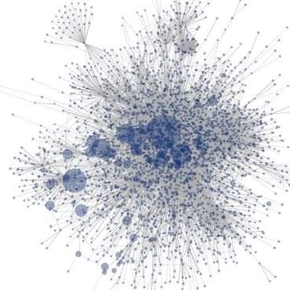
Work flow for NB SEIR Model
Nebraska Population
µ(N-S)*β(S*I/N)
S
ν S
β(S*I/N)
Barabasi Scale Free network with minimum 13 neighbors for each node
E
(µ+σ)E
σE
Find the number of neighbors for a random node
I
Aggregating number of infected individuals
(µ+ϒ)I
ϒ*I+νS
$$\sum{\text{Exposed} }$$
R
µR
Repeat 1000 times
β: Infection rate
γ: Recovery rate
σ: Incubation rate
µ: Mortality rate
ν: Vaccination rate
Average of # Exposed

Slide 17
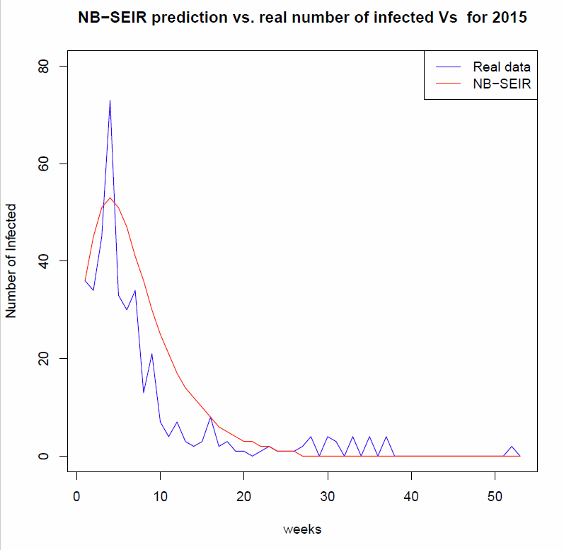
NB-SEIR Result

Slide 18
year | Real number of infected | NB_SEIR prediction | ME | RMSE
2000 | 16 | 148 | -2.490566 | 5.719876
2001 | 5 | 146 | -2.660377 | 5.564375
2002 | 9 | 146 | -2.584906 | 5.58806
2003 | 12 | 148 | -2.566038 | 5.613326
2004 | 85 | 162 | -1.45283 | 7.413654
2005 | 177 | 177 | 0 | 6.288654
2006 | 37 | 146 | -2.056604 | 5.353539
2007 | 45 | 148 | -1.943396 | 5.896913
2008 | 170 | 164 | 0.1132075 | 8.323642
2009 | 91 | 166 | -1.415094 | 4.912441
2010 | 163 | 179 | -0.3018868 | 7.394542
2011 | 42 | 196 | -2.90566 | 6.6076
2012 | 90 | 115 | -1.226415 | 6.244998
2013 | 117 | 148 | -0.5849057 | 6.048546
2014 | 243 | 230 | 0.245283 | 11.65948
2015 | 393 | 519 | -2.377358 | 7.3279
2016 | 100 | 208 | -0.509434 | 3.423008
2017 | 45 | 155 | -0.4528302 | 2.754071

Slide 19
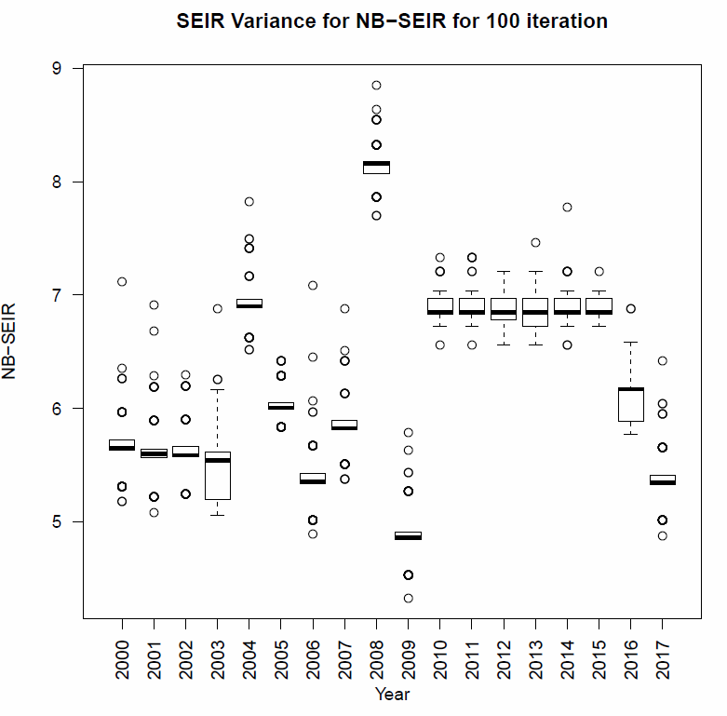
RMSE for 100 different repeats for each year

Slide 20
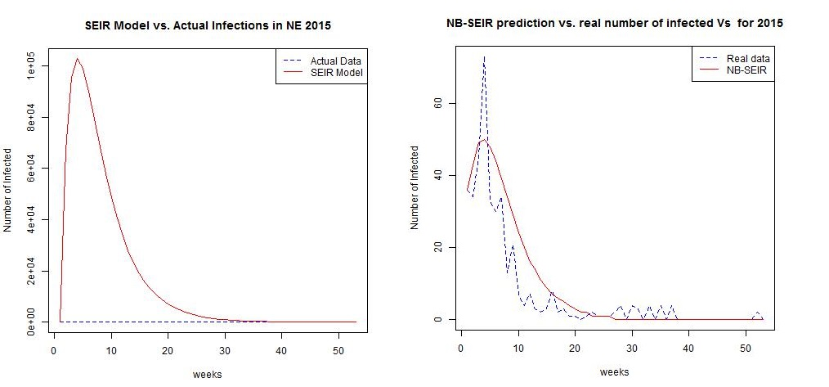
Conclusion
SEIR ME | SEIR RMSE
-21994.72 | 42414.11
-22199.58 | 42808.61
NB_SEIR ME | NB-SEIR RMSE
-0.509434 | 3.423008
-0.4528302 | 2.754071
year | Real number of infected | SEIR prediction | SEIR RMSE | NB_SEIR prediction | NB-SEIR RMSE
2016 | 100 | 1165820 | 42414.11 | 208 | 3.423008
2017 | 45 | 1176623 | 42808.61 | 155 | 2.754071
Codes are available at:
https://github.com/kmcooper/SEIR

Slide 21
Future work
How networks (social networks) changes over time
Evaluate our model based on the changes of networks and therefore exposed individuals.

Slide 23
Thank you!
Special thanks to my supervisor Dr. Kate Cooper
Question?

