Slide 1
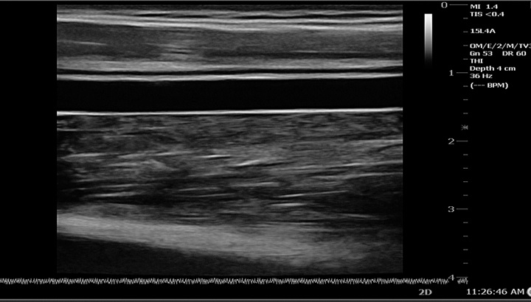
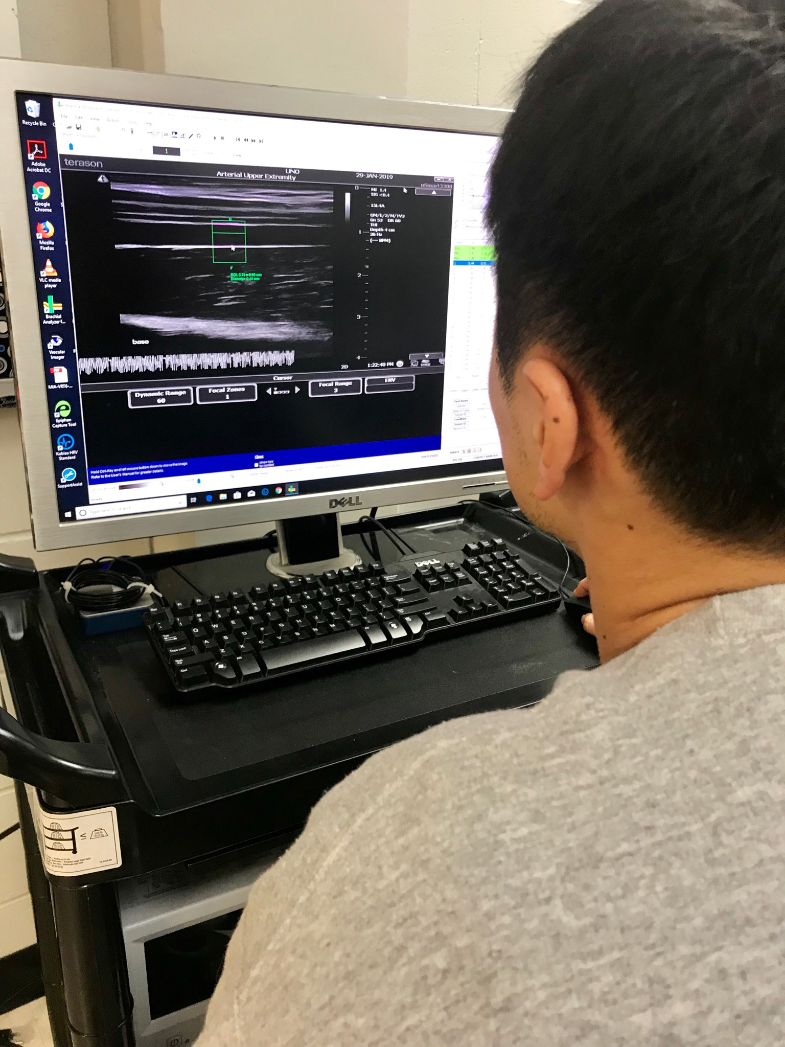
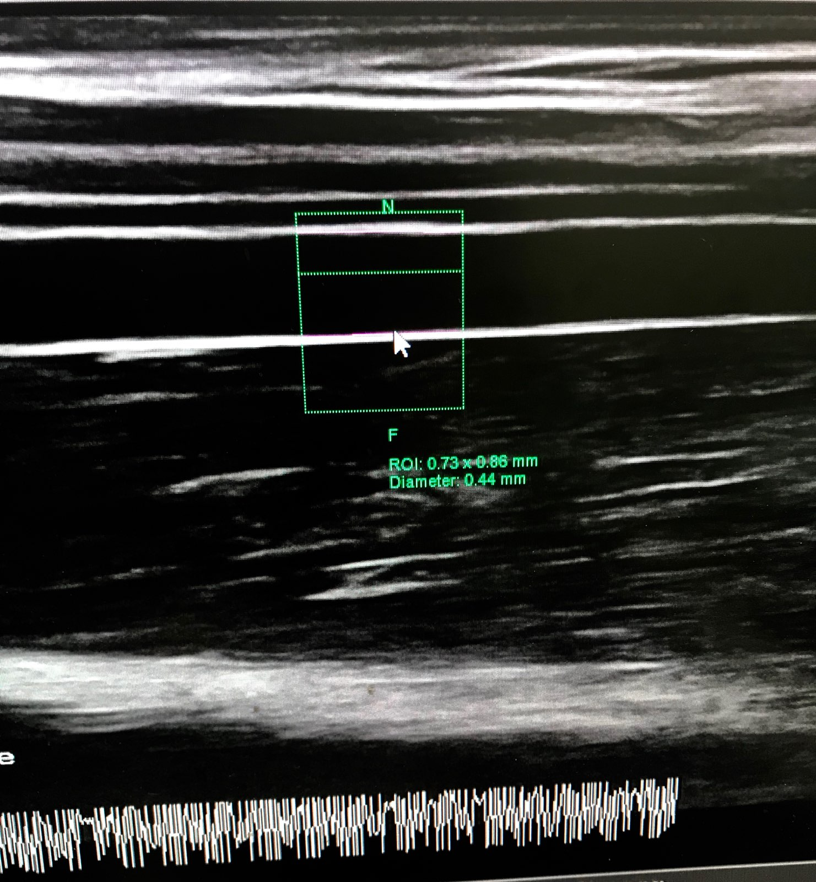
IMPACTS OF MITOCHONDRIAL-TARGETED ANTIOXIDANT (MitoQ) ON SKELETAL MUSCLE MITOCHONDRIAL FUNCTION IN PERIPHERAL ARTERIAL DISEASE PATIENTS: PILOT STUDY
Jiwon Song, Elizabeth J. Pekas, Steve D. Scott, Ronald J. Headid III, Michael D. Shukis, Jeonghwa Shin, and Song-Young Park
University of Nebraska at Omaha, School of Health and Kinesiology, Omaha, NE
Vascular Research Lab
BACKGROUND
METHODS
RESULTS
Peripheral arterial disease (PAD) is an atherosclerotic disease characterized by the development of plaque buildup in the peripheral arteries of the legs resulting in decreased blood flow which attenuates oxygen transfer capacity to the skeletal muscle.
A prominent symptom of PAD is claudication, or pain and/or cramping in the lower legs caused by inadequate blood flow. Claudication caused by PAD can drastically reduce an individual’s quality of life and exercise capacity. Markers of vascular health, such as endothelial function and arterial stiffness, have also been shown to be attenuated in patients with PAD which may contribute to the pathology of PAD.
Excessive reactive oxygen species (ROS) has been shown to disrupt endothelial function via oxidative stress. Mitochondrial-targeted antioxidant (MitoQ) has been shown to ameliorate impairments of endothelial dysfunction by targeting mtROS.
Previous studies have shown that MitoQ intake can improve vascular function in healthy older individuals. Therefore, the effect of MitoQ intake in PAD patients has been examined in this study
Flow-mediated dilation: non-invasive measurement of endothelial function using a trigger-monitor EKG system and Doppler ultrasound.
RESULTS
Figure 3. Peripheral blood pressure (mmHg) pre- and post-MitoQ intake
Figure 4. Central blood pressure (mmHg) pre- and post-MitoQ intake
Table 1. Participant characteristics and vascular function parameters pre- and post- MitoQ intake (n=2).
 | Pre | Post | Δ
Age, y | 73 | 73 | 0
Height, cm | 165.75 | 165.75 | 0
Mass, kg | 71.1 | 71.1 | 0
BMI, kg/m^2 | 25.2 | 25.2 | 0
Body fat, % | 39.75 | 39.75 | 0
R grip strength | 13 | 13 | 0
L grip strength | 41 | 41 | 0
Heart rate, bpm | 75 | 72.5 | -2.5
Peripheral pulse pressure, mmHg | 54 | 62 | 8
Central pulse pressure, mmHg | 51 | 45.5 | -5.5
Augmented pressure, mmHg | 11.5 | 4 | -7.5
PURPOSE
To examine the impacts of MitoQ intake on heart rate (HR), blood pressure, endothelial function, arterial stiffness, mitochondrial function in patients with PAD.
Hypothesis: MitoQ intake would improve vascular function in PAD patients.
Figure 5. Flow-mediated dilation (%) pre- and post-MitoQ intake
Figure 6. Deceleration time (ms) pre- and post-MitoQ intake
CONCLUSIONS
METHODS
These preliminary findings suggest that the utilization of MitoQ may potentially improve central and peripheral vascular function and may be useful as a therapeutic treatment for PAD patients.
There should be future studies with more participants to demonstrate the effectiveness of MitoQ on vascular function in PAD patients.
Two patients with PAD (stage II-III, age around 73) had vascular measurements taken pre- and post-MitoQ intake.
MitoQ dose was 80mg
Participant characteristics including height, weight, body composition, and grip strength were measured.
Before and after intake of MitoQ, resting HR, peripheral and central BP, endothelial function by flow-mediated dilation and arterial stiffness by carotid-to-radial wave velocity were measured.
Figure 1. Carotid-to-radial pulse wave velocity (m/s) pre- and post-MitoQ intake
Figure 2. Resting HR (bpm) pre- and post-MitoQ intake
This project was funded by the University Committee on Research and Creative Activity (UCRCA) and the Graduate Research and Creativity Activity (GRACA) Grant.

