Slide 1
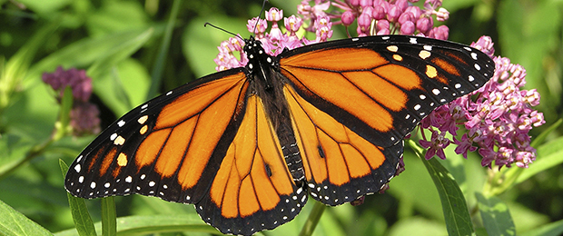
Effects of Rangeland Management on Milkweed Grazing and Monarch Conservation
Brittany Poynor¹, Timothy L. Dickson¹, Chris Helzer²
¹ UNO Biology ² The nature conservancy’s Director of Science in Nebraska
www.nfwf.org

Slide 2
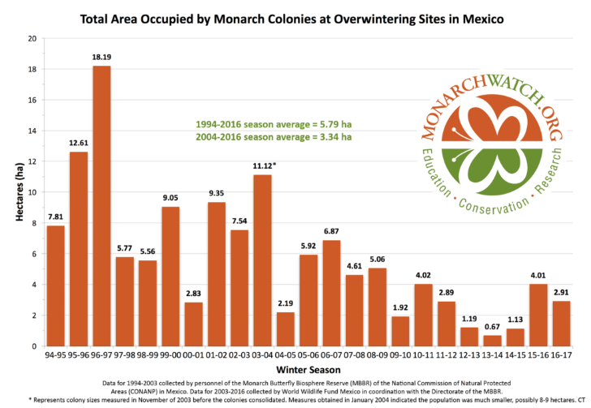
Monarch Population Decline
http://blog.nwf.org/

Slide 3
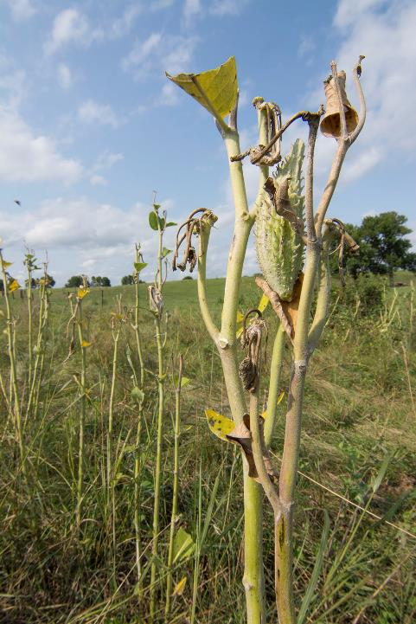
Introduction
Milkweed declines in the Midwestern USA are likely responsible for monarch declines
Asclepias syriaca, common milkweed, is the most important monarch host plant
Cattle graze Asclepias syriaca, but not other more toxic milkweed species
I sampled Patch Burn Grazing Sites
Photo of cattle grazed milkweed provided by Chris Helzer
Flockhart et al. 2013, McCarty and Scifres 1968, Thomsen et al. 1993, Fuhlendorf and Engle 2004

Slide 4
hypotheses
H₁: In the patch-burn-grazed managed land, there will be more undefoliated milkweed present in previous year burned fields where there is cattle choice because cattle will graze primarily in the current year burned area.
H₂: Cattle will intentionally graze milkweed. This will cause milkweed densities to be higher in the ungrazed fields than patch-burn grazed fields. This will also cause the percentage of A. syriaca that are defoliated to be the same or higher than the percentage of palatable grasses in the same field (i.e. cattle will graze A. syriaca more than surrounding vegetation).

Slide 5
methods
Milkweed density was sampled from three 200x2 meter transects per field
  3 ungrazed fields
  5 burned in the current year and grazed fields
  5 burned in previous years and grazed fields
The density of all milkweed species was counted in each transect
Within each field, I measured the timing of grazing for up to 25 A. syriaca stems
Within each field, I also measured the presence of grazing for 25 big bluestem plants
Harmoney et al. 1997

Slide 6
results
Grazed fields, both burned in the current year and burned in previous years have a significantly lower number of milkweed per square meter than fields that were ungrazed by cattle.

Slide 7
results
Less milkweed and big bluestem grazed in ungrazed fields.
Less big bluestem grazed in fields burned in previous years than fields burned in the current year.
No significant difference in number of A. speciosa grazed in fields burned in the current year compared to fields burned in previous years.

Slide 8
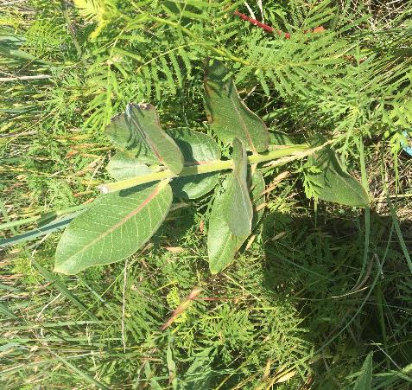
Discussion
Cattle do not leave common milkweed to rest, and may even preferentially graze it
Patch burn grazing is not likely the best management practice to conserve milkweed

Slide 9
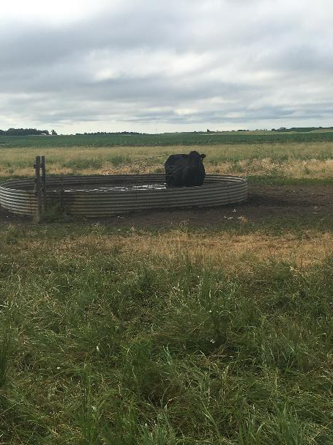
conclusion
Future studies should be completed on rotational grazing and other practices currently done by ranchers, to examine whether other grazing practices reduce milkweed grazing
Future studies to include more milkweed species with lower toxicity levels

Slide 10
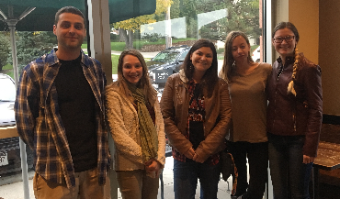
Acknowledgements
Grants and Scholarships:
University of Nebraska Omaha: GRACA & UCRCA
UNO Biology Department: Graduate Research Funds & The Bouteloua Scholarship
Nebraska Native Plant Society Grant
The Nature Conservancy Weaver Grant
Heartland Bank Scholarship
Merle E. Brooks Scholarship
Justin Speicher
Sage Evans
Jordan Matula
Liz Klug
Anastasia Zuerlein
Committee:
Dr. Timothy Dickson
Dr. John McCarty
Dr. Ted Burk
Friends and Family

Slide 11
References
Flockhart, D. T. T., L. I. Wassenaar, T. G. Martin, K. A. Hobson, M. B. Wunder, and D. R. Norris. 2013. Tracking multi-generational colonization of the breeding grounds by monarch butterflies in eastern North America. Proceedings of the Royal Society B 280:20131087.
Fuhlendorf, S. D., and D. M. Engle. 2004. Application of the fire-grazing interaction to restore a shifting mosaic on tallgrass prairie. Journal of Applied Ecology 41:604–614.
Harmoney, K. R., K. J. Moore, J. R. George, E. C. Brummer, and J. R. Russell. 1997. Determination of pasture biomass using four indirect methods. Agronomy Journal 89:665–672.
McCarty, M., and C. Scifres. 1968. Western Whorled Milkweed and Its Control. Weed Science 16:4–7.
Thomsen, C. D., W. A. Williams, M. Vayssiéres, F. L. Bell, and M. R. George. 1993. Controlled grazing on annual grassland decreases yellow starthistle. California Agriculture 47:36–40.

