Slide 1
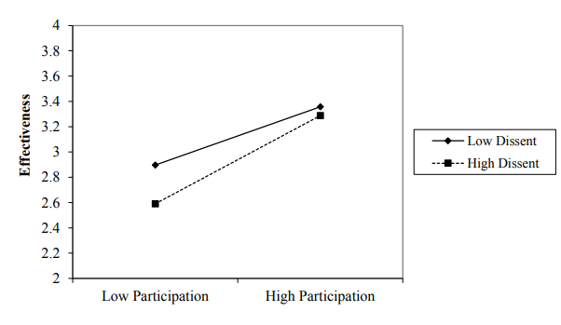
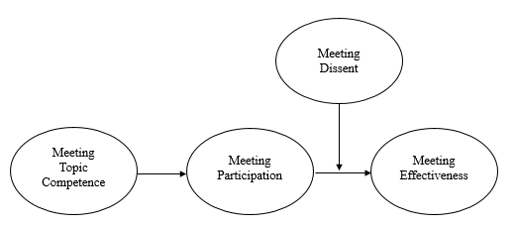
Topic Competence’s Effects on Meeting Participation and Effectiveness
Isaac A. Lindquist, Emily. E Adams, Joseph A. Allen
University of Nebraska at Omaha
Background
Methods
Moderation Effect
Workplace meetings are often held to discuss ongoing projects or the state of the organization and to identify problems and find solutions (Allen et al., 2014).
Participation is vital to the success of meetings held for such purposes.
Employees who participate in decision-making in meetings report more positive work outcomes such as work engagement (Hinkel & Allen, 2013; Yoerger et al., 2015).
Meeting attendees who do not participate are often seen by others as a detriment to the meeting, and the meeting’s effectiveness can suffer (Nixon & Littlepage, 1992; Odermatt et al., 2017).
Self-efficacy theory may explain one predictor of participation.
Self-efficacy theory states that those who believe that they are able to perform tasks are more likely to attempt the tasks and see their results as satisfactory (Bandura, 1997).
Organizational dissent is an important form of meeting participation
According to organizational support theory, employees who feel support from the organization are more likely to raise dissent in a formal way, such as in meetings ( Kassing, 1997; Rhodes & Eisenberger, 2002).
Participants included 602 employees who had participated in a meeting within the past week. Most (74.4% )of the respondents were Caucasian, and 53% were female. The average age was 35.52, and the respondents averaged approximately three meetings per week. Participants responded to a survey on Amazon’s MechanicalTurk.
Measures utilized:
Meeting Topic Competence—adapted from Williams, Freedman & Deci, 1998
Meeting Participation—Yoerger, Mroz, Landowski, Crowe, & Allen, 2018
Meeting Effectiveness—Rogelberg, Leach, Warr, & Burnfield, 2006
Meeting Dissent—adapted from Kassing, 1998
Discussion
When employees are knowledgeable on a topic, they are more likely to participate in a meeting and will believe that the meeting is more effective.
The relationship above is strongest when an employee feels comfortable speaking out in the form of disagreement in a meeting.
Theoretical Implications
Self-efficacy explains why competent attendees are more likely to participate in the meetings.
Meetings in which employees are made free to speak are more likely to be seen as effective, even if the participation is dissent.
Practical Implications
Managers should ensure that only necessary, knowledgeable personnel be included at meetings, and employees should understand effective meetings require contribution.
Leaders should foster a supportive work environment so that employees feel welcome to speak up
Hypothesized Model
Results
H4
Meeting topic competence predicts meeting participation, controlling for demographic variables, F(4, 597) = 39.63, R² = .21, ΔR² = .14, p < .01.
Meeting participation predicts meeting effectiveness, controlling for demographic variables, F(4, 597) = 38.30, R² = .20, ΔR² = .20, p < .01.
Meeting topic competence has an indirect effect on meeting effectiveness through meeting participation B = 0.11, 95% CI [0.8, 0.15], based on a 5,000 bootstrap sample.
The indirect effect on of meeting topic competence on meeting effectiveness through meeting participation is moderated by meeting dissent, B = 0.11, p > .05. The relationship is stronger when meeting dissent is high.
H1
H2
H3

