Slide 1
Electronically Monitored Youth
Perceptions of Stigma
Marijana M. Kotlaja, Doctoral Candidate
(University of Nebraska – Omaha)
Gaylene Armstrong, PhD
Primary GRACA Mentor
(University of Nebraska – Omaha)
Lindsey E. Wylie, JD, PhD
(University of Nebraska – Omaha)
Juvenile Justice Institute

Slide 2
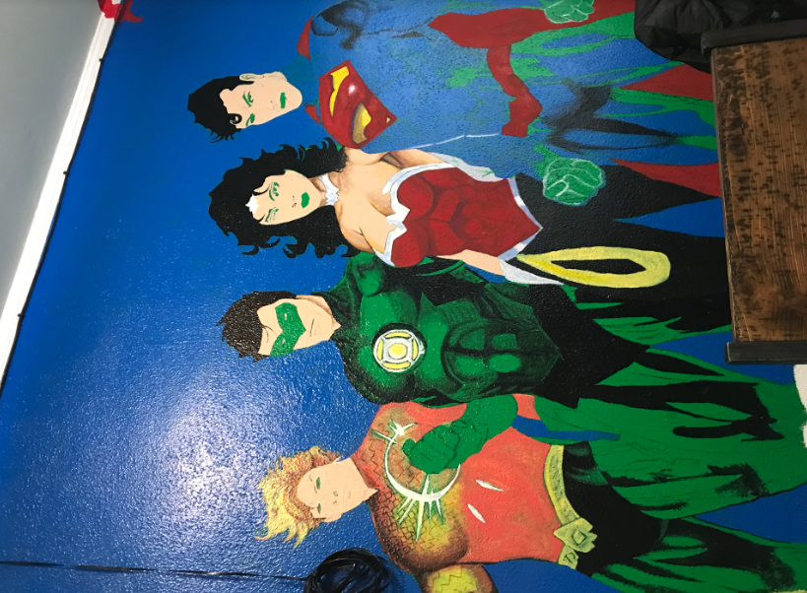
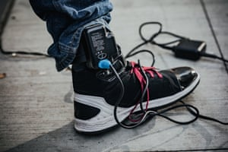

Slide 3
Prior Research
Evidence suggests that EMs are being used more across jurisdictions on juveniles as an alternative to detention.
(e.g., Lilly, Ball, Curry & Smith, 1992; Roy, 1997; Burrell & Gable, 2008; Kilgore, 2012; Yeh, 2010; Kilgore, 2013; Arnett, 2018).
Limits to existing research
Few studies examining EM with juveniles
Limited Methodology
Small Samples
Narrow Outcome Measures

Slide 4
Present Study
Brief Overview
This study tests how EM salience affects criminological thinking and whether having on an EM contributes to perceived stigmatization, unintended social costs and pains, program completion, and future law violations (post interview recidivism data).
Stigma and Stereotype Confirmation Literature
Participants randomly assigned to one of two conditions: a) Stigma Salience, and b) Stigma Nonsalience.
Stigma can be defined as “bodily signs designed to expose something unusual and bad about the moral status of the signifier” (Goffman, 1963, p. 1) or “the relationship between attribute and stereotype.”
“Blemish of Character”
Stereotype Confirmation Theory
EM serves as “a constant reminder of their status” as juveniles under supervision, this may create threat within youth on EM that they may confirm the stereotype that they are juvenile delinquents.
Experiment:
Salient vs. Non-Salient Condition
Salient Prompt
Participants asked to describe what it is like to wear an EM, and prompted to think about the physical and emotional aspects of the EM, as well as their interactions with others while on an EM.
Non-Salient Prompt
Participants were not be told the study is about their experiences on EM, and instead were asked to describe their day (using similar prompts).

Slide 5
Hypotheses
H1: Youth on EM will experience high levels of group stigma, personal stigma, and shaming and negative treatment by others.
H2: Youth in the stigma salient condition who are asked to think about wearing an EM, will have increased criminal thinking following the manipulation than youth in the control non-stigma salient condition.
H3: Youth with higher levels of perceived stigma, impulsive risk seeking behavior, and perceptions of shaming and negative treatment by others will have poorer outcomes including failure to complete the EM program successfully and future law violations.

Slide 6
Data
Participants
Youth
Expected Sample Size:140 juveniles currently enrolled in an EM program in Nebraska
Current Sample Size: 46
Data collection is ongoing and preliminary results are presented.
Two Types:
Pre-adjudicated
Prior to the adjudication phase of the juvenile justice process; EM administered to make sure youth go to court
Adjudicated (probation)
The term "adjudicated" is similar to "convicted" and indicates that the court concluded that the youth did commit a crime.

Slide 7
Measures
Psychological Inventory of Criminal Thinking Styles – Current Subscale (PICTS, Walters, 1990; 13 items; α = .87)
Measures criminal thinking and has been found in previous research to be sensitive to change following intervention
Personal Stigma Scale (LeBel, 2012; 9 items; α = .87)
The degree to which stigma is personally felt for being on EM
Costs and Pains Scale (Payne &Gainey, 1999; α = .88)
Negative experiences as a result of being on EM, such as not being able to do certain activities, being monitored, etc. (17 items)
Questions developed specifically for this study
Benefits of EM (6 items; α = .83), Deserving of the EM as Punishment (5 items; α = .19), Perceiving the EM as a source of Pride (4 items; α = .29)

Slide 8
Descriptive statistics
Controls | Mean / % | SD | Min | – | Max
Male sex | 87 % | -- | 0 | – | 1
Age | 16.33 | 1.22 | 12 | – | 18
Race
Caucasian | 33.3% | 1.15 | 1 | – | 4
African American | 40% | 1.15 | 1 | – | 4
Asian | 2.2% | 1.15 | 1 | – | 4
Hispanic | 24.4% | 1.15 | 1 | – | 4
Highest Education Mother
No High School | 22.2% | 2.17 | 1 | – | 7
GED | 31.1% | 2.17 | 1 | – | 7
Some College | 11.1% | 2.17 | 1 | – | 7
Bachelors | 8.9% | 2.17 | 1 | – | 7
Masters | 4.4% | 2.17 | 1 | – | 7
Advanced Work (PhD) | 4.4% | 2.17 | 1 | – | 7
Not Sure | 17.8% | 2.17 | 1 | – | 7

Slide 9
Descriptive statistics
Controls | Mean / % | SD | Min | – | Max
Highest Education Father
No High School | 26.7% | -- | 1 | – | 7
GED | 26.1% | .75 | 1 | – | 7
Some College | 13.0% | .85 | 1 | – | 7
Bachelors | 2.2% | 1.01 | 1 | – | 7
Masters | 4.3% | .90 | 1 | – | 7
Not Sure | 21.7% | .93 | 1 | – | 7
Other | 4.3% |  | 1 | – | 7
Grades (Last Year)
Mostly F’s | 11.4% | 1.19 | 0 | – | 5
Mostly D’s | 34.1% | 1.19 | 0 | – | 5
Mostly C’s | 25.0% | 1.19 | 0 | – | 5
Mostly B’s | 25.0% | 1.19 | 0 | – | 5
Mostly A’s | 2.3% | 1.19 | 0 | – | 5
First Time on EM | 60 % | .49 | 0 | – | 1
If no, how many times? | 3.00 | 1.74 | 0 | – | 5
Length of Time in Weeks on EM | 10.73 | 9.24 | 1 | – | 44

Slide 10
H1: Youth on EM will experience high levels of group stigma, personal stigma, and shaming and negative treatment by others, while also perceiving the EM as having some positive impact.
 | M | SD | Range
Costs and Pains | 2.12 | 0.68 | 1 to 4
Personal Stigma | 2.62 | 0.92 | 1 to 5
Benefits of EM | 3.48 | 1.03 | 1 to 5
Deserving of EM as Punishment | 3.10 | 0.70 | 1 to 5
EM as Source of Pride | 2.05 | 0.72 | 1 to 5
ANOVAs testing differences by race and sex demonstrated no significant differences for any of these measures

Slide 11
General Linear Model (GLM)
H2: Youth in the stigma salient condition who are asked to think about wearing an EM, will have increased criminal thinking following the manipulation than youth in the control non-stigma salient condition.
GLM Predicting Current Criminal Thinking
Variable | Type III SS | df | Mean Square | F | p | η²
Intercept | 0.49 | 1 | 0.49 | 1.63 | 0.21 | 0.04
condition | 1.74 | 1 | 1.74 | 6.12 | 0.02* | 0.14
status | 0.01 | 1 | 0.01 | 0.04 | 0.84 | 0.00
gender | 1.08 | 1 | 1.08 | 3.78 | 0.06 | 0.09
race | 2.68 | 2 | 1.34 | 4.70 | 0.02* | 0.20
age | 0.04 | 1 | 0.04 | 0.12 | 0.73 | 0.00
condition * status | 0.05 | 1 | 0.05 | 0.18 | 0.68 | 0.01
* n = 1 Asian youth was removed from analysis

Slide 12
GLM Estimated Means
Notes:
Present mean values for the variables that were significantly different – condition
Contrary to hypothesis, youth in the non-salient condition reported a higher degree of current criminal thinking than youth in the salient condition

Slide 13
GLM Estimated Means
* n = 1 Asian youth was removed from analysis

Slide 14
Qualitative Feedback Post-Interview
“Met at youth’s home. His mom mentioned she didn’t send the kids to school today because of the cold. We met at 1:00pm, but it appeared the youth had just woken up and acted sleepy.”
“While the youth insisted it didn’t bother them to have the EM on, they did mention that they do try to hide it when they’re out, but will admit to having it on if asked.”

Slide 15
Future directions
Recidivism ( Longitudinal Assessment)
Data about each participant’s case and program completion will be obtained from the program staff.
Recidivism at 6 months will be calculated by matching participants to data in the state trial court database (i.e., sealed and unsealed cases filed in court).
Expansion of Data Collection Initiative
Great Plains/Midwestern States

Slide 16
Electronically Monitored Youth
Perceptions of Stigma
Marijana M. Kotlaja, Doctoral Candidate
(University of Nebraska – Omaha)
Gaylene Armstrong, PhD
Primary Mentor
(University of Nebraska – Omaha)
Lindsey E. Wylie, JD, PhD
(University of Nebraska – Omaha)
Juvenile Justice Institute
Notes:
AKA: Ankle Bracelets

