Slide 1
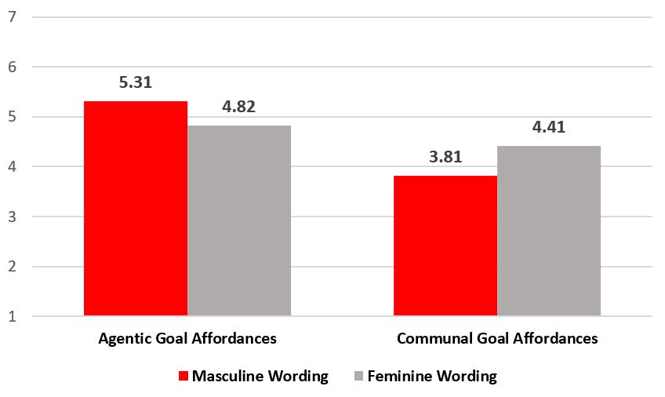
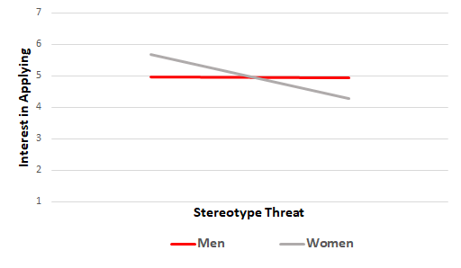
Applicant Reactions to Gendered Wording in Job Advertisements
Sahra Kaboli-Nejad, Eric M. Scheller, and Carey S. Ryan
University of Nebraska at Omaha
Introduction
Key Takeaways
Results
Women account for only 28% of the STEM workforce (Neuhauser, 2014). One contributing factor may be gendered wording in advertisements (e.g., the use of more masculine wording in male-dominated fields). Masculine wording may discourage women from applying for male-dominated STEM careers. Research has shown, for example, that participants perceive there to be more men in occupations that use more masculine than feminine wording in their advertisements, resulting in women finding the jobs less appealing (Gaucher et al., 2011; Horvath & Sczesnya, 2016).
The present research examined whether gendered wording in an advertisement for a male-dominated STEM career affects perceptions of interest in the job. In addition, we examined whether gendered wording affects experiences of stereotype threat and perceptions of the the job as affording communal and agentic goals. Perceptions of the types of goals afforded by careers has been shown to impact career preference. For example, STEM careers tend to be viewed as less likely to afford communal goals (Diekman et al., 2010). Because women seek roles that afford communal goals, they may be more likely to be deterred from seeking STEM careers.
Inconsistent with previous findings (e.g., Barbulescu & Bidwell, 2013), gendered wording did not affect stereotype threat, job suitability, job belongingness, or interest in applying, all ps > .407. While participants generally perceived the job to afford more agentic than communal goals, F(1, 231) = 82.63, p < .001, gendered wording affected perceived goal affordances. The job was perceived as affording more agentic (vs. communal) goals when the wording was masculine, F(2, 231) = 4.86, p = .009, and as affording more communal (vs. agentic) goals when the wording was feminine, F(2, 231) = 3.55, p = .030 (See Figure 1).
Further, women (M = 3.13) experienced greater stereotype threat than did men (M = 2.02), F(1, 228) = 24.40, p < .001. For women (but not men), greater stereotype threat predicted less interest in applying for the position, F(1, 81) = 4.52, p = .040, R² = .05 (See Figure 2).
Finally, perceiving the position as affording communal goals was more strongly correlated with job suitability, Steiger’s Z-test = -1.76, p = .039, and job belongingness, Steiger’s Z = -2.24, p = .012, than was perceiving the job as affording more agentic goals. (See Table 1.) Although the correlation between communal goal affordances and interest in applying for the job was greater than that between agentic goal affordances and interest in applying, the difference between them was not significant, Steiger’s Z = -1.11, p = .134.
Male (vs. female) dominated fields more often use masculine wording, which may deter women from applying for roles in male-dominated industries (e.g., STEM; Gaucher et al., 2011).
We created three job advertisements that utilized gendered wording for a position as a data analyst, examining their effects on communal and agentic goal affordances, stereotype threat, job suitability, job belongingness, and interest in the job.
Regardless of wording, women experienced greater stereotype threat than did men, resulting in less interest in applying. Overall, the job was viewed as affording greater agentic (vs. communal) goals, but viewing the job as affording communal (vs. agentic) goals was associated with greater job suitability and job belongingness.
Figure 1
Method
Participants
Participants (N = 252; 63.4% male) completed an online questionnaire in exchange for $2. They ranged in age from 21-69 years (M = 35.58, SD = 10.42), and a majority (65.5%) had at least some college education.
Procedure
Participants were randomly assigned to view a job advertisement that used masculine (e.g., dominant), feminine (e.g., interpersonal skills), or neutral wording to describe a fictitious position as a data analyst (where women represent only 26% of workers; AAUW, 2015). After viewing the advertisement, participants completed the following measures.
Measures
Stereotype threat. Three items (Deemer, Thoman, Chase, & Smith, 2014) assessed stereotype threat (e.g., “I worry that my ability to perform well in this job would be affected by my gender;” α = .93). Goal affordances. Fifteen items (Diekman et al., 2011) assessed participant perceptions of the career fulfilling agentic (e.g., competition; α = .81) and communal (e.g., connection with others; α = .91) goals.
Job suitability. Four items (Bosak & Sczesny, 2008) assessed participants’ perceived suitability for the advertised position (e.g., “I think I am very well qualified for the advertised position;” α = .94). Job belongingness. Four items (Gaucher et al., 2011) measured anticipated belongingness in the advertised job (e.g., “I could fit in well at this company;”α = .89). Interest in applying. One item assessed participants’ interest in applying for the position (i.e., “How interested are you in applying to the job?”).
Table 1
 | Interest in Applying | Job Suitability | Job Belongingness
Communal Goal Affordances | .337** | .204** | .270**
Agentic Goal Affordances | .253** | .063 | .093
**p < .01
Conclusions and Implications
Gendered wording only affected perceived goal affordances, such that masculine (vs. feminine) wording resulted in perceptions that the role afforded more agentic (vs. communal) goals. Regardless of condition, women experienced greater stereotype threat than did men and women who experienced stereotype threat were less interested in applying for the position. Interestingly, for men, stereotype threat was not associated with decreased interest in applying. Positions that were perceived to afford communal goals (vs. agentic goals) had significantly stronger relationships with job suitability and job belongingness. Organizations may benefit from using job advertisements that suggest the jobs would afford communal goals rather than agentic goals.
Perhaps wording is not be strong enough to overcome
participants’ preconceived notions about a role as a data
analyst. Perhaps, simply knowing that a role is in a male-
dominated industry is enough to induce stereotype threat.
Future researchers might conduct a similar study with
various positions to determine whether findings replicate for
other positions (e.g., stereotypically feminine roles).
Figure 2

