Slide 1
Electronic Music and The UNO Technology assisted performance ensemble
Fuse grant recipient: Nick Spencer
Advisor: Dr. Seth Shafer

Slide 2
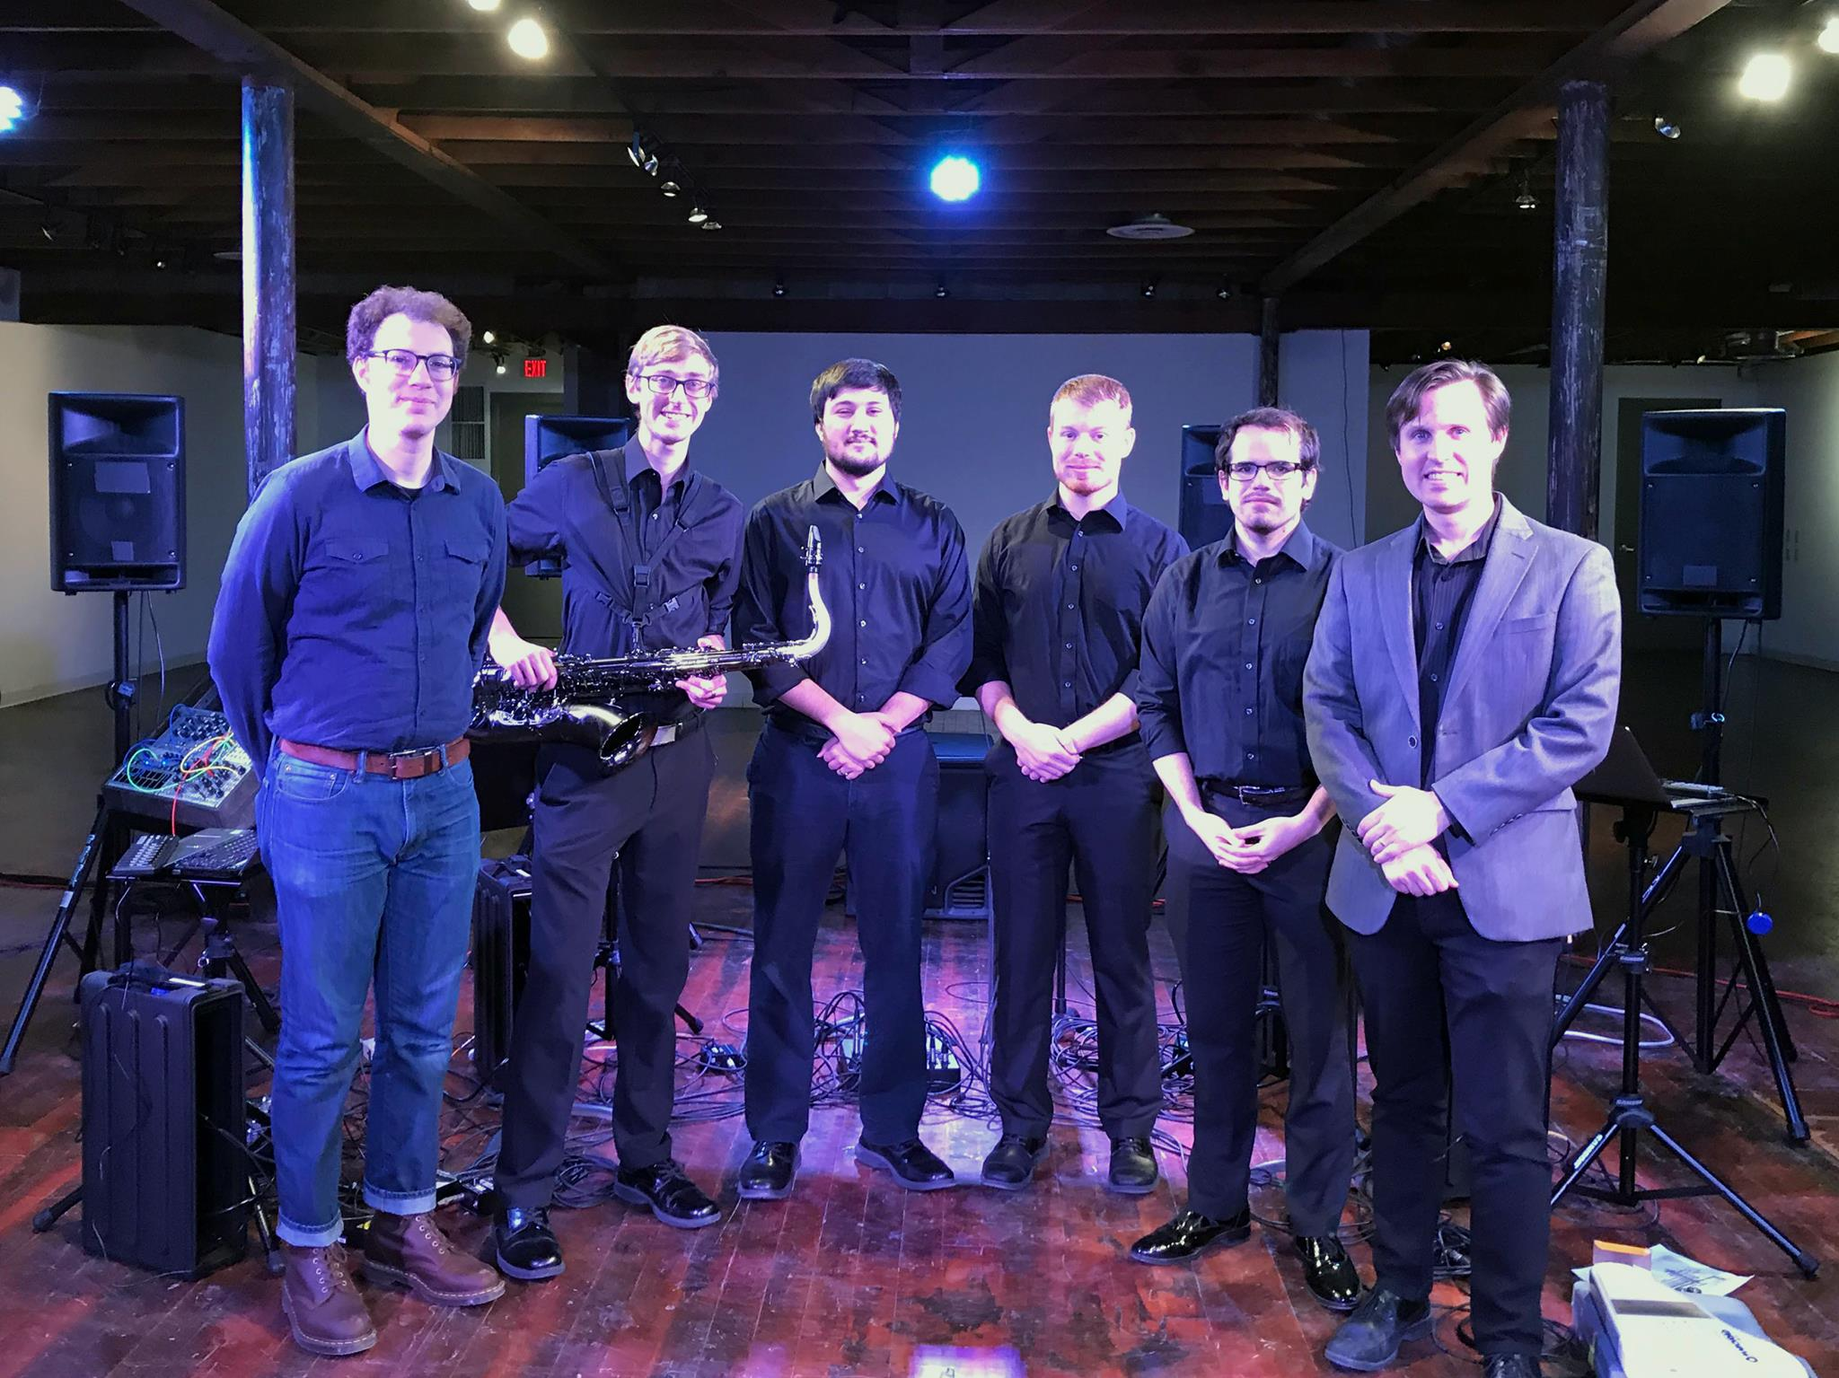
About Me
Senior Undergraduate Music Technology Student.
Emphasis on Digital Synthesis and modern music.
Assistant Director of the UNO TAPEnsemble.

Slide 3
What is a laptop ensemble and why do we need one?
Digital Instruments and acoustical support
A mixture of traditional music studies and music technology
A new way to expand the boundaries of modern music
Providing Music Tech students an open performance outlet
Notes:
Plork and Center for Computer Research in Music and Acoustics (CCRMA).

Slide 4
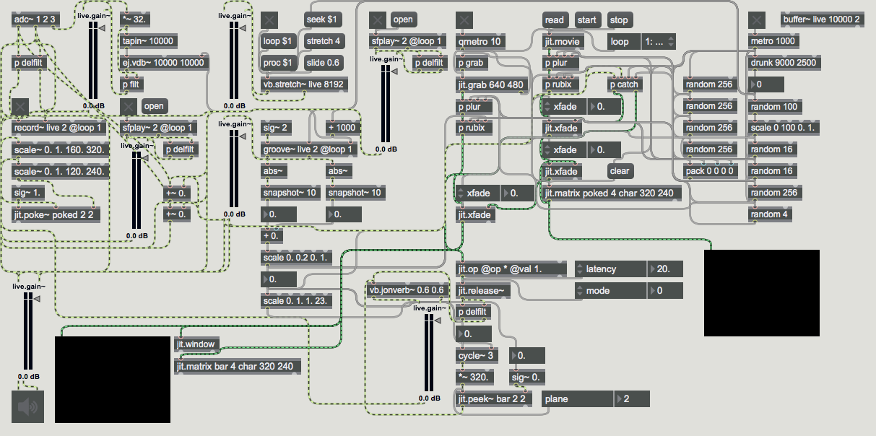
How the Tape ensemble performs
Audio Interfaces and MIDI Keyboards
Max/MSP →
Coding for music

Slide 5
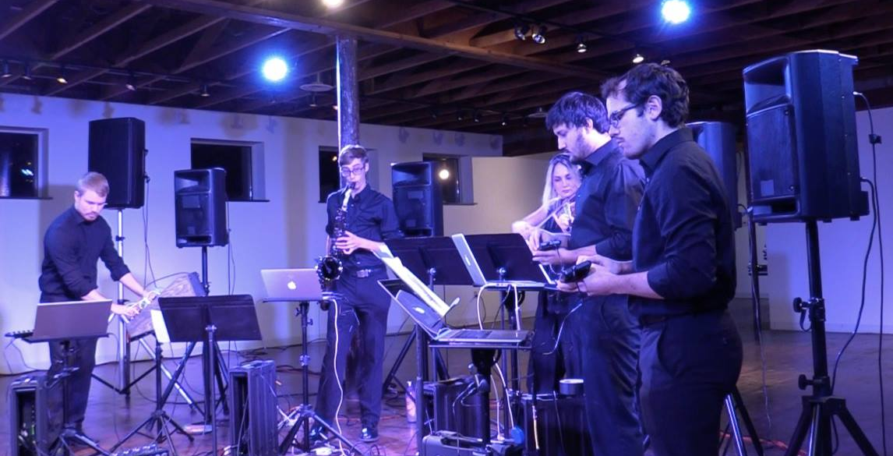
Nick Palensky and his modular synthesizer

Slide 6
The future
New expansions in Strauss make it easier to find practice areas as well as recording spaces.
Expanding curriculum allows students to explore other aspects of music technology that go beyond “recording”.
Working towards new gear to make more elaborate instruments.
Concerts!
April 26th, 7:30 PM @ OutrSpaces.

Slide 7
Thank you! (And possibly a demonstration)
Nick Spencer 2019

