Slide 1
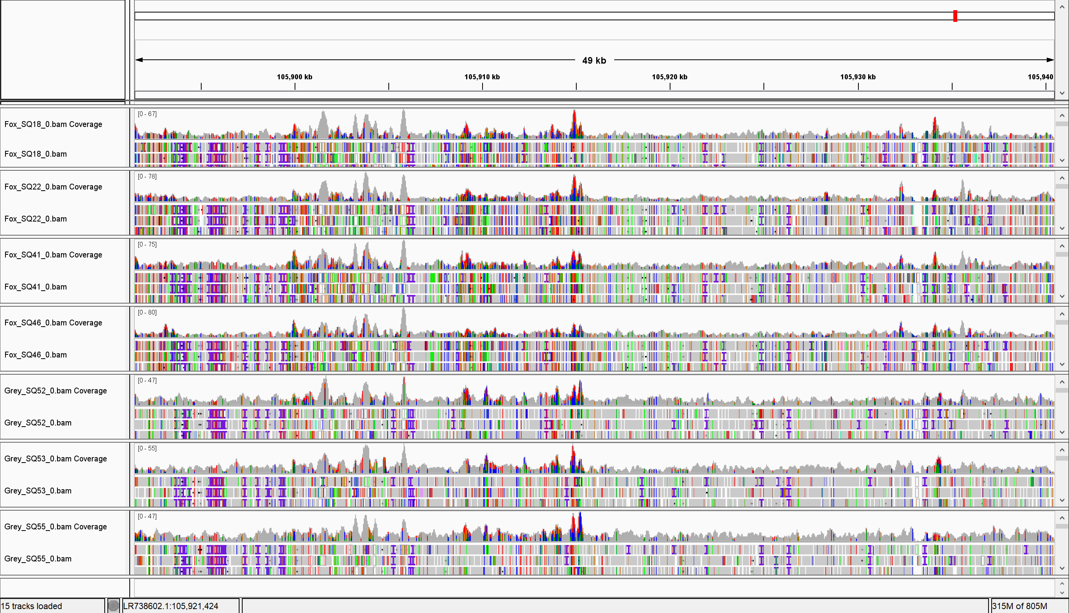
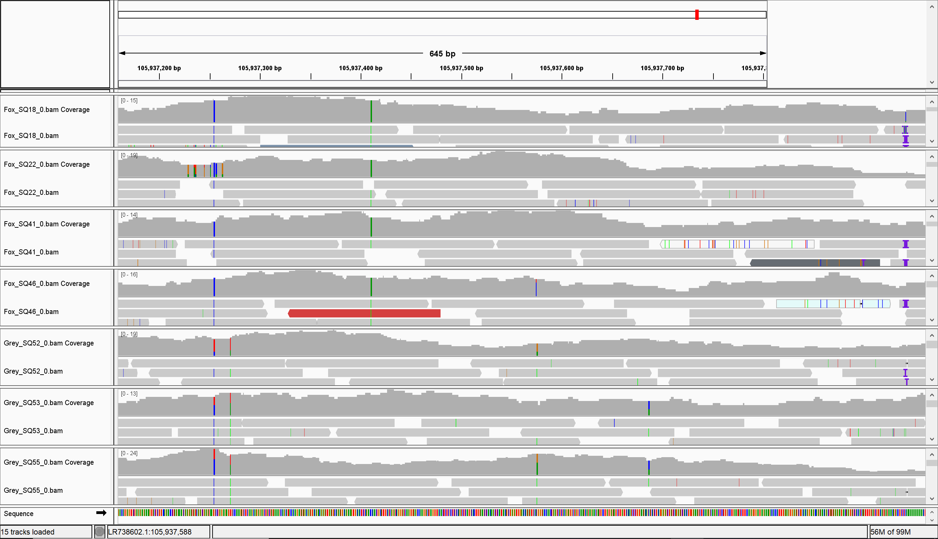
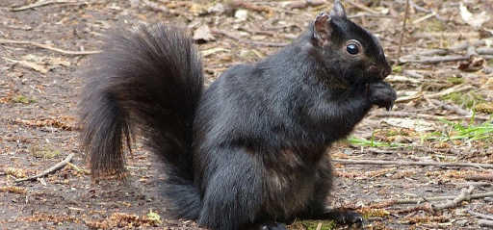
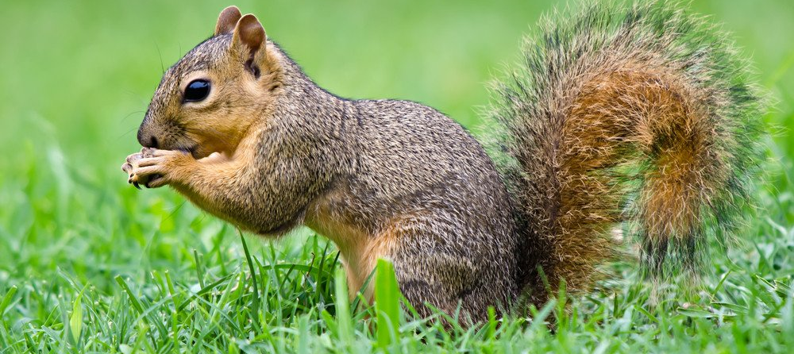
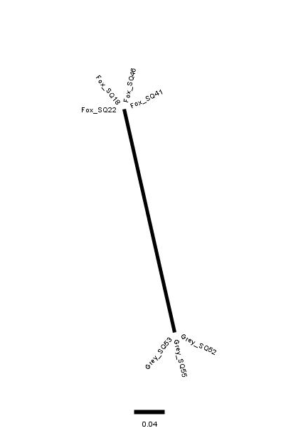
Comparison of gray squirrel (Sciurus carolinensis) and fox squirrel
(Sciurus niger) to explore conserved genes
Joshua Franzen, Department of Biology, University of Nebraska at Omaha
Introduction
Results
Discussion
Fox Squirrels, found throughout the eastern USA, have a mutation in the MC1R gene that produces melanistic (all black fur) individuals.
In Nebraska, Melanistic fox squirrels have been increasing in frequency and moving west
Evidence of interbreeding and past gene flow between gray and fox squirrels is found in the shared MC1R mutation
It is likely that other genes were transferred during interbreeding
By investigating similar regions between the squirrels, it is possible to discover other genes that have been conserved since interbreeding
Hypothesis: introgression between fox and gray squirrels can be identified through the sharing of genomic regions
The phylogenetic tree, generated from the MC1R gene region, shows that the two melanistic fox squirrels were closer to the gray squirrels compared to the wild type squirrels.
Trees generated from other gene regions don’t depict the melanistic squirrels as having greater similarity (compared to the wild type squirrels) to the gray squirrels.
The difference in similarity that can potentially exist between genes can be visualized in the tree for CSF1R (Figure 4).
The phylogenetic tree for the SPIDR gene, has interesting features. The Fox_SQ18 sample is closer than expected to the gray squirrels and Fox_SQ22 is more similar to the gray squirrel samples than it is to most of the fox squirrel samples. This potentially indicated that this fox squirrel contains a gene that was transferred from interbreeding.
The tree for SRGAP3 also has interesting features. In this tree, the Gray_SQ55 sample is more similar to the fox squirrels than expected, potentially indicating a conserved gene.
I think that better data may result from looking at similarities between shorter regions than 50,000 bp. This would allow the genes conferring similarity to be pinpointed more easily.
More exploration into these genes could elucidate important conserved genes.
Figure 1. Genome Similarity Comparison Plot. Genome similarity to the reference genome was calculated and plotted for every 50,000 bp for each sample. The plot above is for chromosome 12 (LR738602.1). The red box surrounds a point on the graph (105,891,449) that appeared to have more similarity between species than average.
Figure 2. IGV Images. Whole-genome sequence of regions of interest were examined in Integrative genomics viewer (IGV) to visually evaluate the quality of the genomic region. Left: IGV image of one of the 50,000 bp region (Chromosome 12:105,891,449- 105,940,449) found using the genome similarity comparison plot. Right: IGV image of the sequence of one of the genes found in the 50,000 bp region.
Figure 3. Squirrel images. Top: a melanistic fox squirrel with the MC1R mutation. Bottom: a wild type fox squirrel.
Methods
DNA was isolated from 4 fox squirrels and 3 gray squirrels using standard protocols
Isolated DNA was sequenced using 150bp paired-end sequencing to a targeted depth of 15-fold coverage
DNA sequences were aligned to the gray squirrel reference genome
Differences (heterozygous and homozygous) between each squirrel and the reference genome were quantified and plotted in 50,000bp windows across the genome.
Regions of high similarity among all squirrels were identified and genes within those regions predicted using Blast.
A neighbor-joining tree was constructed to visualize the relationships among samples for regions of interest.
Gene Coordinates | Gene
LR738606.1:192152-193088 | MC1R
LR738602.1:105,891,449-105937960 | CSF1R
LR738608.1:25833610-25834819 | SPIDR
LR738609.1:15867282-15870303 | SRGAP3
Table 1. Genes of Interest. Contains data about genes of interest found using similarity analyses and BLAST.
Figure 4. Phylogenetic Trees.
Genes from Left to Right: MC1R, CSF1R, SPIDR, and SRGAP3.
Acknowledgements
I would like to thank the UNO FUSE Program for funding this project, Dr. Jessica Petersen and Anna Fuller for their guidance and support in learning genetic analyses, and Dr. James Wilson for mentoring me and allowing me to pursue this opportunity.

Slide 2
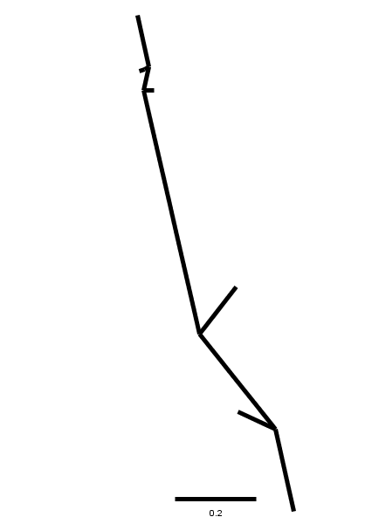
Fox_SQ22
Fox_SQ46
Fox_SQ41
Fox_SQ18
Gray_SQ55
Gray_SQ52
Gray_SQ53

