Slide 1
Developing A Discrete Event Simulation Model to Overcome Human Trafficking
Authors: Sydney Meier and Fabio Vitor

Slide 2
01
02
03
04
Background Information
What is human trafficking and what is the problem to solve?
Data
Acquisition
Where did the data come from?
Simulation Model
How does the model work?
Future
Work
How can the model be used? What work still needs to be done?

Slide 3
What is trafficking and who is affected?
Sex Trafficking
Labor Trafficking
71%
22%
Human trafficking is the illicit exploitation of humans through force, fraud, or coercion for monetary gain
An estimated 214,000 - 217,000 individuals are trafficked or targetted every year in the United States
Sex trafficking accounts for 71% of known cases
Labor trafficking accounts for 22% of known cases
Friend or Family
Intimate Partner
44%
40%
44% were recruited by friends or family
40% were recruited by an intimate partner

Slide 4
How can we combat human trafficking in the United States?
By modeling the movement of trafficked individuals in relation to their traffickers, law enforcement, and advocacy organizations, we can how governmental funding influences the number of people trafficked.
Intended goal: Develop a simulation model to act as an assistive tool for government agencies

Slide 5
Data Collection
Initial Data Collection
Interview Survivor Advocates
Interview Special Agents
Develop Comprehensive Map

Slide 6
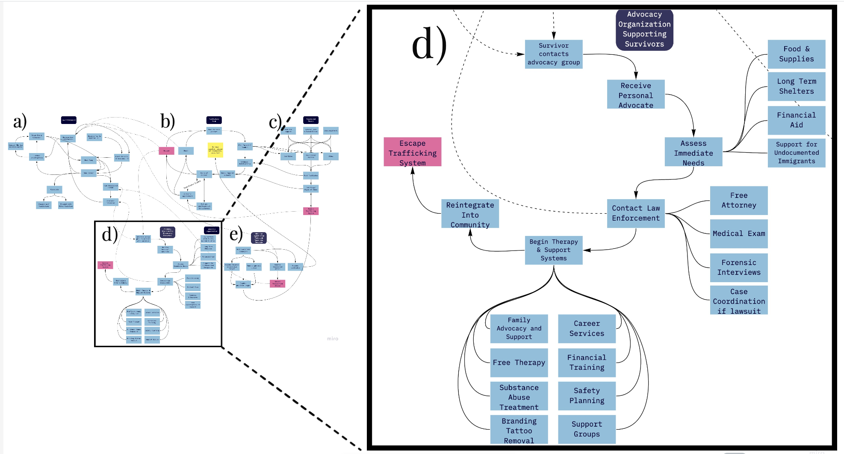
Miro Map

Slide 7
What is a discrete event simulation model?
A discrete event simulation models the behavior of a distinct number of events over a specific time period.
Entity: object that moves throughout the model
Source: object that generates entities
Server: object that processes an entity
Sink: object that destroys entities once they are finished in the system

Slide 8
Developing a Simulation Model
Modeling Tool: Simio
Server Wait Time: random triangular distributions using available data
Routing Logic: link weights
Trafficked_Person: entity object created every 2.4 minutes
Leave_Trafficking_System: sink object signifying complete removal from the trafficking system

Slide 9
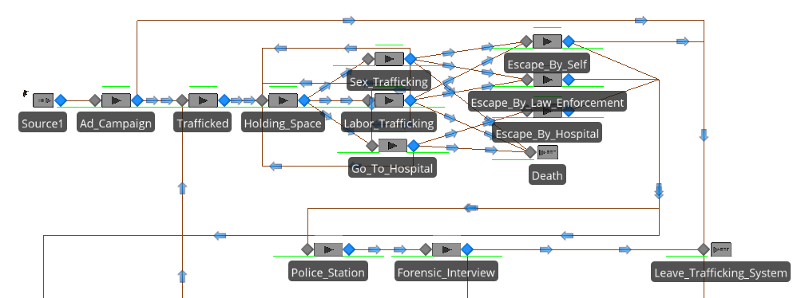
Simulation Model: Part 1

Slide 10
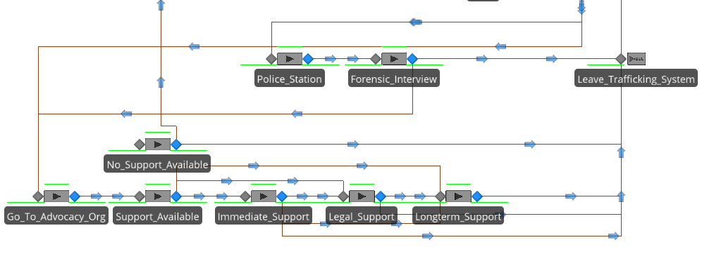
Simulation Model: Part 2

Slide 11
Validation Efforts
Validation Efforts
Ensuring the duration of trafficking lasts approximately 2 years
Seek out government-regulated data to test accuracy of assumptions

Slide 12
Possible Applications & Future Work
Governmental Applications
Project the results of possible funding allocations
Determine optimal services that need grants
Advocacy Organization Future Work
Future endeavors may include developing a simulation model specific to advocacy organization to optimize the services they provide.

Slide 13
Thanks
Does anyone have any questions?
sydneymeier@unomaha.edu
University of Nebraska-Omaha
/in/sydney-meier-0465601bb/ on LinkedIn

Slide 14
References
U.S. Office of Victims of Crime, “National Crime Victims’ Rights Week: Human Trafficking,” U.S. Office of Victims of Crime Archive, 2005. [Online]. Available: https://www.ncjrs.gov/ovc_archives/ncvrw/2005/pg5l.html#:~:text=Each%20year%2C%20an%20estimated%2014%2C500,(U.S.%20Department%20of%20Justice. [Accessed: Jan. 10, 2021].
Polaris Project, “2019 Data Report: The U.S. National Human Trafficking Hotline,” Polaris, United States, Date. Accessed: Jan. 10, 2021. [Online]. Available: https://polarisproject.org/wp-content/uploads/2019/09/Polaris-2019-US-National-Human-Trafficking-Hotline-Data-Report.pdf
Counter Trafficking Data Collaborative, “The Global Dataset.” (April 14, 2020). Distributed by Counter Trafficking Data Collaborative. https://www.ctdatacollaborative.org/dataset/resource/511adcb7-b1a2-4cc7-bf2f-0960d43a49cc
R. A. Konrad, A. C. Trapp, and T. Palmbach, “Overcoming Human Trafficking via Operations Research and Analytics: Opportunities for Methods, Models, and Applications,” European Journal of Operations Research, vol. 259, no. 2, pp. 733–745, Nov. 2016, doi: 10.1016/j.ejor.2016.10.049.
A. Novotny and V. . Personal Interview. (Sept. 25, 2020).
J. S. Webb. Personal Interview. (Nov. 17, 2020).
L. Groeger. “ER Inspector: Find and Evaluate Every Emergency Room Near You.” (Sept. 19, 2019). Distributed by ProPublica. https://projects.propublica.org/emergency/
U.S. Office of Victims of Crime, “TIMS Snapshot Report, July 2015-June 2016: Services for Victims of Human Trafficking,” U.S. Office of Victims of Crime, April 2020. [Online]. Available: https://ovc.ojp.gov/library/publications/office-victims-crime-tims-snapshot-report-july-2015-june-2016-services-victims. [Accessed: Jan. 10, 2021].
U.S. Office of Victims of Crime, “TIMS Snapshot Report, July 2016-June 2017: Services for Victims of Human Trafficking,” U.S. Office of Victims of Crime, April 2020. [Online]. Available: https://ovc.ojp.gov/library/publications/office-victims-crime-tims-snapshot-report-july-2016-june-2017-services-victims. [Accessed: Jan. 10, 2021].
U.S. Office of Victims of Crime, “TIMS Snapshot Report, July 2017-June 2018: Services for Victims of Human Trafficking,” U.S. Office of Victims of Crime, April 2020. [Online]. Available: https://ovc.ojp.gov/library/publications/office-victims-crime-tims-snapshot-report-july-2017-june-2018-services-victims. [Accessed: Jan. 10, 2021].
U.S. Office of Victims of Crime, “TIMS Snapshot Report, July 2018-June 2019: Services for Victims of Human Trafficking,” U.S. Office of Victims of Crime, April 2020. [Online]. Available: https://ovc.ojp.gov/library/publications/office-victims-crime-tims-snapshot-report-july-2018-june-2019-services-victims. [Accessed: Jan. 10, 2021].

