Slide 1
Insights into viral genome function through comparative structural analysis Lydia Phillips
Organtini, L. J., Makhov, A. M., Conway, J. F., Hafenstein, S., & Carson, S. D. (2014).

Slide 2
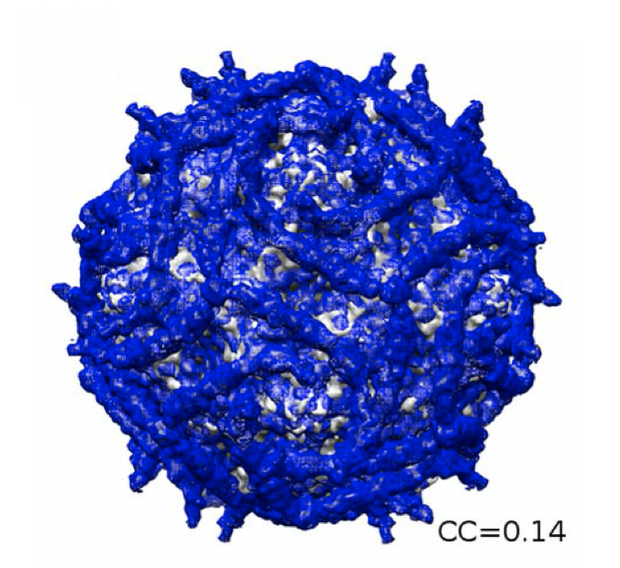
The Elusive Avirulent Coxsackievirus: CVB3/GA
The CVB3/GA strain is the only known naturally occurring strain which displays no known pathogenicity.
The primary difference between CVB3/GA and the virulent strains of CVB3: sixty-three nucleotide substitutions in the 5’UTR
Four of these substitutions could cause a change in predicted base pairing
Understanding the differences could lead to vaccine development, and better understanding of enteroviruses
Adapted from Yoder, J. D, et al (2012)
But which one is it?
Notes:
Yoder, J. D., Cifuente, J. O., Pan, J., Bergelson, J. M., & Hafenstein, S. (2012). The crystal structure of a coxsackievirus B3-RD variant and a refined 9-angstrom cryo-electron microscopy reconstruction of the virus complexed with decay-accelerating factor (DAF) provide a new footprint of DAF on the virus surface. Journal of virology, 86(23), 12571-12581.
The CVB3/GA strain is the only known naturally occurring strain which displays no known pathogenicity.
Studies show that it could be a candidate vaccine strain
The primary difference between CVB3/GA and the virulent strains of CVB3 is sixty-three nucleotide substitutions in the 5’UTR
Four of these substitutions cause a change in predicted base pairing and ultimately the structure.
Theoretical secondary structures of CVB3/GA has been proposed and chemical probing in our lab has confirmed some of the theoretical structures
More work is needed to accurately determine the structural differences in the 5’UTR of genomes from virulent and nonvirulent viruses. Evolution of molecular probes allows for higher accuracy in structural analysis.
Evolution of molecular probes allows for higher accuracy in structural analysis.

Slide 3
Coxsackievirus B3 in a nutshell
Member of Picornavirus Family, enterovirus genus
Non-enveloped viruses with +RNA genome
Enteroviral RNA genomes share a key region called the 5’ untranslated region (5’ UTR)
Has a conserved organization of six structural domains called the Internal Ribosome Entry Site (IRES)
Each domain plays a key role in replication and translation
Coxsackievirus B3 (CVB3) is one of 218 serotypes of Picornaviruses
Associated with severe diseases such as myocarditis, pancreatitis, and type I diabetes
Virulence determinants have been mapped to Stem-Loop II (SLII)
Domain II + connecting region between Domain I and II
Bailey et al.,2014

Slide 4
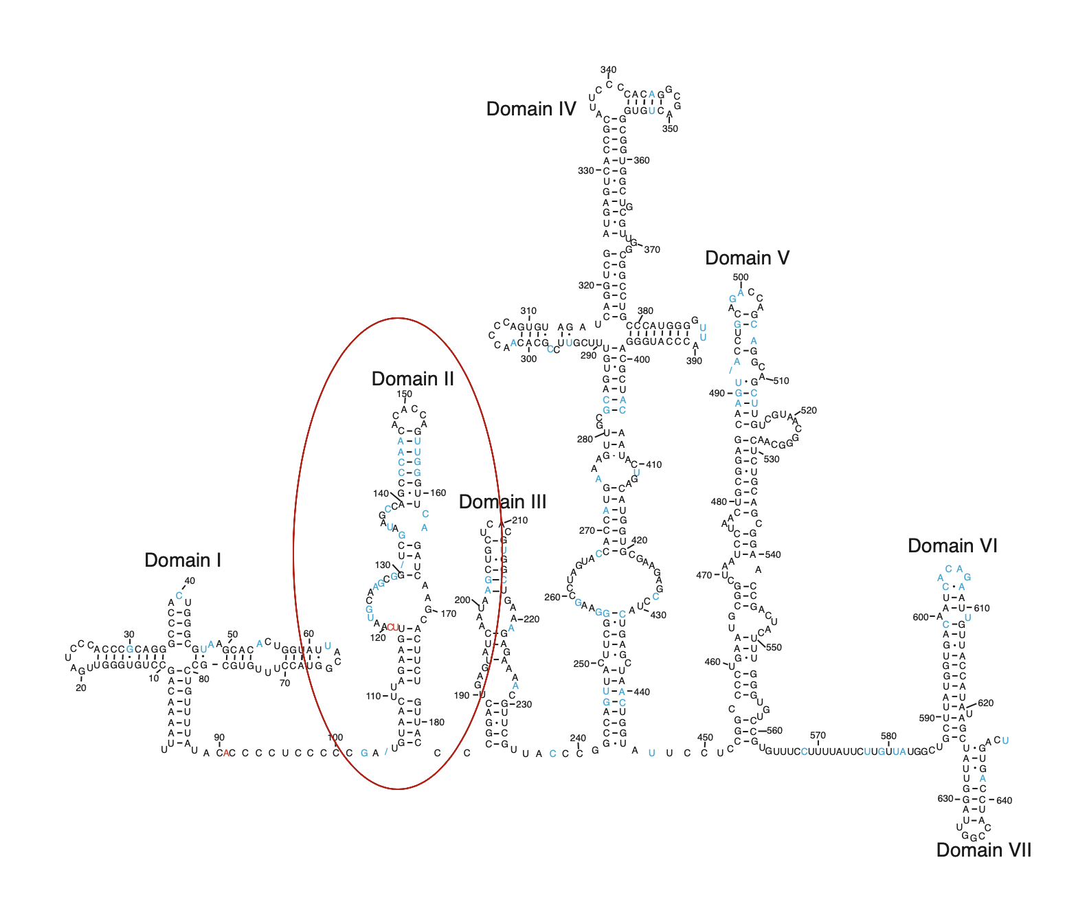
CVB3/28 (Virulent)
Early Structure Prediction of CVB3/GA (Avirulent)
First Proposed Structure of CVB3/GA
Proposed structure (derived from the chemical modification experiments) suggested that the SLII region did not exhibit any major differences from virulent CVB3/28
Mahmud, et al. 2019
Prusa ( unpublished data), 2014

Slide 5
Hypothesis
SHAPE-MaP probing will show significant structural differences in the 2-dimensional folding of the 5’UTR between CVB3/28 (virulent) and CVB3/GA (avirulent), particularly in the SLII region.
Determine the structure of genomic CVB3/GA 5’UTR through SHAPE-MaP
Comparison of CVB3/28 (Avery model) and CVB3/GA
Specific Aims

Slide 6
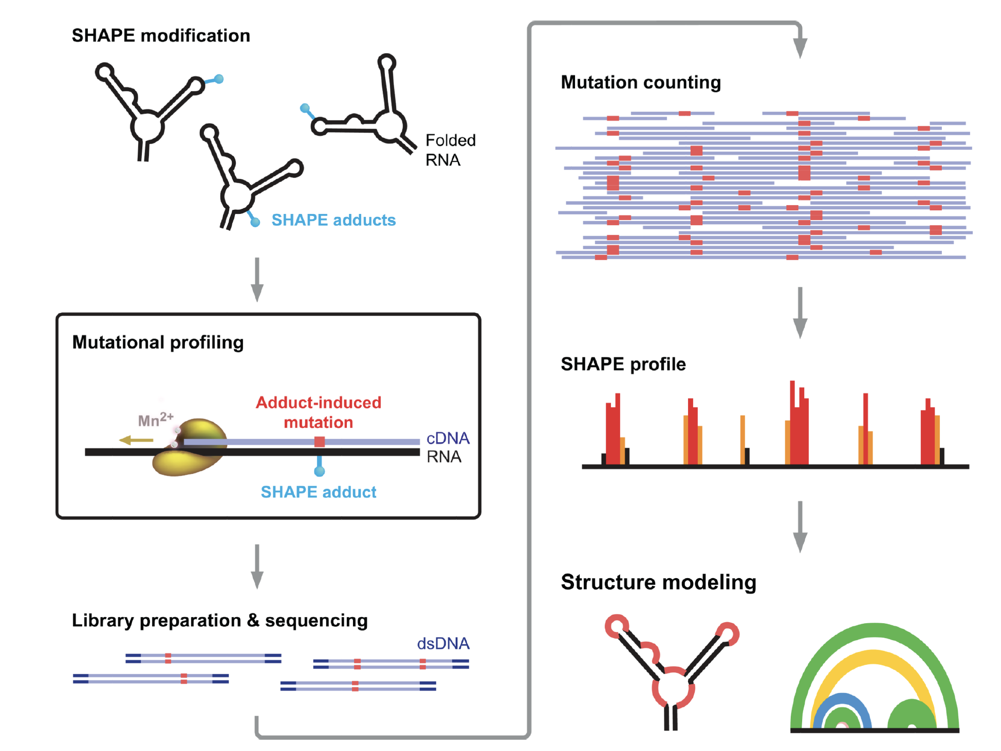
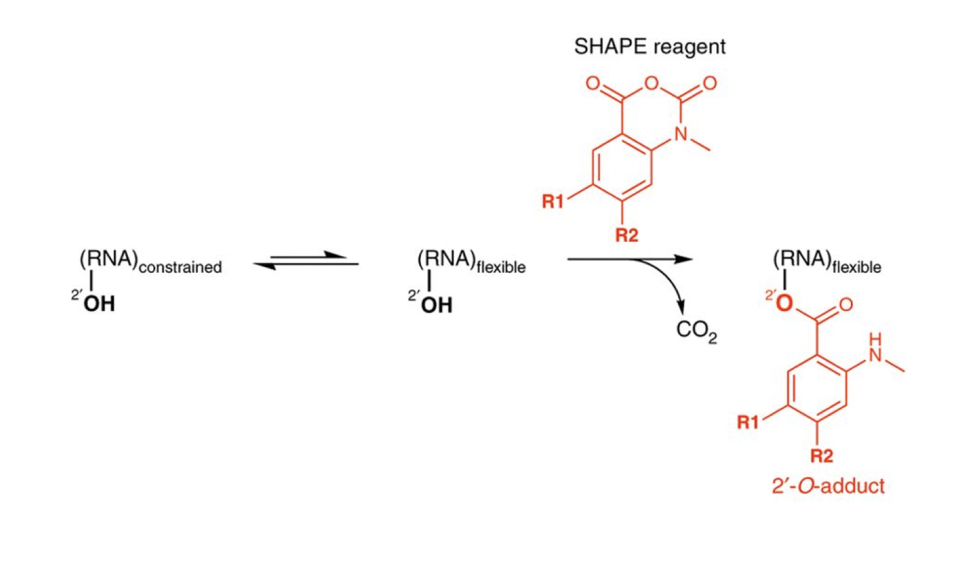
TACKLING COMPARATIVE STRUCTRUE ANALYSIS VIA MUTATIONAL PROFILING
Selective 2′-Hydroxyl Acylation analyzed by Primer Extension and Mutational Profiling (SHAPE-MaP) :
Hydroxyl-specific electrophiles to probe local nucleotide flexibility; non-base specific
SHAPE reagents induce covalent chemical adducts
Polymerase reads through the adducts and later adducts are read as noncomplementary nucleotides in the cDNA.
Reverse transcription step creates the MaP
Busan and Weeks, 2015
Notes:
Past chemical probing methods relied on interactions with specific RNA bases.
RNA Folding and Modification
RNA Folding under biologically relevant conditions
Modification of RNA 2'OH with 1M7
RNA/Protein Interactions*
Incubate RNA and Protein prior to modification
Reverse Transcription and dsDNA Production
use of a random nonamer during second strand synthesis
Sequencing
UNMC Core Facility: Nextera library preparation
Reactivity profiles and read depth analysis are generated from Illumina sequencing.
Bioinformatics
FASTA files fed in to Shapemapper2 program generates .Map files
Map files read by Turbofold to predict structure based on Shannon Entropy
Base pairing has low entropy , free nucleotides have high entropy

Slide 7
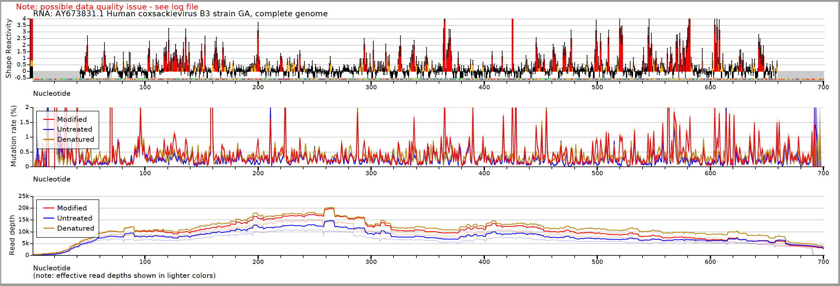
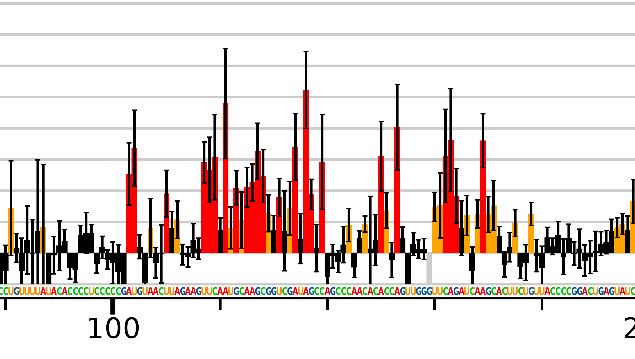
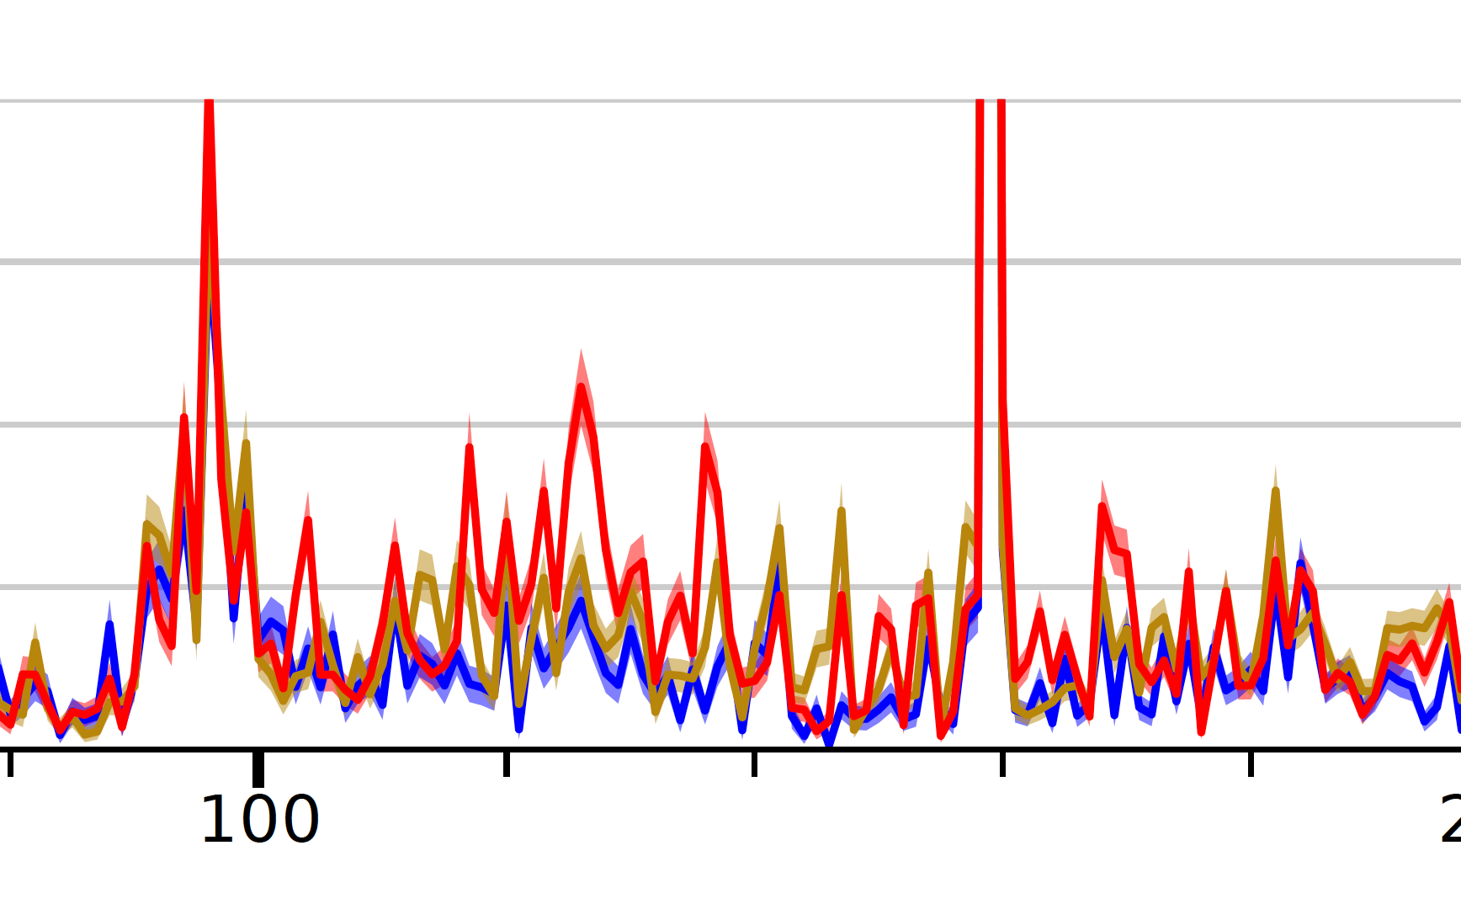
SHAPE-MaP Reactivity Profile
A.
Red - modified
Blue – unmodified
Tan - denatured
Red – high reactivity
Orange – medium reactivity
Black low reactivity
B.
C.
SHAPE Reactivity
Mutation Rate (%)
Notes:
Shape profile of CVB3/GA, stem-loop II (SLII). SLII is comprised of Domain II (DII) and the connecting region between Domain I (DI). DI ranges from 89-103. DII ranges from 105-181. A. The full shape profile is generated from the mutation frequencies detected from the sequencing reads. Reactivities are recorded as many individual events from massively parallel sequencing. Accuracy is dependent on read depth and mutation rates. Accurate read depths range from 2,000-5,000, based on computational inputs. The read depth represents 6-15 mutations per nucleotide Our experiments are set to a read depth of 4,000. Reactivities below 0.4 are shown in black, representing low modification. Reactivities between 0.4 and 0.85 are shown in orange, showing moderate modification. Reactivities 0.85 and above are shown in red, representing regions of high modification. Low reactivities represent a highly structured region, High reactivities represent less structured regions. B. Shape reactivities between 118 and 128 correspond with the left side of the loop in Figure 5B., the reactivity decreases from 140 to 160 corresponding with the small key hole shown in both CVB3GA and CVB328. Another curious region of interest is between 90-100 which shows low reactivity, indicating a highly structured region. This has not been shown previously and is not present in CVB3/28. C. Mutation rates at a given nucleotide are a count of each mismatch or deletion in the cDNA divided by the read count at that location. Red is modified (+), untreated (-) is blue, and denatured (DC) is tan.
ShapeMapper2 automatically detects sequence variants in input target sequences. Several quality control checks are implemented into the program utilizing the additional control reactions, such as a read depth-check, positive mutation rates above background check, high background mutation rates check, and number of highly reactive nucleotides check. Failure at any of these points causes the program to eliminate that point. Normalized modification values are generated using ShapeFinder.
The raw data are run through Turbofold analysis and then structure editor. SHAPE profiles are then input in to TurboFold which utilizes the input of three reference sequences to fold them into the lowest free energy conformations and calculates base pairing probabilities and a multiple-sequence alignment file. Reference sequences are used to generate pairwise alignment data and provides three alternative folding models. Each reference sequence is used to comparatively improve the other models

Slide 8
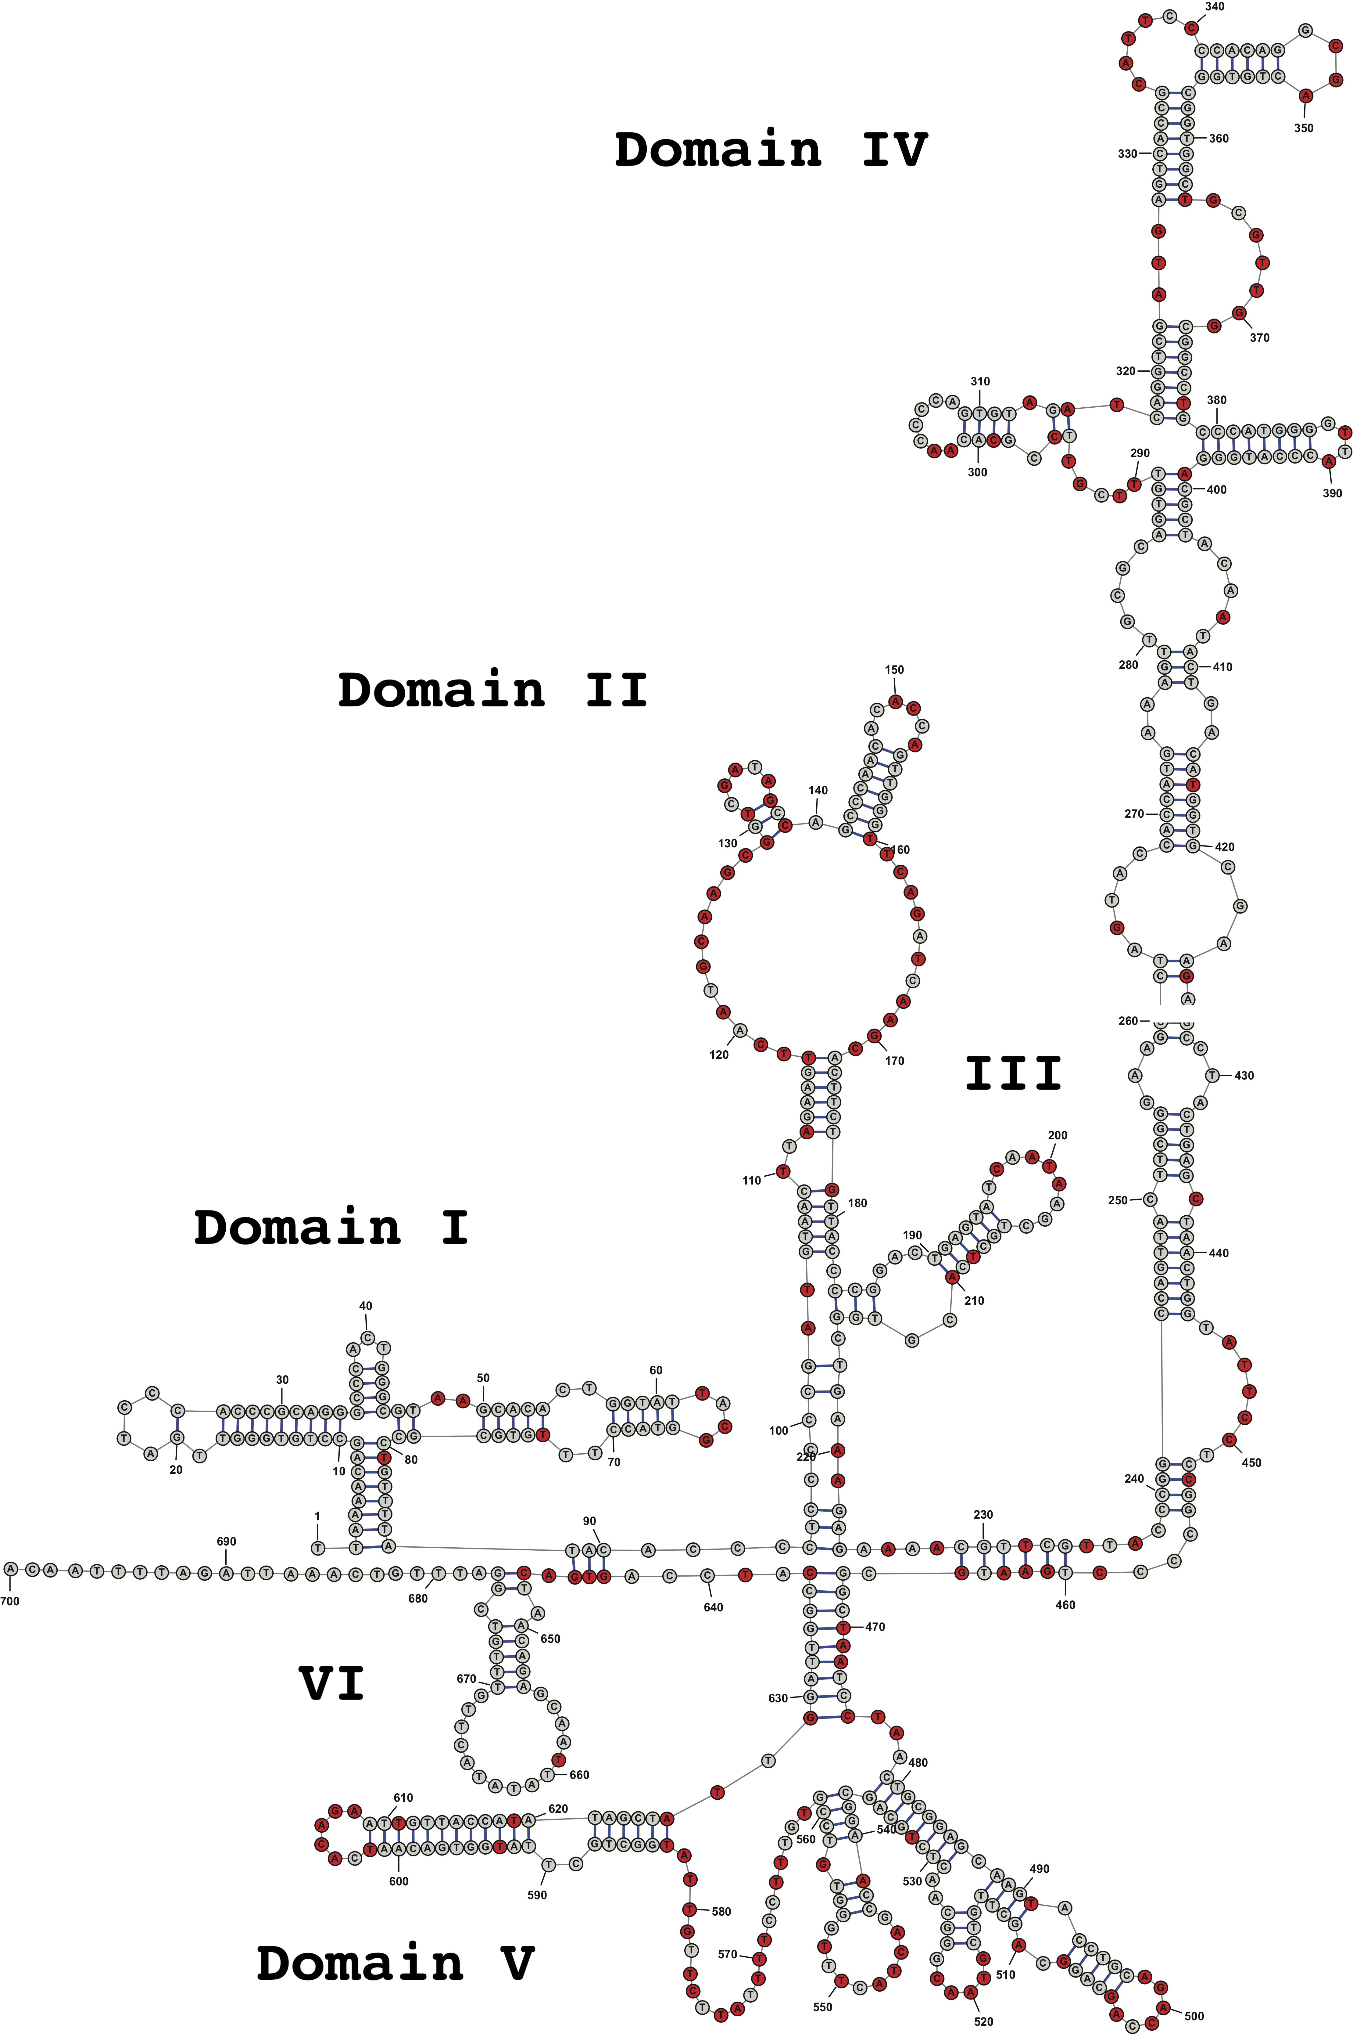
Structures of CVB3/28 5’UTR vs. CVB3/GA (preliminary)
5’ UTR of CVB3/GA
CVB3/28 - Domain II

Slide 9
Future Directions
Comparison of Avirulent and Virulent CVB3
More than just comparing pictures!
Individual regions
SHAPE-MaP: RNA/Protein challenge
What does it look like in the presence of host proteins?

Slide 10
References
Tracy, S. M., & Gauntt, C. J. (1987). Phenotypic and genotypic differences among naturally occurring coxsackie virus B3 variants. European Heart Journal, 8(suppl_J), 445-448.
Tracy, S., Kristen M. Drescher, N. M. Chapman, K-S. Kim, Steven D. Carson, S. Pirruccello, P. H. Lane, J. R. Romero, and J. S. Leser (2002). Toward testing the hypothesis that group B coxsackieviruses (CVB) trigger insulin-dependent diabetes: inoculating nonobese diabetic mice with CVB markedly lowers diabetes incidence. Journal of virology, 76(23), 12097-12111
Garmaroudi, F.S., Marchant, D., Hendry, R., Luo, H., Yang, D., Ye, X., Shi, J. and McManus, B.M (2015). Coxsackievirus B3 replication and pathogenesis. Future microbiology, 10(4), 629-653.
Hughes, A. L. (2004). Phylogeny of the Picornaviridae and differential evolutionary divergence of picornavirus proteins. Infection, Genetics and Evolution, 4(2), 143-152.
Witwer, C., Rauscher, S., Hofacker, I. L., & Stadler, P. F. (2001). Conserved RNA secondary structures in Picornaviridae genomes. Nucleic acids research, 29(24), 5079-5089.
Daijogo, S., & Semler, B. L. (2011). Mechanistic intersections between picornavirus translation and RNA replication. In Advances in virus research(Vol. 80, pp. 1-24). Academic Press.
Jackson, R. J., Howell, M. T., & Kaminski, A. (1990). The novel mechanism of initiation of picornavirus RNA translation. Trends in biochemical sciences, 15(12), 477-483.
Prusa, J., Missak, J., Kittrell, J., Evans, J. J., & Tapprich, W. E. (2014). Major alteration in coxsackievirus B3 genomic RNA structure distinguishes a virulent strain from an avirulent strain. Nucleic acids research, 42(15), 10112-10121.
Jackson, R. J., Howell, M. T., & Kaminski, A. (1990). The novel mechanism of initiation of picornavirus RNA translation. Trends in biochemical sciences, 15(12), 477-483.
Bailey, J. M., & Tapprich, W. E. (2007). Structure of the 5′ nontranslated region of the coxsackievirus b3 genome: chemical modification and comparative sequence analysis. Journal of virology, 81(2), 650-668.
Smola, M. J., Rice, G. M., Busan, S., Siegfried, N. A., & Weeks, K. M. (2015). Selective 2′-hydroxyl acylation analyzed by primer extension and mutational profiling (SHAPE-MaP) for direct, versatile and accurate RNA structure analysis. Nature protocols, 10(11), 1643.
Mahmnud, B., Horn, C., Tapprich, WE. 2019. Structure of the 5’ Enteroviral Genomic RNA. Unpublished manuscript.
Tracy, S., Drescher, K. M., Chapman, N. M., Kim, K.-S., Carson, S. D., Pirruccello, S., Lane, P. H., Romero, J. R., & Leser, J. S. (2002). Toward Testing the Hypothesis that Group B Coxsackieviruses (CVB) Trigger Insulin-Dependent Diabetes: Inoculating Nonobese Diabetic Mice with CVB Markedly Lowers Diabetes Incidence. Journal of Virology, 76(23), 12097–12111. https://doi.org/10.1128/JVI.76.23.12097-12111.2002
Smola, M. J., Calabrese, J. M., & Weeks, K. M. (2015). Detection of RNA–Protein Interactions in Living Cells with SHAPE. Biochemistry, 54(46), 6867–6875. https://doi.org/10.1021/acs.biochem.5b00977
Busan, S., & Weeks, K. M. (2018). Accurate detection of chemical modifications in RNA by mutational profiling (MaP) with ShapeMapper 2. RNA (New York, N.Y.), 24(2), 143–148. https://doi.org/10.1261/rna.061945.117

Slide 11
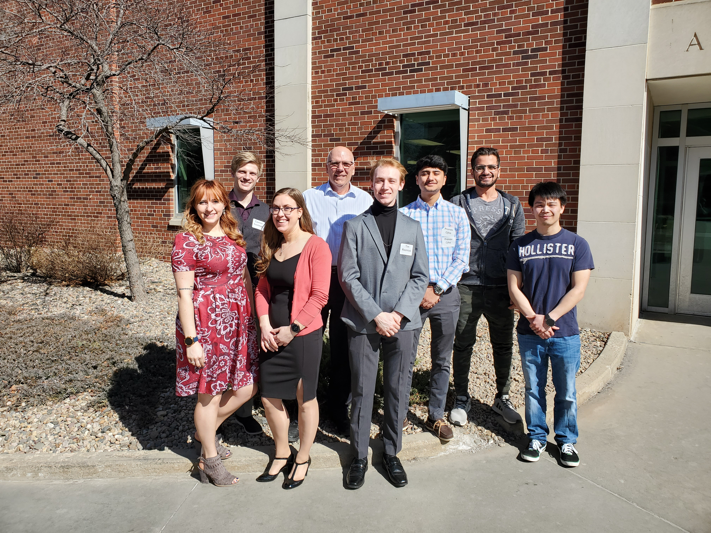
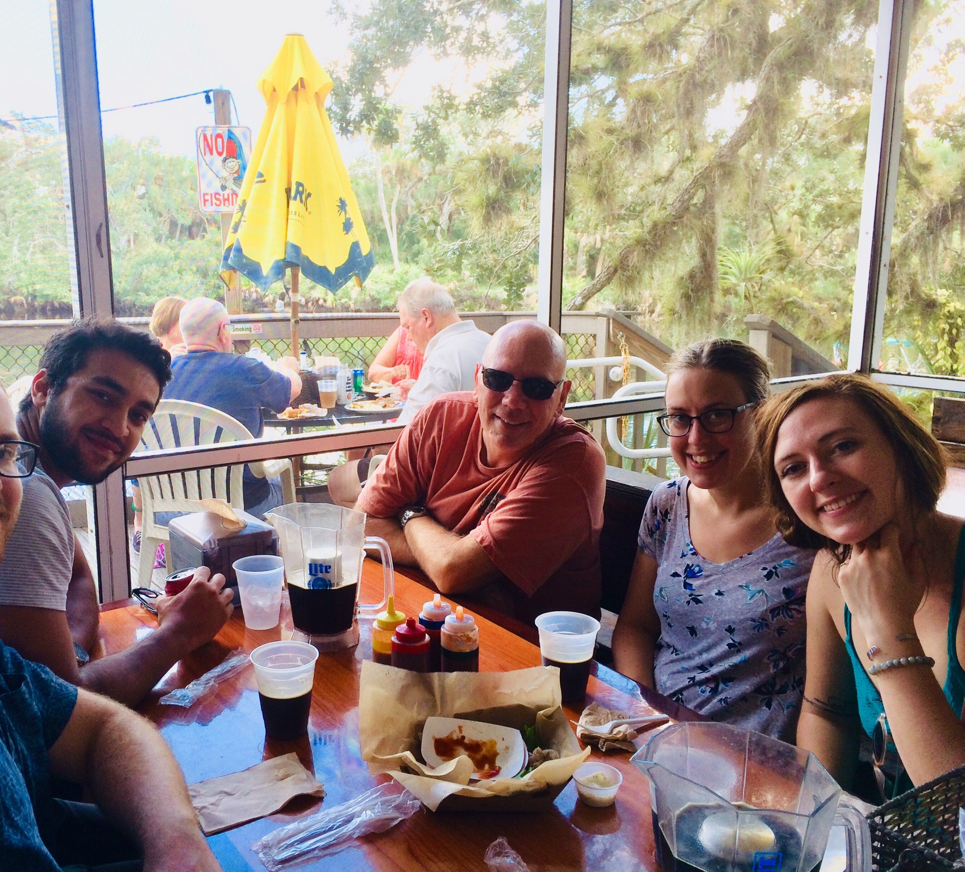
I would like to express my gratitude to:
Dr. William Tapprich
Special thanks to Tim Reznicek for his coaching and assistance through the bioinformatic steps
The Tapprich lab group
University and Biology Department
Funding:
Biology Department
GRACA
This publication was made possible by grants from the National Center for Research Resources (5P20RR016469) and the National Institute for General Medical Science (NIGMS) (8P20GM103427), a component of the National Institutes of Health (NIH) and its contents are the sole responsibility of the authors and do not necessarily represent the official views of NIGMS or NIH.

