Slide 1
The Moderating Role of Coping Resilience on the Relation Between Total Role Demands on Daytime Sleepiness in Working College Students
Emily A. McQuade & Lisa L. Scherer, Ph.D. (Faculty Mentor)
Department of Psychology, University of Nebraska at Omaha
Presentation to the UNO Research and Creativity Fair, March 26, 2021
Notes:
Why does this study matter?
Sleepiness and sleep health

Slide 2
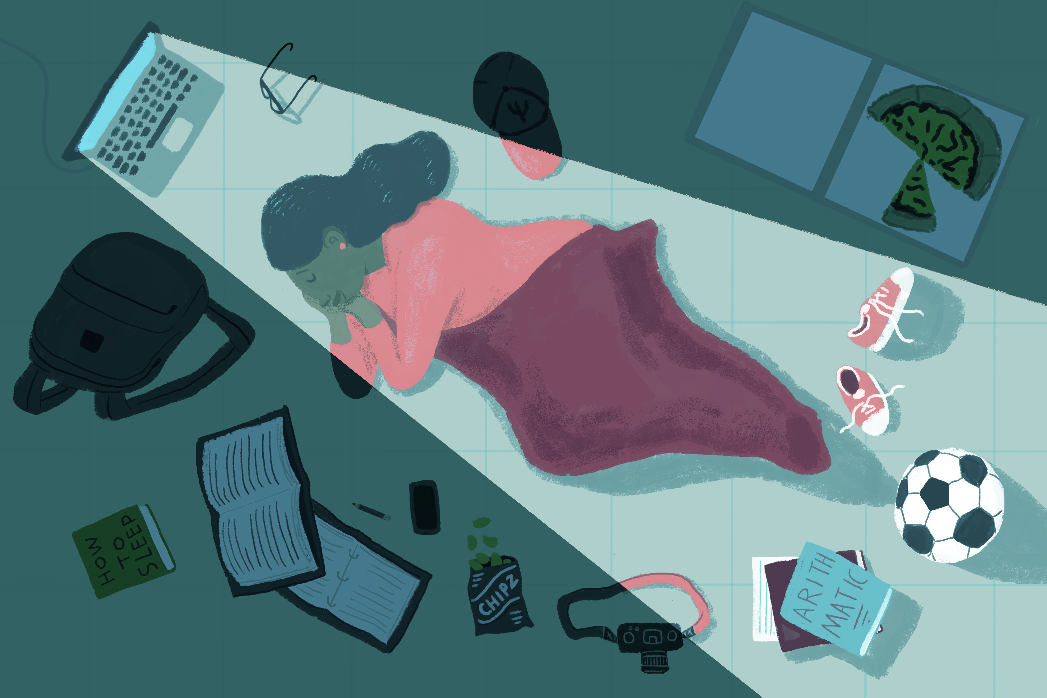
Big Picture: The Problem
College students are taking on several life roles that are physically and psychologically demanding, which has led to an increase in poor sleep health and daytime sleepiness

Slide 3
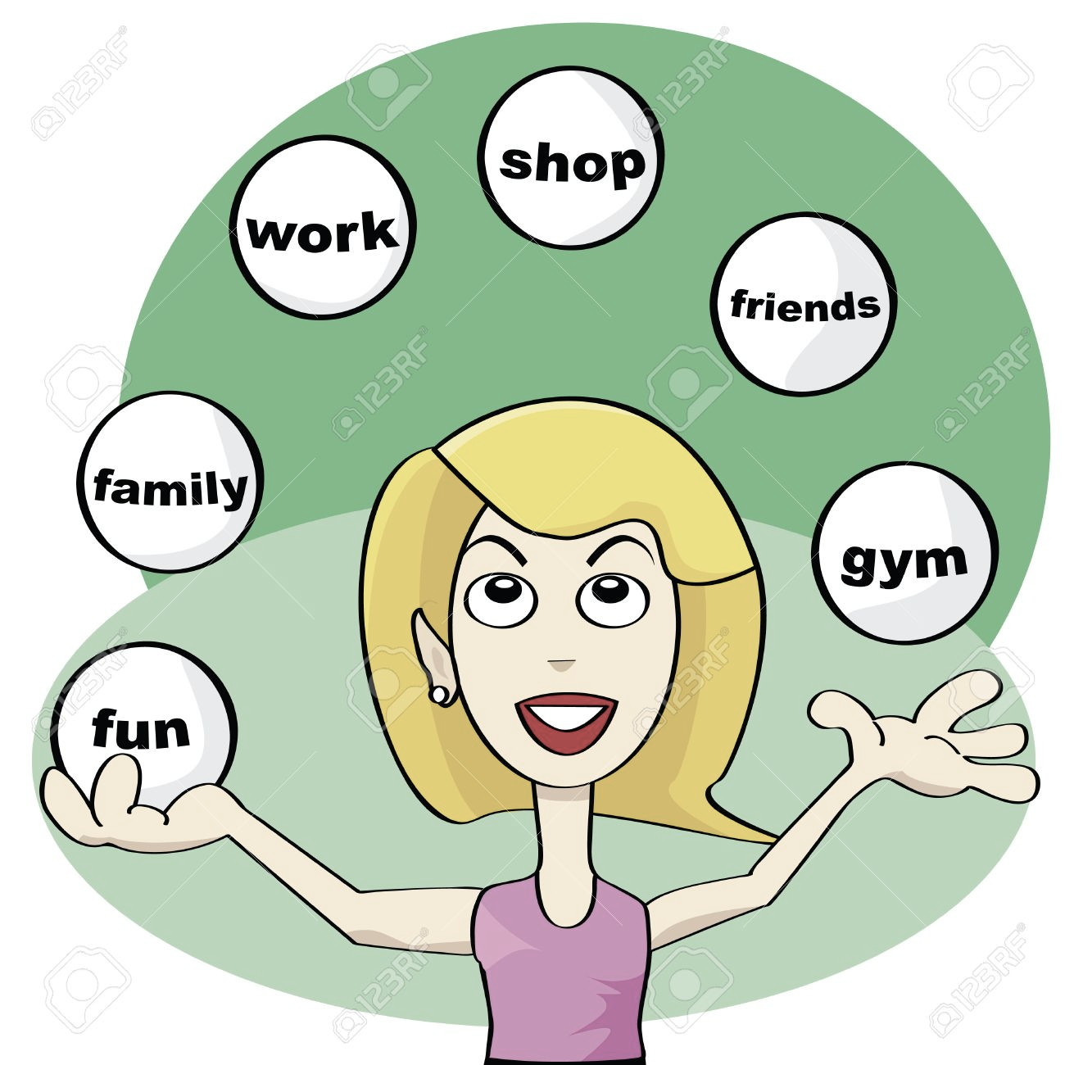
Big Picture: Possible Solution
Research has shown that resilience can be beneficial in decreasing these negative stress responses that are associated with the participation in several demanding roles

Slide 4
Big Picture: Purpose of Study
To help working college students consider not only how the various roles they are participating in may be affecting their sleep health and daytime sleepiness, but to also demonstrate how coping resilience may be able to moderate these negative stress responses that may be associated with total role demands
Notes:
Move ahead***

Slide 5
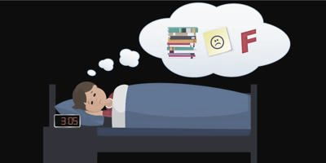
Why We Care?
College student’s sleep health is suffering
74% of college students claim to not get enough sleep (Hershner & Chervin, 2014)
As sleep quality decreases, physical and psychological issues may arise such as tension, anxiety, and depression (Pilcher & Ott, 1998)
More college students are experiencing daytime sleepiness
50% of college students claim to experience daytime sleepiness (Hershner & Chervin, 2014)

Slide 6
Total Life Role Demands
Extra-
curriculars
Work
High work pressure
Inflexible hours
Little vacation time
Emotional demands
Inflexible hours
Commitment
Family
School
Volunteer
Childcare
Eldercare
Spouse/significant other
Schoolwork (homework, exams, papers)
Communication with faculty
Furthering education
Time of transition
Work time with no pay
Little autonomy
Notes:
Care for elderly family and home maintence—future directions
Living away from family for the first time
Independent living demands—meal preparation, bills, grocery shopping, daily living activities, laundry
Future directions—focus on many different family types
Consider independent living demands in future directions—”learning how to be an adult”
Future demand—I would like to emphasize, not so much the demands part, but that there is a coping resilience that can help. A positive psychology construct…look at other qualities that can help working college students work with their demands…best advice is to reduce those demands, but sometimes they are difficult to reduce…what other qualities might be helpful? How can we help people develop these skills?
Enhance the number and quality of resources available to people so that they have those resources to address those demands in their life
***Last two slides---discuss reasons for enjoying this research and full circle back to JDR***
****Future research then conclusion—how it will benefit me and how I will utilize positive approaches in my career as a therapist—opportunity to study firsthand something I have experienced

Slide 7
Role Demand Issues Previously Explored
Role Demands are the physical, mental, and emotional aspects of a role
Role Demands Explored as Conflicts with One Another
Work-Family Conflict
Work-School Conflict
Work-Family-School Conflict
Notes:
Why should I care? What is unique about my study? Role demands are generally this…

Slide 8
Total Role Demands
Total Role Demands
Stress Response
Notes:
demands in EVERY role—some seem to be not stressed and some seem to be extremely stressed. Is it role demands? Do working students that have more total role demands, are they going to have more negative stress responses?
Arrow going up

Slide 9
Important Role of Resources
Resources
Negative Stress Response and Burnout
Total Role Demands
Resources: Means provided to a person
(i.e. adequate personnel, supportive boss, supportive spouse, flexible hours, online classes, supportive professor/advisor)

Slide 10
Theoretical Framework
Resources
Negative Stress Response and Burnout
Total Role Demands
Notes:
People may have a lot of demands but if they have a lot of resources, they may not be burnout and have negative stress responses, but more engaged. This theoretical framework was originally just focusing on one role—the role of an employee—my study is taking on the TOTAL role demands
I’d also like to look at engagement in the future, with this study we were looking at negative stress responses (sleep)…something Dr. Scherer has always been interested is the general sleep health of students

Slide 11
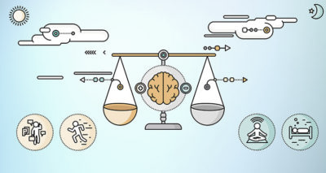
Theoretical Framework: Job Demands-Resource Model
Job strain is caused by an imbalance of demands and resources (Bakker & Demerouti, 2006)
Job-related anxiety
Exhaustion
More effort leads to greater physiological costs (Bakker & Demerouti, 2006)
Resources have motivational potential (Bakker & Demerouti, 2006)
High work engagement, low cynicism, excellent performance
Job resources may buffer the effects of job demands (Bakker et al., 2003)
https://mindworks.org/blog/how-does-meditation-reduce-stress/

Slide 12
Job Resources-Demand Model
Mental
+
Job Demands
Strain
-
Emotional
Physical
-
Organizational Outcomes
Support
+
Job Resources
Autonomy
+
Motivation
Feedback
Bakker & Demerouti, 2006

Slide 13
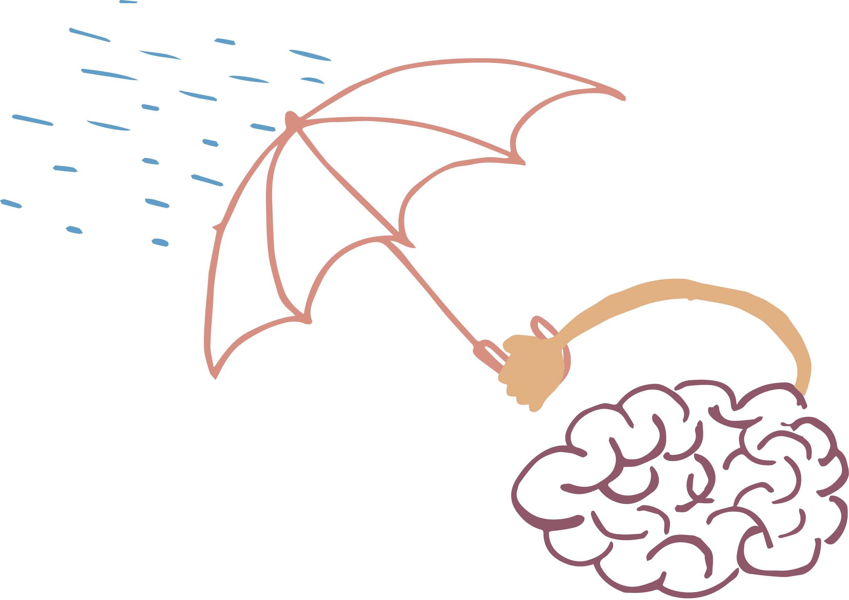
Coping Resilience
Coping is the efforts made to manage demands that are strenuous on a person’s resources (Lazarus & Folkman, 1984)
Difference between resilience and coping (Fletcher & Sarkar, 2013)
Resilience refers to how a stressful event is evaluated
Coping refers to the strategies utilized after the stressful event

Slide 14
Hypotheses and Variables
Hypothesis 1: Total role demands are negatively associated with sleep health
-
Total Role Demands
Sleep Health

Slide 15
Hypotheses and Variables
Hypothesis 2: Total role demands will be positively associated with daytime sleepiness
+
Total Role Demands
Daytime Sleepiness
Notes:
What’s the connection? A to C1, A to C2?

Slide 16
Hypotheses and Variables
Hypothesis 3: Coping resilience will be positively associated with sleep health
+
Coping Resilience
Sleep Health

Slide 17
Hypotheses and Variables
Hypothesis 4: Coping resilience will be negatively associated with daytime sleepiness
-
Coping Resilience
Daytime Sleepiness

Slide 18
Hypotheses and Variables
Hypothesis 5: Coping resilience will moderate the effect of total role demands on sleep health. For those lower in coping resilience, sleep health will decrease as demands increase; however, for those higher in coping resilience, sleep health will be high regardless of level of role demands
Coping Resilience
Total Role Demands
Sleep Health
Notes:
Moderating to C1
Why and how resilience is a resource that can help meet demands

Slide 19
Hypotheses and Variables
Hypothesis 6: Coping resilience will moderate the effect of total role demands on daytime sleepiness. For those lower in coping resilience, as demands increase, daytime sleepiness will increase; however, those higher in coping resilience will not demonstrate increased daytime sleepiness, regardless of level of total role demands
Coping Resilience
Total Role Demands
Daytime Sleepiness
Notes:
Moderating to C1
Why and how resilience is a resource that can help meet demands

Slide 20
Hypotheses and Variables
Coping Resilience
Poor Sleep Health
Total Role Demands
Daytime Sleepiness

Slide 21
Methodology

Slide 22
Participants and Data Collection
Participants
159 working college students at UNO
Gender: Female = 181(71.8%) Male = 58(23.8%) Other = 5(2.0%)
Race: Caucasian = 61.9%, Latino/Hispanic = 17.9%, African American = 4.8%, Asian = 4%, Other/Mixed = 8.4%
Age: Ranged from 17-41, M=20.56 , SD=3.03
Data Collection
Anonymous online survey via Qualtrics taken by working students at the University of Nebraska at Omaha

Slide 23
Measures of Study Variables

Slide 24
Total Role Demands: Hours Spent in Various Roles (Scherer, 2018)
4 items
Students were asked to specify the number of hours they’ve spent in various life roles comprised of work, school, volunteering, and extra-curricular activities
What is the average number of hours PER WEEK you are working THIS SEMESTER?
How many credit hours are you enrolled in this semester?
What is the average number of hours PER WEEK you have spent volunteering THIS SEMESTER?
What is the average number of hours PER WEEK you have spent engaging in UNO-sponsored extracurricular activities THIS SEMESTER?

Slide 25
Sleep Health: Jenkins Sleep Scale (Jenkins et al., 1988)
4 items
How often in the past month did you:
Have trouble falling asleep?
Wake up several times per night?
Have trouble staying asleep?
Wake up after your usual amount of sleep feeling tired or worn out?
Reliability: α = .823
Scale
0=Not at all
1=1-3 days
2=4-7 days
3=8-14 days
4=15-21 days
5=22-31 days

Slide 26
Daytime Sleepiness: Epworth Sleepiness Scale (Johns, 1991)
8 items
How likely are you to doze off or fall asleep in the following situations, in contrast to feel just tired?
Sitting, inactive in a public place (movie theater, meeting, lecture)
Sitting and reading
Lying down to rest in the afternoon when circumstances permit
Reliability: α = .766
Scale
0=Would never doze
1=Slight chance of dozing 2=Moderate chance of dozing 3=High chance of dozing
Notes:
Add one example on sleeping during classes

Slide 27
Coping Resilience: Brief Resilient Coping Scale (Sinclair & Wallston, 2004)
4 items
I believe that I can grow in positive ways by dealing with difficult situations
Regardless of what happens to me, I believe I can control my reaction to it
I look for creative ways to alter difficult situations
I actively look for ways to replace for losses I encounter in life
Reliability: α = .80
Scale
1=Does not describe me well
2=Describes me slightly well
3=Describes me moderately well
4=Describes me very well 5=Describes me extremely well
Notes:
Add reliability to each slide

Slide 28
Results

Slide 29
Analysis
Hayes (2017) Process Macro used to preform moderated regression analysis for the study

Slide 30
Results for Hypothesis 1: Total role demands on sleep health
Total role demands were negatively correlated with sleep health
r(104) = -.14, p < .05
Notes:
Test reliability of measures..0-1…Coefficient alpha along with each measure—how reliable

Slide 31
Results for Hypothesis 2: Total role demands on daytime sleepiness
Total role demands were positively correlated with daytime sleepiness
r(104) = .26, p < .01

Slide 32
Results for Hypothesis 3: Coping resilience on sleep health
Coping resilience was negatively correlated with sleep health
r(104) = -.17, p < .05

Slide 33
Results of Hypothesis 4: Coping resilience on daytime sleepiness
Coping resilience was negatively correlated with daytime sleepiness
r(104) = -.14, p < .05

Slide 34
Results of Hypothesis 5: Coping resilience moderating the effect of total role demands on sleep health
Hypothesis was not supported

Slide 35
Results of Hypothesis 6: Coping resilience moderating the effect of total role demands on daytime sleepiness
Hypothesis was supported
Coping resilience moderated the harmful effects of role demands on daytime sleepiness
Those higher in coping resilience did not show an increase in daytime sleepiness as role demands increased
Those lower in coping resilience demonstrated increased daytime sleepiness as role demands increased

Slide 36
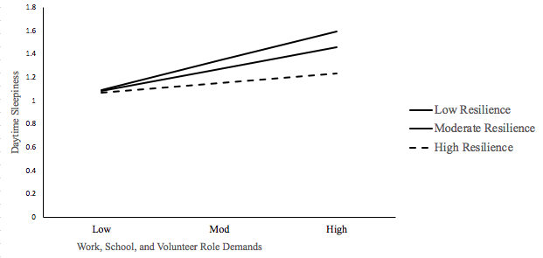
Notes:
Change up figure chart

Slide 37
Discussion

Slide 38
Summary of Results
As predicted, as student total role demands increased, daytime sleepiness increased and sleep health decreased
Coping resilience served as a protective factor in decreasing the negative effect of total role demands on sleepiness
Coping resilience did not protect working students from the harmful effects of total role demands on sleep health

Slide 39
Implications
Given that sleep is critical for physical and emotional health, universities should help students reduce their total role demands
Explore and reduce role demands through compassionate advising
Reduce employment hours worked by securing additional scholarships and other financial support mechanisms
Researchers should identify other protective factors besides coping resilience that help students manage their demands when total role reduction is unrealistic

Slide 40
Limitation 1: Cross-Sectional Study
All data was gathered at the same point in time
Need to look at this same model over time to confirm causality

Slide 41
Limitation 2: Lack of Diversity in the College Sample
Most students were white, at sophomore level, and were psychology majors
It would be interesting to look at greater diversity of ethnicity, age, socioeconomic status, etc.

Slide 42
Limitation 3: Over Reliance on Self-Report Data
Self-reports were aimed at beliefs and attitudes
Future research could look at other variables such as burnout to utilize physiological measures like the Galvanic Skin Response
Notes:
there are other measures that could be used like the galvanic skin response—"common method bias” say “over reliance on self-report data via questionnaires” —have to show the reason you got these relationships

Slide 43
Future Direction 1: Further Exploration of Measures
Explore the conditions under which working college students are helped more by coping resilience vs. general resilience
Explore situations in which positive psychological interventions such as the ones we used here help with daytime sleepiness or sleep quality
Notes:
saw effect for coping resilience and not for general resilience…further explore general resilience helps college students vs. coping resilience. When student sleep health is helped vs. decrease in sleepiness…no effect for resilience but found effect for coping. But other studies found differing points

Slide 44
Future Direction 2: Social Companionship and Relationships
Further exploration into how social companionship and relationships make a difference in reducing stress levels
Would this moderate or lower the negative effects of total role demands like coping resilience does?

Slide 45
Future Direction 3: Recovery
Investigation into whether there is enough recovery time for those with numerous roles
Recovery = no demands; specifically, job-related demands (Meijman & Mulder, 1998)
Provides resources such as feelings of control, motivation, or energy (Hobfoll, 1998)
Rest breaks, weekends, vacations, evenings

Slide 46
Thank You to Dr. Lisa Scherer and My Colleagues on Her Research Team Questions?

Slide 47
Key References
Bakker, A. B., Demerouti, E., Taris, T., Schaufeli, W.B. and Schreurs, P. (2003) A multi-group analysis of the Job Demands-Resources model in four home care organizations. International Journal of Stress Management, 10, 16-38.
Dundes, L., & Marx, J. (2006). Balancing work and academics in college: why do students working 10 to 19 hours per week excel? Journal of College Student Retention: Research, Theory & Practice, 8(1), 107–120. https://doi.org/10.2190/7UCU-8F9M-94QG-5WWQ
Fletcher, D., & Sarkar, M. (2013). Psychological resilience: A review and critique of definitions, concepts, and theory. European Psychologist, 18(1), 12–23. https://doi.org/10.1027/1016-9040/a000124
Hayes, A. F. (2017). Introduction to mediation, moderation, and conditional process analysis: A regression-based approach. Guildford Press.
Hershner, S.D., Chervin, R.D. (2014). Causes and consequences of sleepiness among college students. US National Library of Medicine National Institutes of Health, 6, https://dx.doi.org/10.2147%2FNSS.S62907
Hobfoll, S. E. (1998). Stress, culture, and community: The psychology and physiology of stress.
Jenkins, C., Stanton, B., Niemcryk, S., Rose, R. (1988) A scale for the estimation of sleep problems in clinical research. Journal of Clinical Epidemiology, 41(4), 313-321. https://doi.org/10.1016/0895-4356(88)90138-2
Johns, M.W. (1991). A New Method for Measuring Daytime Sleepiness: The Epworth Sleepiness Scale. Sleep, 14(6), 540-545. https://doi.org/10.1093/sleep/14.6.540
Lazarus, R. S., & Folkman, S. (1984). Stress, appraisal, and coping. New York: Springer.
Magnusson Hanson, L. L., Chungkham, H. S., Åkerstedt, T., Westerlund, H. (2014) The role of sleep disturbances in the longitudinal relationship between psychosocial working conditions, measured by work demands and support, and depression. Sleep, 37(12), 1977-1985. doi:10.5665/sleep.4254

Slide 48
Key References
Meijman, T. F., & Mulder, G. (1998). Psychological aspects of workload. In P. J. D. Drenth & H. Thierry (Eds.). Handbook of work and organizational psychology: Work psychology, (2), 5–33.
Pilcher, J & Ott, E. (1998) The Relationships Between Sleep and Measures of Health and Weil-Being in College Students: A Repeated Measures Approach, Behavioral Medicine, 23:4, 170-178, https://doi.org/10.1080/08964289809596373
Walker, M. P. (2008) Sleep-dependent memory processing, Harvard Review of Psychiatry, 16(5), 287-298, https://doi.org/10.1080/10673220802432517
Sinclair, V. G., & Wallston, K. A. (2004). The Development and Psychometric Evaluation of the Brief Resilient Coping Scale. Assessment, 11(1), 94–101. https://doi.org/10.1177/1073191103258144
Smith, B.W., Dalen, J., Wiggins, K. et al. (2008) The brief resilience scale: Assessing the ability to bounce back. International Journal of Behavioral Medicine. 15, 194–200. https://doi.org/10.1080/10705500802222972

