Slide 1
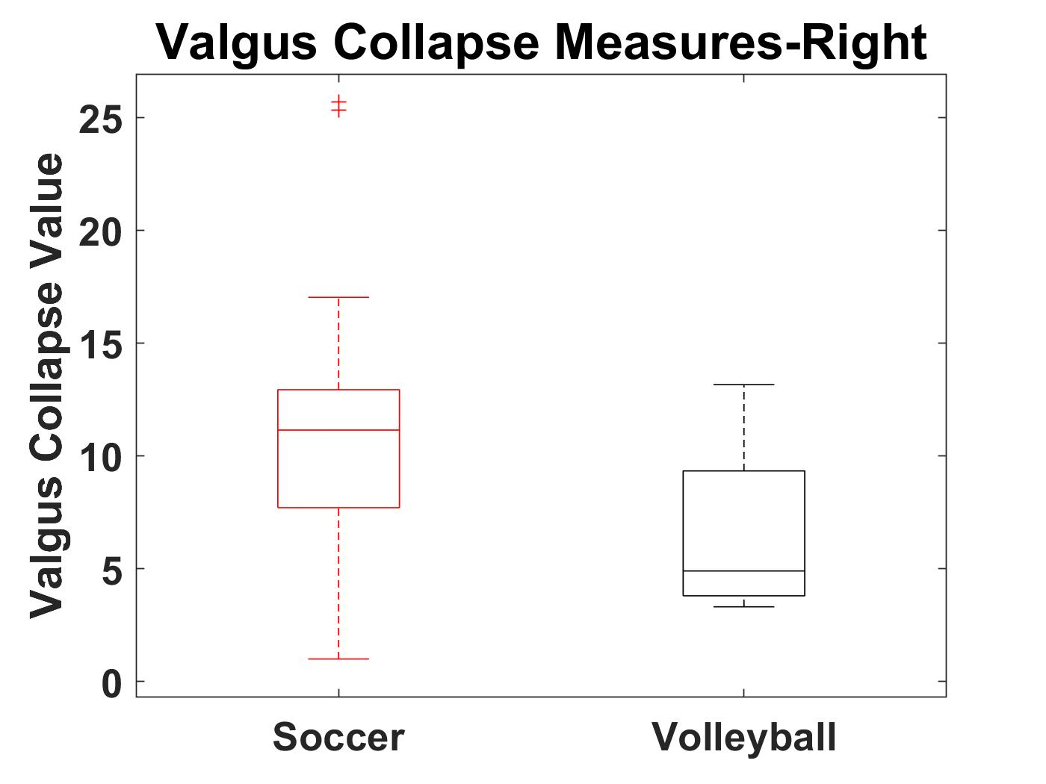
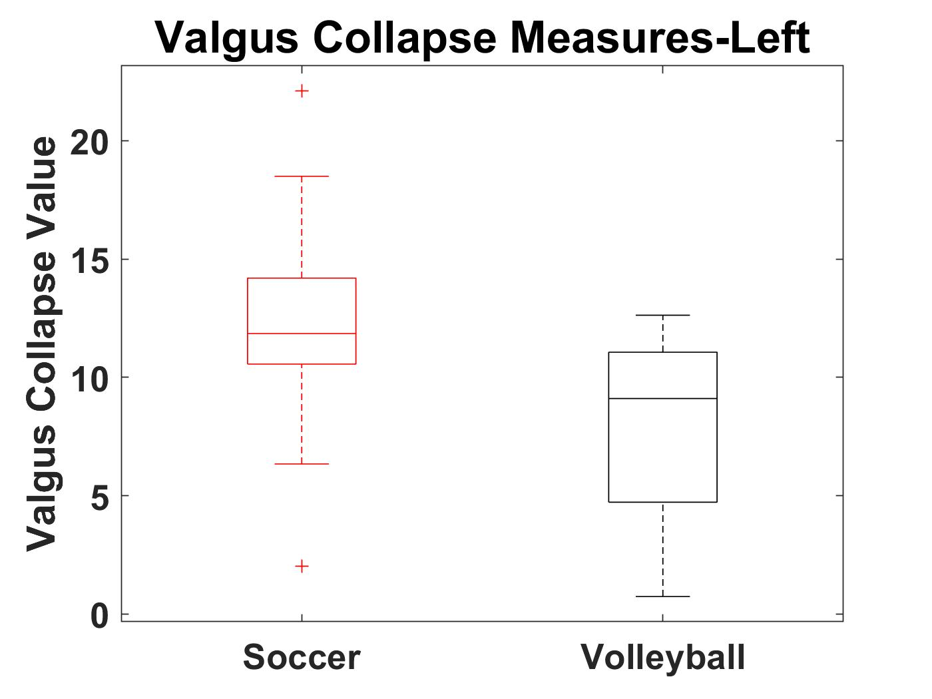
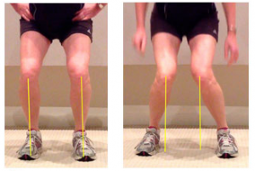
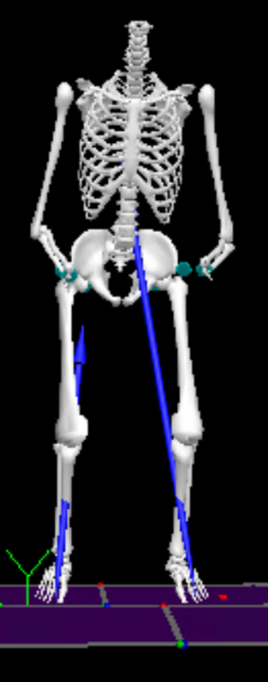
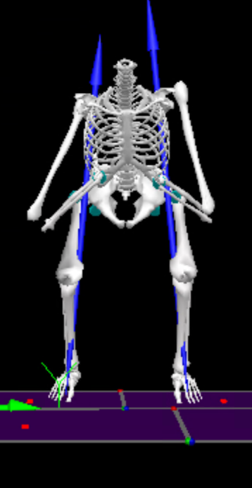
Risk Factor Assessment for ACL Injuries in D1 Soccer and Volleyball Athletes
K. Guhl¹, L. Remski¹, A.B. Rosen², B.A. Knarr¹,
¹Department of Biomechanics, University of Nebraska at Omaha, Omaha, NE 68182
²School of Health and Kinesiology, University of Nebraska at Omaha, Omaha, NE 68182
INTRODUCTION
RESULTS
CONCLUSIONS
Research has shown that females are 6-8 times more likely to sustain an anterior cruciate ligament (ACL) injury compared to men²
Females are 3.5 times more likely to receive a non-contact ACL injury⁴, specifically soccer and volleyball players
Most non-contact ACL injuries occur during Valgus collapse, which is when the knee abduction, hip adduction, and internal and external rotation angles are high
Research has led to the identification of ACL risk factors which can be found through biomechanical and clinical tests
Injury prevention programs have been developed to largely meet the needs of all athletes
Different sports place different demands on their athletes which could lead to the development of different risk factors
In order to develop the most effective injury protocols for different sports, we must first understand the differences in biomechanics related to ACL injury risk factors between sports
Therefore, the purpose of this project is to determine if athletes specializing in soccer and volleyball present different biomechanics related to ACL injury risk factors.
Sport | Number of Participants | Age | Height | Weight
Soccer | 14 | 20.21±0.67 | 1.68±0.07 | 65.56±8.60
Volleyball | 4 | 20.25±0.83 | 1.80±0.02 | 70.20±2.92
Statistically significant differences were not demonstrated for the outcomes measured
This is likely due to the small sample size
The effect sizes for the right and left valgus collapse measure were large, which demonstrates that soccer players are potentially at a higher risk for valgus collapse injuries
The effect sizes for the right and left H/Q tests were medium, which demonstrates that soccer players potentially display greater muscle imbalance at the knee.
Although no statistically significant outcomes were found, this work provides greater insight into sport specific risk factors for ACL injuries
The results are helpful for developing more effective injury prevention programs
Future studies should evaluate the results of these tests with a larger sample size and an even number of volleyball and soccer players
Table 1: Participants demographics.
Figure 1: A boxplot of the valgus collapse measures for the right leg.
METHODS
This study included 18 healthy female D1 athletes from UNO; 14 soccer players and 4 volleyball players
Biomechanical and clinical tests were performed, including the drop vertical jump test, or DVJ, a quadriceps/hamstrings ratio test using a Biodex, a cross-over hop test, and the International Knee Documentation Committee (IKDC) survey
Lower body kinematics were used to calculate valgus collapse values for each DVJ
Four 2-sample t-tests and two Mann-Whitney U tests were used to compare the outcomes between sports
Corresponding Hedge’s g effect sizes were also calculated
Figure 2: A boxplot of the valgus collapse measures for the left leg.
Test | Mean±Standard Deviation- Soccer | Mean±Standard Deviation- Volleyball | P-Value | Effect Size
Right H/Q | 57.29±13.17 | 52.33±12.02 | 0.509 | 0.38336
Left H/Q | 54.09±14.69 | 50.53±13.37 | 0.669 | 0.24688
Right Valgus Collapse | 11.94±6.94 | 6.56±4.48 | 0.167 | 0.86296
Left Valgus Collapse | 12.18±4.95 | 7.89±5.06 | 0.147 | 0.82109
Cross Over Hop Test | 100.71±5.72 | 100.08±1.58 | 0.645 | 0.1225
IKDC Survey | 99.26±1.47 | 100.00±0.00 | 0.442 | N/A
Figure : A picture comparing a healthy landing (left) to a landing where valgus collapse is occurring (right) ⁴.
REFERENCES
Arundale et al (2018). Scan, J. of Med. & Sci. in Sports. 28: 2592-2603.
Hughes (2014). Res. In Sports Med. 22: 193-212.
Shultz et al (2015). J. of Athl. Train. 50: 1076-1093.
Voskanian (2013). Curr. Rev. in Mus. Med. 6: 158-163.
Desrosiers (2018). ACL Strong.
Eitzen et al (2016). Ortho, J. of Sports Med. 4: 1-10.
Kabacinski et al (2018). PLOS ONE. 13.
Myers et al (2014). Int. J. Sports Phy. Ther. 9: 596-603.
Figure 1: Visual 3D data from a participant during the drop vertical jump test.
Table 2: Descriptive statistics of the results from the four tests with the soccer and volleyball athletes. The significance level is p=0.05.

