Slide 1
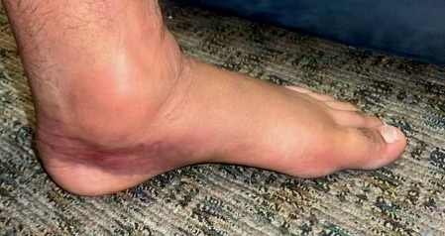
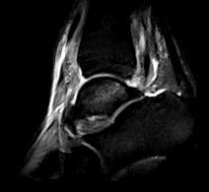
Acute Simultaneous Medial and Lateral Ankle Sprain in a Collegiate Football Player: A Case Report Ian D. Matlack, University of Nebraska at Omaha
Context
Imaging
Treatment
An ankle injury is one of the most common injuries to sideline an athlete.¹
Around 27,000 ankle sprains have been reported in collegiate sports from 1989 to 2004.¹
Nearly 10,000 occurring in men’s football alone.¹
The most prevalent types of ankle injuries occurring on a football field are lateral, syndesmotic, and medial ankle sprains.²
During halftime, the player reported no pain when walking or at rest. The athlete had no limp.
The athlete was point tender over his distal 1/3rd fibula, anterior border of the medial malleolus, and midfoot region.
The athlete noted numbness when his foot was elevated but it went away when lowered.
Significant visible amounts of edema and ecchymosis.
Magnetic resonance imaging (MRI) revealed:
Tears of the Anterior Talofibular Ligament (ATFL), Calcaneofibular Ligament (CFL), structures of the Deltoid Ligament Complex, and peroneal retinaculum.
Bone contusions on his talar dome, posterior lateral tibia, and his distal fibula.
Figure 1. Edema and Ecchymosis levels 24 hours post-injury.
Figure 2. MRI sagittal view revealing a talar dome bruise (red circle) and an anterior pocket of swelling (yellow circle)
For the first 72 hours, treatment included cryotherapy for 15 min every 2 hours and the use of NSAIDs, swapping between Ibuprofen and Tylenol every 4 hours.
Rehab includes a simple range of motion, strengthening exercises, and stretching exercises.
Manual therapies used to help combat edema include milking massages, cupping, joint mobs, and IASTM.³
The intensity and complexity of these exercises gradually increased over the course of several months.
The athlete was allowed to participate in practice and games with proper bracing and taping being used.
Background
Red-Shirt freshman tight-end male football player
Twenty years old African American male, athletic build, 77 in, 133.4 kg.
The athlete was blocking when his ankle gave way laterally, and then an opponent fell on top of his ankle.
Athlete went down on the field and was taken to the sideline for further evaluation.
He was taped and continued playing but removed himself due to pain and stiffness a quarter later.
Was sent for X-rays and an MRI a week later.
Uniqueness
No case reports were found for an athlete who suffered a simultaneous lateral and medial ankle sprain without fracturing their ankle.
A similar case report was noted of a dislocated talus.⁴
This athlete opted to treat his injury conservatively while the team doctor highly recommended surgery.
The athlete continues to have localized swelling in his mid-foot region, several months post-injury.
Signs and Symptoms
Conclusion
In collegiate football, ankle sprains are very common.¹
If a patient chooses a non-surgical route, clinicians must be prepared to rethink typical treatment protocols.
This athlete must continue his rehab to resume playing as well as to prevent developing chronic ankle instability.
References
Hootman JM, Dick R, Agel J. Epidemiology of collegiate injuries for 15 sports: summary and recommendations for injury prevention initiatives. J Athl Train. 2007;42(2):311-319.
Lievers WB, Adamic PF. Incidence and Severity of Foot and Ankle Injuries in Men’s Collegiate American Football. Orthopaedic Journal of Sports Medicine. 2015;3(5). doi:10.1177/2325967115581593
Bervoets, D. C., Luijsterburg, P. A., Alessie, J. J., Buijs, M. J., & Verhagen, A. P. (2015). Massage therapy has short-term benefits for people with common musculoskeletal disorders compared to no treatment: a systematic review. Journal of Physiotherapy, 61(3), 106–116. https://doi.org/10.1016/j.jphys.2015.05.018
Koukoulias, MD, PhD NE, Papastergiou, MD, PhD SG, Panagopoulos, MD P, Dimitriadis, MD T, Koumis, MD P. Pure Tibiotalar Dislocation with Talus Bone Contusion in a Volleyball Player: A case report. The Foot and Ankle Online Journal. Published online September 2009. doi:https://doi.org/10.3827/faoj.2009.0209.0002
Differential Diagnosis
Peroneal Tendon Strain
Talus Subluxation
Potential Nerve Damage
Tibialis Ant/Post Strains

