Slide 1
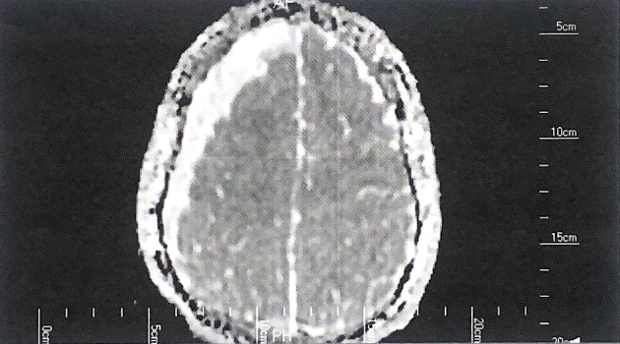
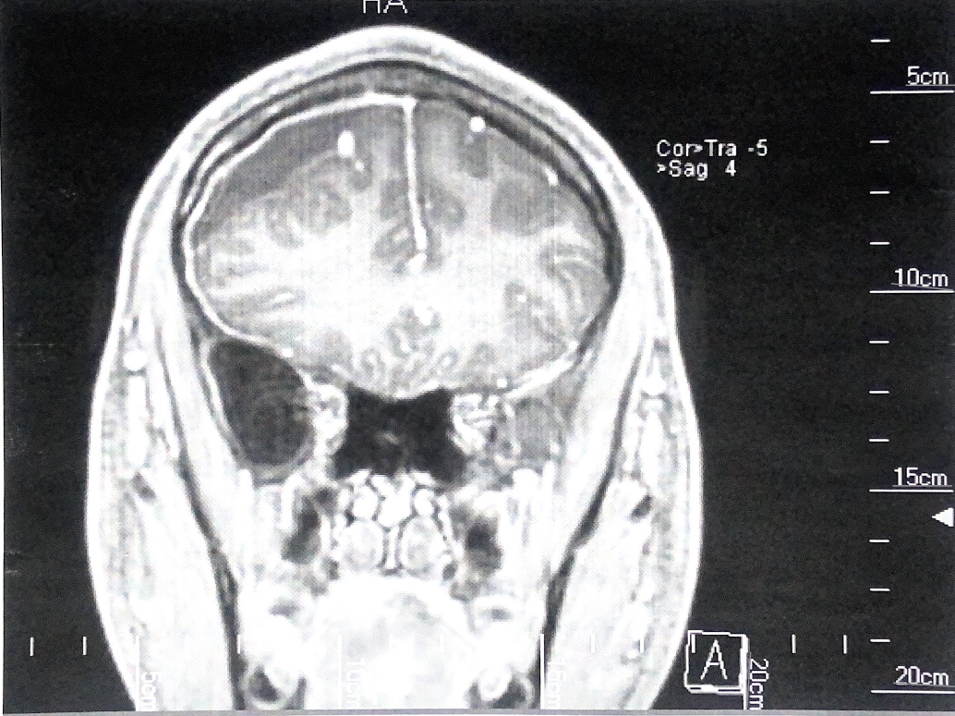
Subacute to Chronic Subdural Hematoma in an 18-Year-Old Male Football Player Peyton Bodemann, University of Nebraska at Omaha
Context
R
L
Table 1. Timeline of Events
Football athletes are at high risk for concussion and other traumatic brain injuries with 1 in 5 HS football athletes diagnosed with a concussion each year. ¹
SDH make up for 90% of deaths in athletes due to brain-related injuries.²
A SDH may be caused by a single traumatic blow to the head, or by repeated head injuries.³
Senior high school male football player (18 years old, height=1.8 m, weight=94.35 kg).
The player had gradual onset of headaches with progressive worsening of symptoms and no traumatic mechanism.
Player initially diagnosed with a concussion and cleared to play after one week.
RTP with increase in headaches, 2 months after concussion went to eye doctor for right eye pain. Referred for imaging (MRI) immediately.
Patient was diagnosed with a subacute subdural hematoma.
MMA embolization procedure, complications lead to 3rd & 7th nerve palsy.
Underwent right sided double burr-hole craniotomy.
Initial headaches (July) 4/10 at rest, 7/10 during activity
Severe headaches (Sept) 8/10 consistently, worsened with forward bending
Aching right eye pain (Sept)
Figure 1. MRI on Sept. 21 showing a 12mm SDH in the right frontal lobe with a 4mm midline shift to the left, inferior view.
Figure 2. MRI on Sept. 21 showing a 12mm SDH in the right frontal lobe with a 4mm midline shift to the left, inferior view.
Before diagnosis (Aug), initial headaches treated with Allegra, 180 mg every day, but no relief after 20 days; discontinued use.
Headaches continued, prescribed 60mg Tramadol shot, relief for 2 hours.
After MMA embolization, headaches continued, and nerve palsy set in.
Double burr-hole craniotomy was performed to drain the SDH and lead to headache relief.
July 19
Mild headaches began
Late Feb.
Mostly recovered, 95% facial function
July 26
Diagnosed with concussion
Nov. 28
Cleared for activity (no football)
Sept. 15
Severe headaches began
Sept 21
MRI- Diagnosed with SDH
Oct. 10
Burr-Hole Craniotomy
Background
Sept. 26
MMA Embolization surgery
Uniqueness
R
L
9% of cSDH patients are under 40 yrs, most are elderly.⁴
Lack of symptoms to indicate further pathology such as neurological deficits, gait disorders, and cognitive complaints. ⁶
MMA embolization complication rates are 1.7%. ⁵
Conclusion
Lack of mechanism makes it difficult to identify an SDH. ³
Although uncommon in this age group, persistent symptoms thought to be from a concussion may be related to a cSDH. ⁶
MRI and CT scans are the gold standard for diagnosing an SDH. ¹
Treatment
Signs and Symptoms
References
Logan SM, Bell GW, Leonard JC. Acute Subdural Hematoma in a High School Football Player After 2 Unreported Episodes of Head Trauma: A Case Report. J Athl Train. 2001;36(4):433-436.
Center, C. C., Wilkins, S. J., Mathiasen, R., & Rosen, A. B. (2020). Acute subdural hematoma in a high school football player requiring emergent decompressive craniectomy. International Journal of Athletic Therapy and Training, 25(3), 131-133.
Shell D, Carico GA, Patton RM. Can Subdural Hematoma Result From Repeated Minor Head Injury?. Phys Sportsmed. 1993;21(4):74-84.
Chou Liliang, Coleman CC, Yokote H, et al. Chronic subdural haematoma in young and extremely aged adults: A comparative study of two age groups.
Ironside N, Nguyen C, Do Q, et al. Middle meningeal artery embolization for chronic subdural hematoma: a systematic review and meta-analysis. J Neurointerv Surg. 2021;13(10):951-957.
Weigel R, Schilling L, Krauss JK. The pathophysiology of chronic subdural hematoma revisited: emphasis on aging processes as key factor. Geroscience. 2022;44(3):1353-1371.
Differential Diagnosis
Concussion
Migraines
Allergies

